Slide 1

Unit 7
Where do you live?
part 4

Slide 2
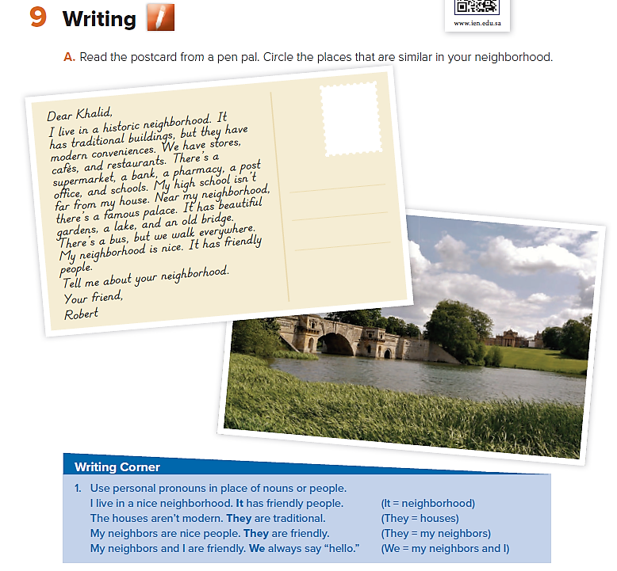

Slide 3
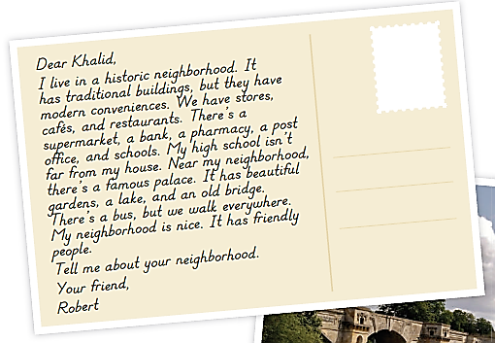
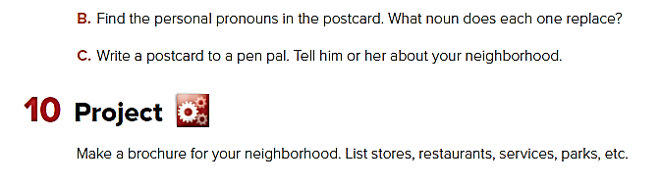
I = Robert
It = (my) neighborhood
they = buildings
We = my neighbors and I
It = palace
we = my neighbors and I
It = my neighborhood

Slide 4
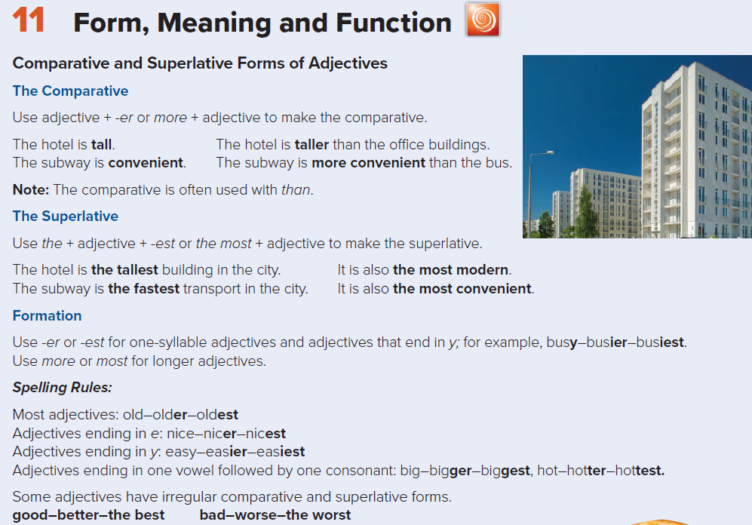

Slide 5
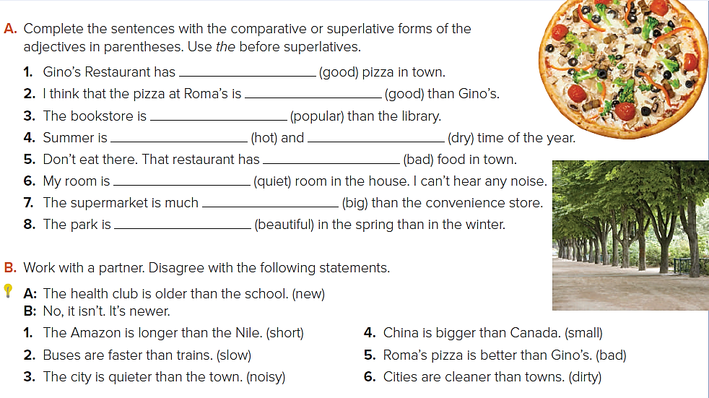
the best
better
more popular
the hottest
the worst
the quietest
bigger
more beautiful
the driest
No, it isn’t. It’s shorter.
No, they aren’t. They’re slower.
No, it isn’t. It’s noisier.
No, it isn’t. It’s smaller.
No, it isn’t. It’s worse.
No, they aren’t. They’re dirtier.

Slide 6
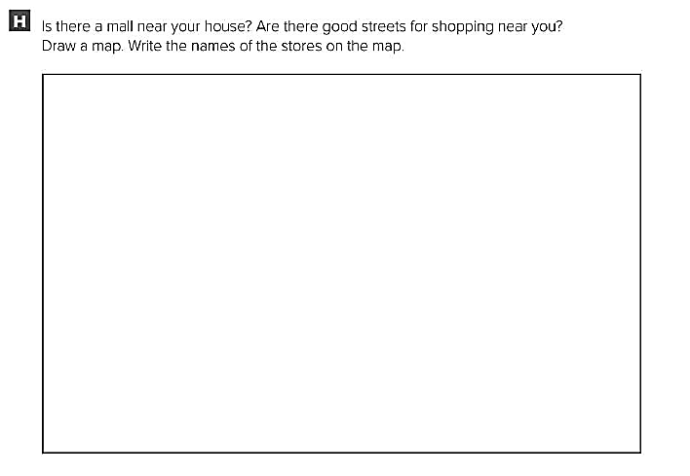
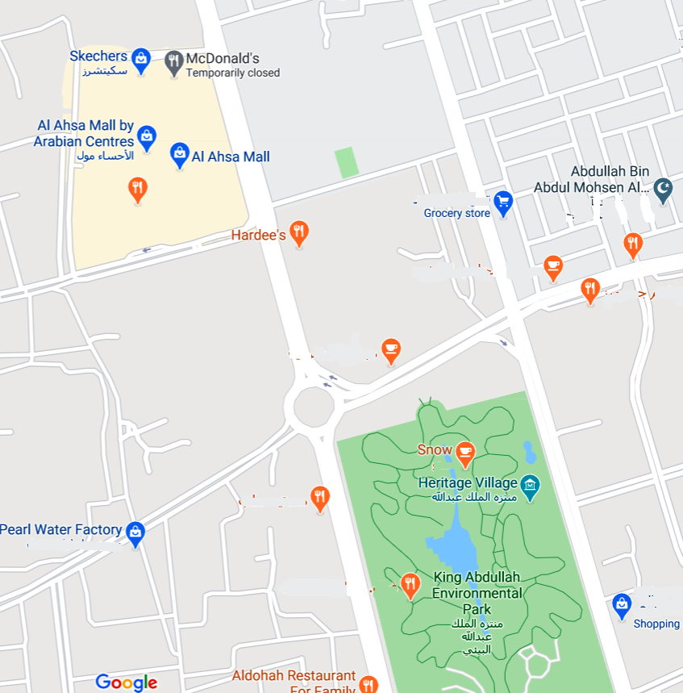

Slide 7
