Slide 1
Warm up
Look at the following pictures and select the correct personal pronoun.

Slide 2
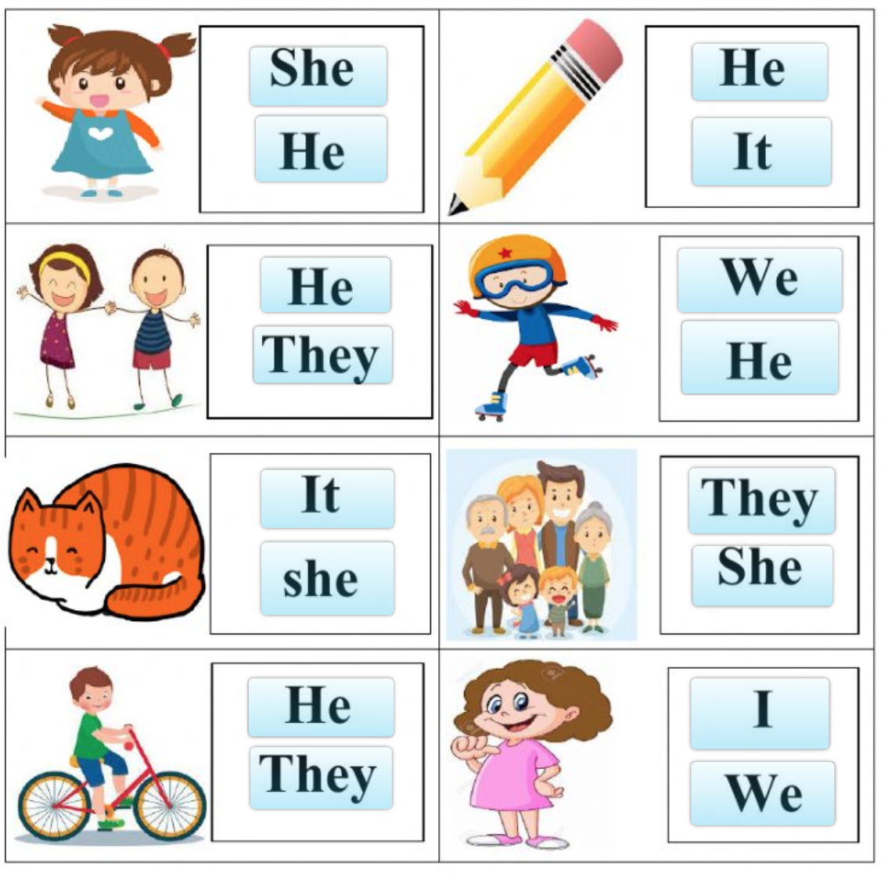

Slide 3


Where do you live?
Unit 7 ( Writing )
62

Slide 4
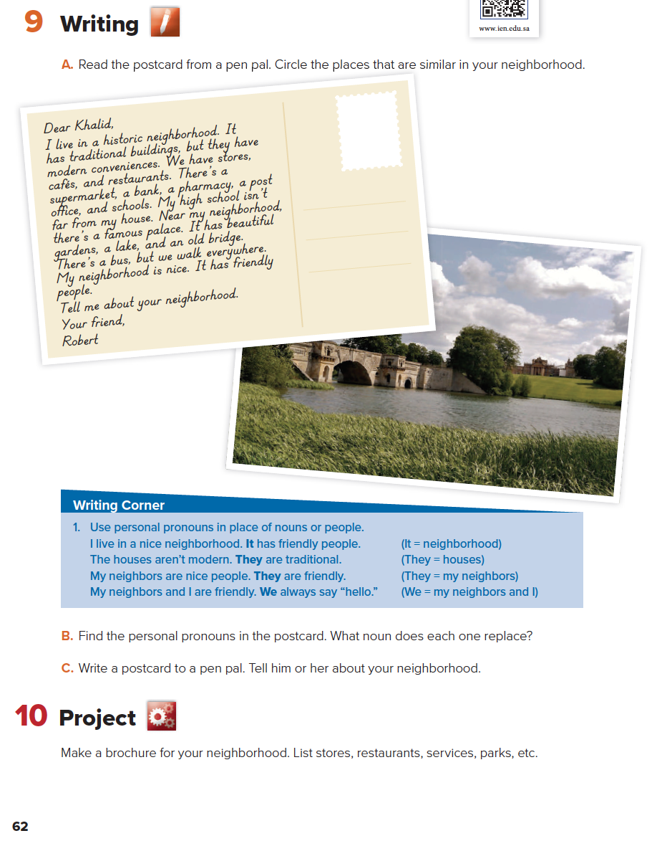
62

Slide 5

Objectives:
Write a post card to a pen pal.
Organize your ideas.
Answer questions based upon the text.
Use personal pronouns correctly.
Make a brochure about your neighborhood.
62

Slide 6
Is a friend who lives in another city or country and someone who you exchange letters or emails with.
62
62

Slide 7
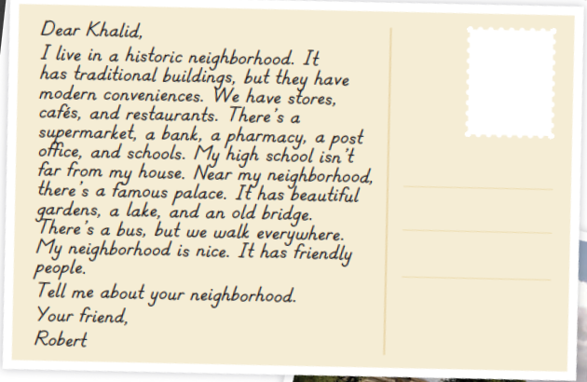

Slide 8

What are the buildings like?
Is the school near Robert’s house?
Do people walk or take the bus?
What are the people like?
They are traditional.
Yes, it is.
They walk everywhere.
They are friendly.
62

Slide 9
62

Slide 10
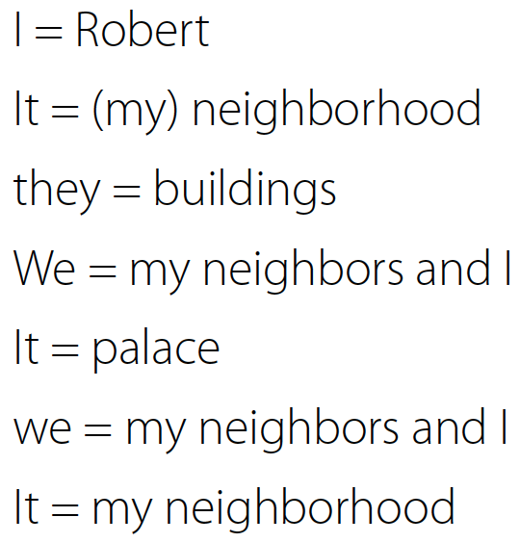

Slide 12

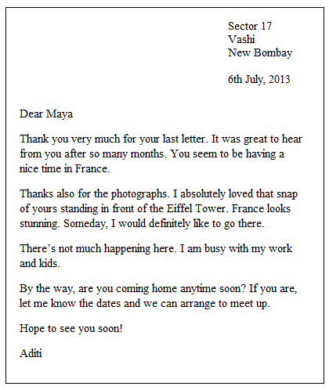
(Greeting)
(set phrase)
(Body)
(Greeting)
(Closing)
(Signature)

Slide 13
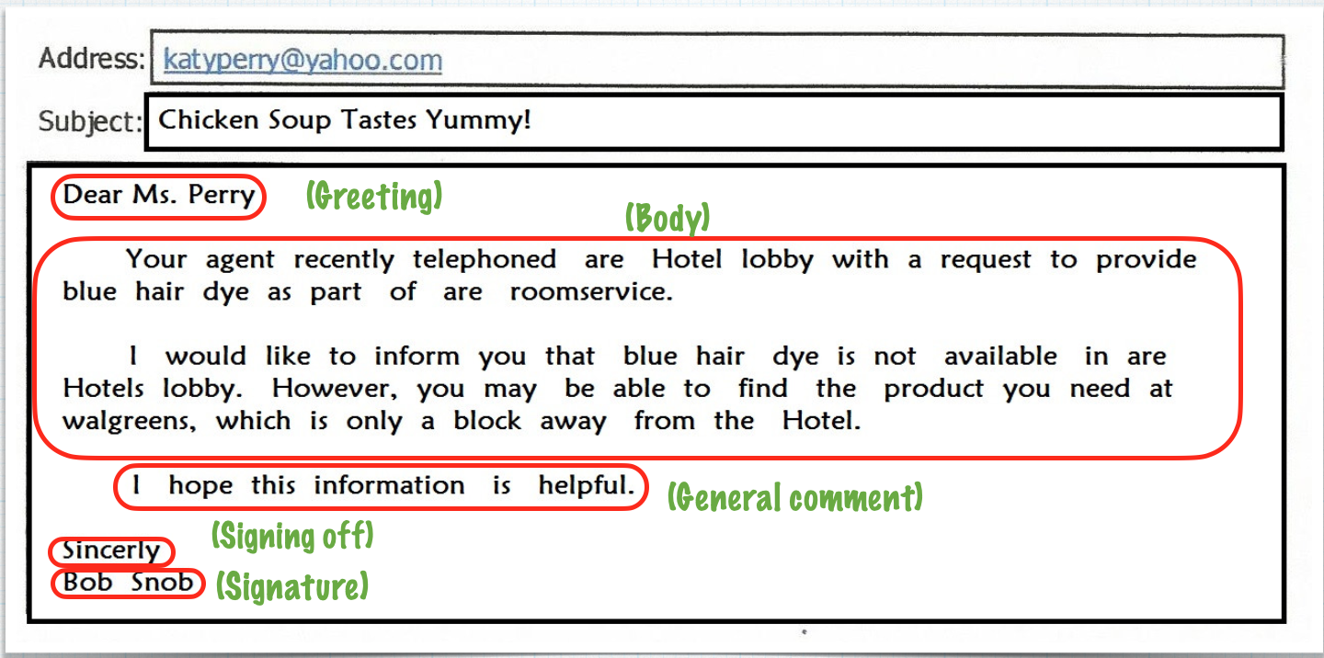

Slide 14
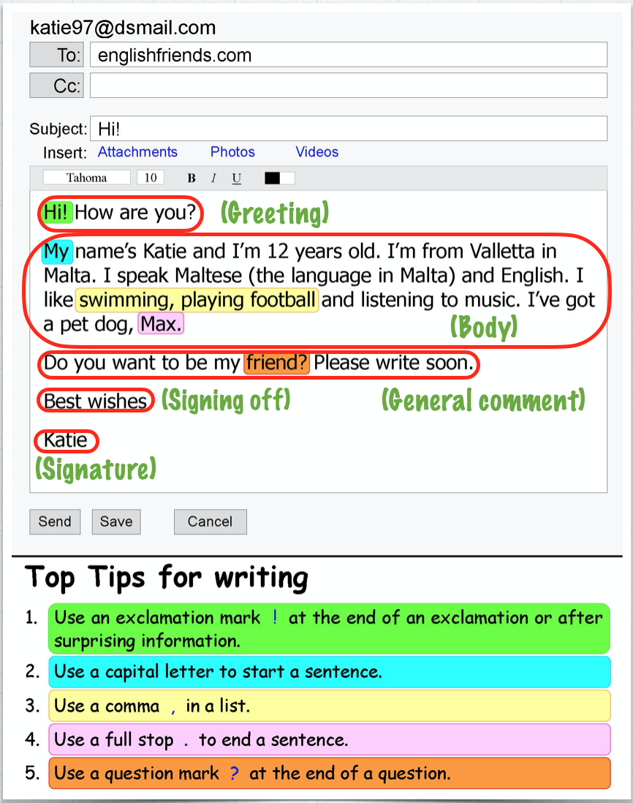

Slide 15
(Greeting)
(Dear Sara, Hi Tom, Hello Ali.)
(Set phrase)
(Body)
(General comment)
(Closing)
(Bye for now, Your friend, Best wishes, Take care.)
(Signature)

Slide 16

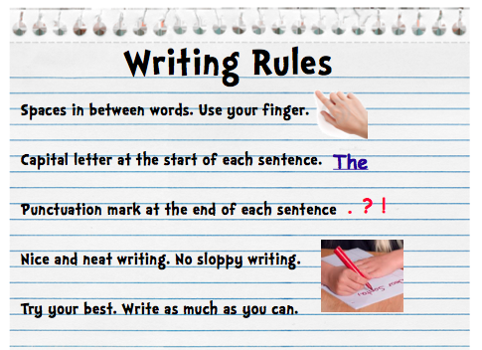

Slide 17

Project
54

Slide 18

Al Zohoor neighborhood
Stores:
Resturants:
Parks
54

Slide 19
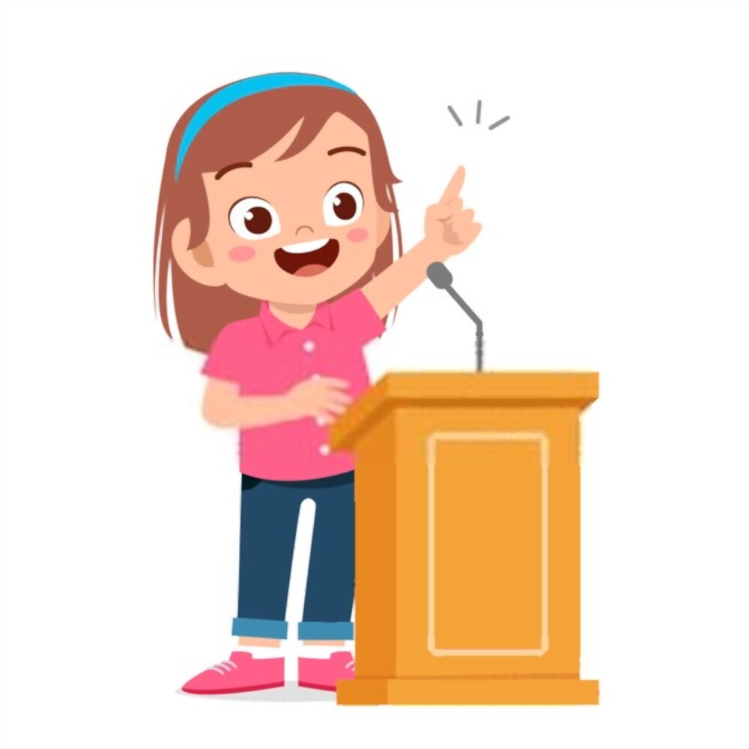

Presentation Time
My neighborhood

Slide 20
Homework
H
Page 118

Slide 21
Where do you live?
Unit 7 ( Form, meaning and Function )
63

Slide 22
List some positive and negative adjectives

Slide 23
Positive adj
Negative adj
Brave
Smart
Creative
Friendly
Funny
Beautiful
Nice
Good
Boring
Silly
Bad
Selfish
Sad
Awful
Ugly
Lazy

Slide 24
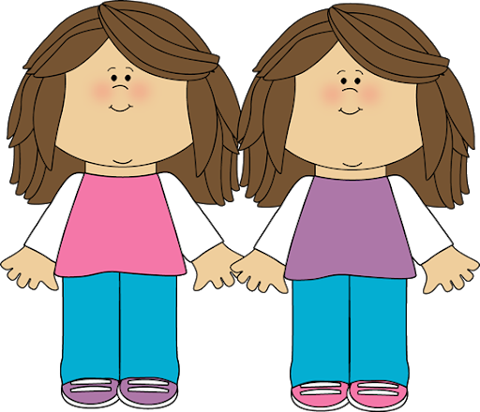
Unit 7
Where Do you live?
Form, meaning and Function

Slide 25
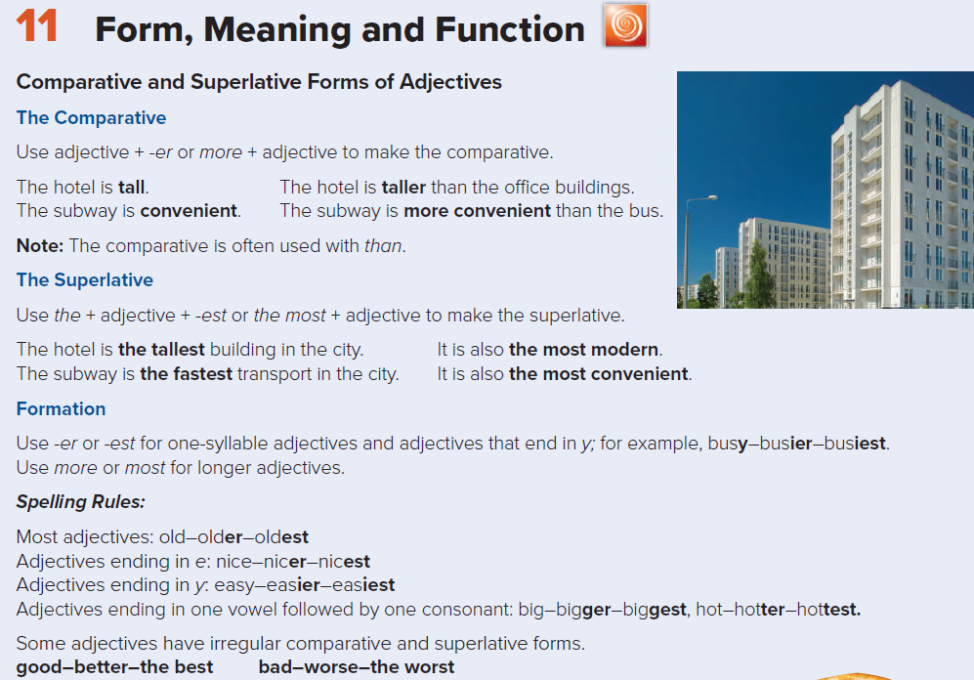

Slide 26
girl - happy - teacher -
Mom - fast -
expensive - tall - big -
brother - big -
chair - board - short - pen -
old - bus - small -
hair - large - window - bad
- city - train - quite
safe - bottle - cub -

Slide 27
girl - happy - teacher -
Mom - fast -
expensive - tall - big -
brother - pin -
chair - board - short - pen -
old - bus - small -
hair - large - window - bad
- city - train - quite
safe - bottle - cub -

Slide 28
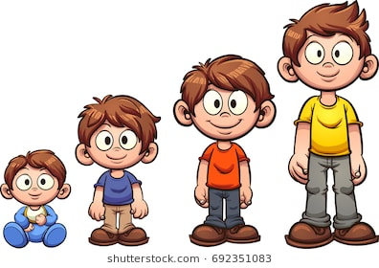
Hello everyone ..
I’m Ali. I am tall.

Slide 29
I am taller than my brother Ahmad.
Ali
Ahmad

Slide 30
Faisal
but
Ali
I’m shorter than my brother Faisal.

Slide 31
Yes, I’m the tallest boy in my family.

Slide 32
superlative
comparative
the tallest
taller
tall
Ahmad
Ali
Faisal

Slide 33
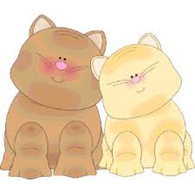
comparative
When
is used to compare differences between the two objects, two people or two cities ect ...

Slide 34
comparative
How
1st noun
Be
adj + er
than
2nd noun
Ali is taller than Ahamad .
tall
taller

Slide 35
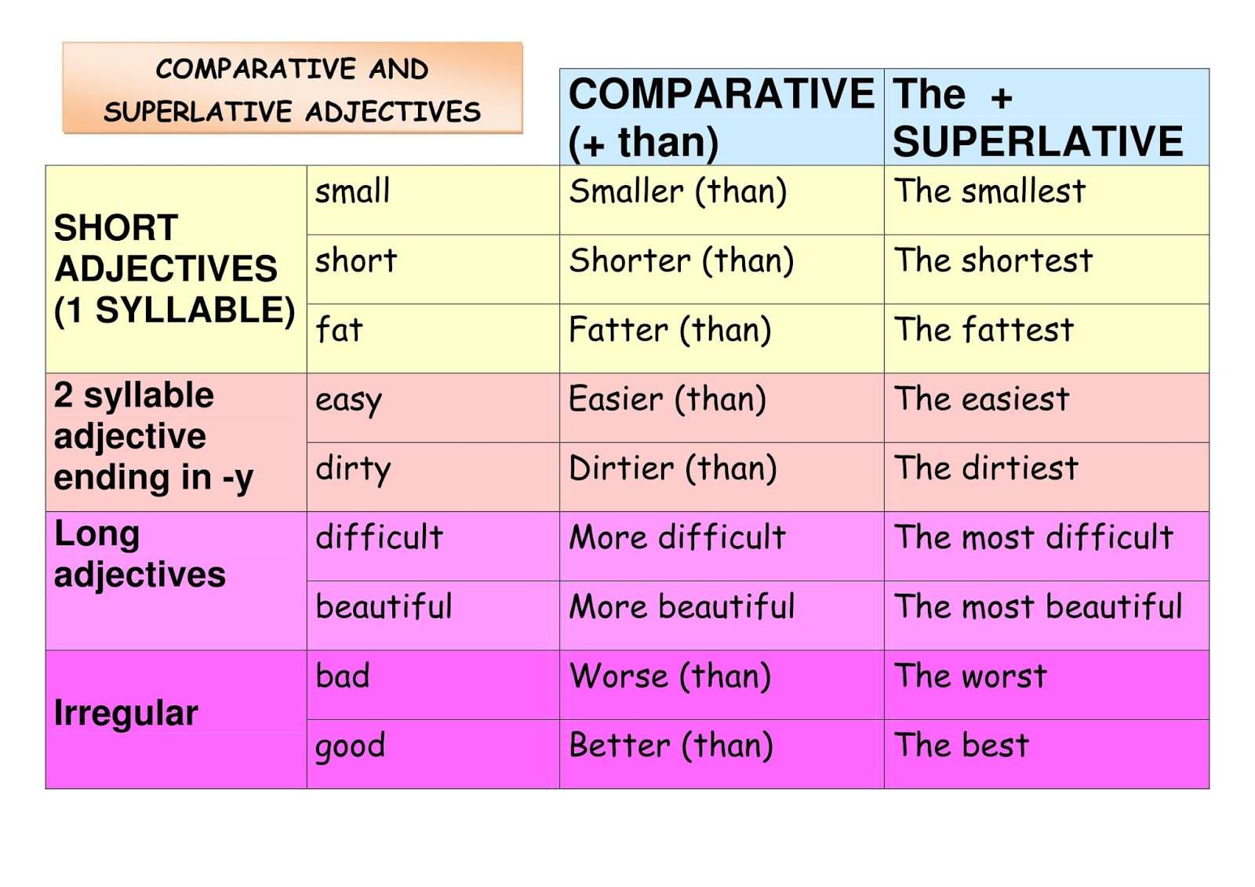

Slide 36
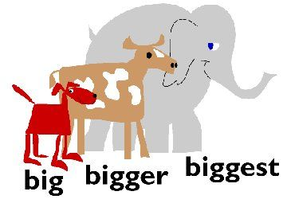
superlative
When
is used to compare differences between one object with a group of objects , one person with a group of people ect ...

Slide 37
superlative
How
1st noun
Be
the
adj + est
noun ( in - of )
Ali is the tallest boy in his family .
tall
taller
The tallest

Slide 39
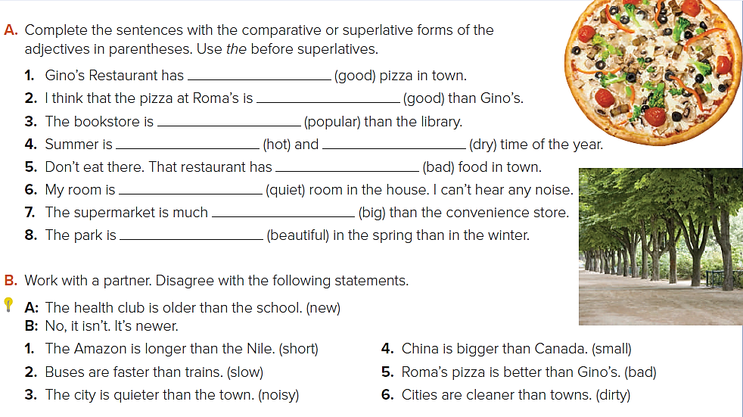
the best
better
more popular
the hottest
the worst
the quietest
bigger
more beautiful
the driest
No, it isn’t. It’s shorter.
No, they aren’t. They’re slower.
No, it isn’t. It’s noisier.
No, it isn’t. It’s smaller.
No, it isn’t. It’s worse.
No, they aren’t. They’re dirtier.

Slide 40
Homework
I
Page 118

