Slide 1

Unit 7
Where do you live?
Grammar

Slide 2
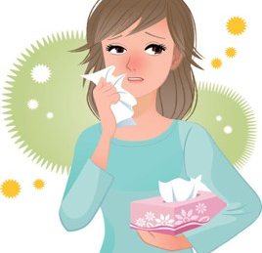
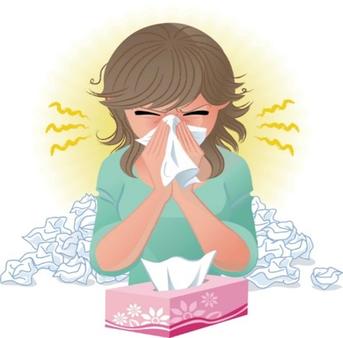
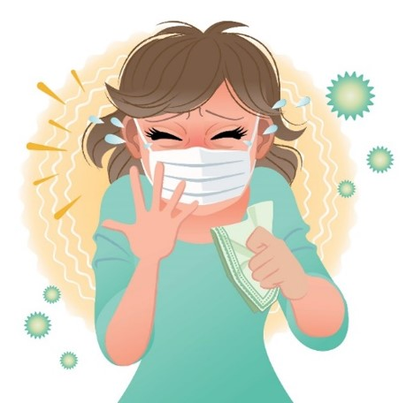
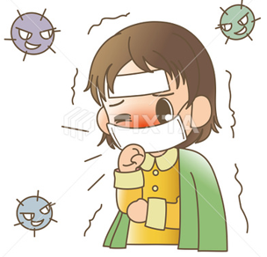

COVID 19
☺ Avoid gathering !
☺ wear a mask before going out
☺ Social distancing is not a choice, it is a must!
☺ Keep a distance of 2 meters to avoid accountability
☺ Wash hands constantly

Slide 3
بسم الله الرحمن الرحيم
Day:
Date:

Slide 4
Learning Objectives
1. Use " live " with prepositions in meaningful sentence
2. Use prepositions correctly.
3. Give directions correctly
4. write names of places after listening
5. practice pronunciation correctly

Slide 5

Warm up

Slide 6
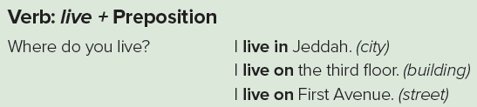
Grammar
Pages 58 & 59

Slide 7
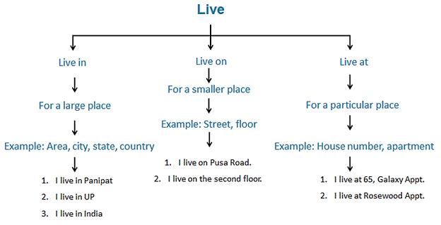
Grammar

Slide 8
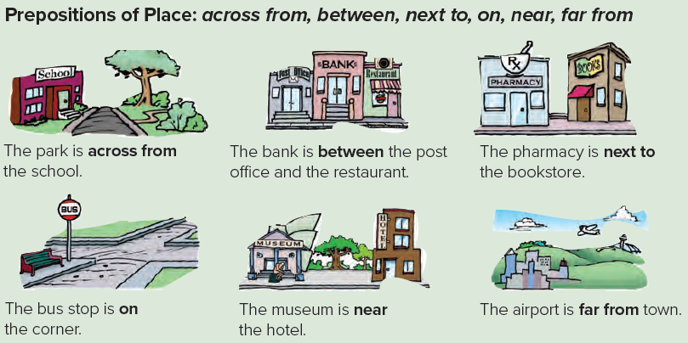
Grammar

Slide 9


Practice

Slide 10
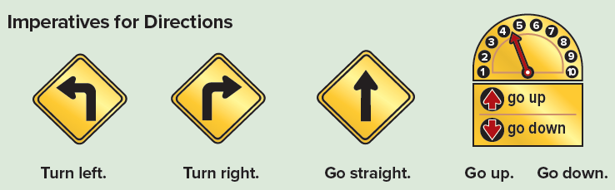
Grammar

Slide 11
Revision

Slide 12
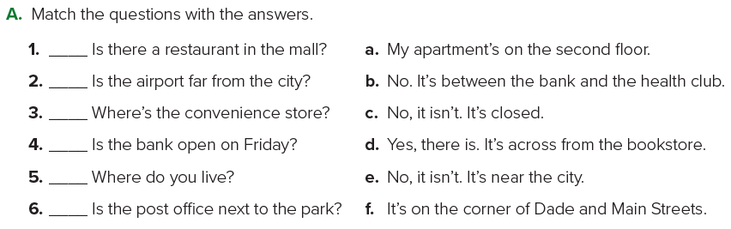
d
e
f
c
a
b

Slide 14
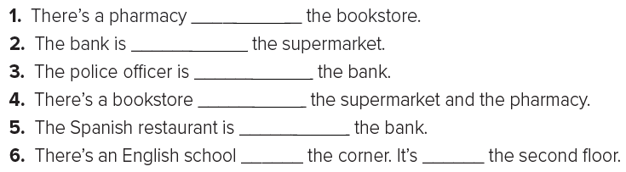
next to
across from
near
between
next to
on
on

Slide 15
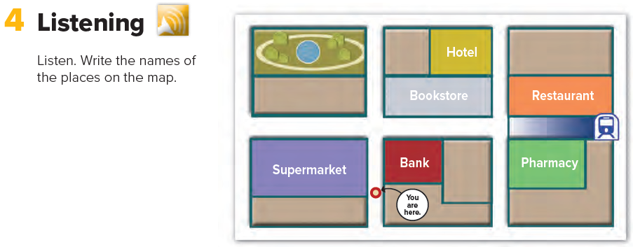

Café
School
Subway
convenience store

Slide 16
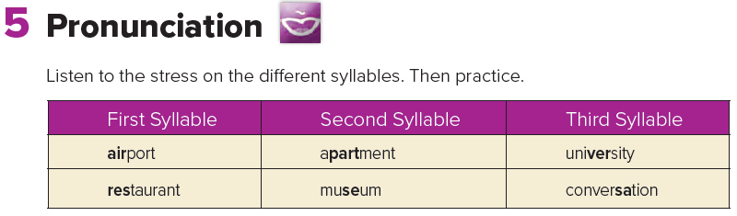

Slide 17
Homework
Page 116

Slide 18
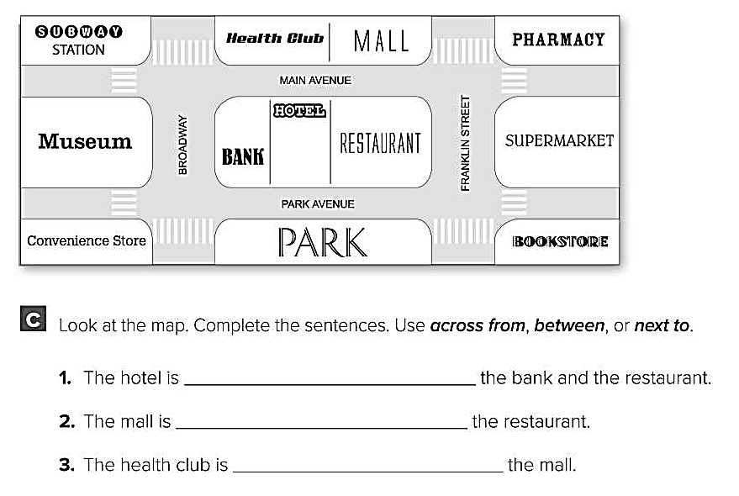
between
across from
next to

Slide 19
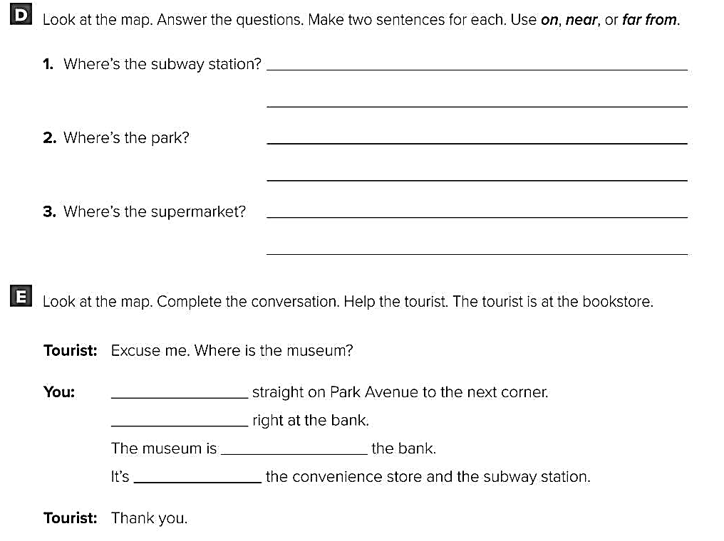
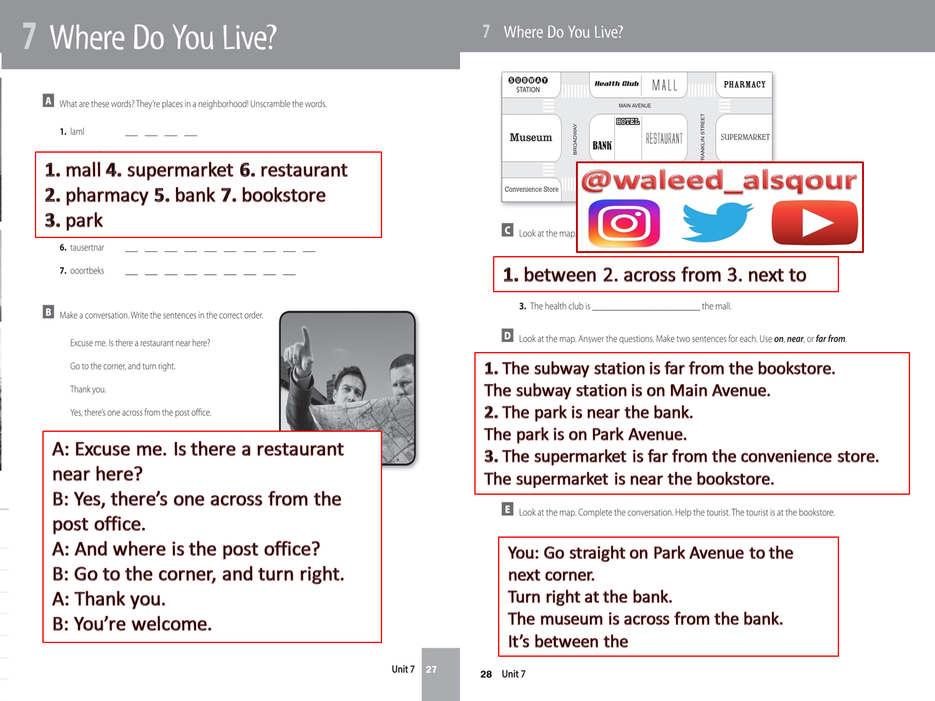
Go
Turn
across from
between

