Slide 1

Unit 7
Where do you live?
Listen & Discuss

Slide 2
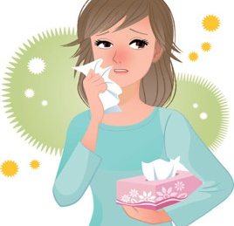
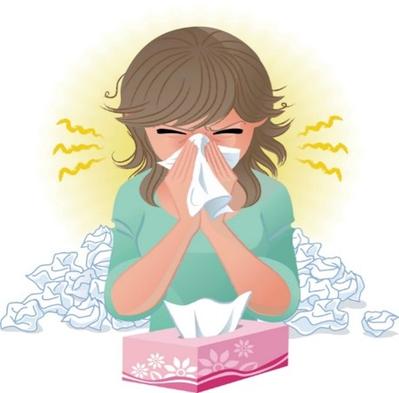
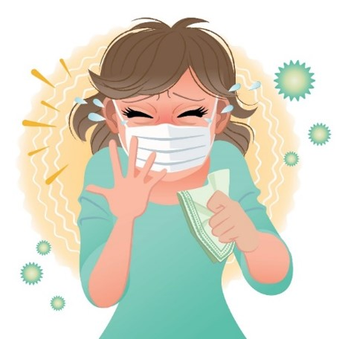
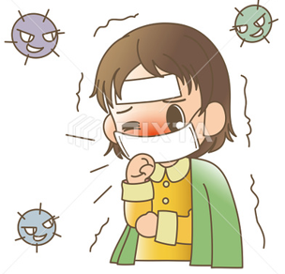

COVID 19
☺ Avoid gathering !
☺ wear a mask before going out
☺ Social distancing is not a choice, it is a must!
☺ Keep a distance of 2 meters to avoid accountability
☺ Wash hands constantly

Slide 3
بسم الله الرحمن الرحيم
Day:
Date:

Slide 4
Learning Objectives
1. Name places in the neighborhood correctly.
2. Define each place correctly.
3. Describe locations correctly
4. Ask questions about places.
5. Answer questions about places.

Slide 5

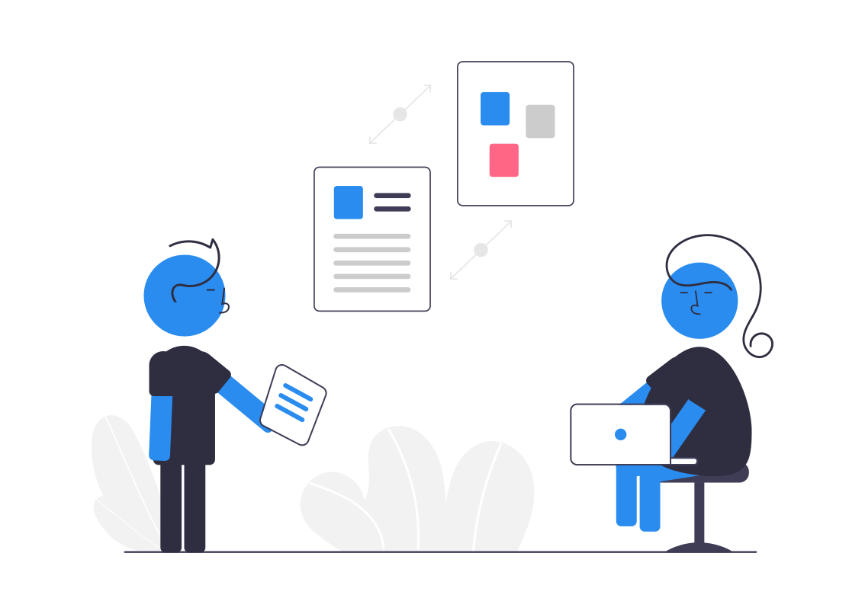
Revision

Slide 6
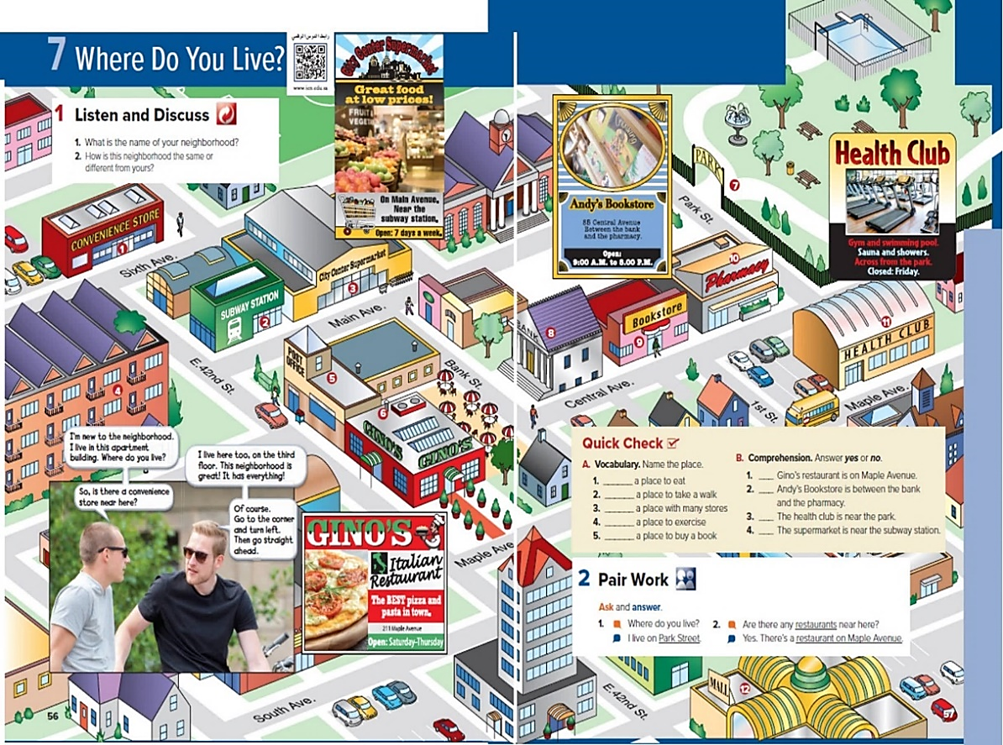
Discussion
Pages 56 & 57

Slide 7
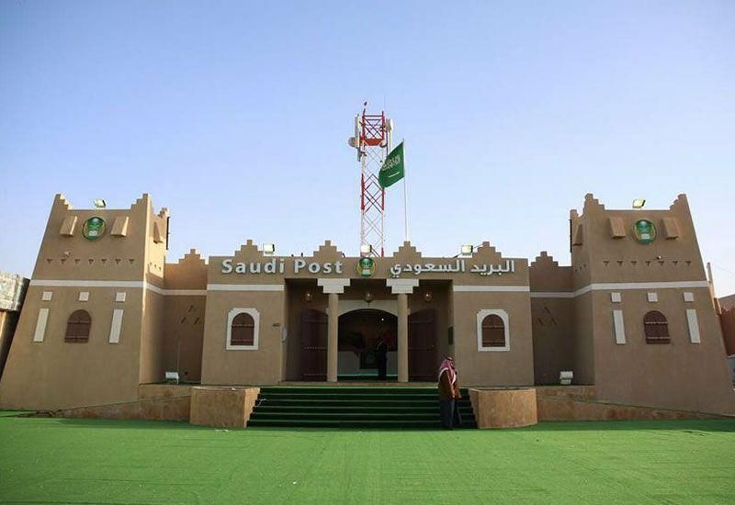
Vocabulary
Post Office

Slide 8
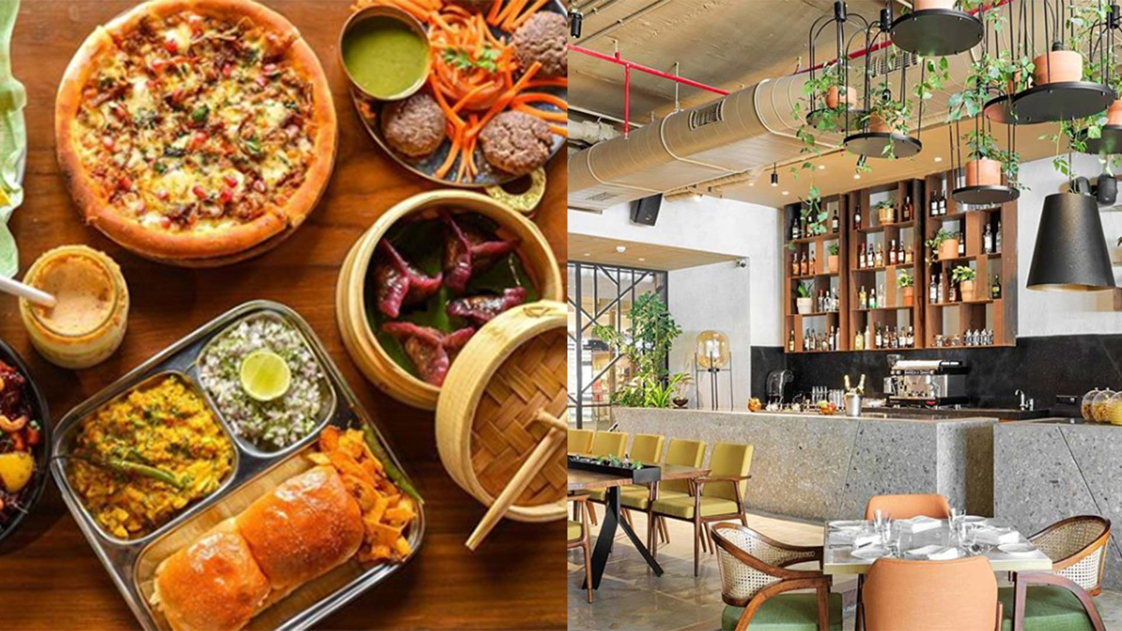
Vocabulary
Restaurant

Slide 9
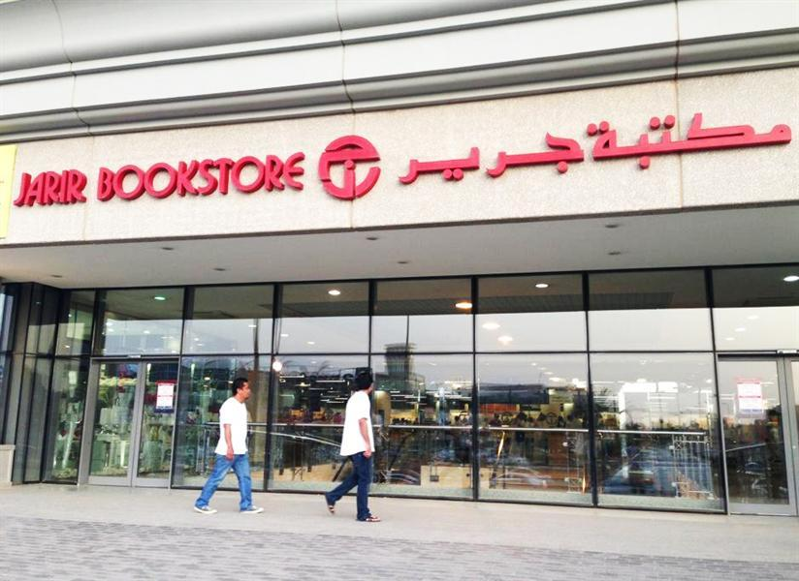
Vocabulary
Bookstore

Slide 10
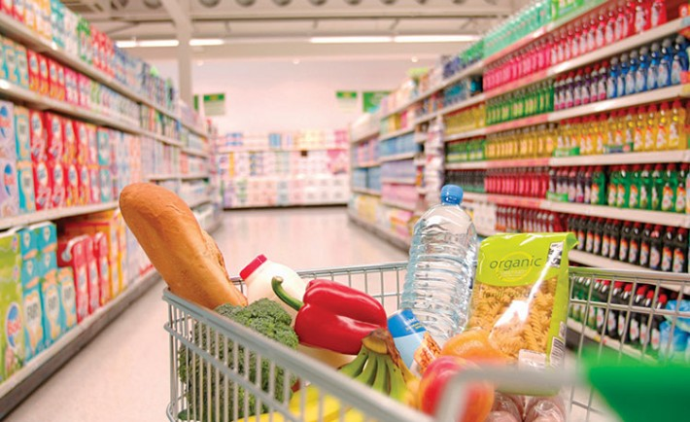
Vocabulary
Supermarket

Slide 11
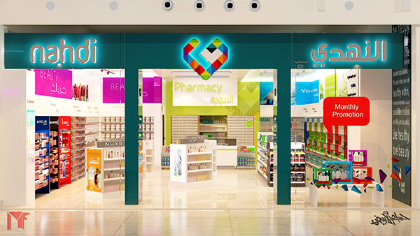
Vocabulary
Pharmacy

Slide 12
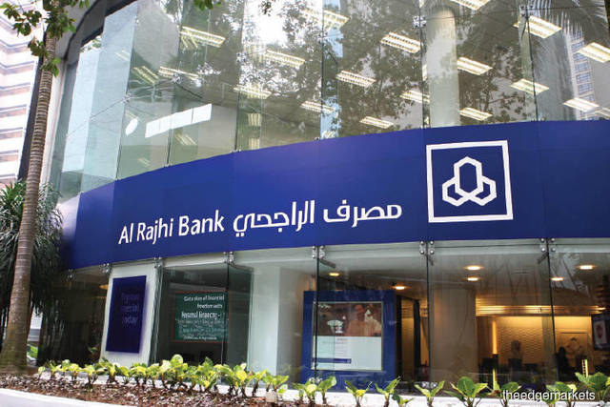
Vocabulary
Bank

Slide 13
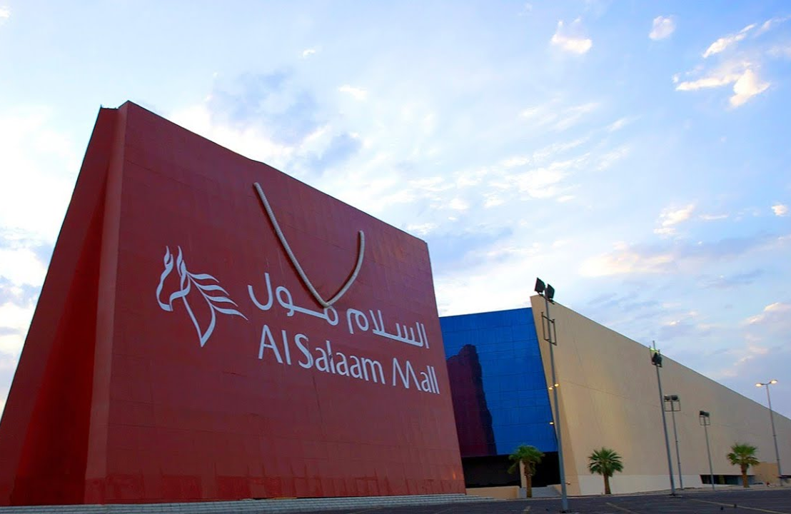
Vocabulary
Mall

Slide 14

Vocabulary
Health
Club

Slide 15
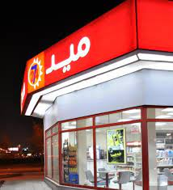
Vocabulary
Convenience
Store

Slide 16
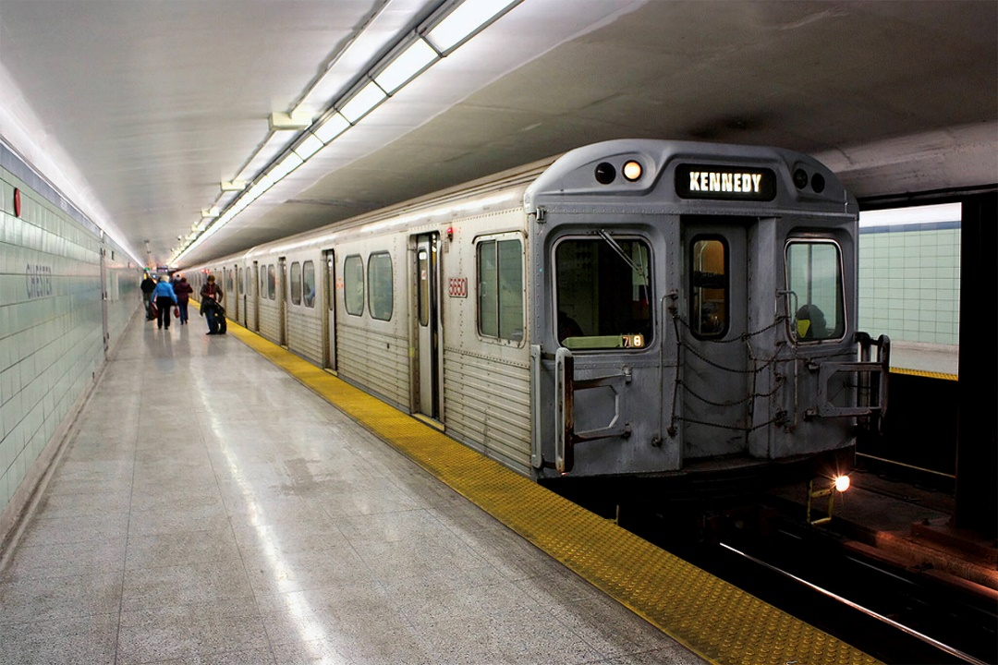
Vocabulary
Subway
Station

Slide 17
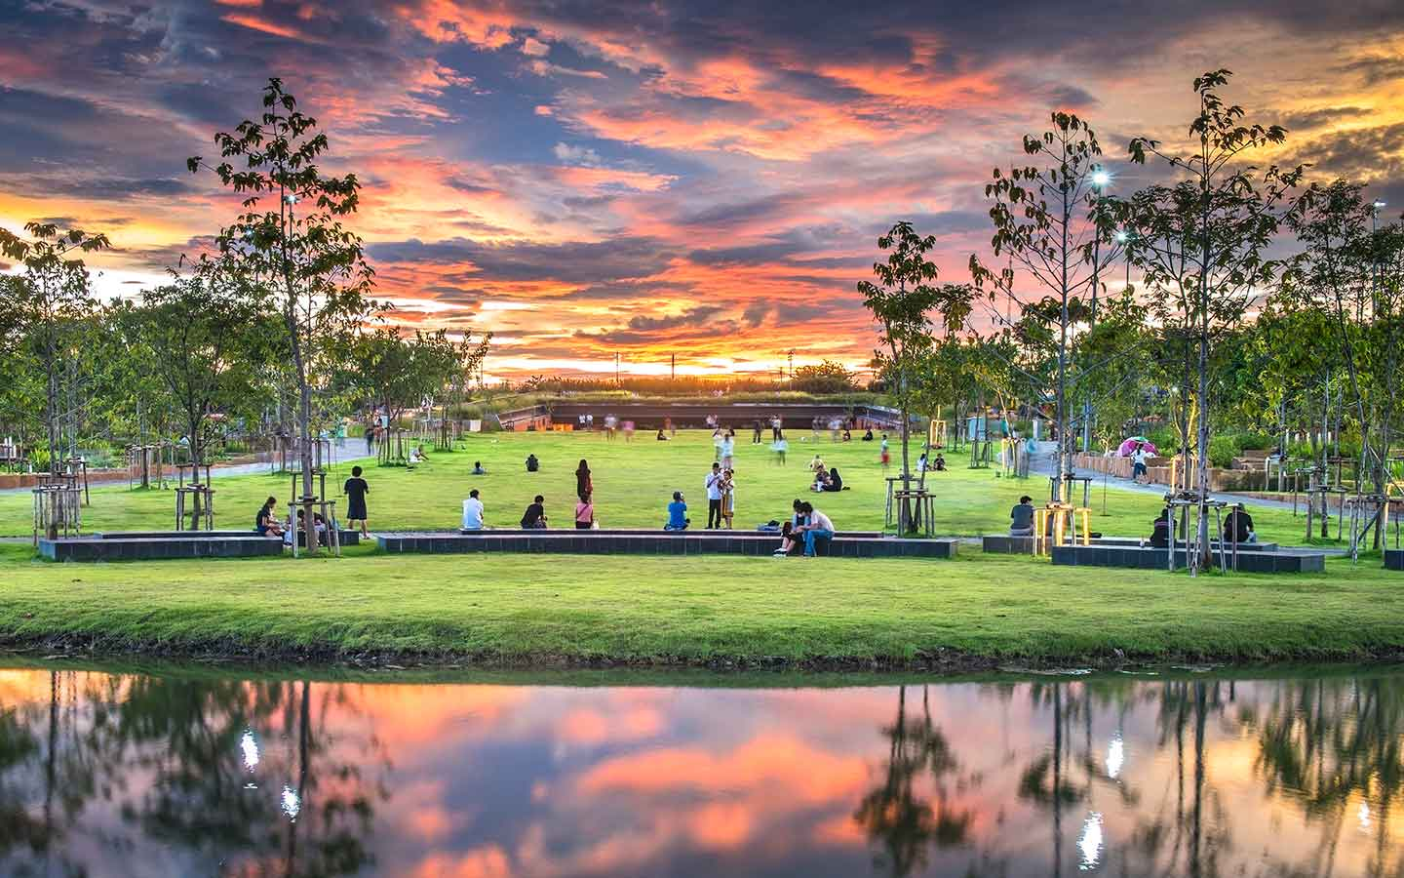
Vocabulary
Park

Slide 18
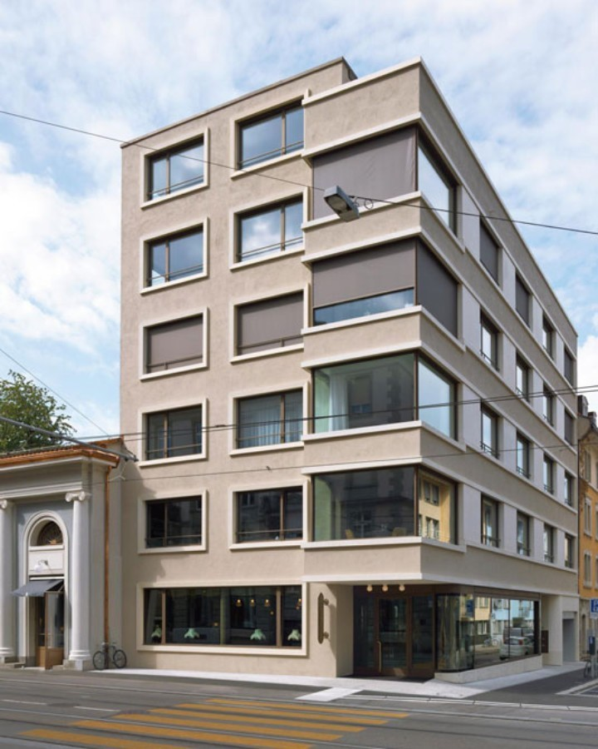
Vocabulary
Apartment
Building

Slide 19

Vocabulary
Go Straight

Slide 20

Vocabulary
Turn Left

Slide 21


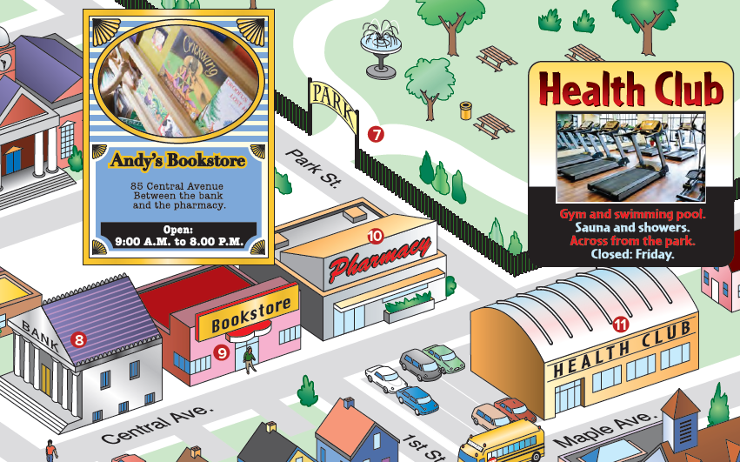

Slide 22

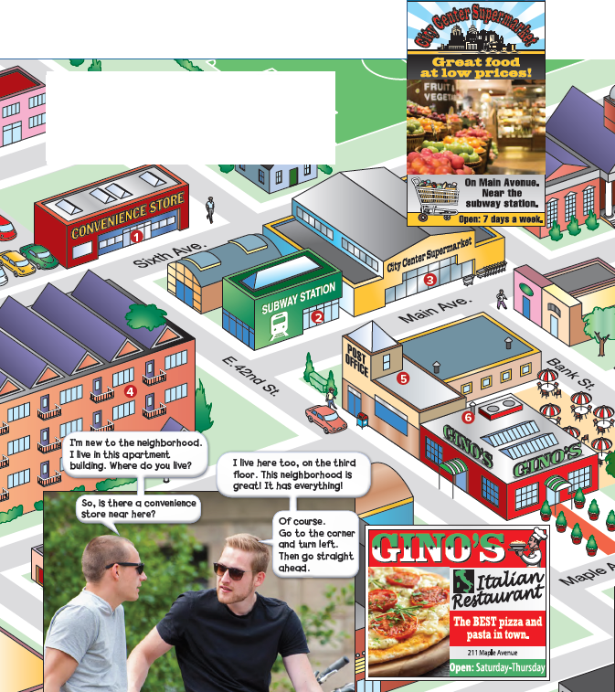
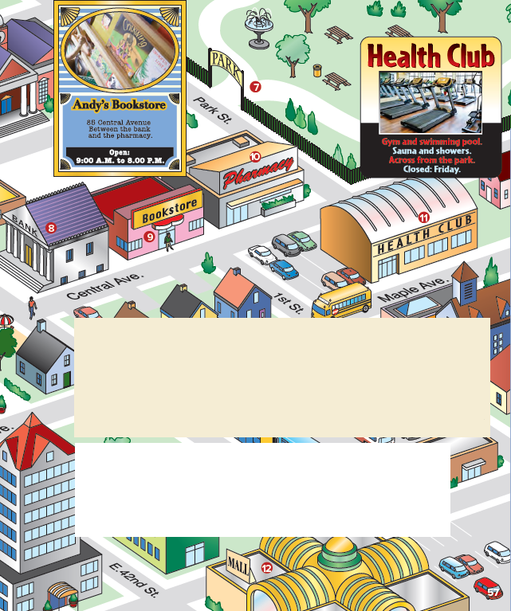
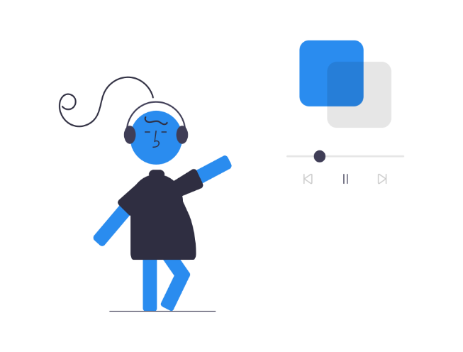
Pages 56 & 57

Slide 25
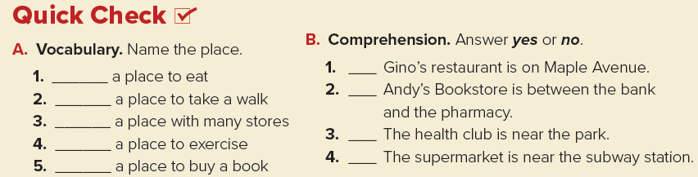
Answers
1. a restaurant
2. the park
3. the mall
4. the health club
5. the bookstore

Slide 26
No
Yes
Yes
Yes

Slide 27
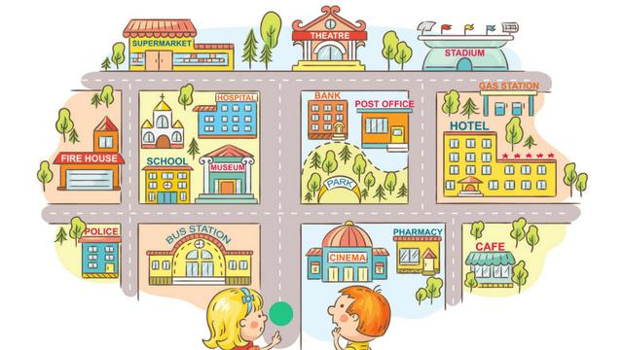
Where am I ?

Slide 28
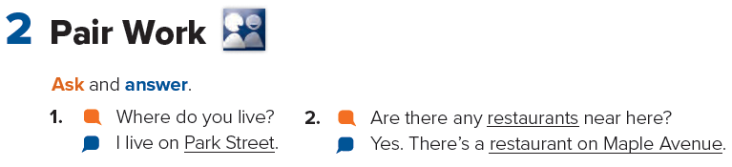

Slide 29
Homework
Page 115

Slide 30
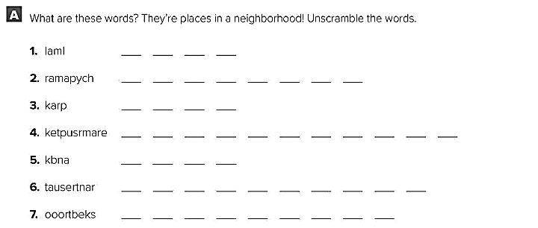
Mall
Pharmacy
park
supermarket
bank
Restaurant
bookstore

Slide 31
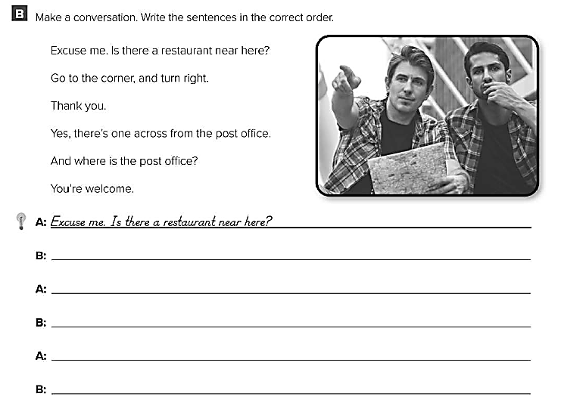
1
4
5
2
3
6
Yes, there one across from the post office
Where is the post office?
Turn right when you reach the corner.
Thank you.
You’re welcome.

