Slide 1

Unit (6) Lesson (3)
Grammar
Page (50)
Done by: T. Haya B.

Slide 2
Is there a veiw?

Slide 3




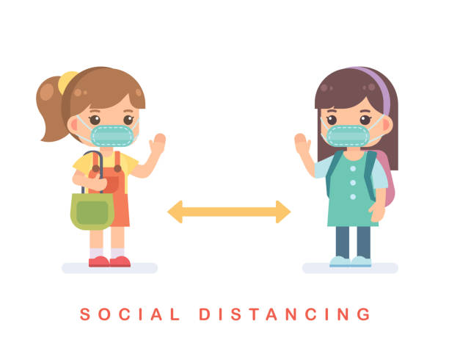
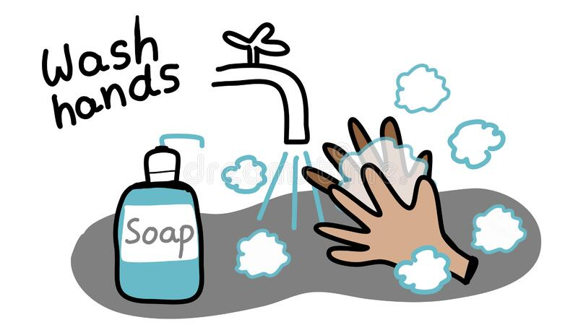

Rules of the classroom:-
1- avoid gathering.
2- we must wear mask.
3- social distancing is not a choice , it is a must.
4- Wash hands.
5- If you want to answer or ask, please, raise your hand

Slide 4

Check homework:-

Slide 5
Revision :-
General questions about the house:-
Is there a ………………. in your house?
Are there ………………. In your house?

Slide 6
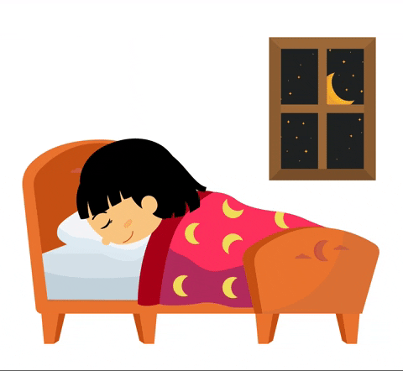
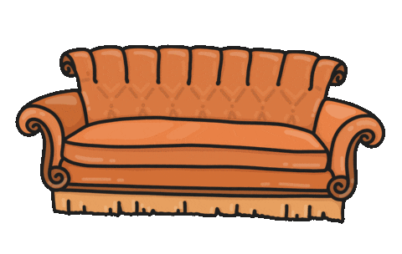
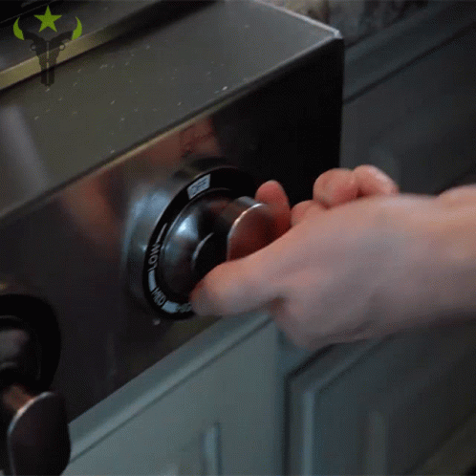
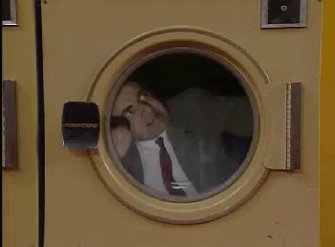
Revision :-
Name these items:-
sofa
bed
stove
dryer

Slide 7
Objectives:-
1- use there is / there are correctly.
2- use preposition correctly.
3- answer the questions.

Slide 8
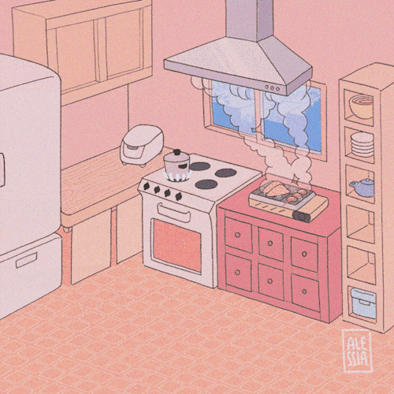
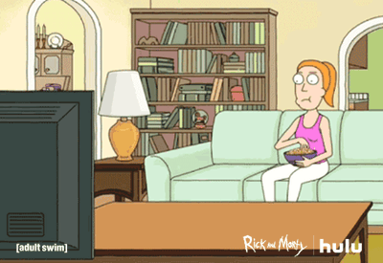
Warm up:-
Describe each picture
There is ………………………..

Slide 9
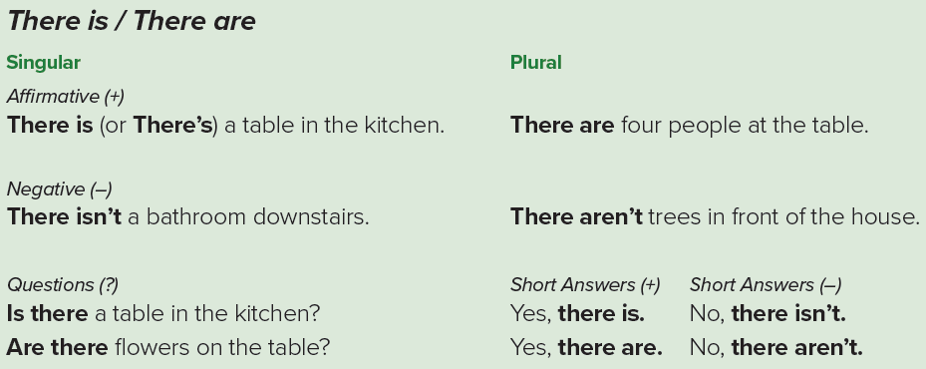
Grammar:-
50

Slide 10
Grammar:-
There is / There are
50
Affirmative:
There is + a/an + noun
There is a bed in the bedroom
There is an orange in the fridge
There are + noun +s
There are four chairs in the kitchen
There are two bathrooms in my house
singular
plural

Slide 11
Grammar:-
There is / There are
50
Negative:
There is not + a/an + noun
There is not a bed in the bedroom
There is not an orange in the fridge
There not are + noun +s
There are not four chairs in the kitchen
There are not two bathrooms in my house
singular
plural

Slide 12
Grammar:-
There is / There are
50
Questions :
There is a car in the garage.
Is there a car in the garage?
Yes , there is .
No , there isn’t .
There are pens in my bag.
Are there pens in my bag?
Yes , there are .
No , there aren’t .

Slide 13
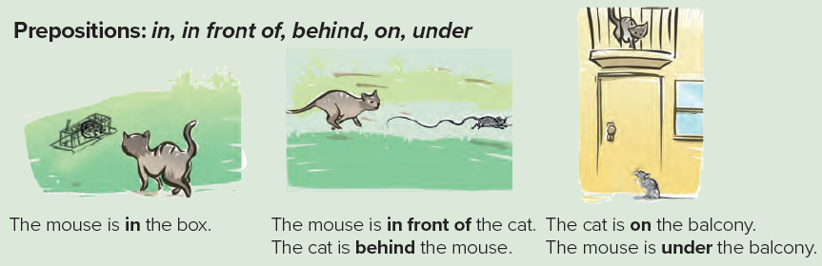
Grammar:-
50

Slide 14
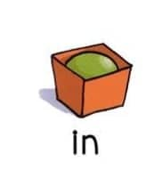
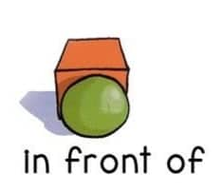
Grammar:-
50
Preposition : in, in front of, behind, on, under
In
The ball is in the box.
In front of
The ball is in front of the box.

Slide 15
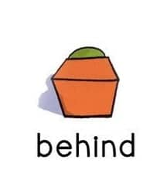
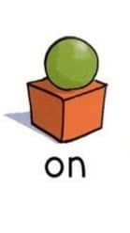
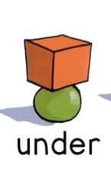
Grammar:-
50
Preposition : in, in front of, behind, on, under
behind
The ball is behind the box.
On
The ball is on the box .
Under
The ball is under the box .

Slide 16
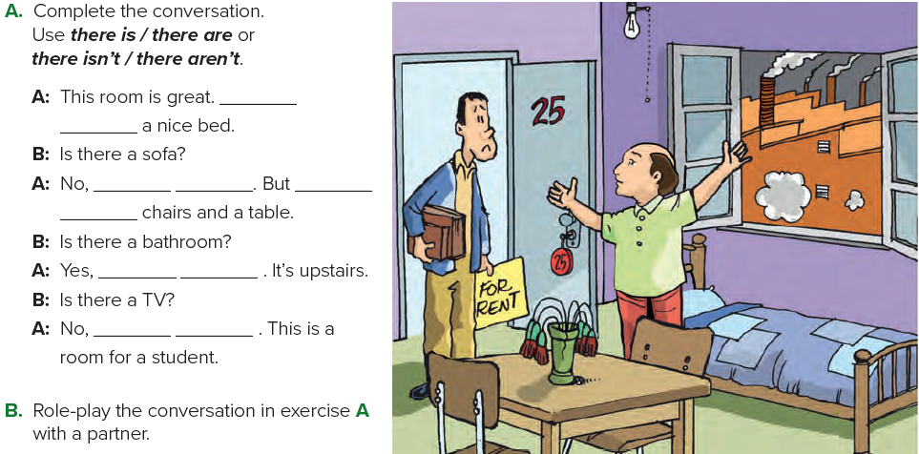
exercise:-
50
there
is
there isn’t
there
are
there is
there isn’t

Slide 17

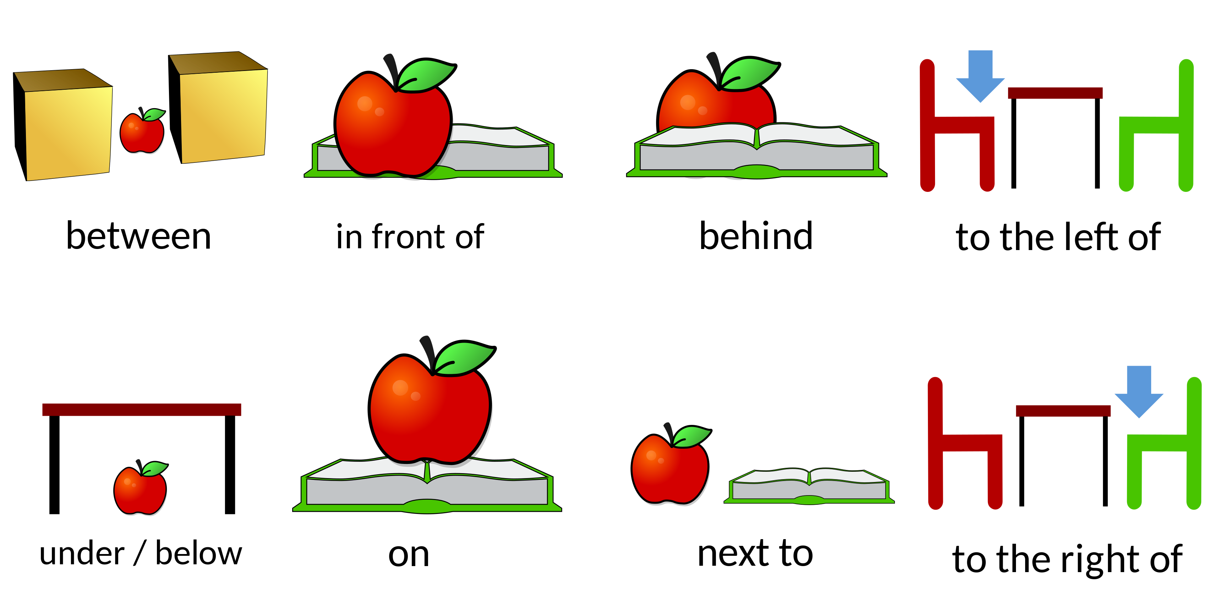
Task :-
Use preposition by drawing pictures???

Slide 18

homework :-
A & B Page (111)

Slide 19


