Slide 1
Oral examinations
2nd semester

Slide 2
3rd grade
1
2
3
4
5
6

Slide 3


What invention you can’t live without ?
What’s your favorite type of movies? Why?
Which city do you wish to visit ? Why ?
What’s this ?
What does it mean ?

Slide 4
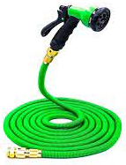
What invention you can’t live without ?
What’s your favorite type of movies? Why?
Which city do you wish to visit ? Why ?
What’s this ?
What does it mean ?

Slide 5
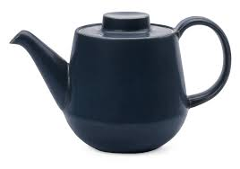
What invention you can’t live without ?
What’s your favorite type of movies? Why?
Which city do you wish to visit ? Why ?
What’s this ?
What does it mean ?

Slide 6
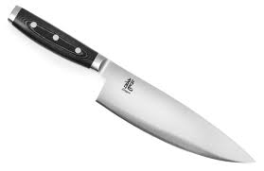

What invention you can’t live without ?
What’s your favorite type of movies? Why?
Which city do you wish to visit ? Why ?
What’s this ?
What does it mean ?

Slide 7
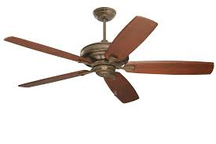

What invention you can’t live without ?
What’s your favorite type of movies? Why?
Which city do you wish to visit ? Why ?
What’s this ?
What does it mean ?

Slide 8
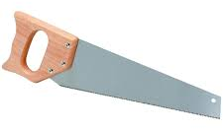

What invention you can’t live without ?
What’s your favorite type of movies? Why?
Which city do you wish to visit ? Why ?
What’s this ?
What does it mean ?

