Slide 1

U8

Slide 2

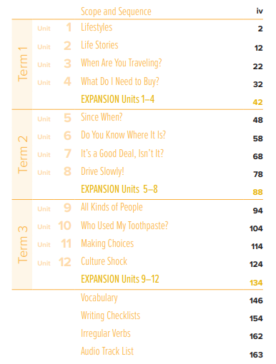


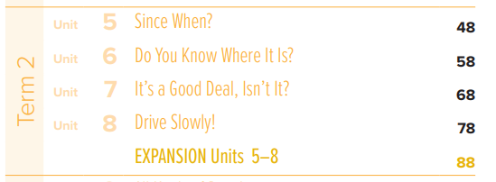
الثالث متوسط

Slide 3

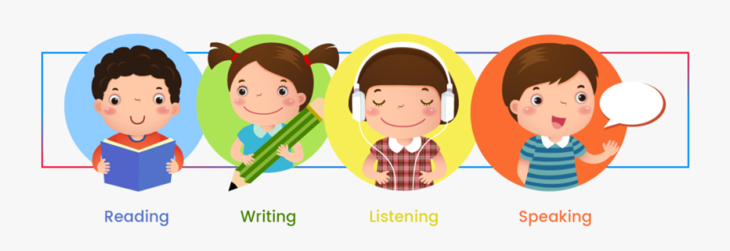

Slide 4
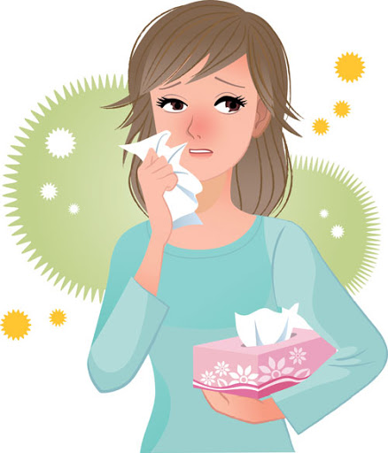
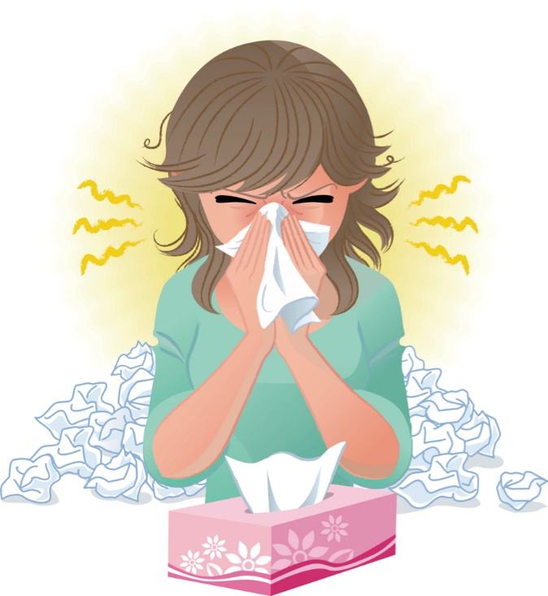
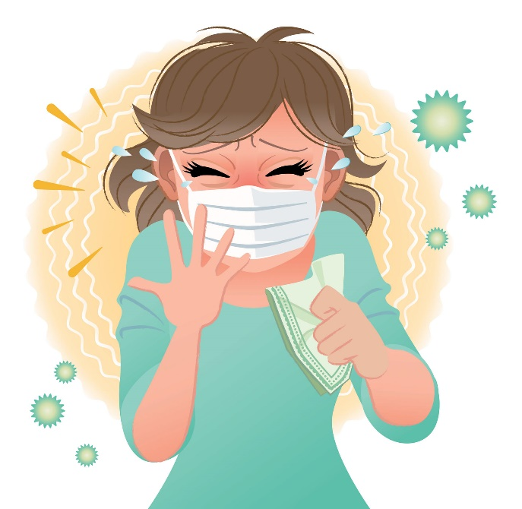
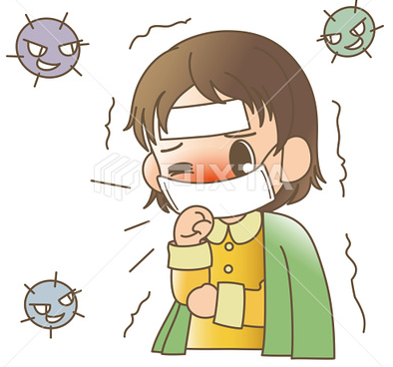
Covid 19
☺Avoid gathering !
☺We must wear a mask before
going out.
☺Social distancing is not a
choice, it is a must!
☺Keep a distance of 2 meters
to avoid accountability
☺wash hands constantly.

Slide 5
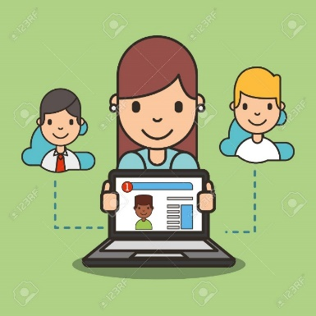



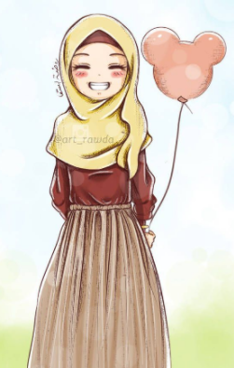
ارجو الالتزام بعدم كتابة أي تعليقات غير لائقة بالأدب العام. علماً بأنه أي محادثة نصية او كتابية مسجلة تحت اسمك ورقم هويتك
وعلية سيتم معاقبة من لم تلتزم بالذوق العام والسلوك الحسن خلال تواجدك في المنصة او الفصول الافتراضية.
وذلك برفع شكوى وبلاغ رسمي ضدك بما تم كتابته او قولة والتواصل مع ولي الأمر والمسؤولين لاتخاذ الاجراء اللازم مع المخالفة.
ونتمنى وضع صوره في ملفك التعريفي لائقة بالمنصة التعليمية

Slide 6
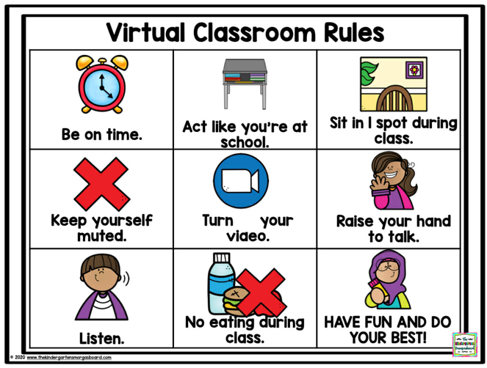
off

Slide 7
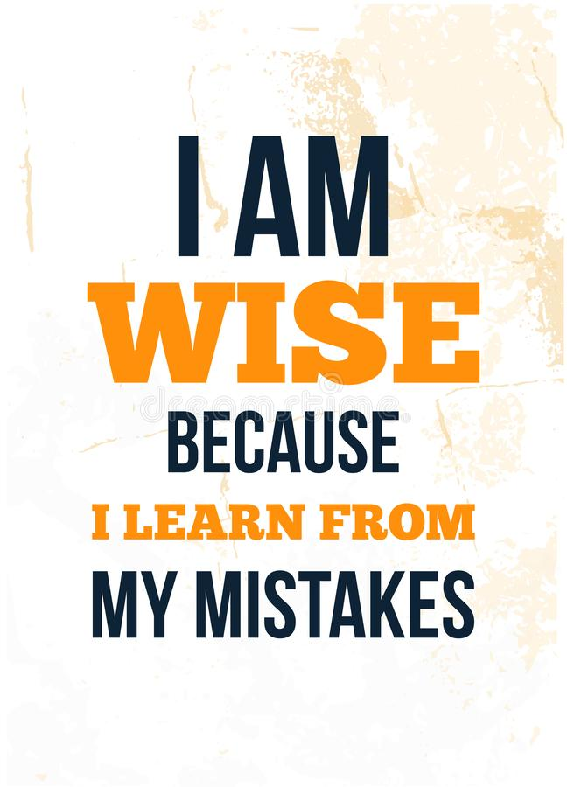

Slide 8

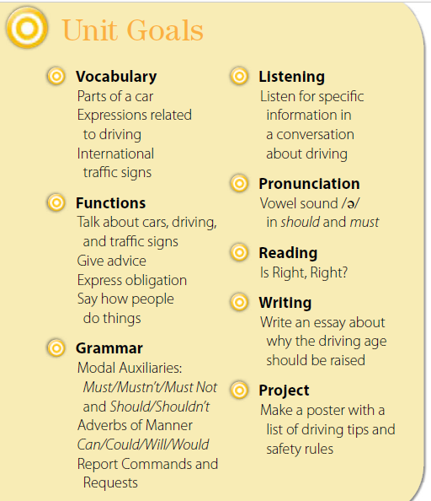

Slide 9


Slide 10
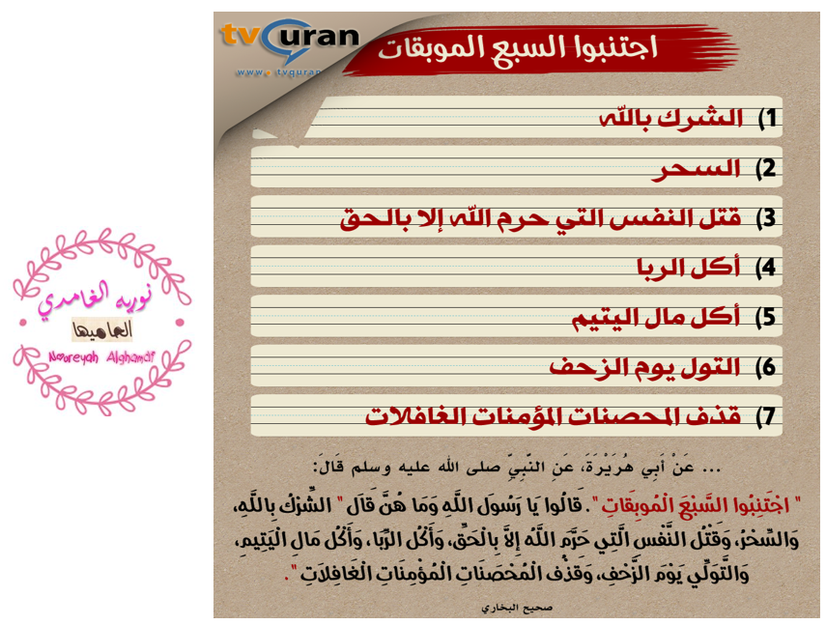

Slide 11


Slide 12



Instilling
values
To put a feeling, idea, or principle gradually into someone's mind, so that it has a strong influence on the way that person thinks or behaves.

Slide 13
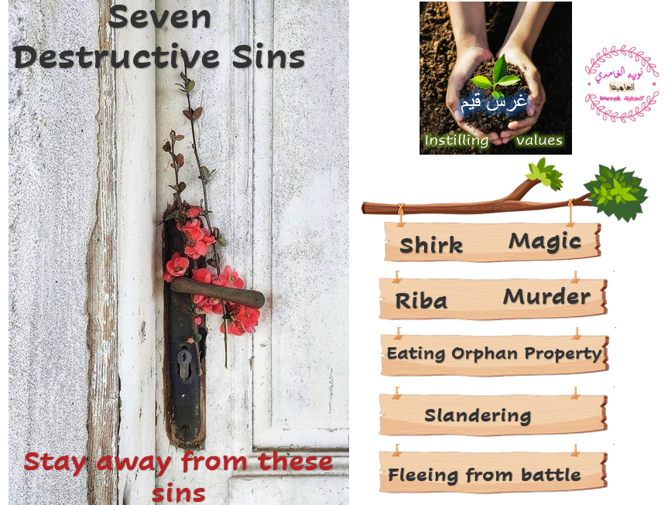

Slide 14
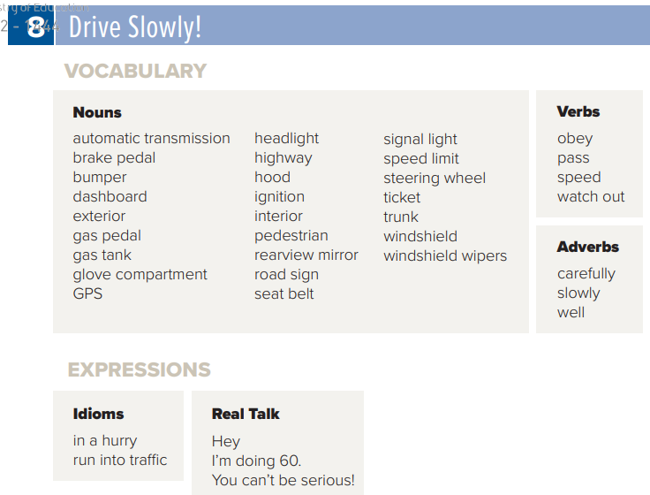

Page 150
الرجاء اختيار 4 أعمدة من الكلمات
وكتابة 4 كلمات من كل 4 أعمدة
في كل وحدة دراسية
U8

Slide 15


Slide 16

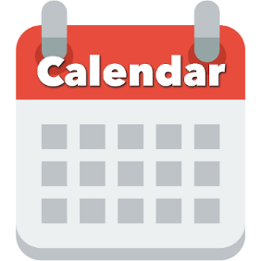

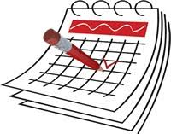



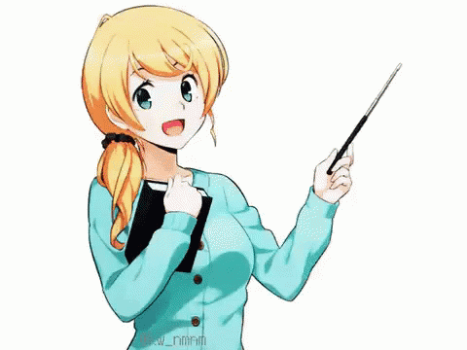
SG3 U8
Page 78 and 79
Today: Tuesday
Date:
29-6-1443 H
February 1st \ 2022
everyone,
How is everything going?

Slide 17
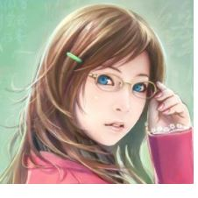



SG3 U8
Page 78 and 79
☺
♥
List a number of car interior and exterior parts
Become familiar with driving expressions
Introduce the international traffic signs

Slide 18
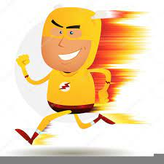

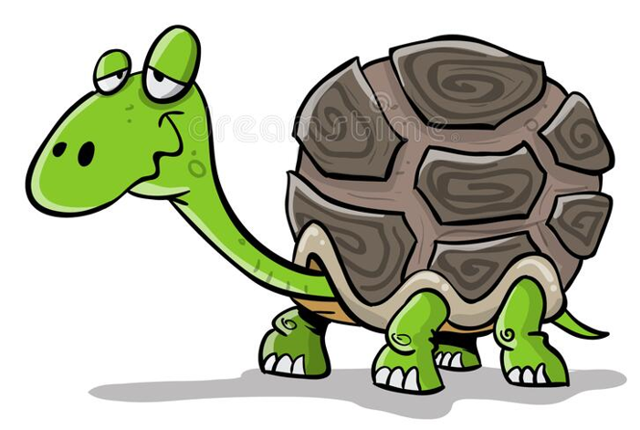
SG3 U8
Page 78
quickly =
at a fast speed
≠ the antonym of slowly

Slide 19
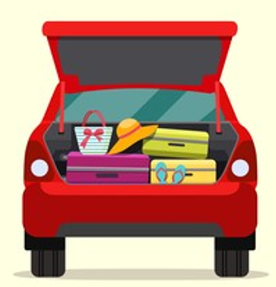
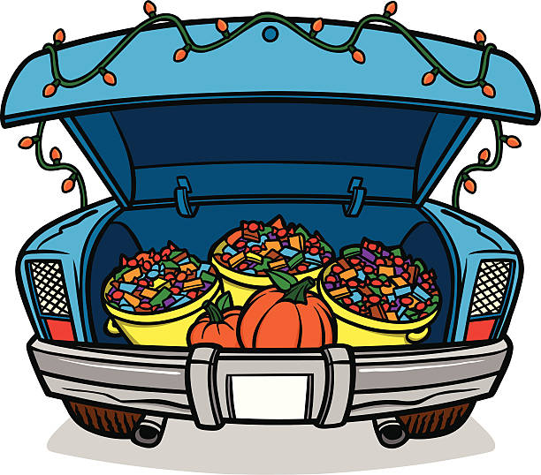
SG3 U8
Page 78
trunk =
a covered space at the back or front
in which you put luggage or other things.

Slide 20
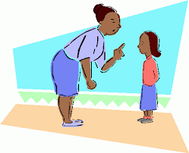
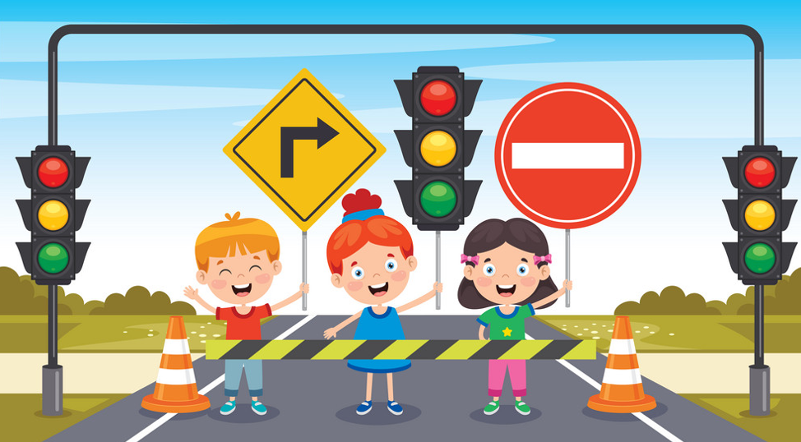
SG3 U8
Page 78
obey =
to do what you are told to do.
to carry out the instructions or orders of
to behave according to a rule or instruction

Slide 21
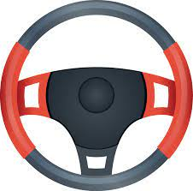
SG3 U8
Page 78
steering wheel =
the wheel which the driver holds when he or she is driving.
a wheel in a vehicle that the driver turns in order to make
the vehicle go in a particular direction
Keep both hands on the steering wheel at all times.

Slide 22
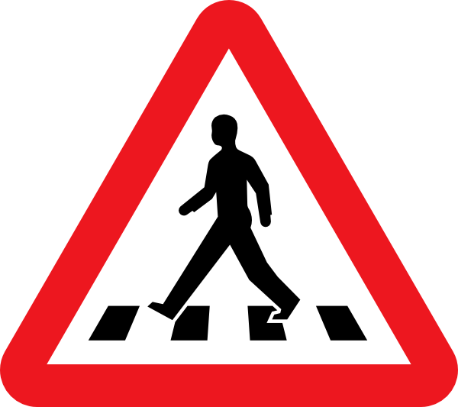
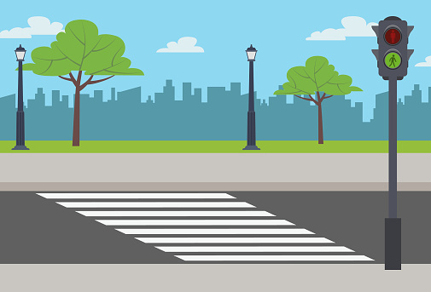
SG3 U8
Page 78
pedestrian crossing = crosswalk
a place where people can cross a street

Slide 23

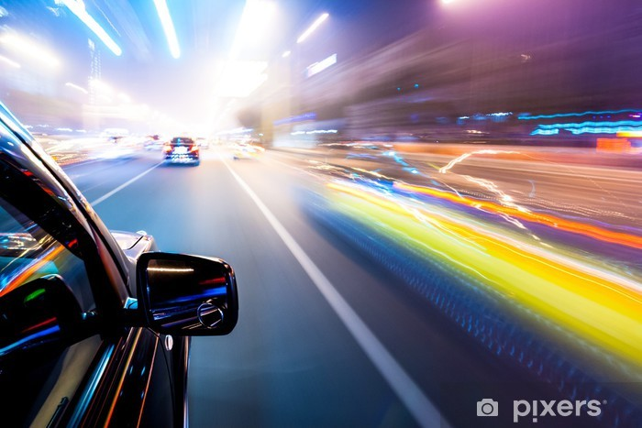

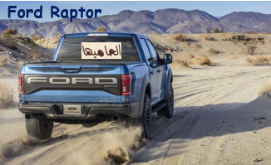
SG3 U8
Page 78
1.Can you drive a car?
Yes, I can.
2. What kind of car do you prefer?
Ford Raptor
3. Would you steal someone's parking spot?
No
4.Would you speed up to stop someone from passing you?
No, I would stay in my lane, and I do not increase my speed.
5.What is the longest trip you have ever taken by car?
The longest time I spent on a road trip was around two months ago to my hometown Abha.

Slide 24
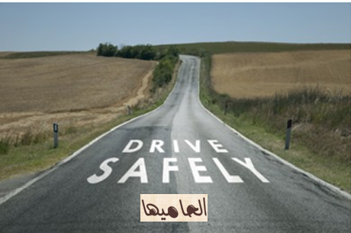
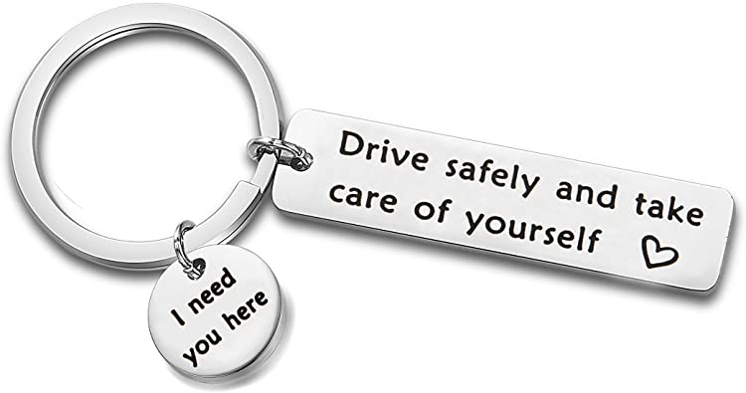
SG3 U8
Page 78

Slide 25
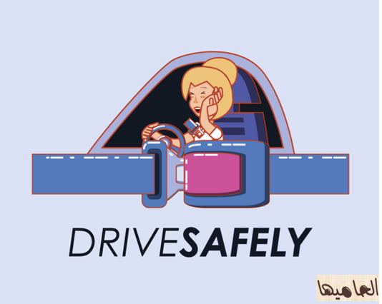
SG3 U8
Page 78

Slide 26
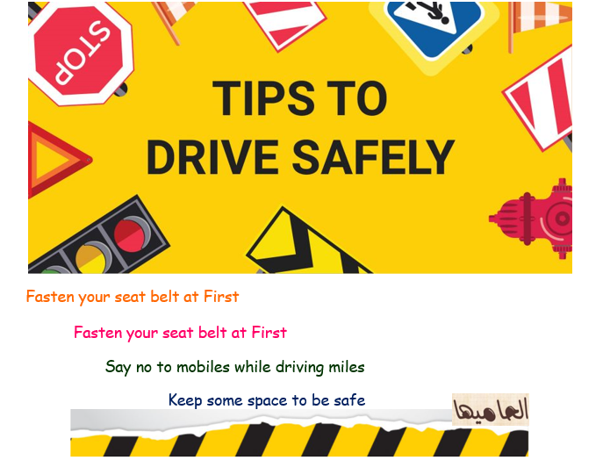
SG3 U8
Page 78

Slide 27

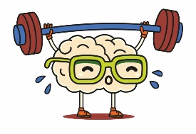
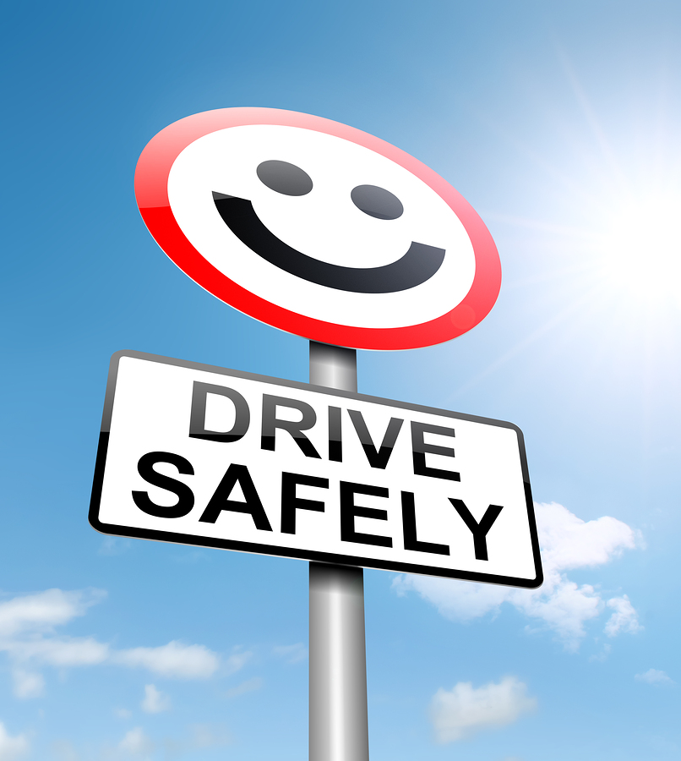
SG3 U8
Page 78
What you, or people you know, do to drive safely.
You must wear a seat belt.
Do you wear a seat belt?
You shouldn’t drive too fast.
☻Do you drive fast?
For example:
Yes, I wear a seat belt.
No, I don’t drive too fast.

Slide 28

SG3 U8
Page 78
Yes, I am.
I can go to many places, the opportunity to plan and go on road trips
which is one of the most amazing things to do in your life.
comfortable and sporty car
I look for features that fit my needs.
the style, the speed, the performance
the engine
speed

Slide 29


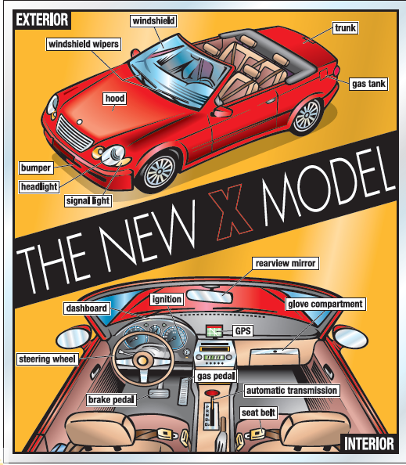

SG3 U8
Page 78
listen and follow along

Slide 30

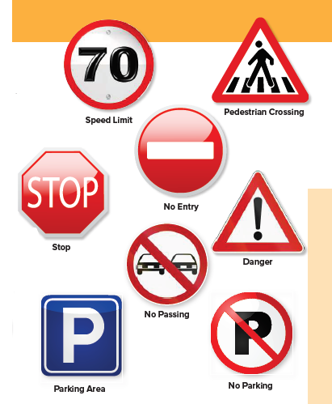
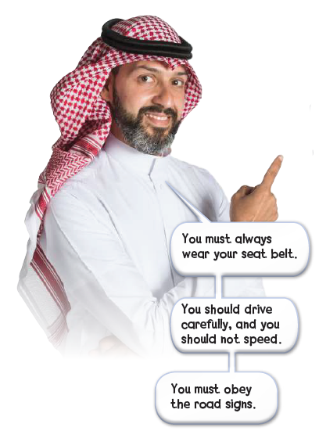
the signs mean the same in our country.
Page 79
speed = go fast, usually faster than the speed limit
obey = do what you are supposed to do
SG3 U8
Page 79
should and shouldn’t are
used to give advice or make a suggestion. Must is
used to talk about obligation, and mustn’t is used to talk about prohibition.

Slide 31
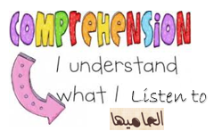
SG3 U8
Page 79
When you are driving at night, what do you need to turn on? (headlights)
What do you turn on if you want to turn left or right?
(signal light)
What do you turn on if it’s raining?
(windshield wipers)
Where can you put suitcases? (trunk)
Where can you see if you need gas? (dashboard)
What do you hold when you’re driving?
(steering wheel)
What do you put your foot on when you want the car to move?
(gas pedal)
What do you put your foot on when you want the car to stop?
(brake pedal)
Where can you keep important papers? (glove compartment)
What should you wear to be safe? (seat belt)
Where do you put the key? (ignition)
Where can you see the cars behind you? (rearview mirror)
What can help you if you’re lost? (GPS)

Slide 32
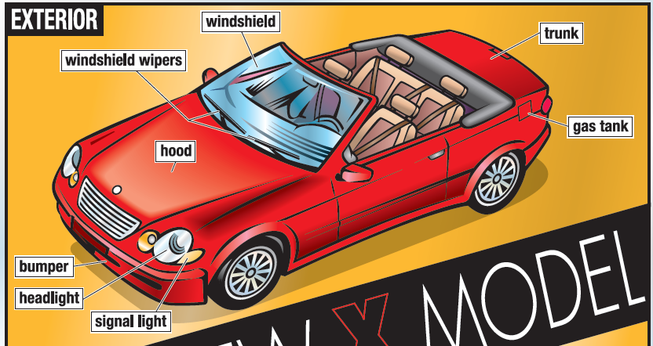
SG3 U8
Page 79

Slide 33
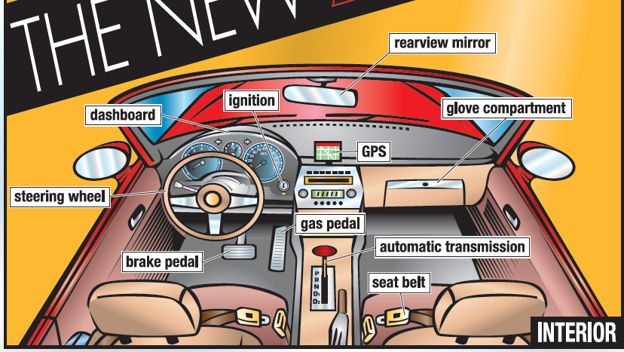
SG3 U8
Page 79

Slide 34

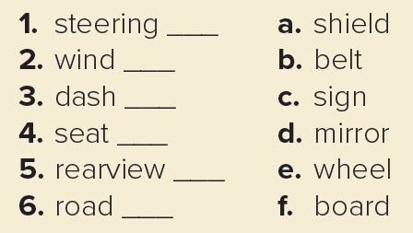
SG3 U8
Page 79
e
Call out all the parts of the car you remember.
a
f
b
d
c

Slide 35

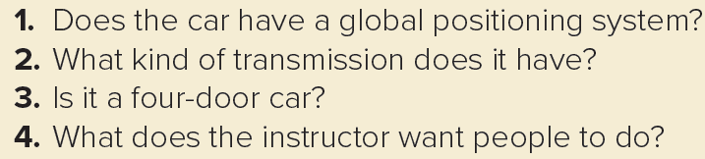
SG3 U8
Page 79
1. Yes, it does.
2. It has automatic transmission.
3. No, it isn’t.
4. He wants people to wear seat belts, to drive carefully, not to speed, and to obey road signs.

Slide 36

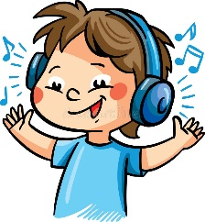
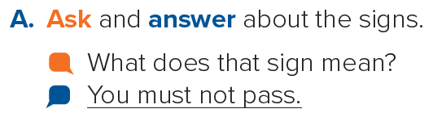
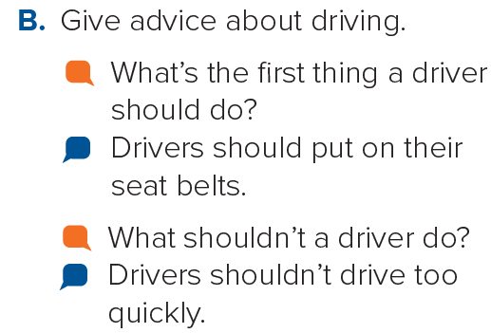
listen and repeat.
SG3 U8
Page 79
What’s the next thing a driver should do?
What should a driver do after that?
What should a driver do?
What else should a driver do?
What else shouldn’t a driver do?

Slide 37

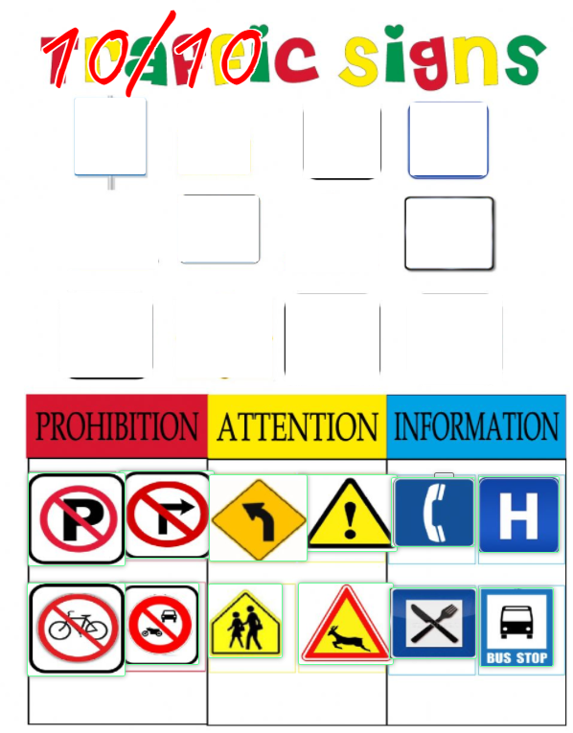

https://www.liveworksheets.com/zg1245676rz

Slide 38
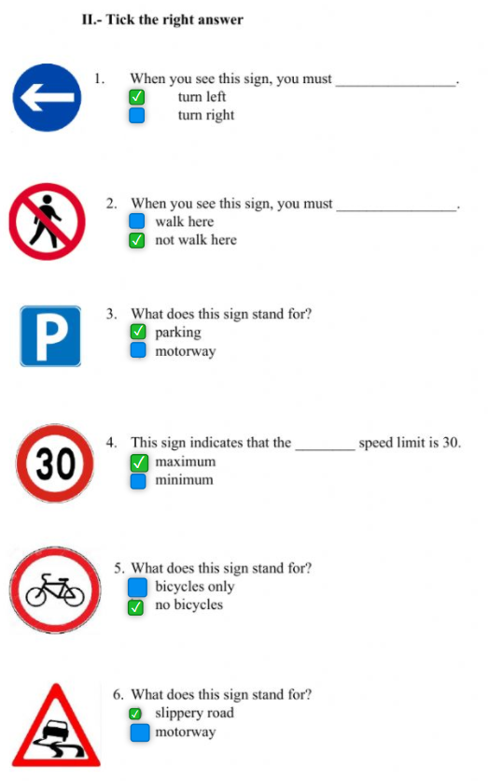
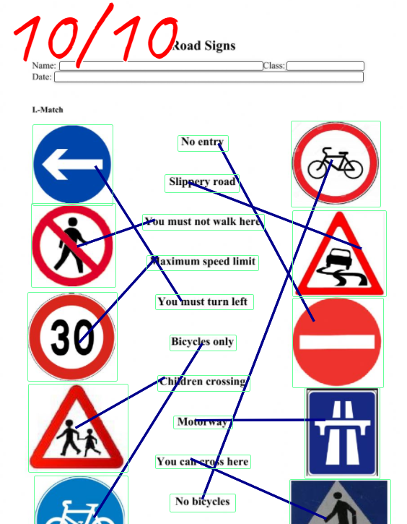
https://www.liveworksheets.com/zo648885zo

Slide 39





بعد حل ورقة العمل
يتم ارسال صورة لذلك
في قسم الإثراءات
على المنصة
Do the live Worksheet Exercise
then upload the photo of the completed activity.
live worksheet\
يكتفى بصورة واحدة لتمرين واحد فقط☺

Slide 40






Platform
واجب المنصة
للتذكير

Slide 41


بعد حل الواجب
يتم ارسال صورة لذلك
في قسم الأنشطة
على المنصة
Page 215 \ A
يكتفى بصورة واحدة لتمرين واحد فقط☺

Slide 42






Assign page 215 for vocabulary practice
Ex A
Assign page 95 for more practice with the vocabulary of
the unit.

Slide 43






Page 215
windshield
hood
headlight
bumper
trunk
gas tank
steering wheel
dashboard
glove compartment
Automatic transmission

Slide 44


أتمنى الاهتمام بمتابعة الدروس في قنوات عين الرسمية من وزارة التعليم
T.Noureyah Alghamdi
The end

Slide 45


SG3 U8
Page 79

Slide 46

SG3 U8
Page 79

Slide 47


Slide 48

SG3 U8
Page 79

Slide 49


تدريب
SG3 U8
Page 79

Slide 50


تدريب
SG3 U8
Page 79

Slide 51


تدريب
SG3 U8
Page 79

Slide 52


تدريب
SG3 U8
Page 79

Slide 53


تدريب
SG3 U8
Page 79

Slide 54



Page 162

Slide 55




