Slide 1
Unit:2
Lesson: 2
Drive
S l o w l y !
Grammar
By: ET Asma AlMjlad

Slide 2

objectives
Use must in a simple sentence
Use should correctly
Use adverb of manner

Slide 3
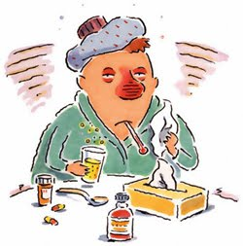
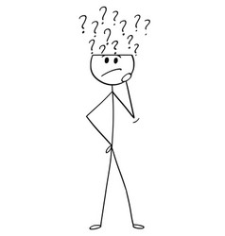
What should he do ?

Slide 4

He should go to the doctor
He should drink orange juice
He should take a rest
He should take a medicine

Slide 5


Things
Must
To do ….

Slide 6


You must stay at home

Slide 7
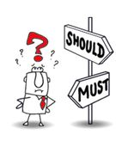
Must \ Mustn’t
To talk about laws and rules.
Should \ shouldn’t
To give advice.

Slide 8


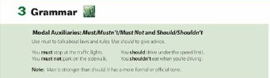
Open your book page 14

Slide 9
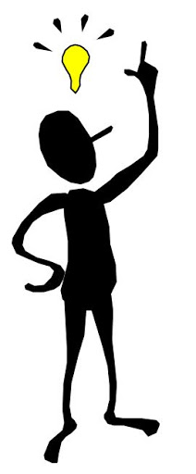
Adverbs of manner
You can make lots of adverbs by using adjectives.
Slow (adj)
+ ly
Slowly (adv)
quick (adj)
+ ly
quickly (adv)

Slide 10
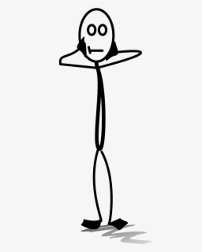
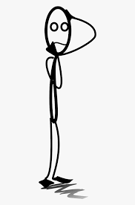
Adjectives
Describe the subject ( things \ people )
For example:
Bader is a slow driver .
Adverbs
Describe the verb ( action ).
For example:
Bader drives slowly .

Slide 11
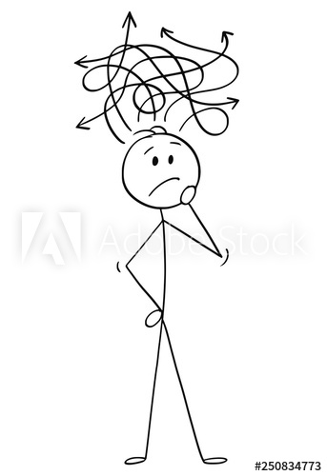
S adj
Sara is a quiet talker
S v adv
Sara talks quietly.

Slide 12


Some an adjective and an adverb have the same form
Fast (adj)
Fast (adv)
Hard (adj)
Hard (adv)
good(adj)
Well (adv)

Slide 13
For example:
He is a good writer. ( adj)
He writes well . ( adv)
You are a fast runner ( adj)
You run fast ( adv)

Slide 14

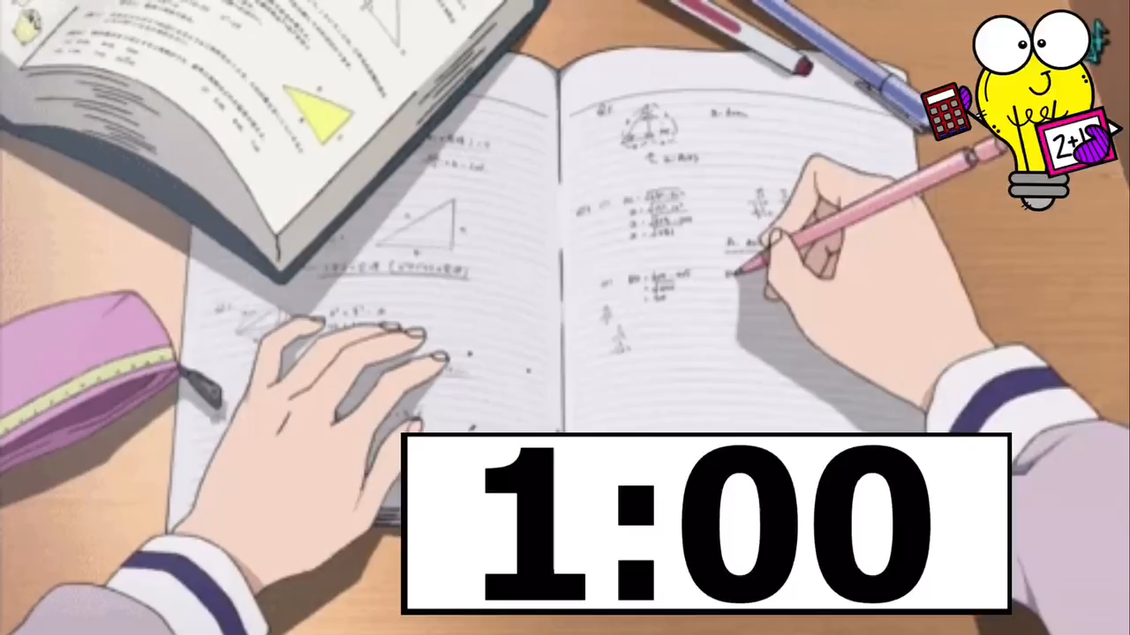
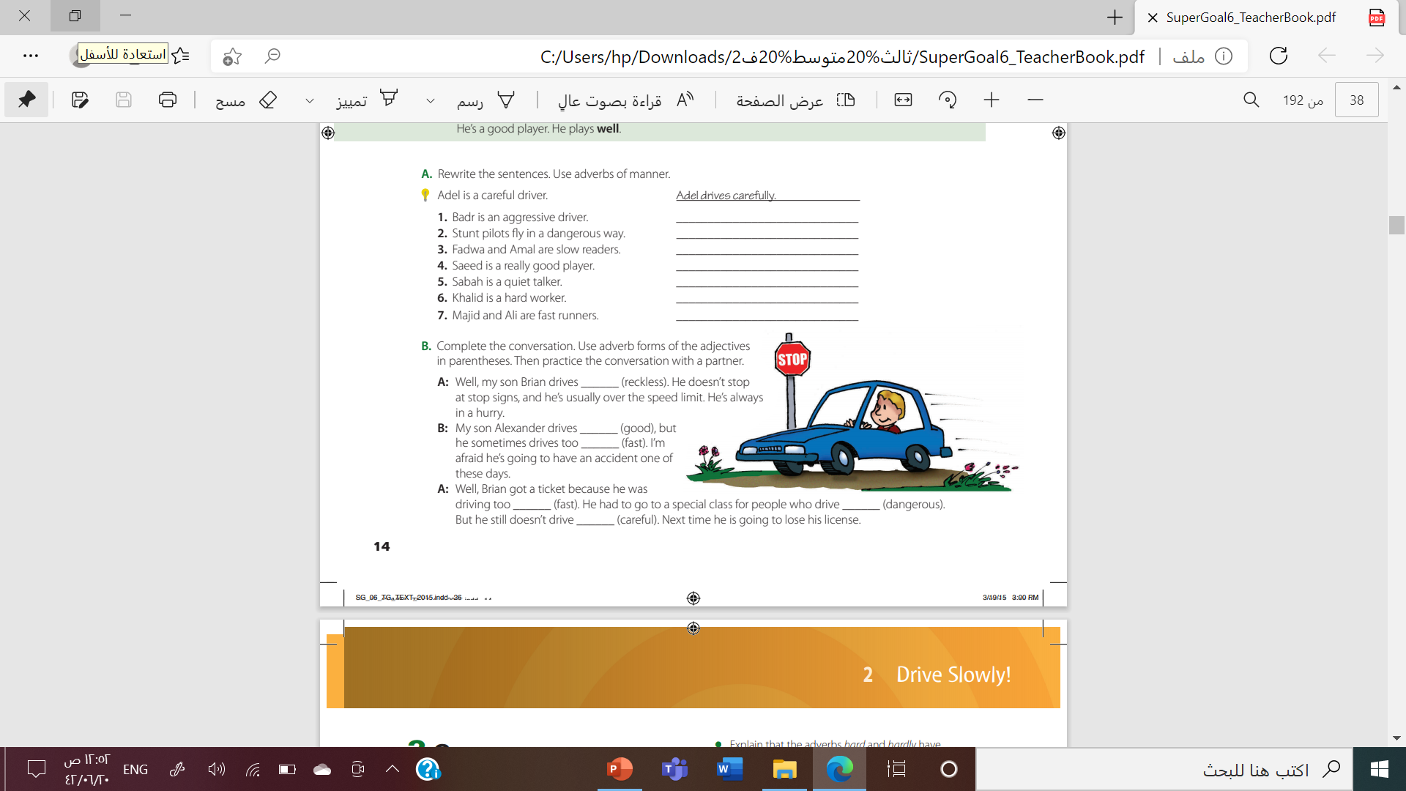

Slide 15

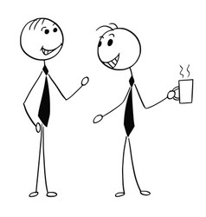
Let’s practice ☺

Slide 16

For more information :

Slide 17

By: Asma AlMjlad

