Slide 1

Drive Slowly
Unit 8
Form, meaning & Functions

Slide 2
بسم الله الرحمن الرحيم
Day:
Date:

Slide 3


Compose requests correctly
Use imperative form to make commands
Learning Objectives
Report requests and commands
Differentiate between requests and commands

Slide 4
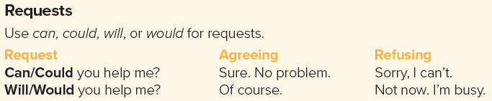
Page 87

Slide 5


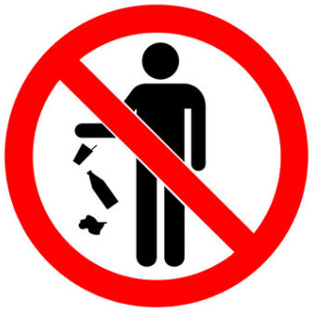

Page 87
Don’t litter

Slide 6

Practice

Slide 7
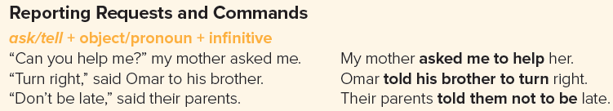

Page 87
The instructor told him to obey the speed limit.
The instructor told him to slow down.

Slide 8
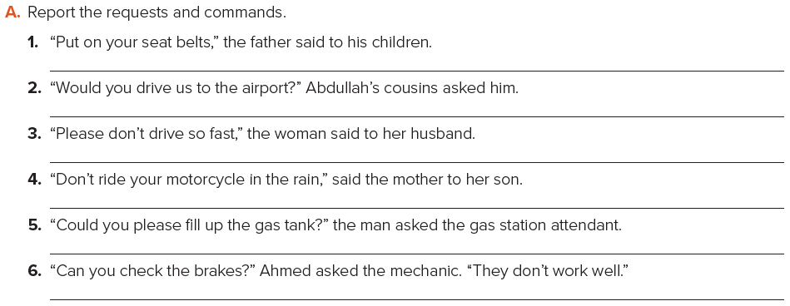
Page 87
The father told his children to put on their seatbelts.
Abdullah’s cousins asked him to drive them to the airport.
The woman told her husband not to drive so fast.
The mother told her son not to drive his motorcycle in the rain.
The man asked the gas station attendant to fill up the gas tank.
Ahmed asked the mechanic to check the brakes.

Slide 9
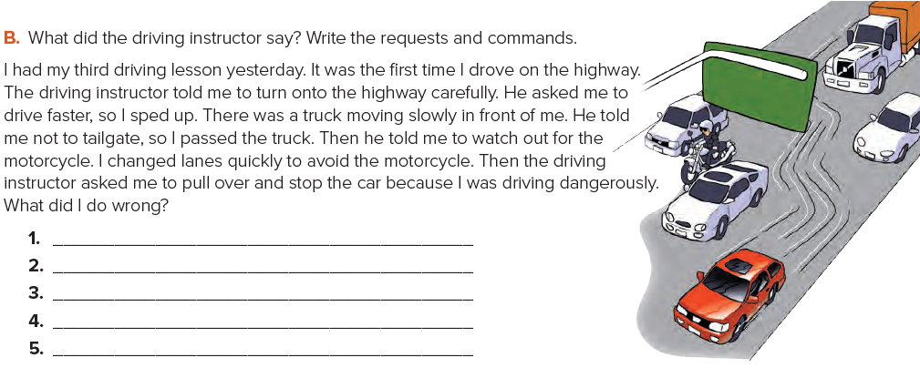
Page 87
Turn onto the highway carefully.
Can you drive faster?
Don’t tailgate.
Watch out for the motorcycle!
Could you pull over and stop the car?

Slide 10
Homework
Page 220 (J)

Slide 11
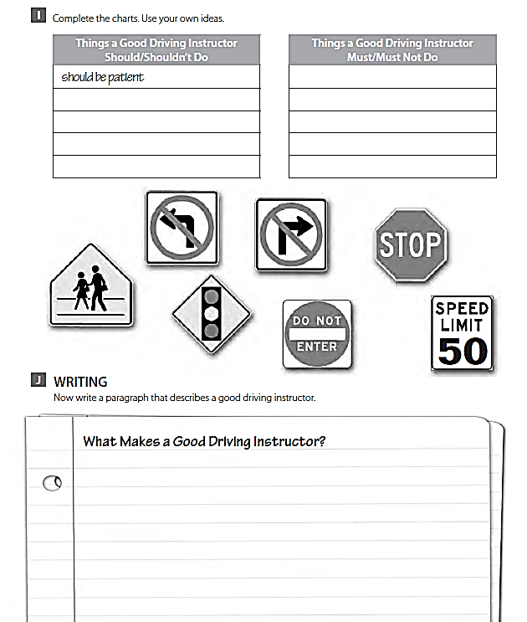
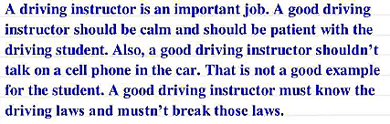

Slide 12
THANK YOU

