Slide 1
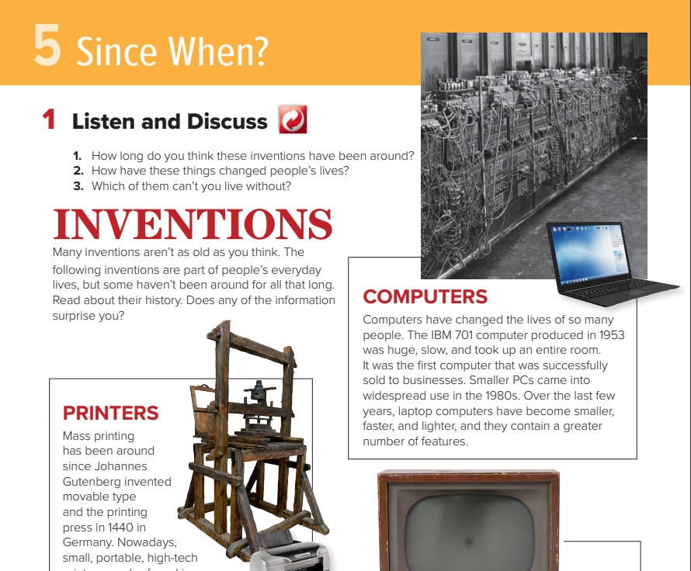

Notes:
Slide 2 – A is correct
Slide 3 – B is correct
Slide 4 – A is correct
Slide 5 – B is correct

Slide 2



8. _____ when have you had that beautiful watch?
for
since

Slide 3
I……….. lived here since 2011.
have
has

Slide 4
How long have you played football?
I’ve played football since I was 12.
I’ve played football 12 years ago.

Slide 5
a new way of doing things
innovation
interrupt

Slide 6
My friends haven’t visited me _____ my graduation.
for
since

Slide 7
When were you there?
I was there two years ago.
I’ve been there two years ago.

Slide 8
We’ve worked on this project _____ a month.
since
for

Slide 9
succeed in doing something
miniature
accomplish

Slide 10
I’ve been drinking tea _____ years
since
for

Slide 11
a way of doing things
interrupt
technique

Slide 12
The Internet is used by millions of people
passive
active

Slide 13
The telephone was invented by Alexander Graham Bell
Passive (Simple Past)
Passive (Present Perfect)

Slide 14
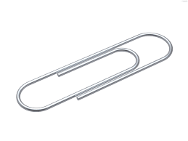
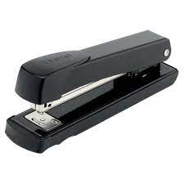
paper clip

Slide 15
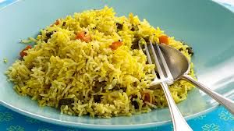
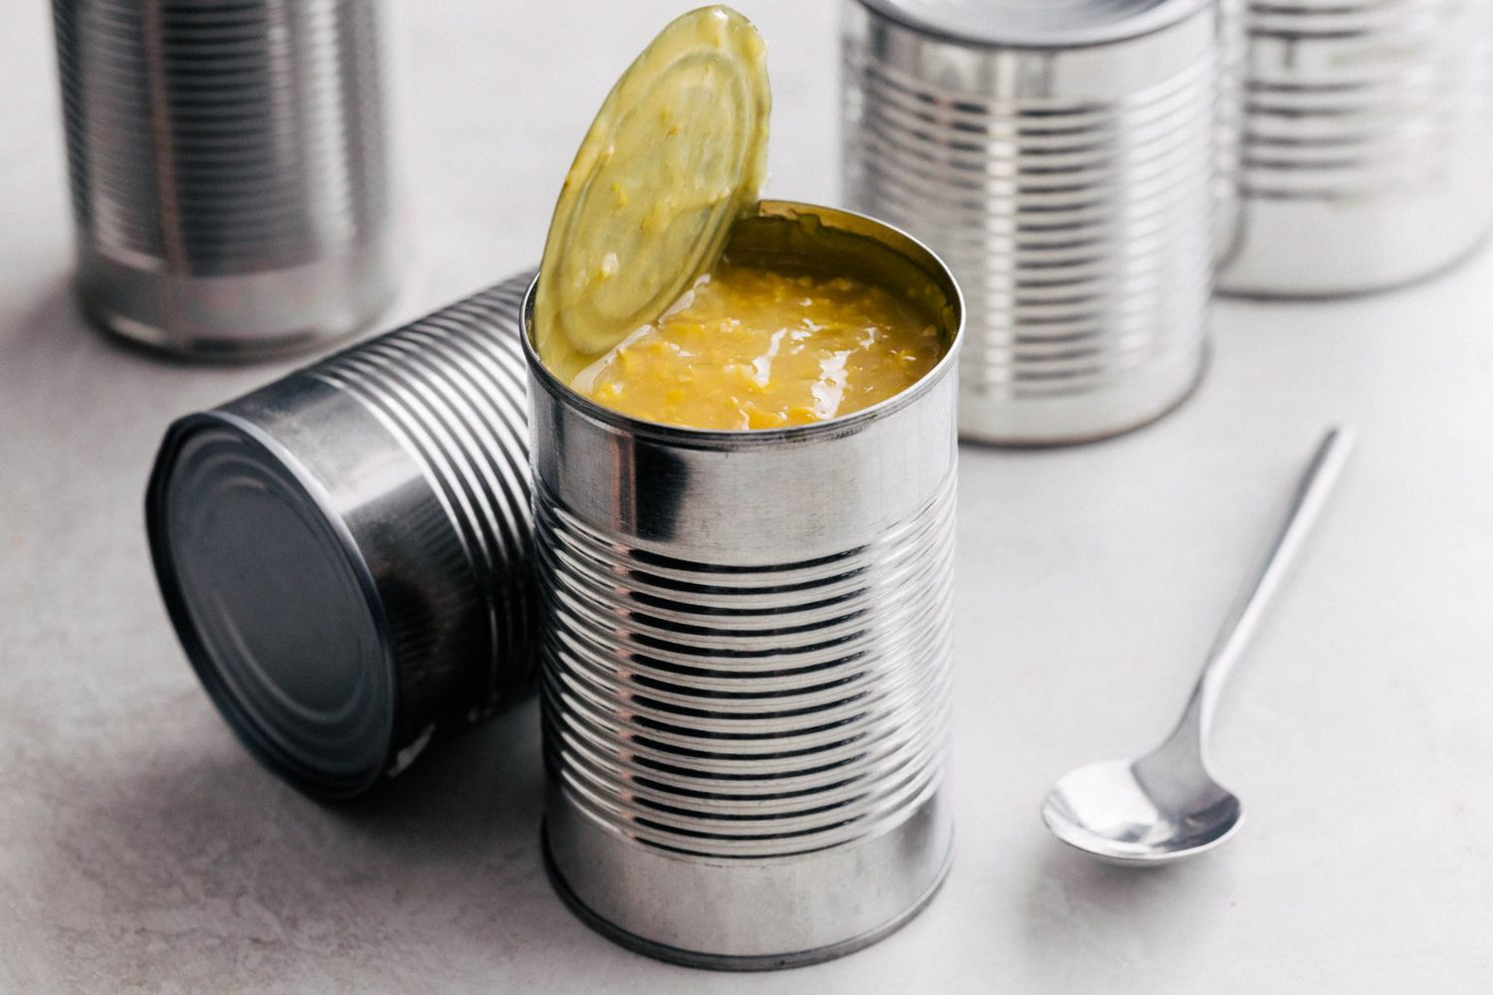
canned food

Slide 16


toothpaste

Slide 17
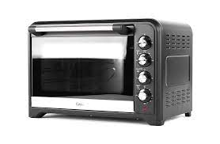
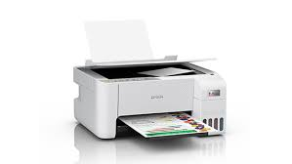
OVEN

