Slide 1

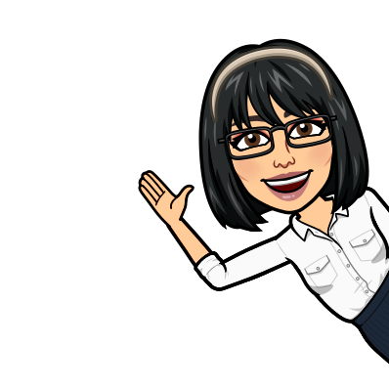
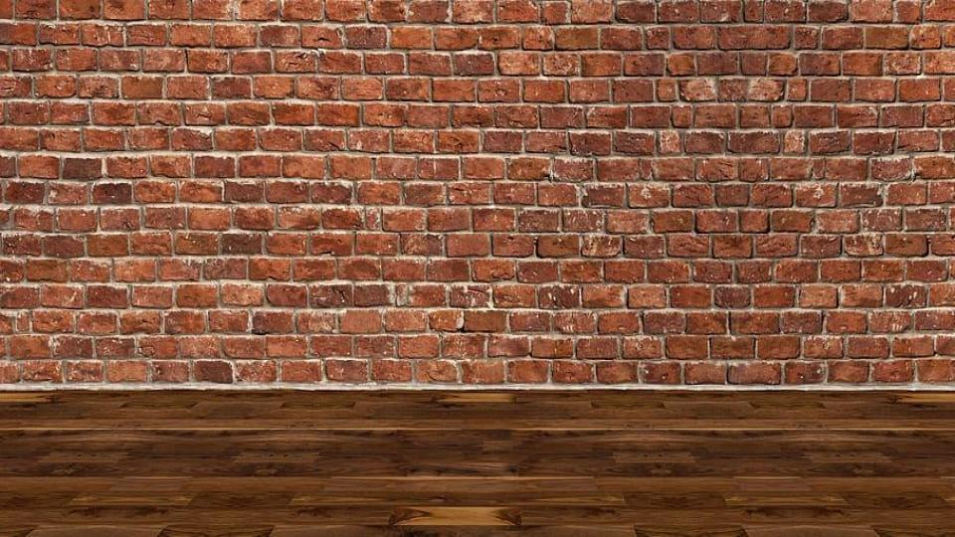
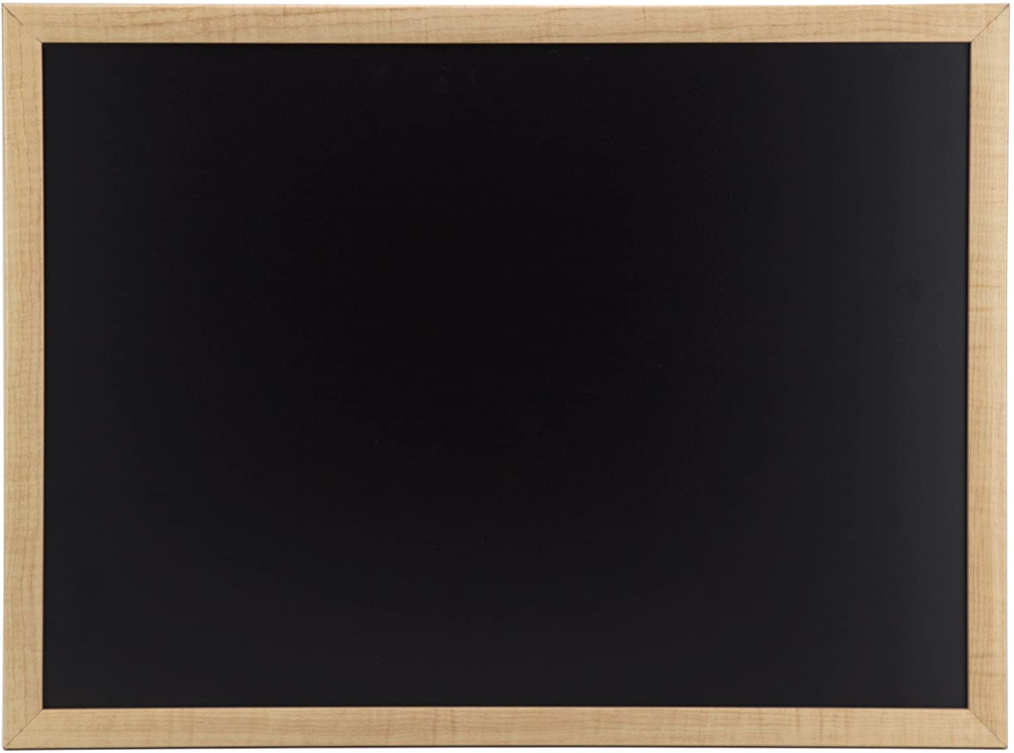
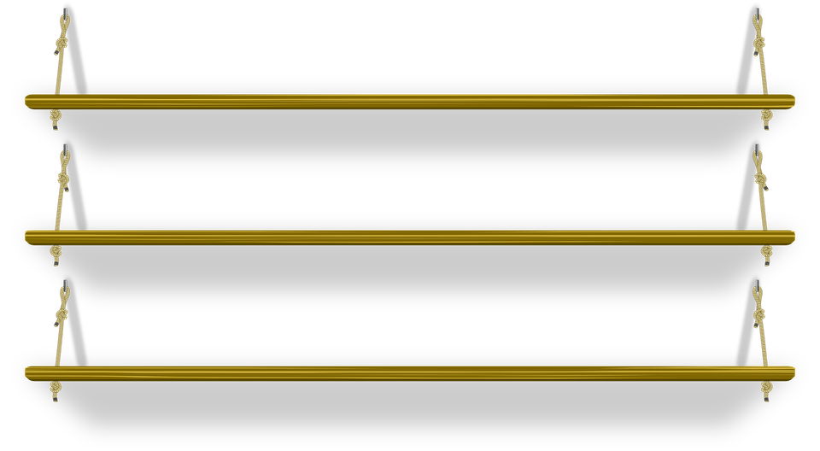



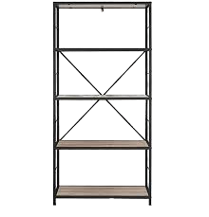
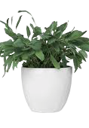

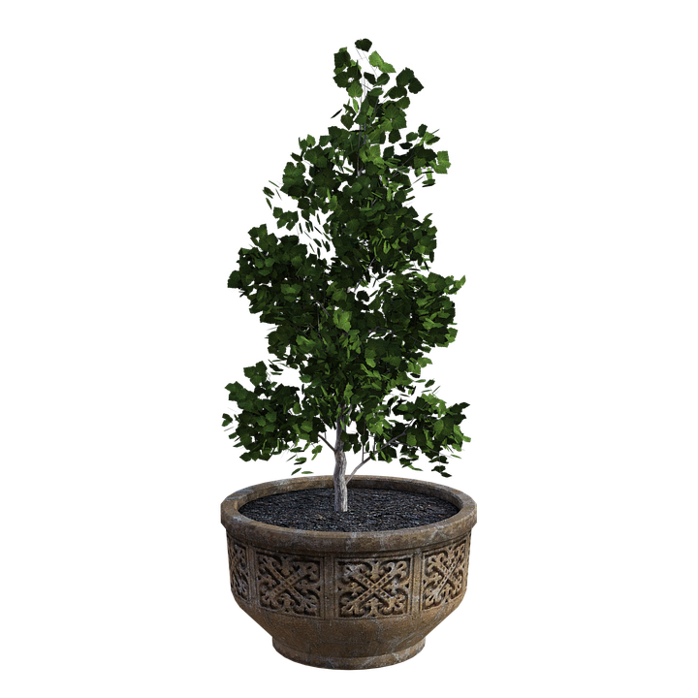

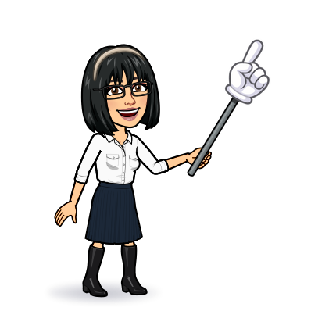


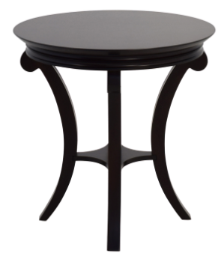
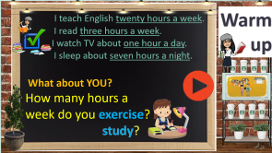
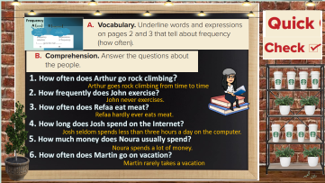

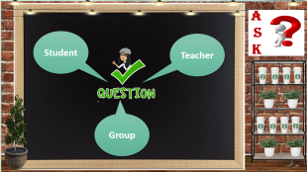
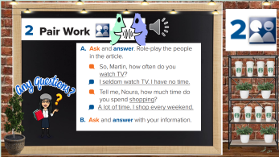

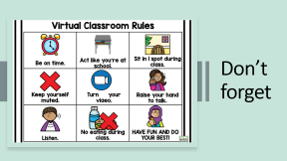
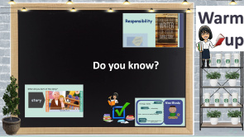
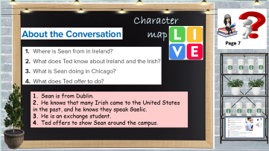
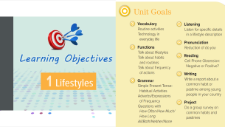
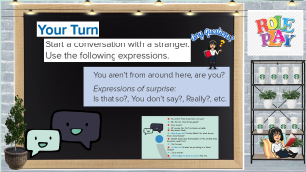
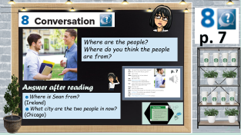
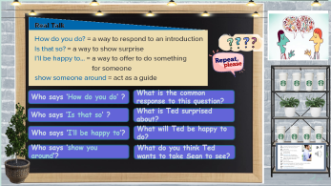

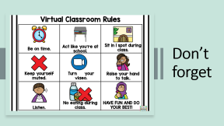
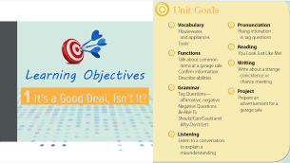
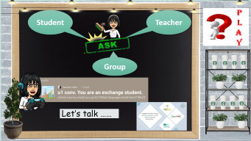
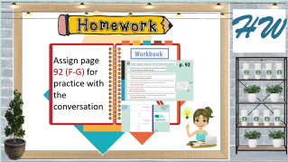
Conversation
Today:
date: / / 1443
Goals:
Rephrase a text (real talk)
Practice a conversation
Answer questions about a conversation

Slide 2

Don’t forget

Slide 3

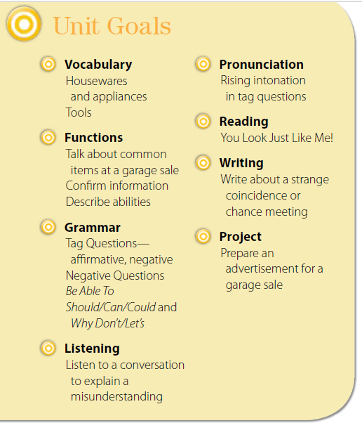


Slide 4
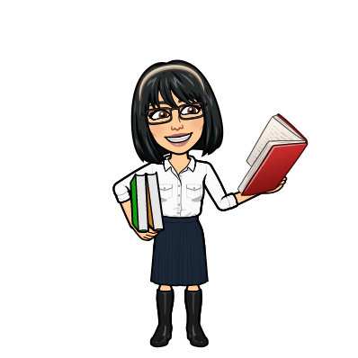


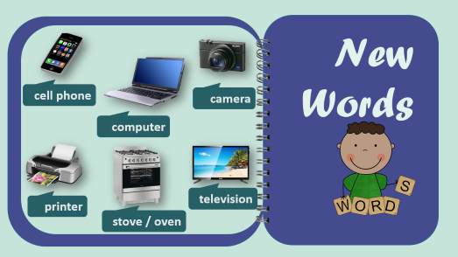

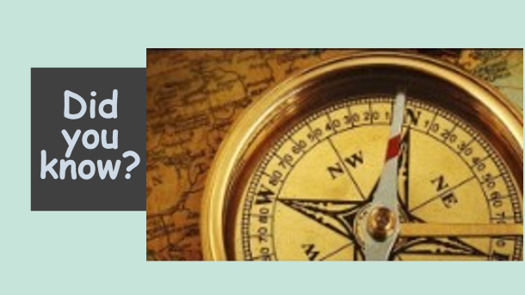
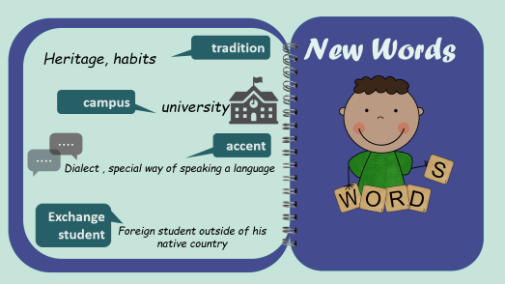
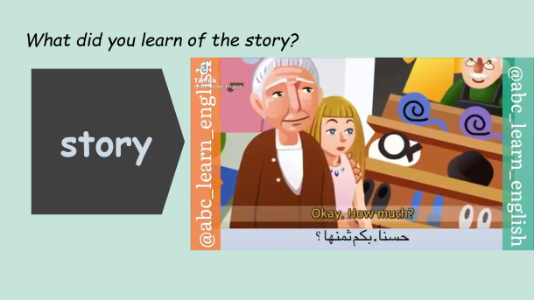

Warm up
Do you know?
تصميم: اماني التركي
دلال الجعيد

Slide 5


Responsibility

Slide 6
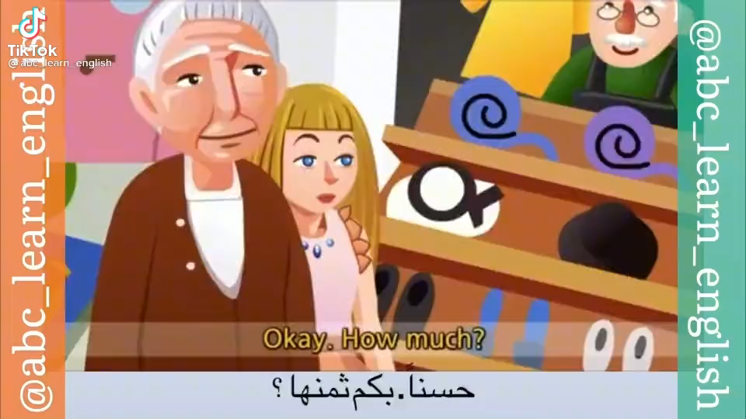
What did you learn of the story?
story

Slide 7
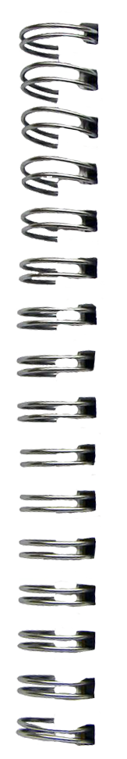



New Words
tradition
Heritage, habits
campus
university
accent
Dialect , special way of speaking a language
Exchange student
Foreign student outside of his native country

Slide 8
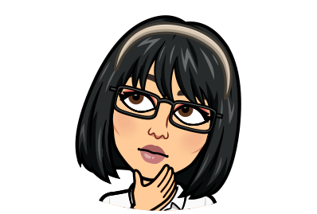
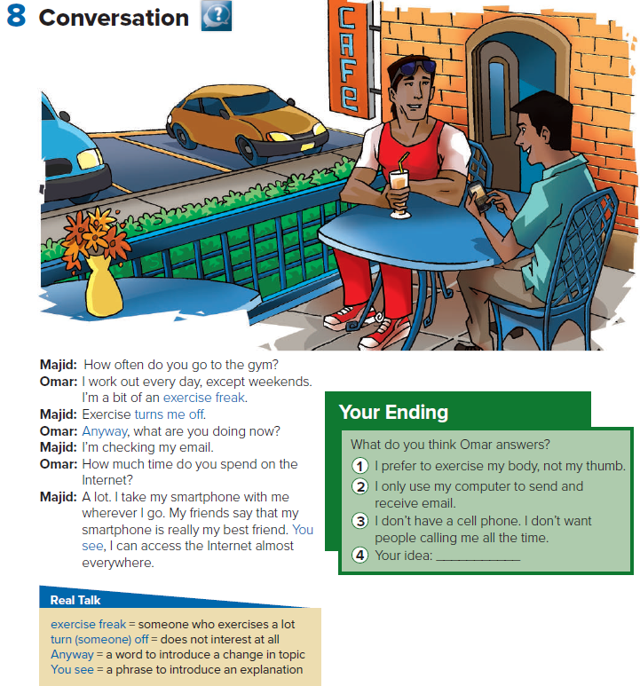

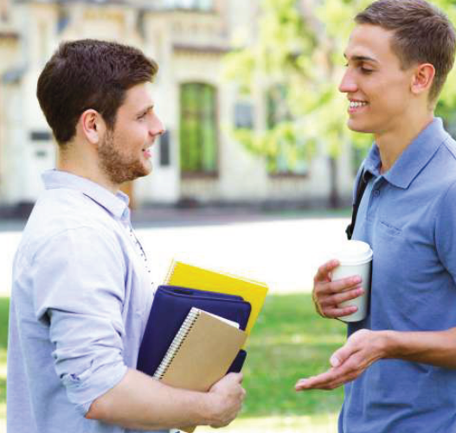

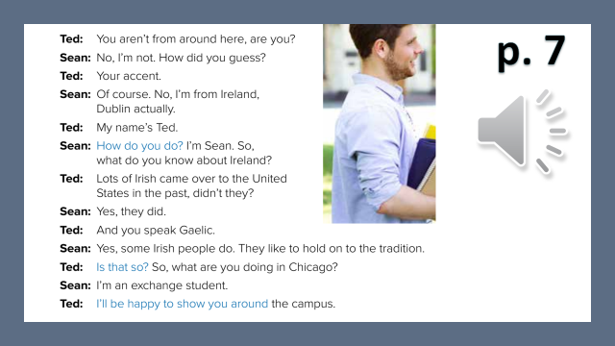
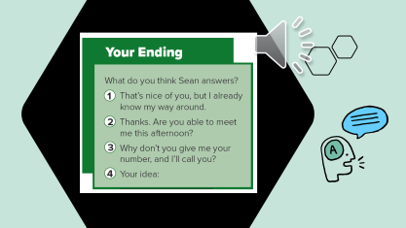
p. 7
Where are the people?
Where do you think the people are from?
Answer after reading
☻Where is Sean from?
(Ireland)
☻What city are the two people in now?
(Chicago)
تصميم: اماني التركي
دلال الجعيد

Slide 9
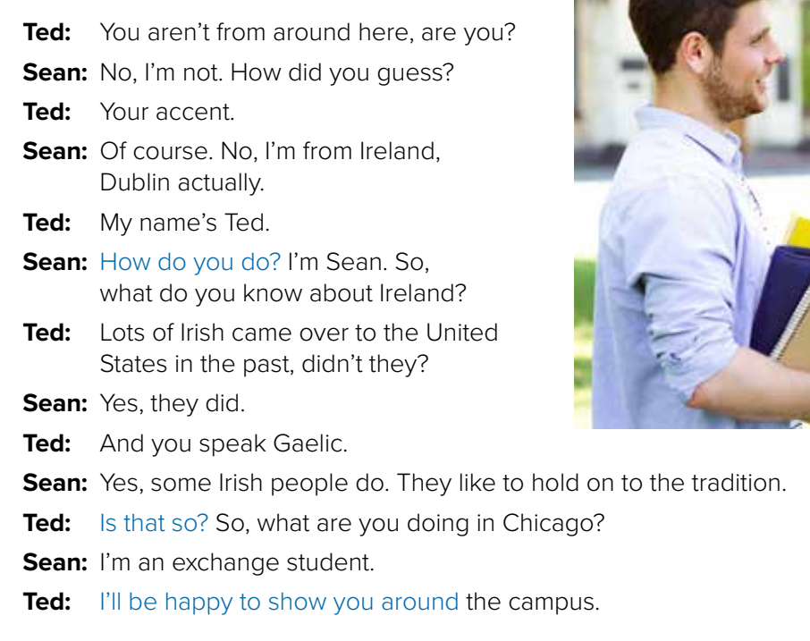

p. 7

Slide 10
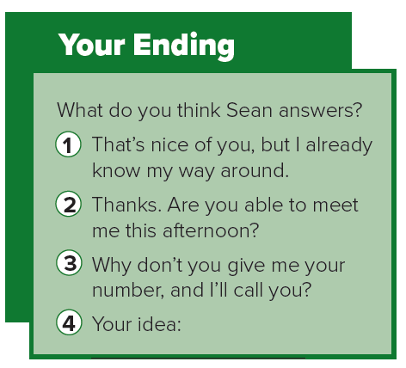

Slide 11




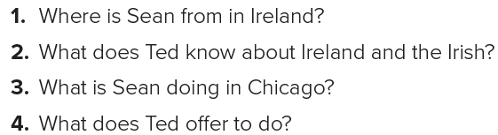


Character
map
Page 7
1. Sean is from Dublin.
2. He knows that many Irish came to the United States in the past, and he knows they speak Gaelic.
3. He is an exchange student.
4. Ted offers to show Sean around the campus.
تصميم: اماني التركي
دلال الجعيد

Slide 12
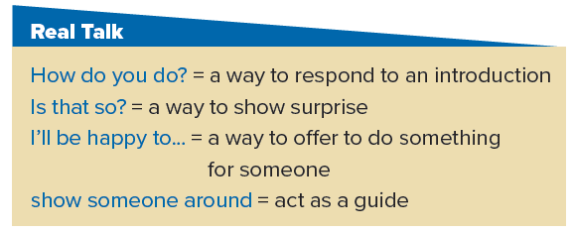
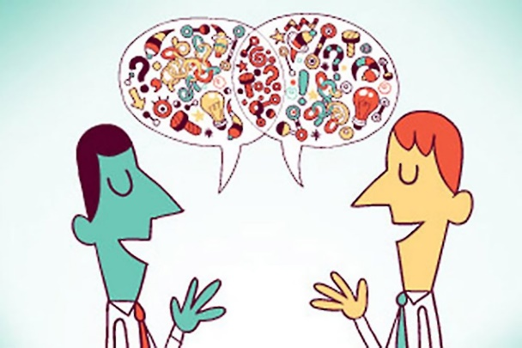



Who says ‘How do you do’ ?
What is the common response to this question?
Who says ‘Is that so’ ?
What is Ted surprised about?
Who says ‘I’ll be happy to’?
What will Ted be happy to do?
Who says ‘show you around’?
What do you think Ted wants to take Sean to see?
تصميم: اماني التركي
دلال الجعيد

Slide 13




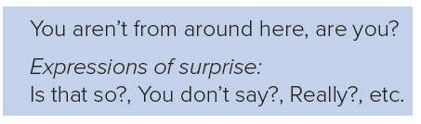

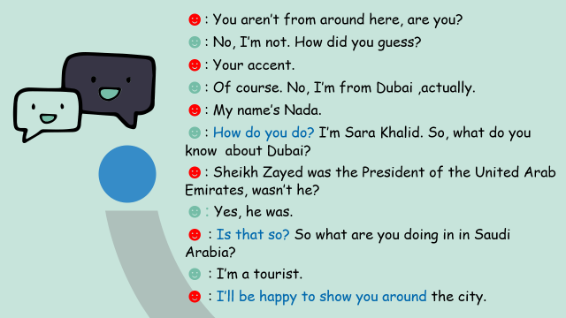
تصميم: اماني التركي
دلال الجعيد

Slide 14
☻: You aren’t from around here, are you?
☻: No, I’m not. How did you guess?
☻: Your accent.
☻: Of course. No, I’m from Dubai ,actually.
☻: My name’s Nada.
☻: How do you do? I’m Sara Khalid. So, what do you know about Dubai?
☻: Sheikh Zayed was the President of the United Arab Emirates, wasn’t he?
☻: Yes, he was.
☻ : Is that so? So what are you doing in in Saudi Arabia?
☻ : I’m a tourist.
☻ : I’ll be happy to show you around the city.

Slide 15


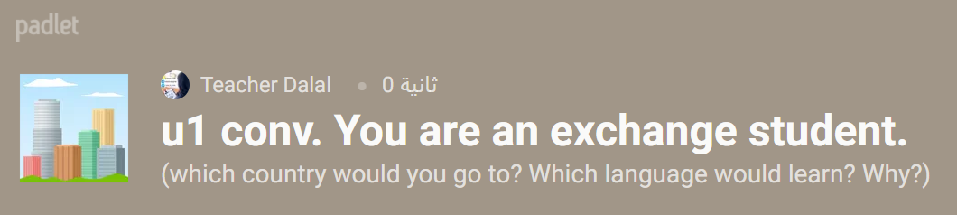


P
L
A
Y
Student
Teacher
Group
Let’s talk ……
تصميم: اماني التركي
دلال الجعيد

Slide 16



Imagine we didn’t have Madrasti platform in the time of Corona quarantine…

Slide 17




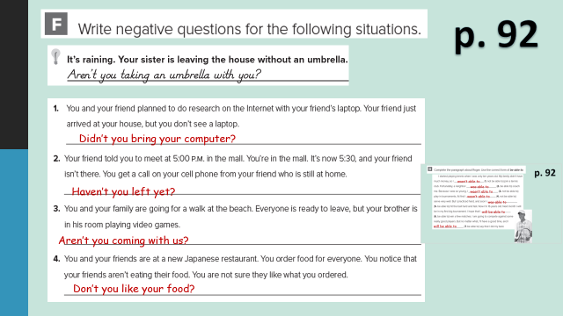
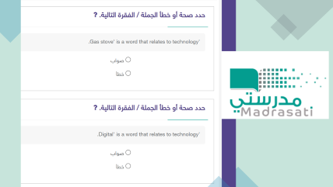
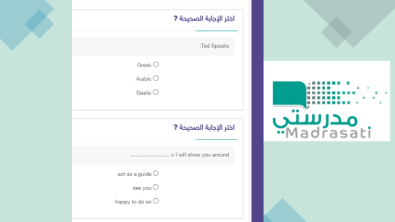
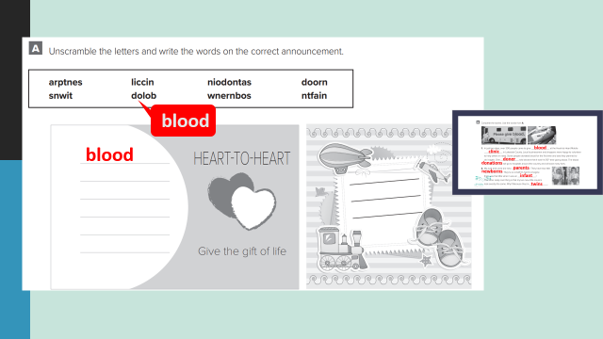
H W
Assign page 92 (F-G) for practice with the conversation
تصميم: اماني التركي
دلال الجعيد

Slide 18
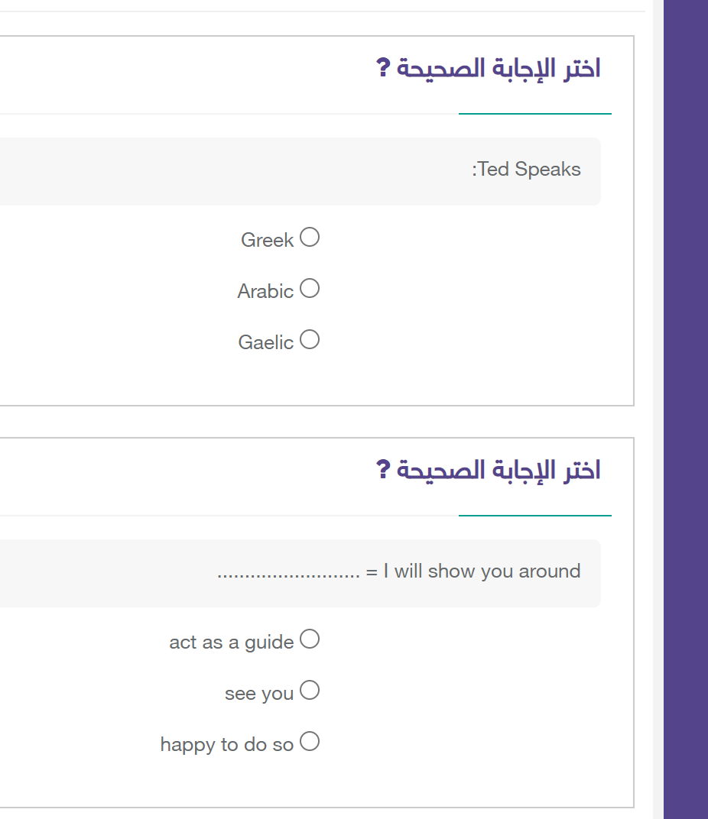

Slide 19



p. 92
Didn’t you bring your computer?
Haven’t you left yet?
Aren’t you coming with us?
Don’t you like your food?

Slide 20


p. 92
wasn’t able to
was able to
wasn’t able to
wasn’t able to
was able to
will be able to
will be able to

