Slide 1


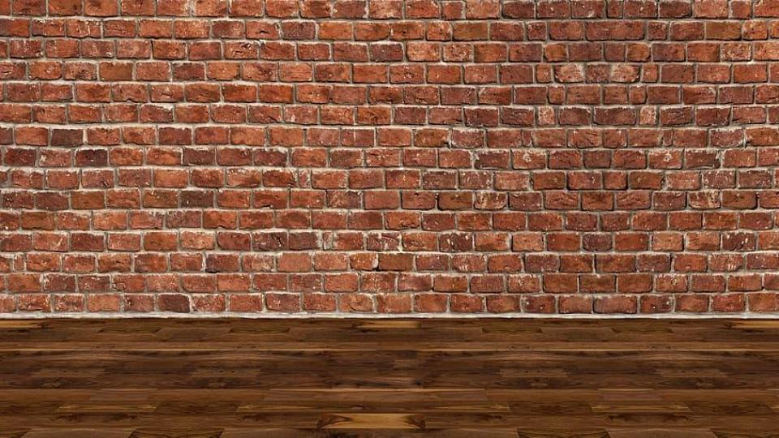
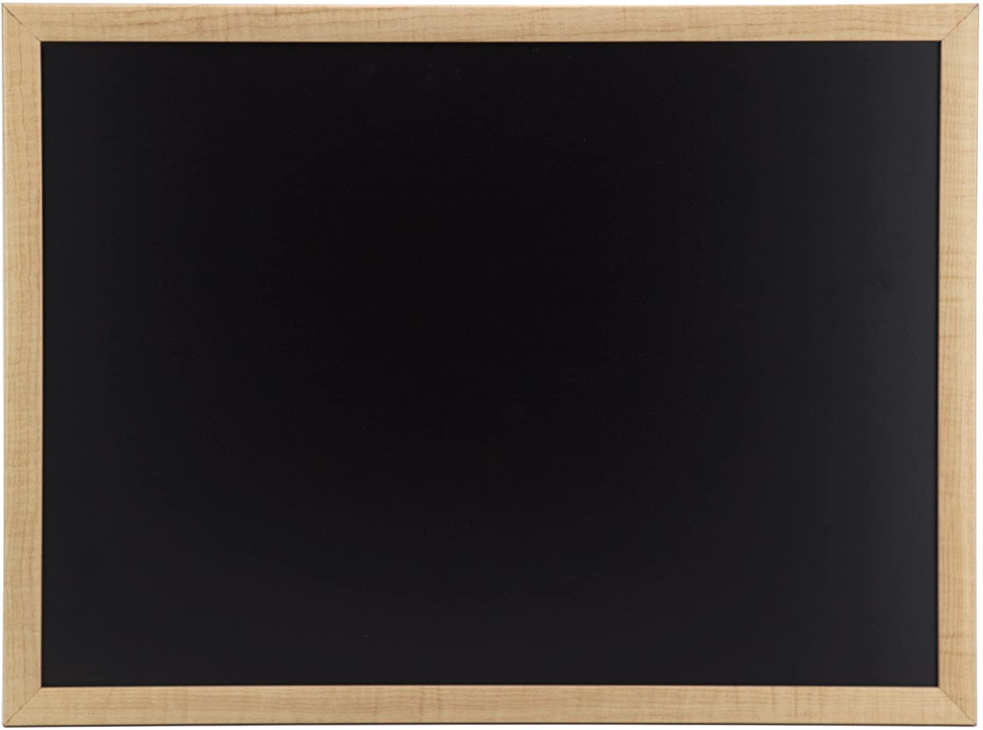
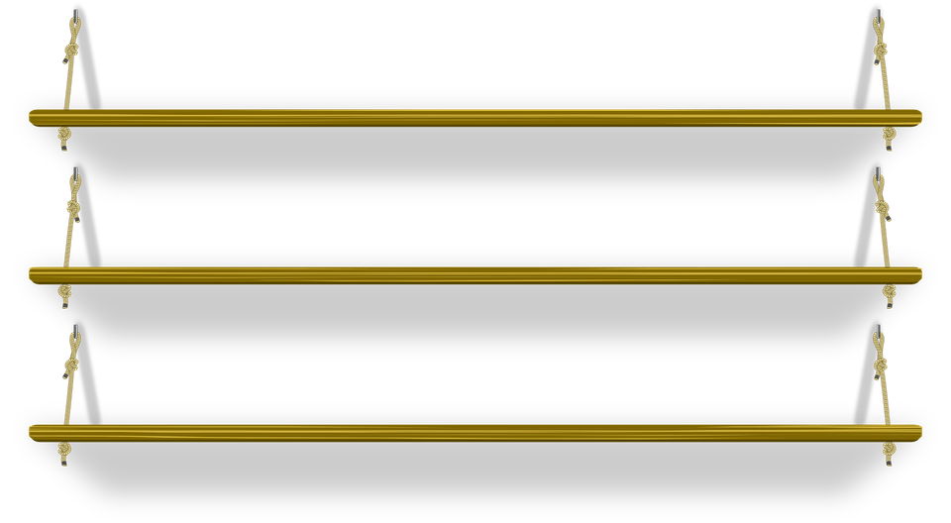
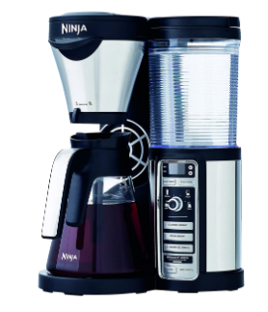


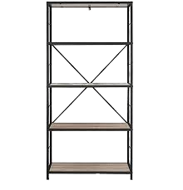
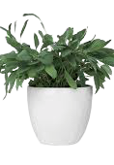

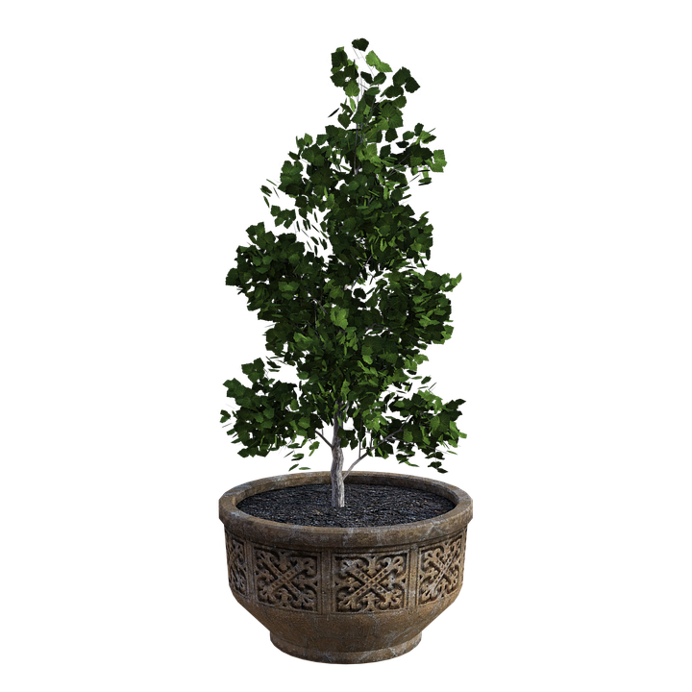

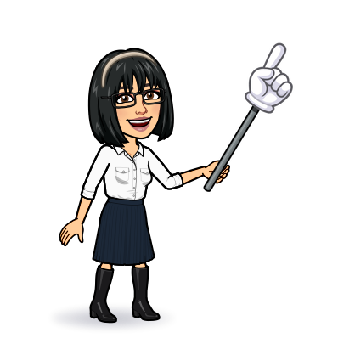
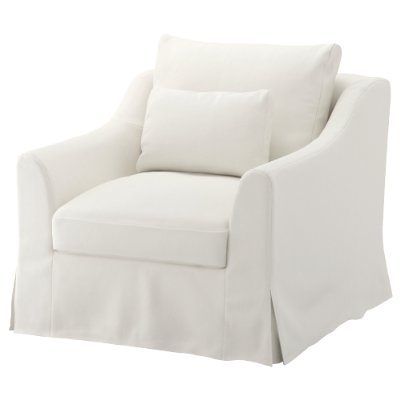

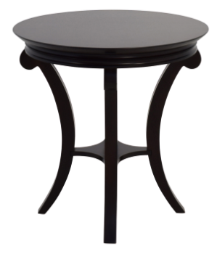
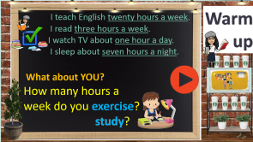
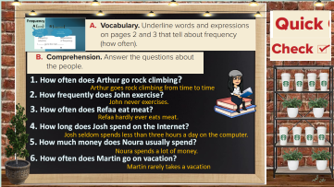

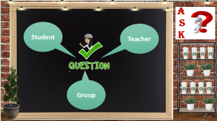
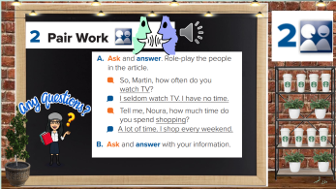
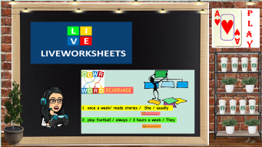
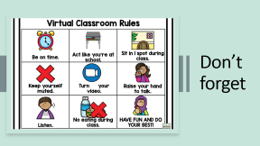
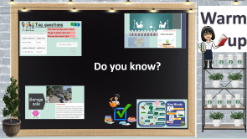
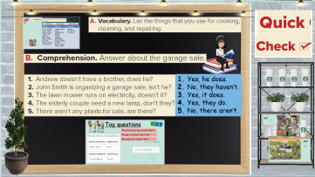
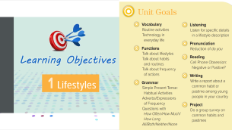
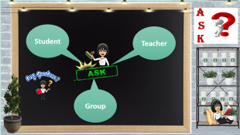
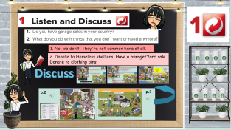
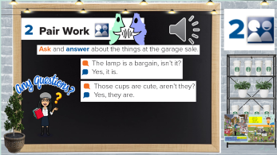
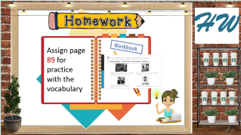
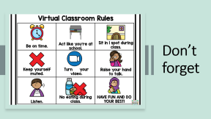
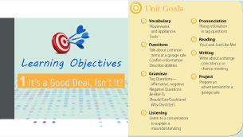
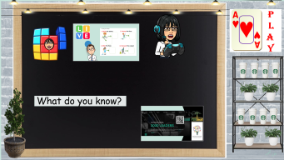
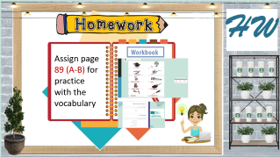
Listen & discuss
Today:
date: / / 1443
Goals:
list a number of tools and sort them according to usage
Confirm information
Talk about common items at a garage sale

Slide 2
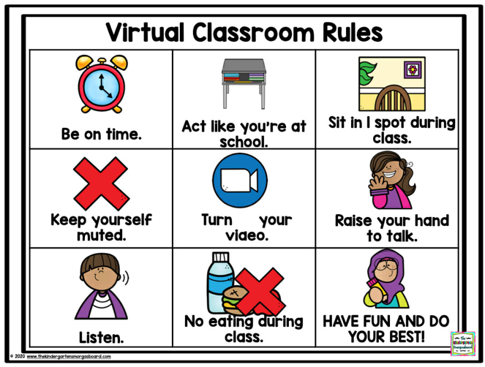
Don’t forget

Slide 3

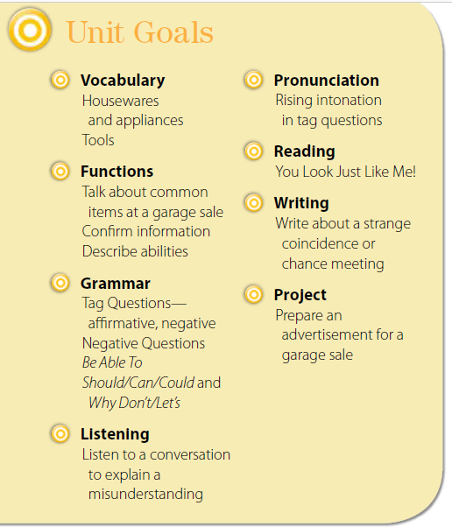


Slide 4



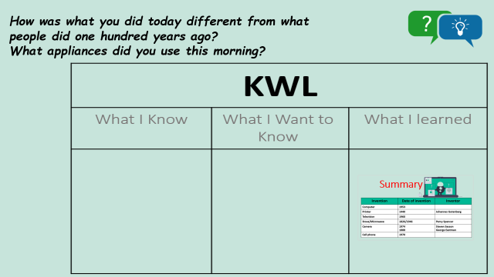
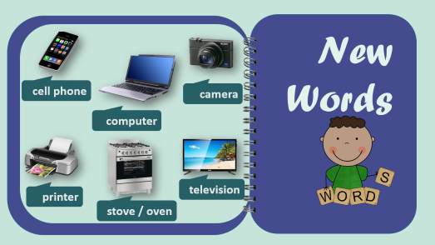

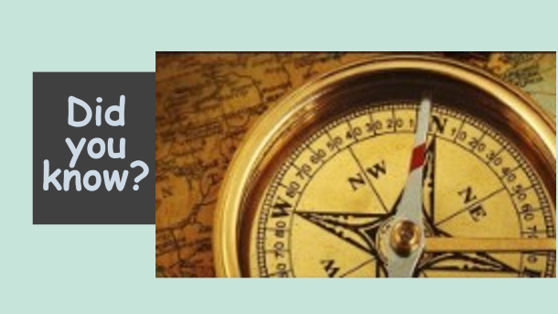
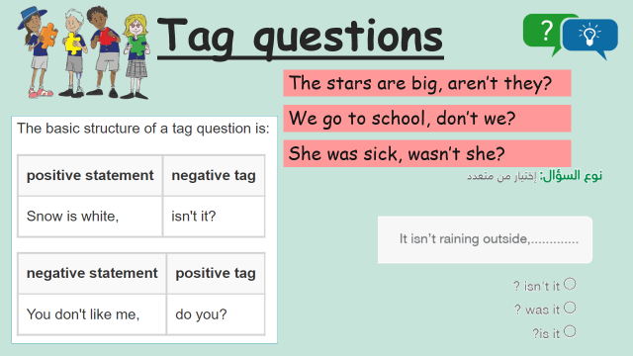
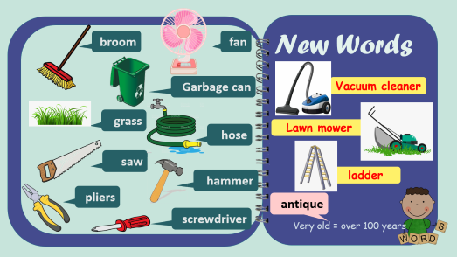
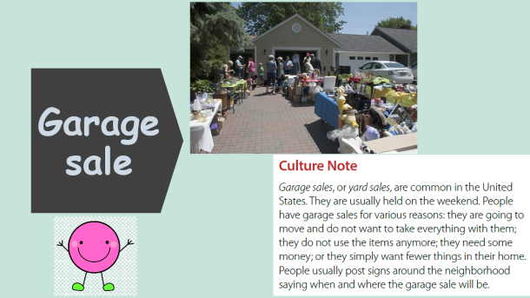

Warm up
Do you know?
تصميم: اماني التركي
دلال الجعيد

Slide 5




Slide 6
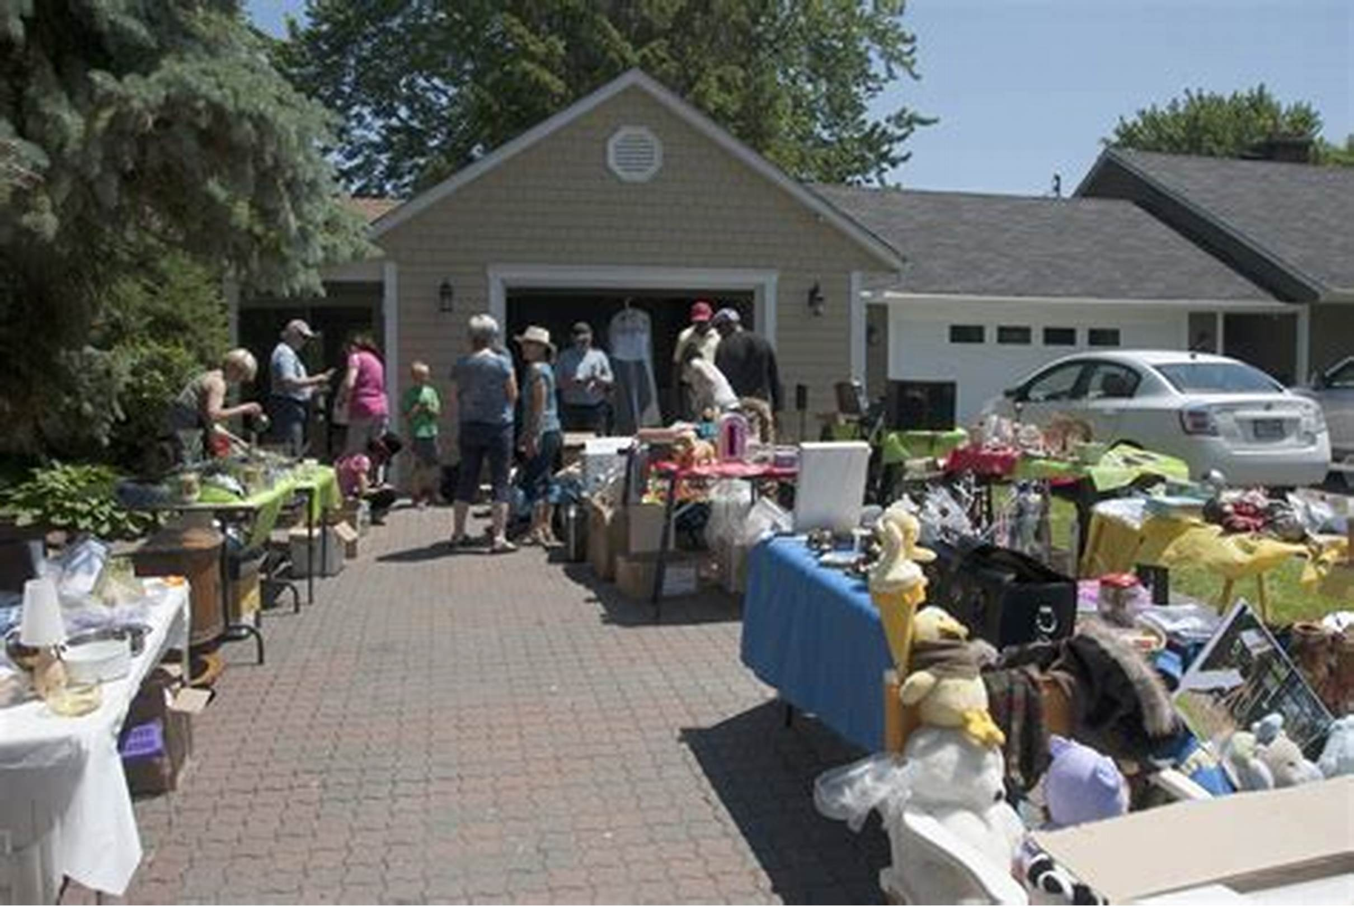
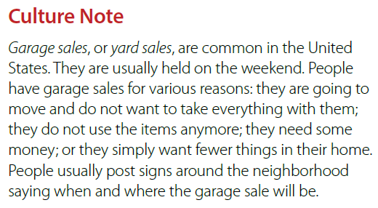

Garage sale

Slide 7
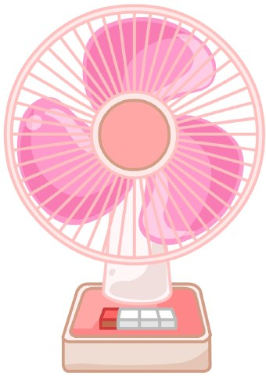

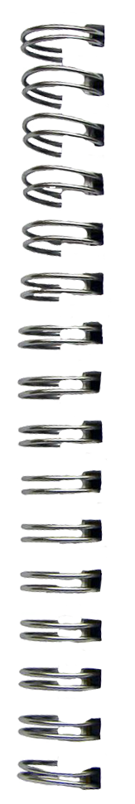

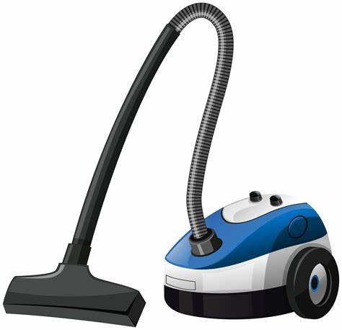



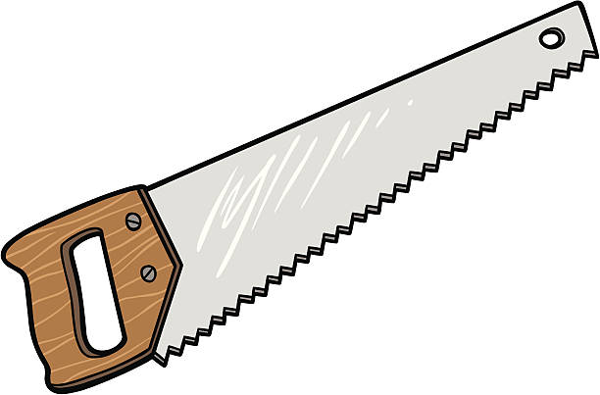
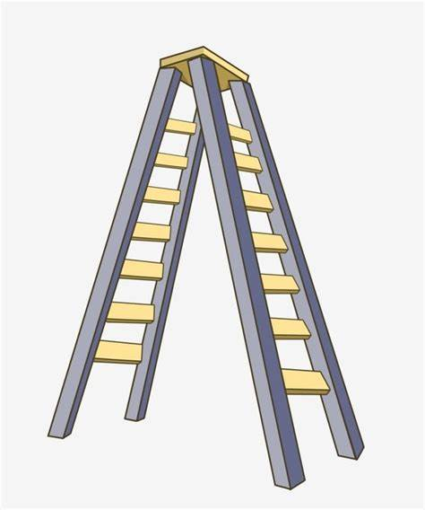
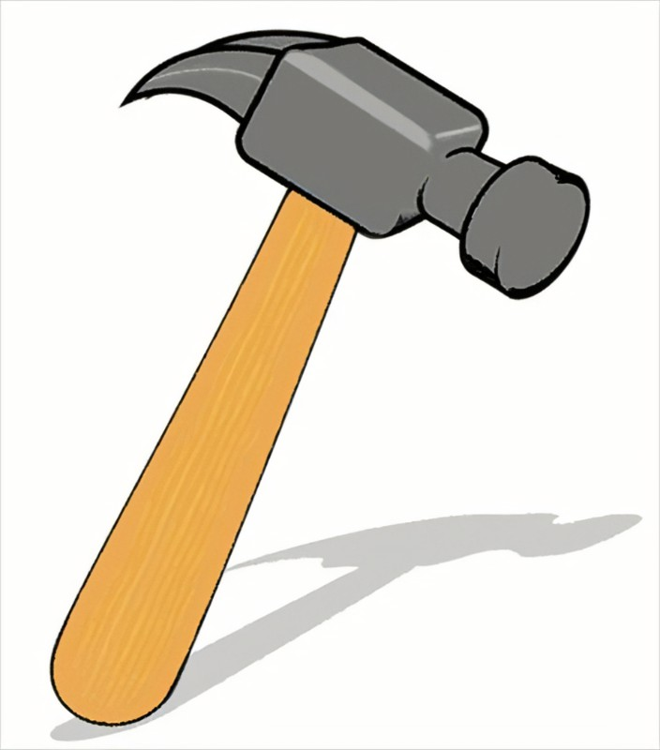
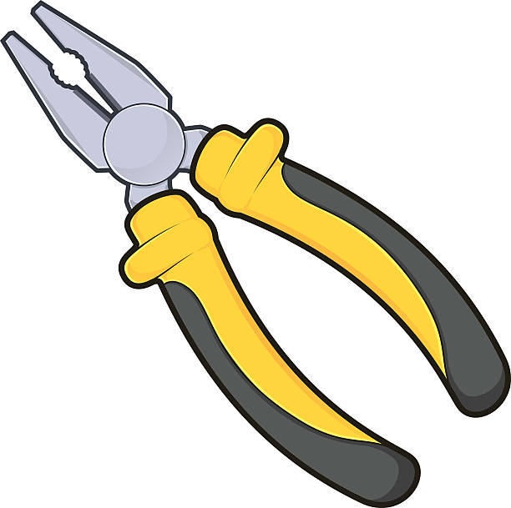


New Words
broom
fan
Garbage can
Vacuum cleaner
grass
hose
Lawn mower
saw
hammer
ladder
pliers
antique
screwdriver
Very old = over 100 years

Slide 8


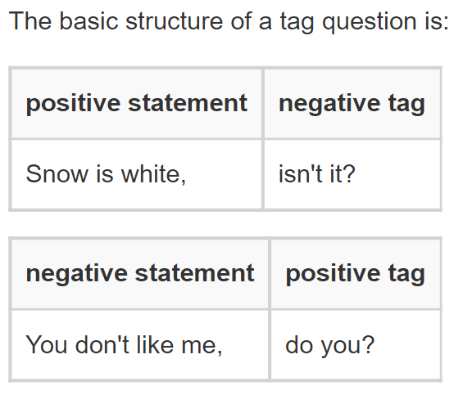
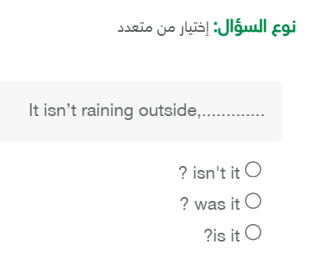
Tag questions
The stars are big, aren’t they?
We go to school, don’t we?
She was sick, wasn’t she?

Slide 9




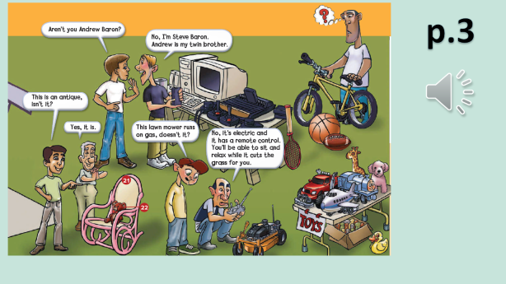
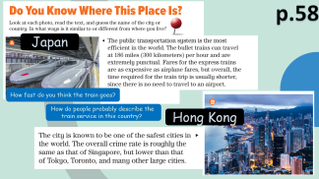
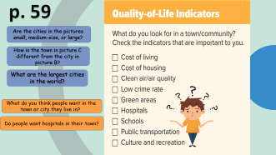
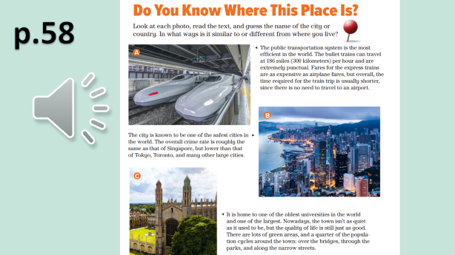






1. No, we don’t. They're not common here at all.
2. Donate to Homeless shelters. Have a Garage/Yard sale.
Donate to clothing bins.
Discuss
تصميم: اماني التركي
دلال الجعيد

Slide 10


p.2-3
How many people are looking at the things for sale?
(11)
What kinds of tools do you see?
(saw, hammer, screwdriver, pliers)
Where are the people?
Describe the pictures in details

Slide 11
What things do you see for use outside the house?
(lawn mower, hose, ladder, garbage can)
What appliances do you see?
(vacuum cleaner, fan)
What kitchen things do you see?
(pot, frying pan, knives, forks, spoons, plates, teapot, cups, saucers)
What travel items do you see?
(luggage or suitcases)
What things do you see for a child?
(teddy bear, toys)
What sports equipment do you see?
(a bicycle, a tennis racket, balls for basketball & football)

Slide 12

…….., isn’t it?
……., don’t we?
………, isn’t it?
…….., doesn’t it?
underline all the tag questions in the conversations

Slide 13


p.2

Slide 14
p.3

Slide 15












1. Yes, he does.
2. No, they haven’t.
3. Yes, it does.
4. Yes, they do.
5. No, there aren’t.
تصميم: اماني التركي
دلال الجعيد

Slide 16



cooking cleaning repairing

Slide 17







تصميم: اماني التركي
دلال الجعيد

Slide 18




Slide 19




A
S
K
Student
Teacher
Group
تصميم: اماني التركي
دلال الجعيد

Slide 20







P
L
A
Y
What do you know?
تصميم: اماني التركي
دلال الجعيد

Slide 21





Slide 22








H W
Assign page 89 (A-B) for practice with the vocabulary
تصميم: اماني التركي
دلال الجعيد

Slide 23



Slide 24







teapot
fan
pliers
pot
rocking chair
saw
teddy bear
frying pan
hammer
screwdriver

Slide 25

hammer
teapot
rocking chair
saw
pot
teddy bear
screwdriver
frying pan
fan
pliers

