Slide 1


Slide 2
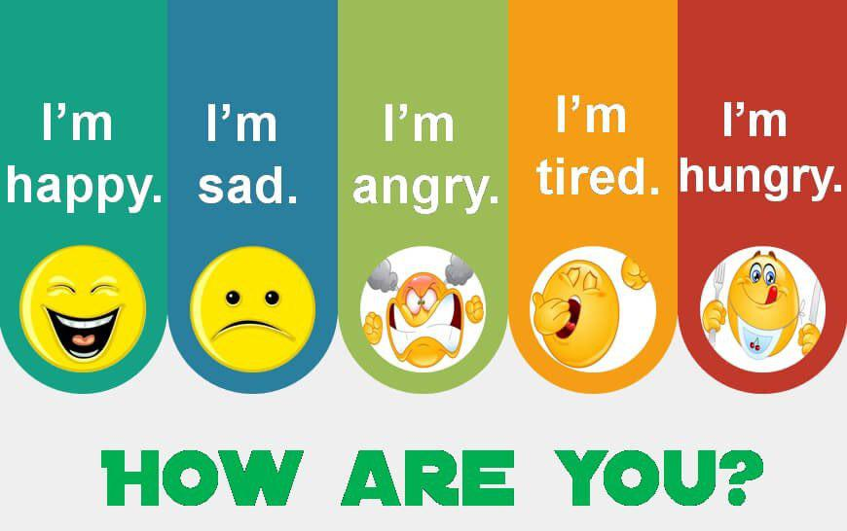

Slide 3

What day is it today?
What is the date?

Slide 4


Slide 5
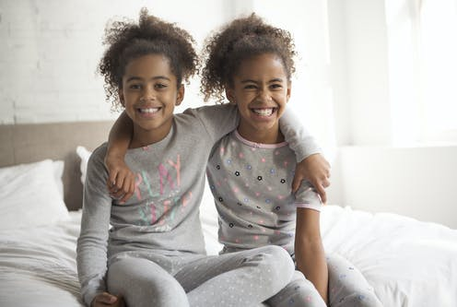
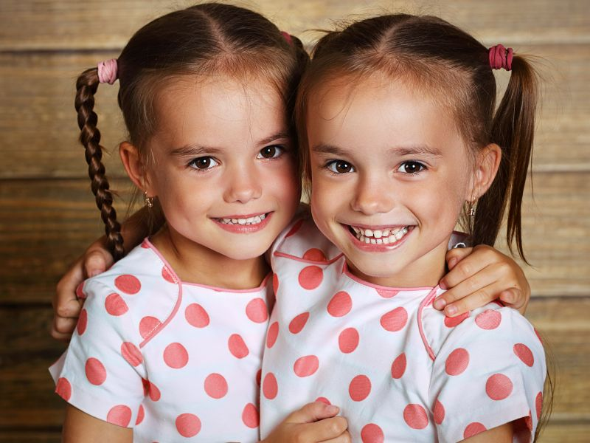
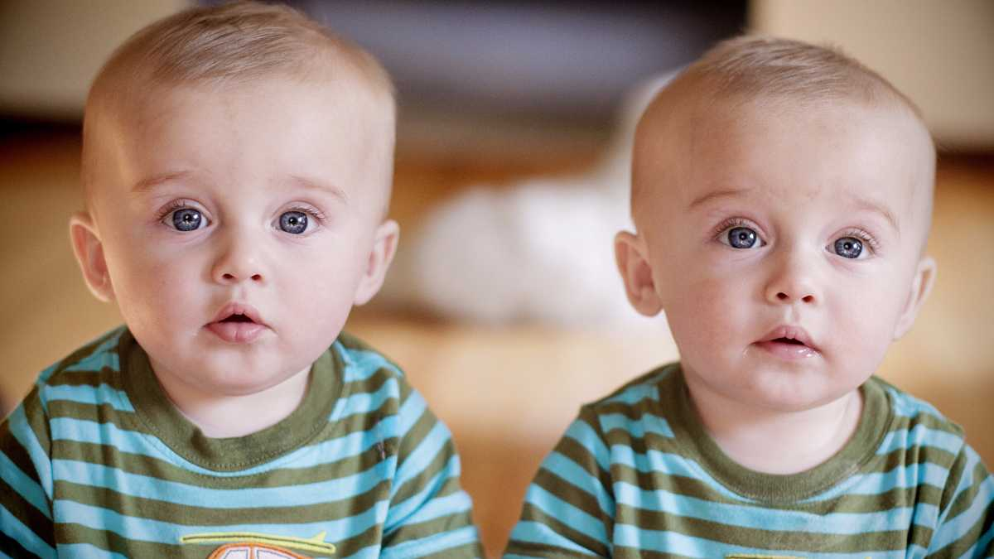
What can you see?
Introduction

Slide 6
Twins

Slide 7
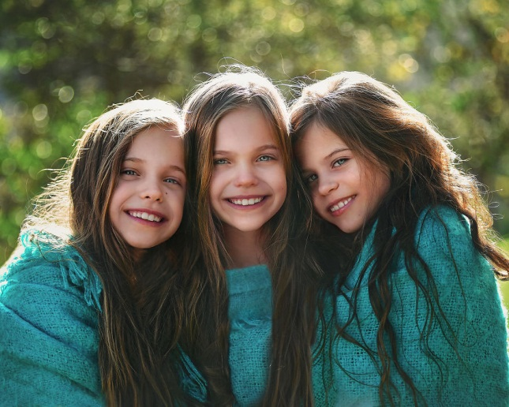
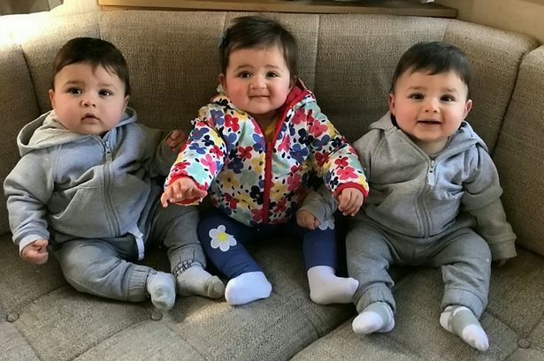
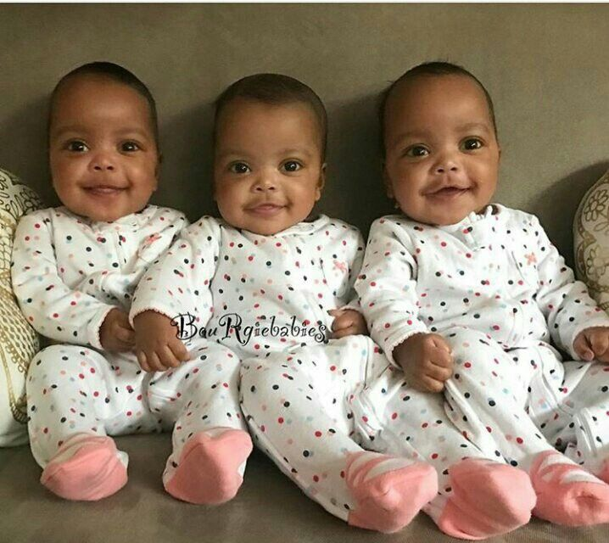
Triplets

Slide 8
Objectives
In this lesson you are going to:
read the text.
learn new words.
answer the questions about the text.
role-play an interview with one set of twins/triplets in the article.
discuss the questions.
prepare an advertisement for a garage sale.

Slide 9

Open your student’s book

Slide 11
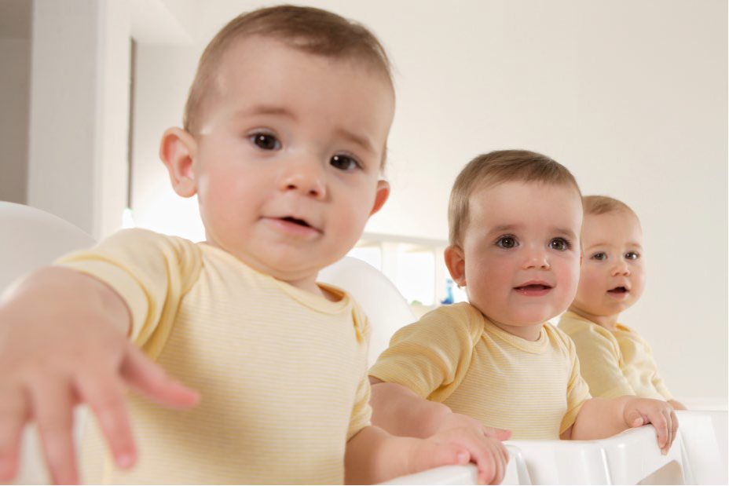
Describe what you see in the photo
Are they twins?
They are triplets.
No

Slide 12
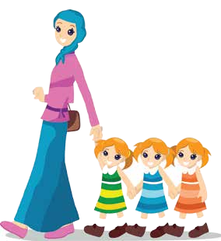
triplets

Slide 13
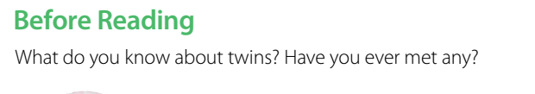

Slide 14

What does the title mean?
It means that two people physically resemble each other.

Slide 15
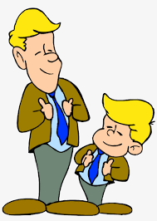
They look like each other.

Slide 16
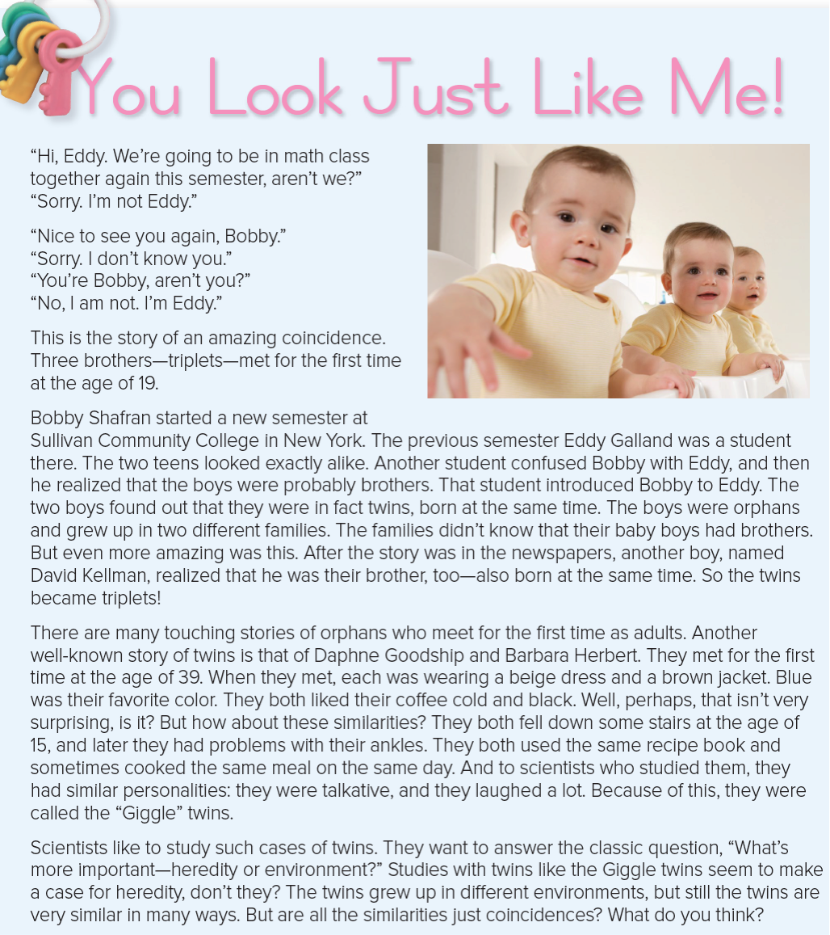


Slide 17
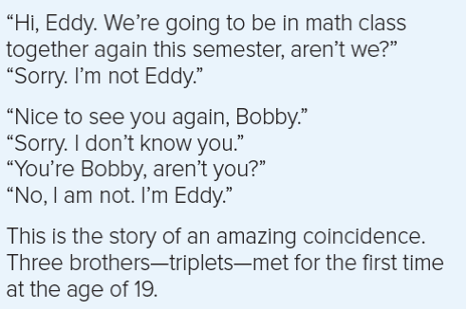

Slide 18
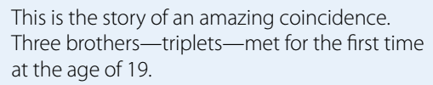

Slide 19
When did the three brothers meet for the first time?
At the age of 19.

Slide 20
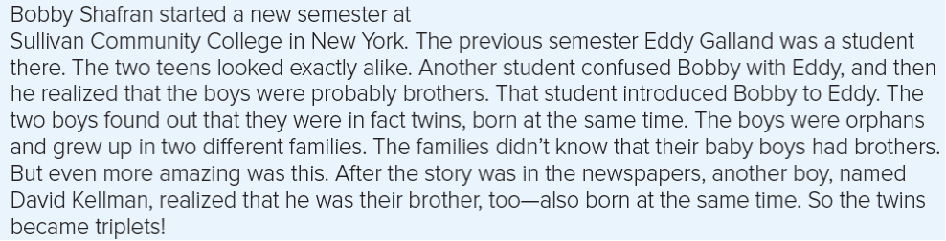

Slide 21
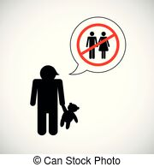
Bobby and Eddy were orphans.
Each one was grew up in in two different families.
The families didn’t know that their baby boys had brothers.

Slide 22
Orphan

Slide 23

Where were Bobby and Eddy students at ?
They were students at Sullivan Community College in New York.
Another student confused Bobby with Eddy, and then he realized that the boys were probably brothers. That student introduced Bobby to Eddy. The two boys found out that they were in fact twins, born at the same time.
knew

Slide 24
confused

Slide 25

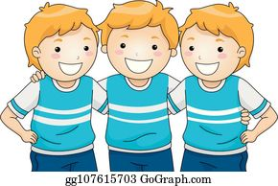
After the story was in the newspapers, another boy, named David Kellman, realized that he was their brother, too—also born at the same time. So the twins became triplets
knew

Slide 26
What is the name of the third brother?
David Kellman

Slide 27
What is the main idea of the paragraph?
a. the names of the three orphan brothers
b. how three orphan brothers found each
other.
✔

Slide 28
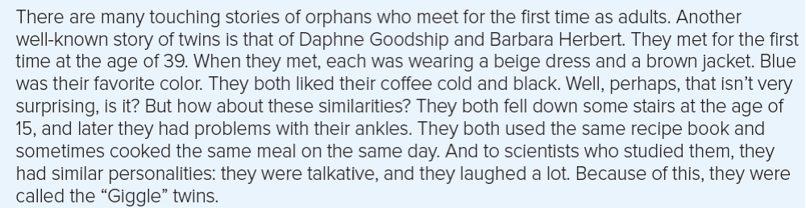

Slide 29
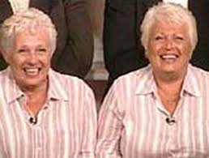
Daphne Goodship and Barbara Herbert

Slide 30
When did Daphne Goodship and Barbara Herbert meet for the first time?
They met for the first time at the age of 39.

Slide 31
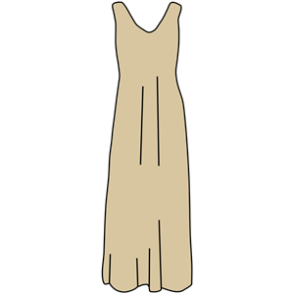
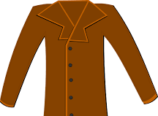
What were they wearing when they met?
a beige dress and a brown jacket.

Slide 32
What was their favorite color?
Blue
Did they both liked their coffee cold and black?
Yes.

Slide 33
What are the similarities between Daphne Goodship and Barbara Herbert ?
They both fell down some stairs at the age
of 15, and later they had problems with their ankles.
They both used the same recipe book and
sometimes cooked the same meal on the same day.
They were talkative, and they laughed a lot

Slide 34

Whey were they called the “Giggle” twins?
Because they laughed a lot

Slide 35
giggle

Slide 36
What is the main idea of the paragraph?
a. the similarities between the “Giggle” twins
b. how the “Giggle” twins found each other
✔

Slide 37
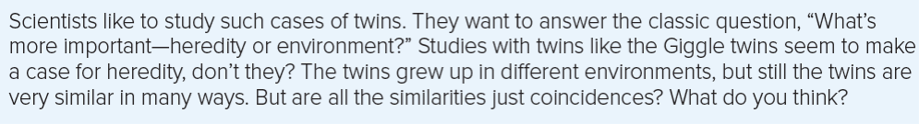

Slide 38
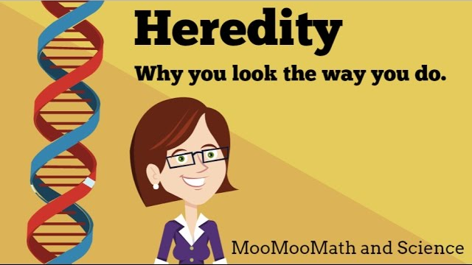
heredity

Slide 39
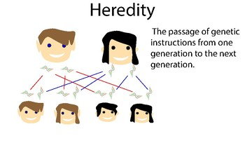
heredity

Slide 40
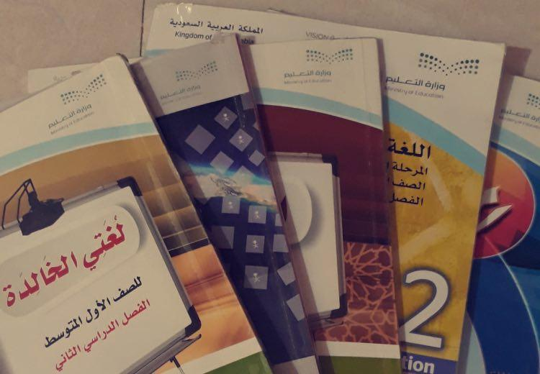
In which school subject can you talk about heredity?

Slide 41
What is the main idea of the paragraph?
a. coincidences in life
b. the heredity versus environment debate
✔

Slide 42
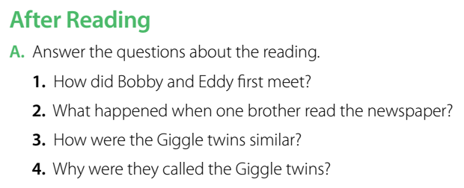

Group work Strategy

Slide 43
They met when another student introduced them.
2. One brother read the story about Bobby and Eddy and realized that he was their brother, too.
3. They wore similar clothes, had the same favorite color, and liked coffee the same way. They both fell down stairs at 15, and they both used the same recipe book. They were talkative and laughed a lot.
4. They laughed a lot

Slide 44
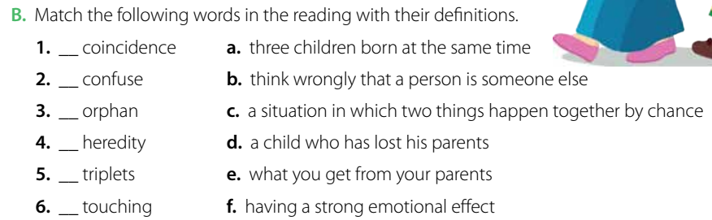
Group work Strategy
c
b
d
e
a
f

Slide 45

Role play strategy

Slide 46
Group work Strategy
What are the good and bad points about being a twin?
Is your twin your best friend?

Slide 47
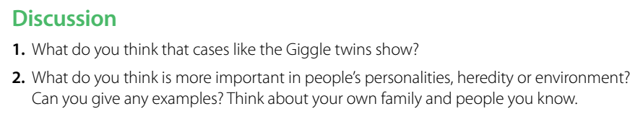
Group work Strategy

Slide 48
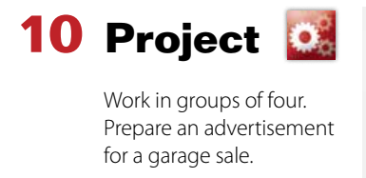
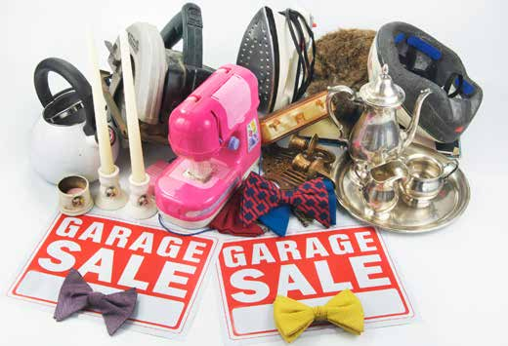
Group work Strategy

Slide 49


Are there any places in your country that take care of orphans?

Slide 50


Slide 51


