Slide 1
It’s A good Deal, Isn’t It?

Slide 2

The objectives of the lesson :
At the end of this session, the students will be able to :
Use tag questions
Use negative questions
Express abilities

Slide 3
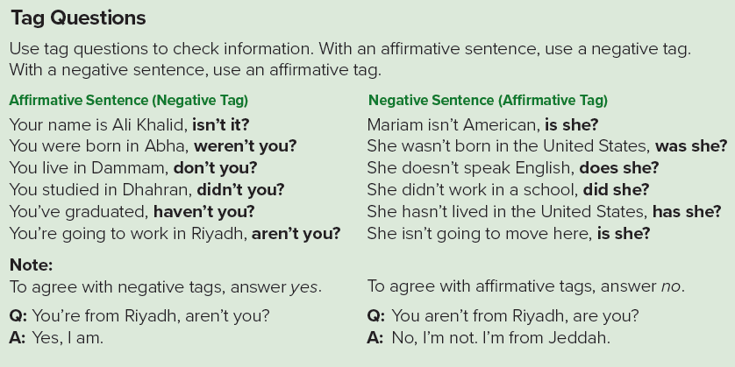

Slide 4
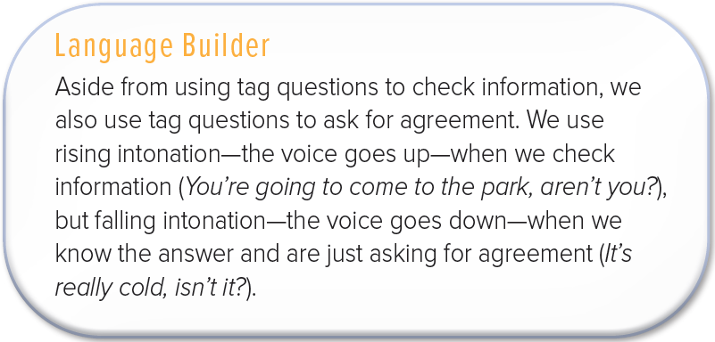

Slide 5
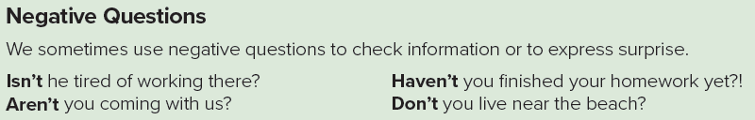

Slide 6


Slide 7
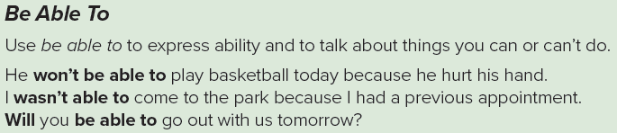

Slide 8
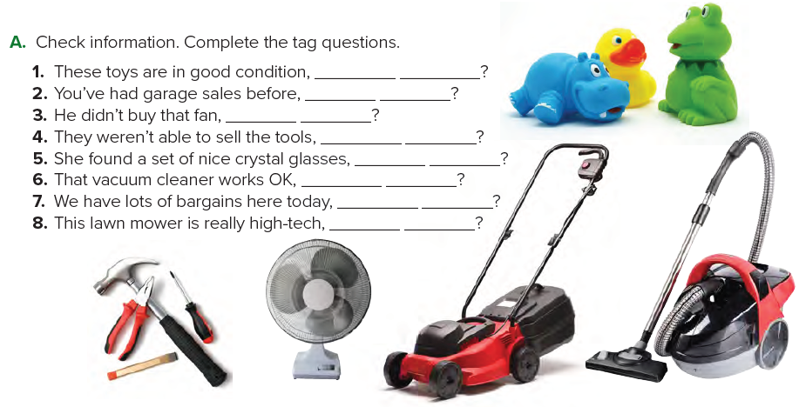
aren’t they
haven’t you
did he
were they
didn’t she
doesn’t it
don’t we
isn’t it

Slide 9
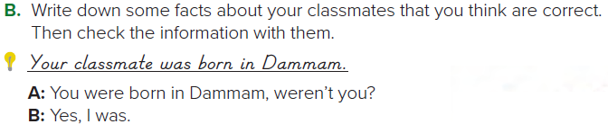


Slide 10
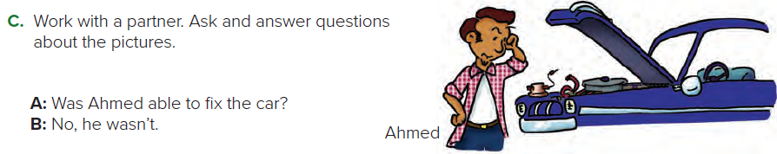

Slide 11
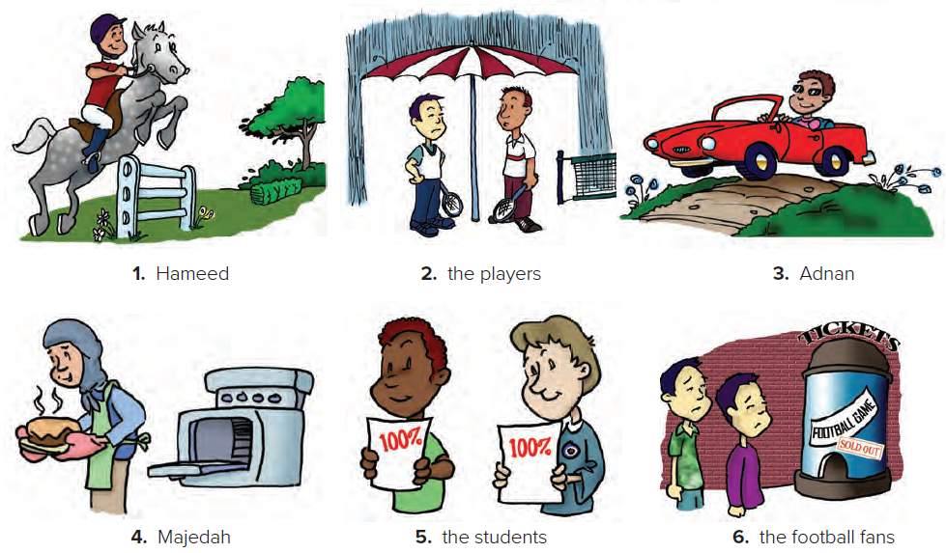
Sample answers:
1. A: Was Hameed able to ride the horse?
B: Yes, he was.
2. A: Were the players able to play tennis?
B: No, they weren’t.

Slide 12
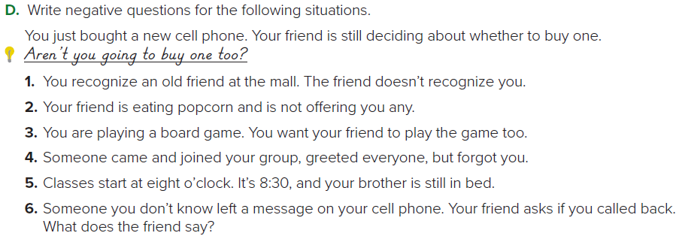
1. Don’t you remember me?
2. Aren’t you going to offer me some popcorn?
3. Don’t you want to play this game too?
4. Don’t you want to say hello to me?/Didn’t you see me?
5. Aren’t you going to school?
6. Aren’t you going to call the person back?

Slide 13

Page 90-92

