Slide 1

Unit 7
It’s a good deal, isn’t it?
Grammar

Slide 2
بسم الله الرحمن الرحيم
Day:
Date:

Slide 3
Learning Objectives
Ask tag questions correctly
Ask negative questions
Express abilities correctly

Slide 4
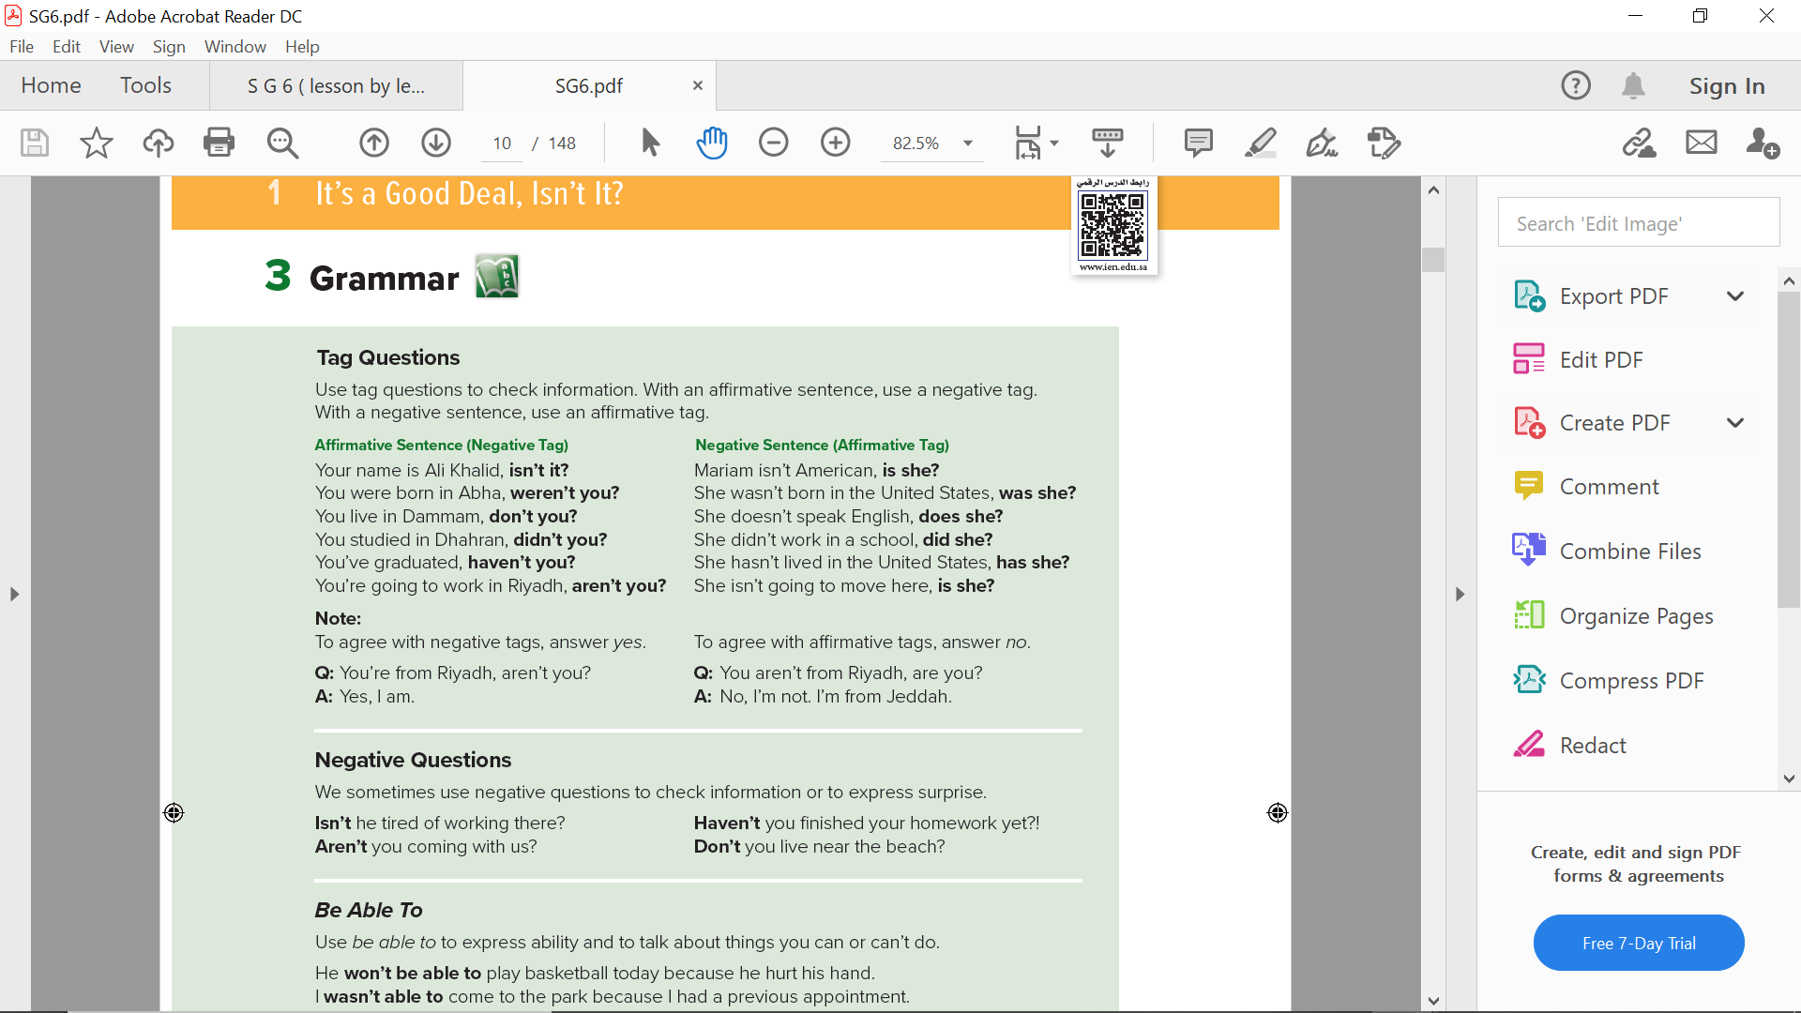
Pages 70 & 71

Slide 5
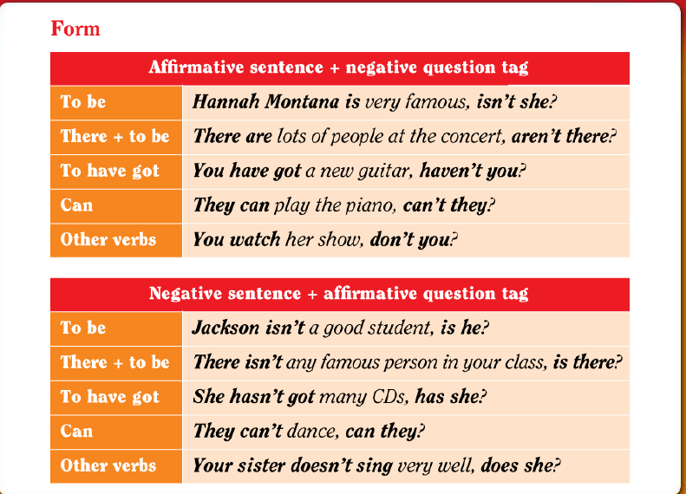

Slide 7

Practice

Slide 8
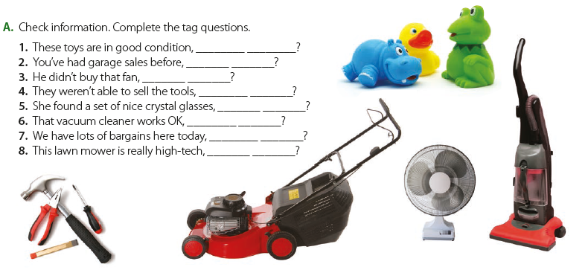
aren’t they
haven’t you
did he
were they
did she
doesn’t it
don’t we
Page 70
isn’t it

Slide 9
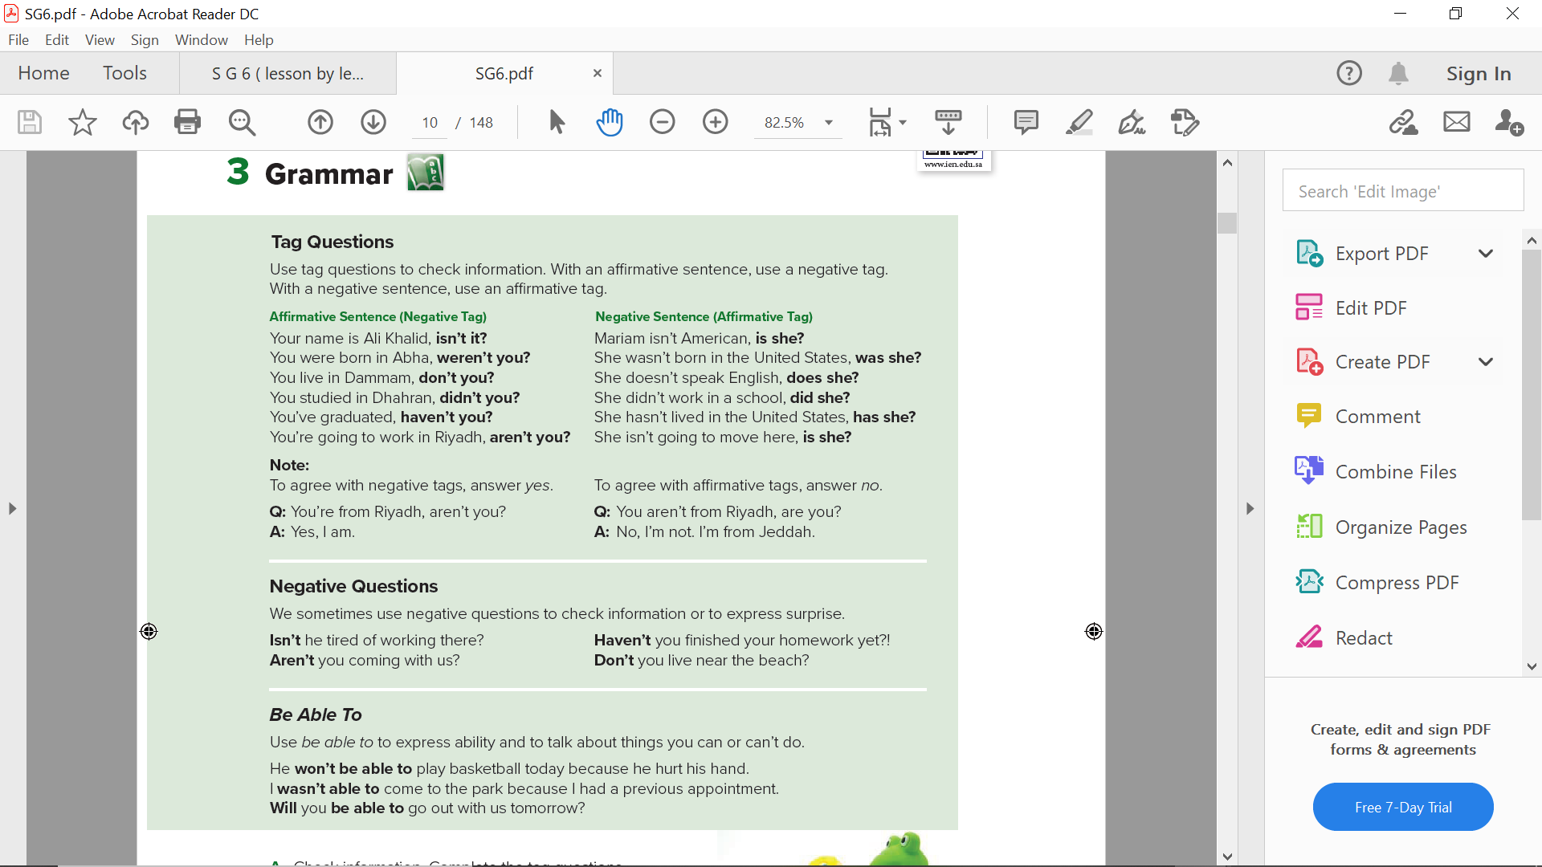
Page 70

Slide 10
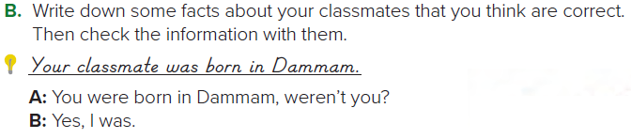
Page 71

Slide 11
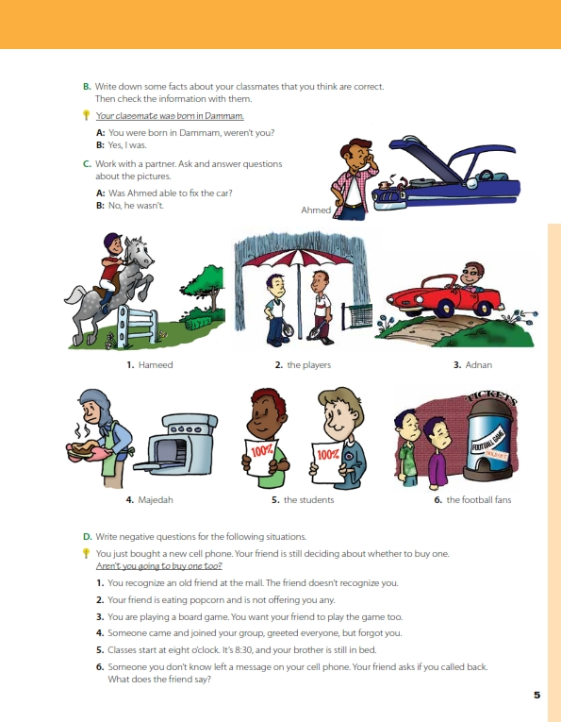
Answers
1. A: Was Hameed able to ride the horse? B: Yes, he was.
2. A: Were the players able to play tennis? B: No, they weren’t.
3. A: Was Adnan able to drive the car? B: Yes, he was.
Page 71

Slide 12
Answers
4. A: Was Majedah able to bake the cake? B: No, she wasn’t.
5. A: Were the children able to get good grades? B: Yes, they were.
6. A: Were the football fans able to get tickets? B: No, they weren’t.
Page 71

Slide 13
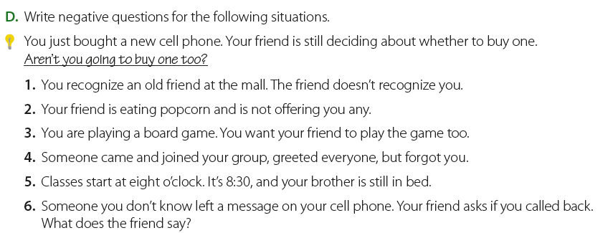
Answers
D:1. Don’t you remember me?
2. Aren’t you going to offer me some popcorn?
3. Don’t you want to play this game too?
4. Don’t you want to say hello to me? / Didn’t you see me?
5. Aren’t you going to school?
6. Aren’t you going to call the person back?
Page 71

Slide 14
Page 210
Homework

Slide 15
