Slide 1
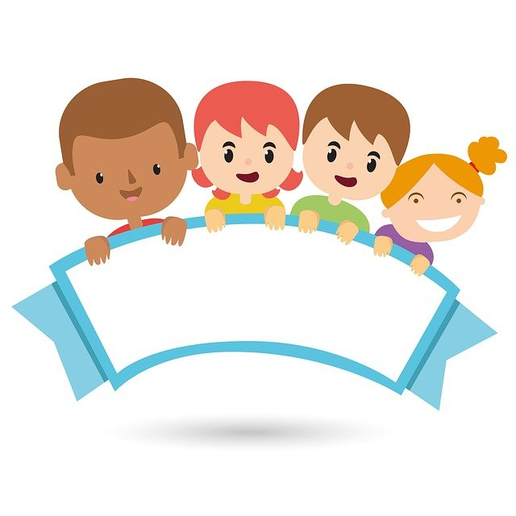
Warm up
https://youtu.be/RDkx4J__-QY

Slide 2
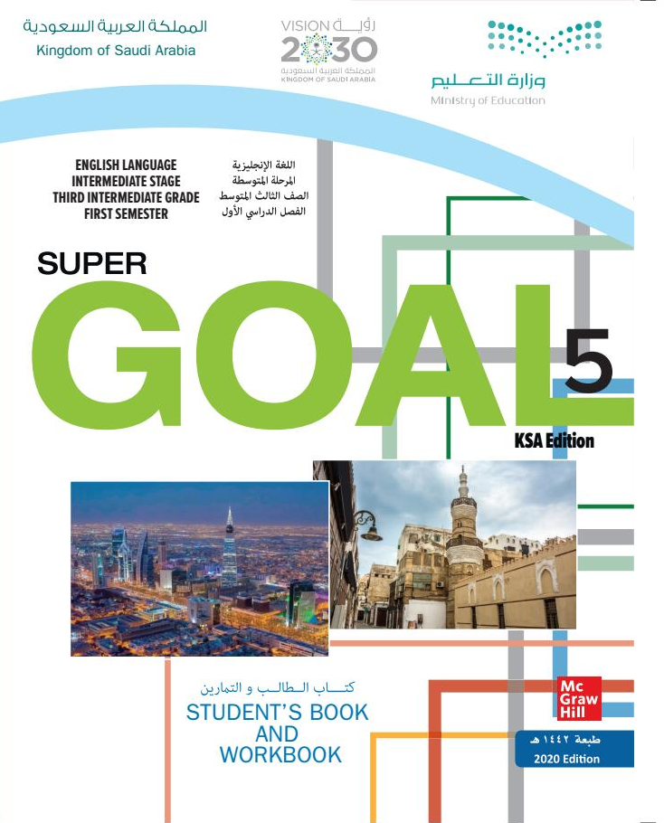
Unit 6
Do you Know Where It Is?
Form, meaning & Function

Slide 3
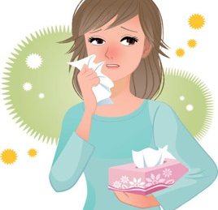
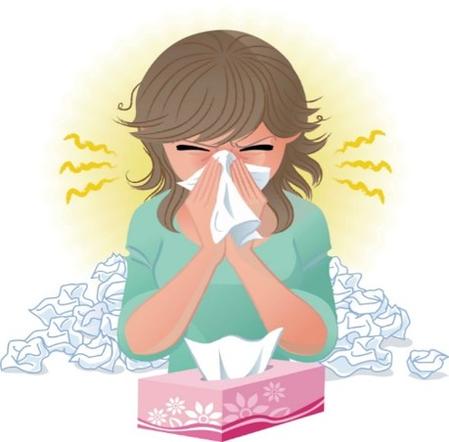
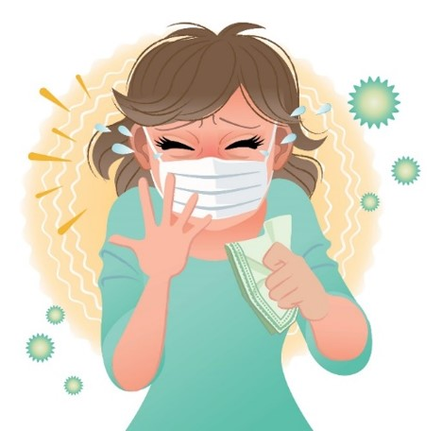
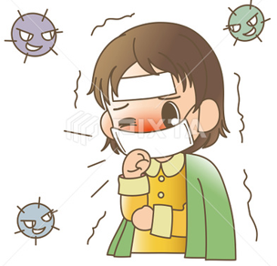

COVID 19
☺ Avoid gathering !
☺ wear a mask before going out
☺ Social distancing is not a choice, it is a must!
☺ Keep a distance of 2 meters to avoid accountability
☺ Wash hands constantly

Slide 4
بسم الله الرحمن الرحيم
Day: Tuesday
Date: 10 / 6 / 1444 H

Slide 5
Learning Objectives
02
04
differentiate between the articles
write the correct article.
01
03
Use articles correctly
use the definite article correctly.

Slide 6
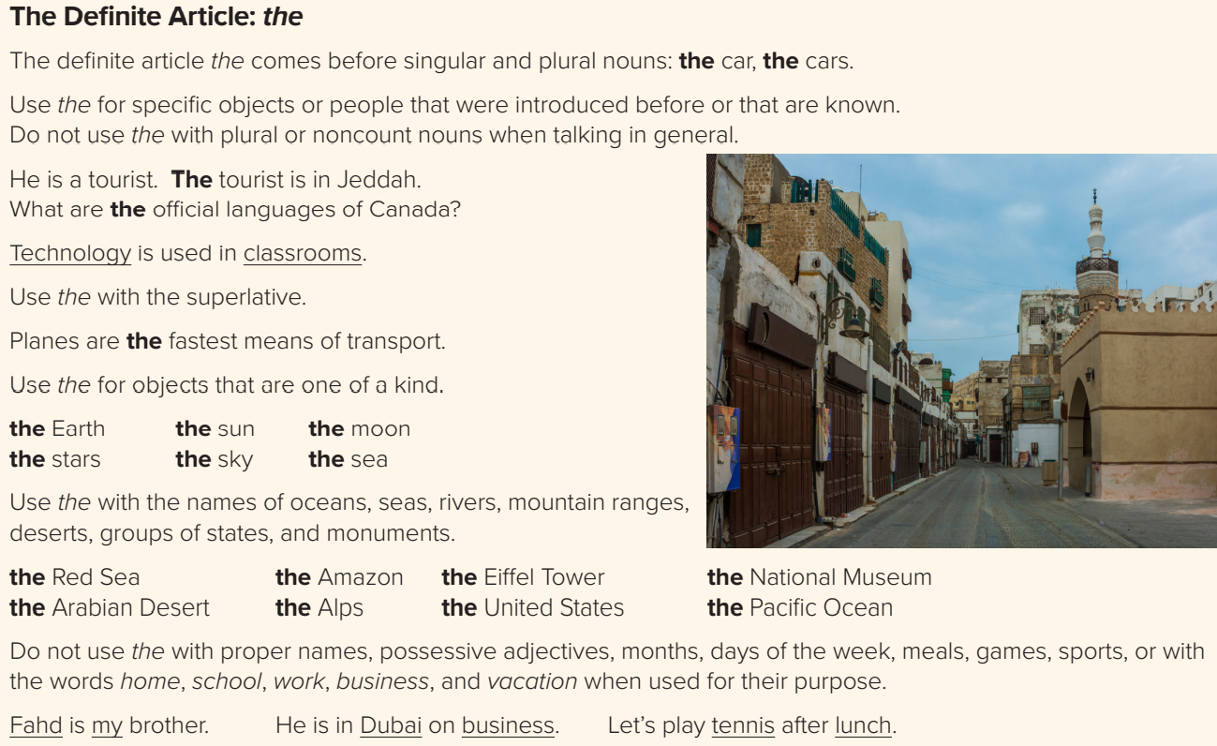
Page:67

Slide 7

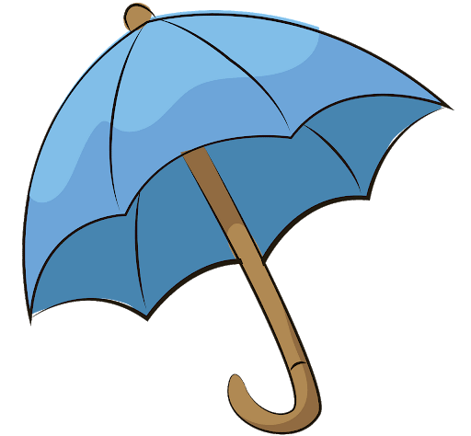

This is a book.
That is an umbrella.
The book is blue .
The umbrella is blue..
Never come with plural
I eat an apple .
The apple is red.

Slide 8
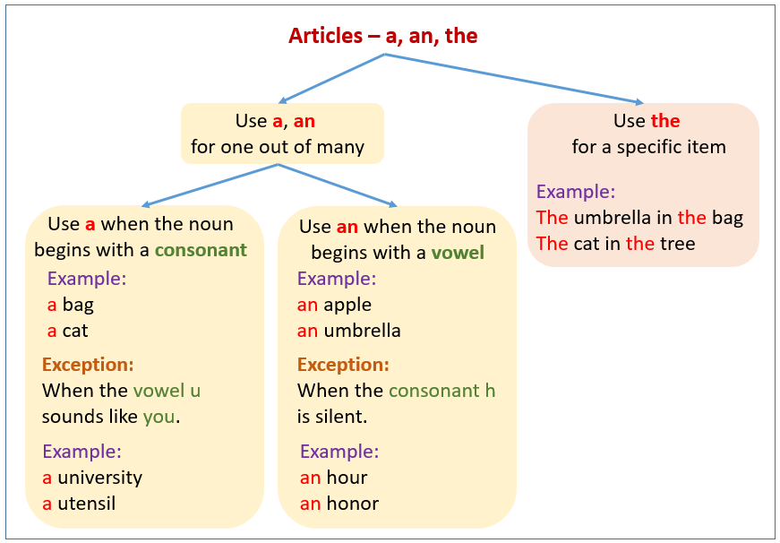

Slide 9
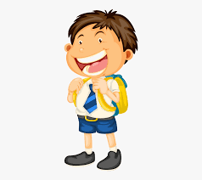
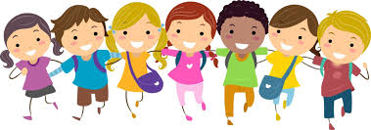
I drove a car
The car is red .
The student
The students
Page:67

Slide 10
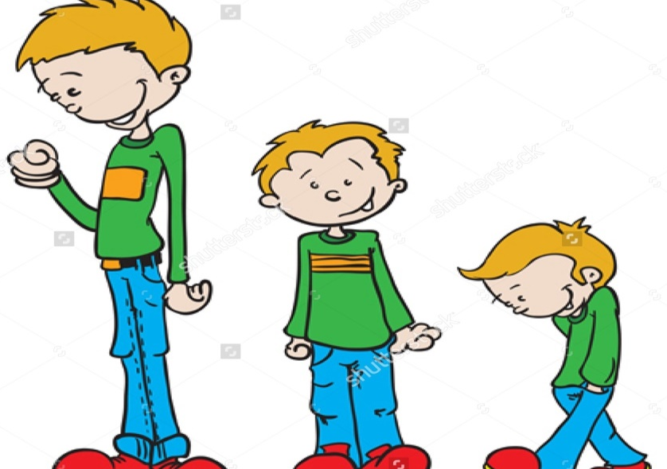
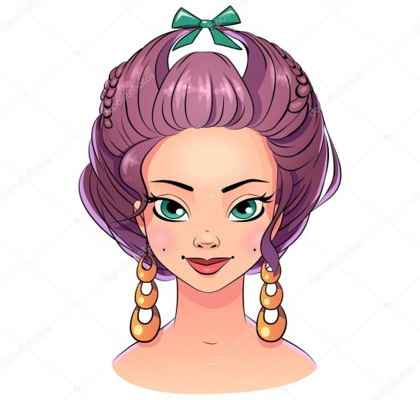
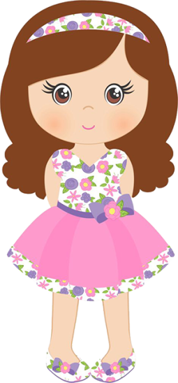
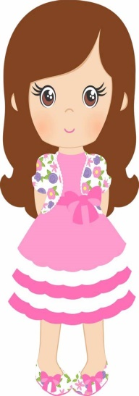
Ahmad is the tallest .
Noor is the most beautiful .

Slide 11
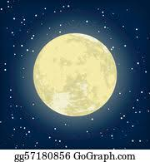

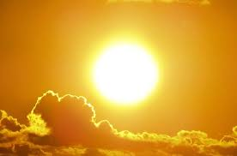
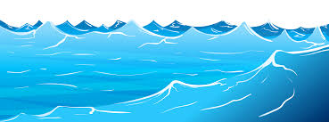

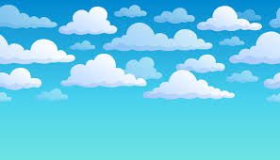

Slide 12
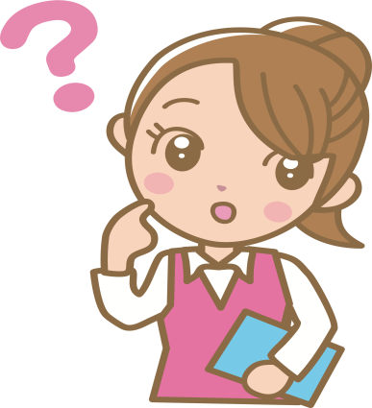
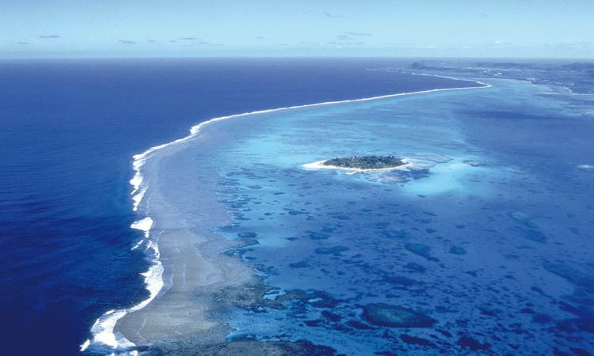
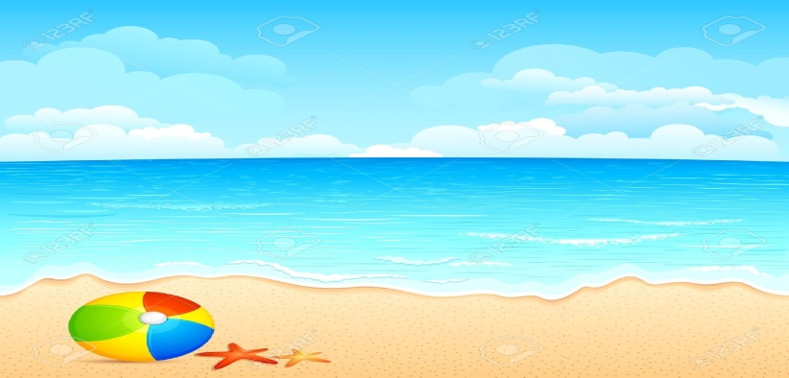
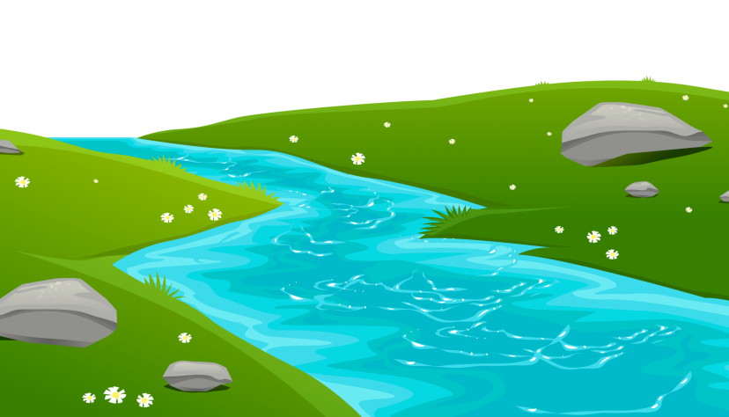
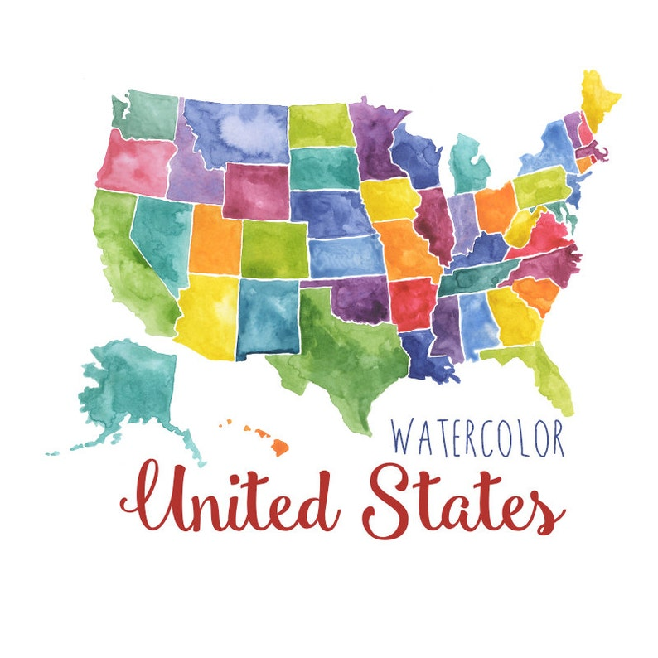
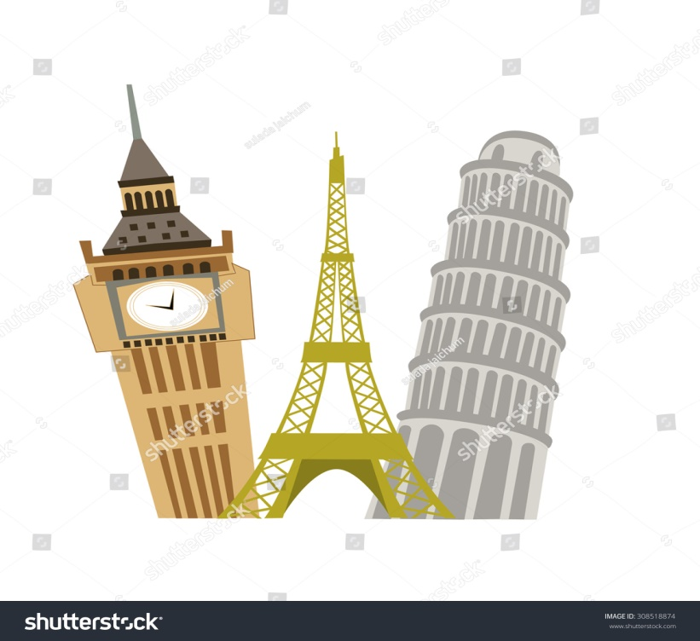
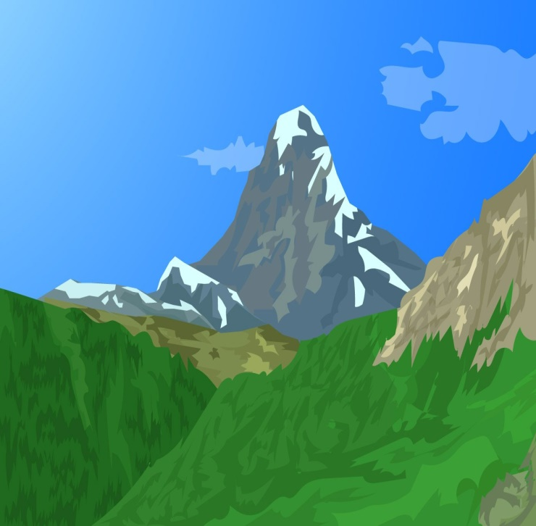

The
Pacific Ocean
The
Indian Ocean
The
Red sea
The
Arab sea
The
Nile river
The
Amazon river

Slide 13

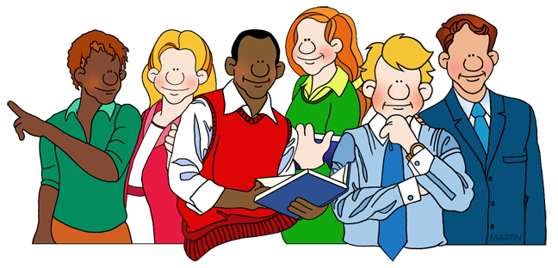
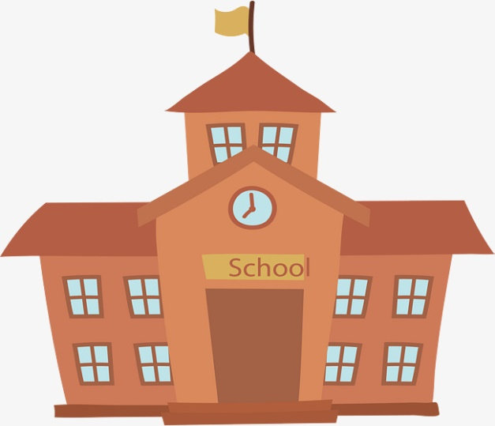
×
The

Slide 14
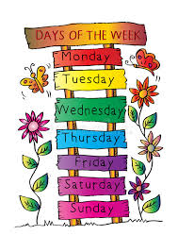
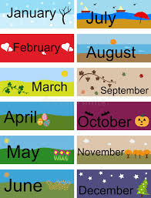
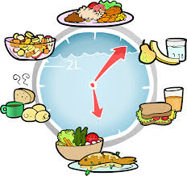
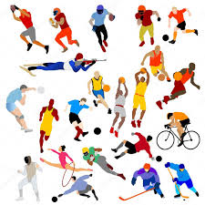
×
The

Slide 15
The:
singular and plural
objects that are one of a kind
the names of oceans .seas , rivers, mountains
×
The:
Proper names
Talking in General

Slide 16
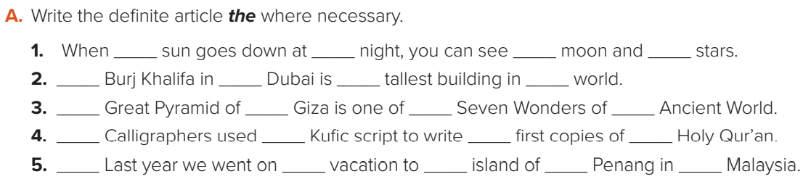
the
the
the
The
the
the
The
the
the
the
the
the

Slide 17
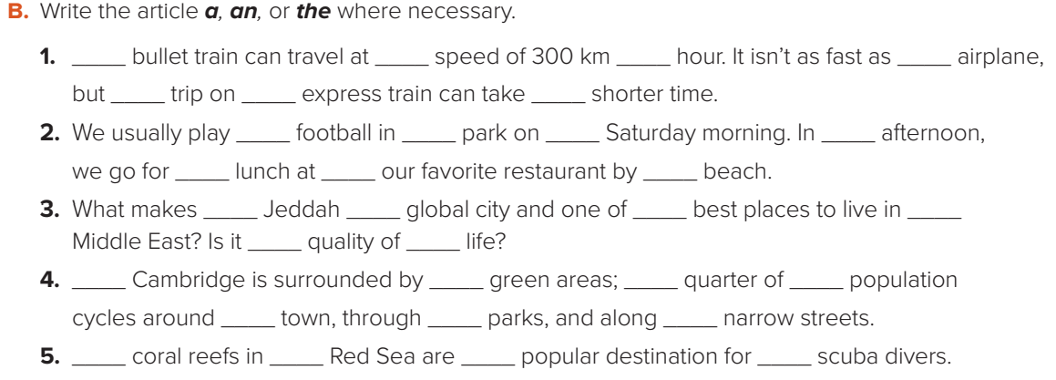
The
a
an
an
a
the
a
the
the
the
a
the
the
the
a
the
the
the
the
The
the
a

Slide 18



Slide 19
Homework!
Page 128 (h)

Slide 20
