Slide 1
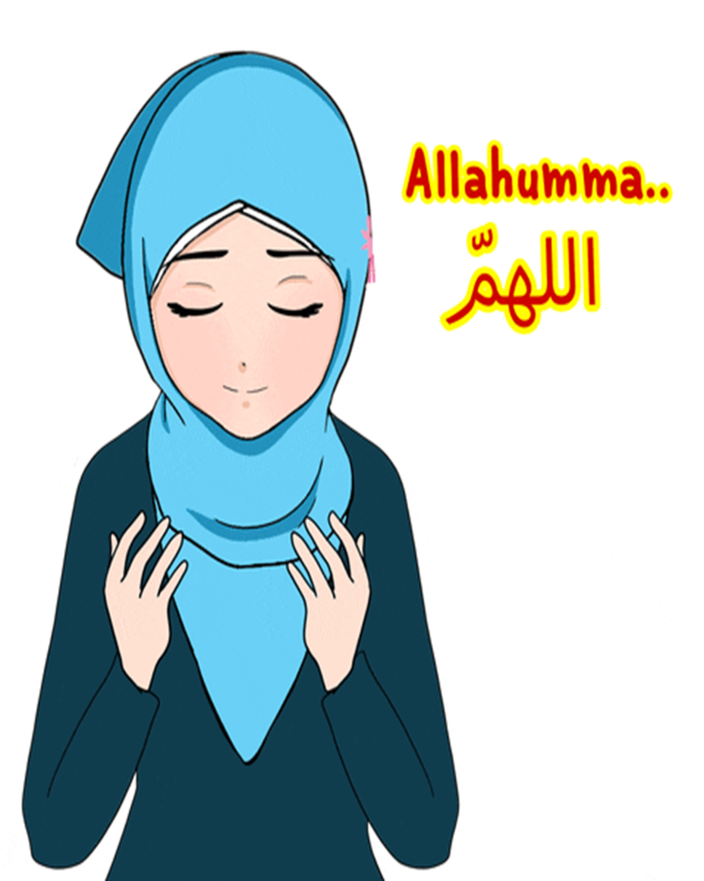


Slide 2
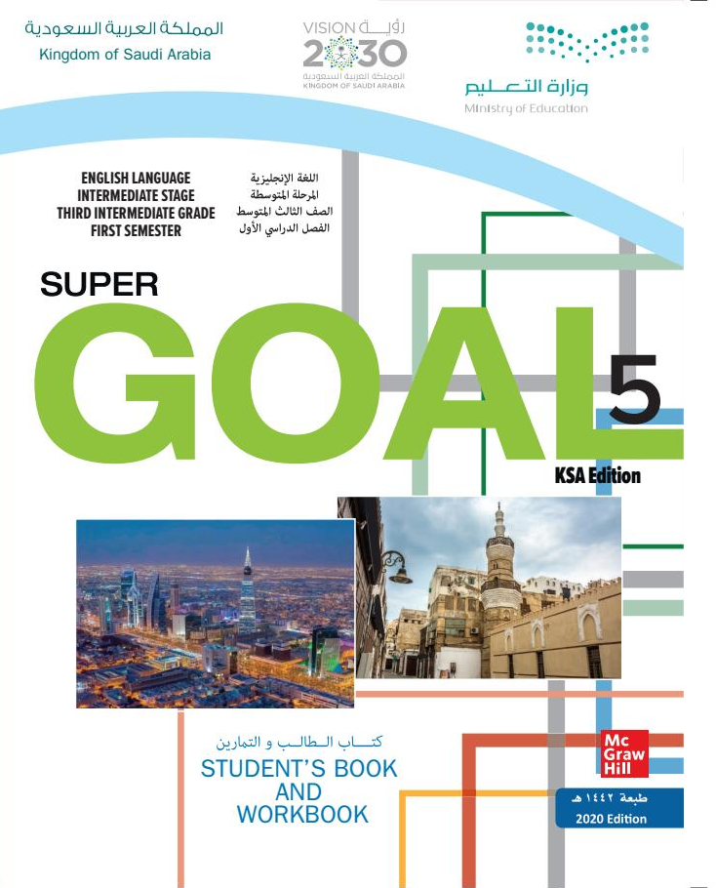
Unit 6
Do you Know Where It Is?
Writing

Slide 3
بسم الله الرحمن الرحيم
Day: Tuesday
Date: 10 / 6 / 1444 H

Slide 4
Learning Objectives
02
04
write about Saudi Arabia
write well-organized paragraphs.
01
03
discuss the topic based on Ss' information
recognize the rules of writing a paragraph.

Slide 5

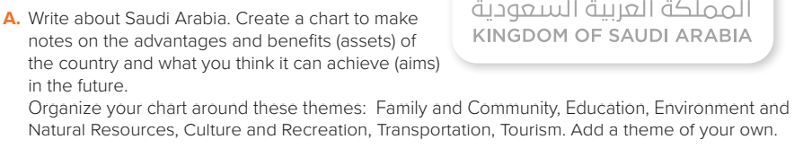



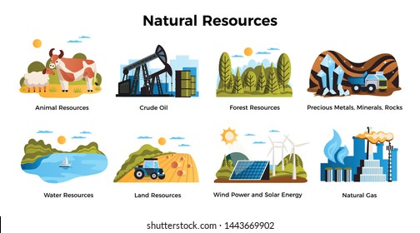


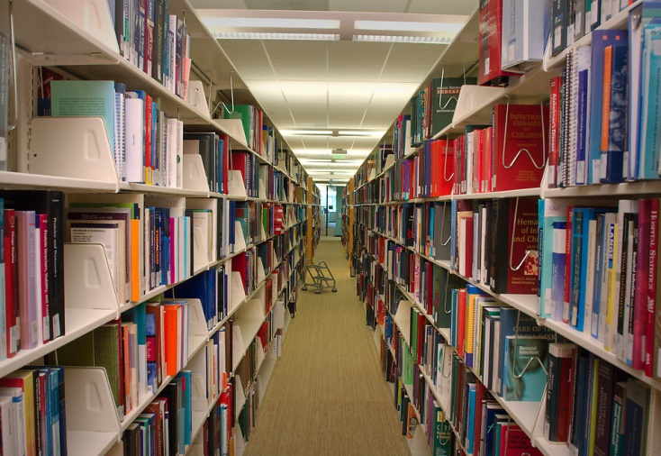
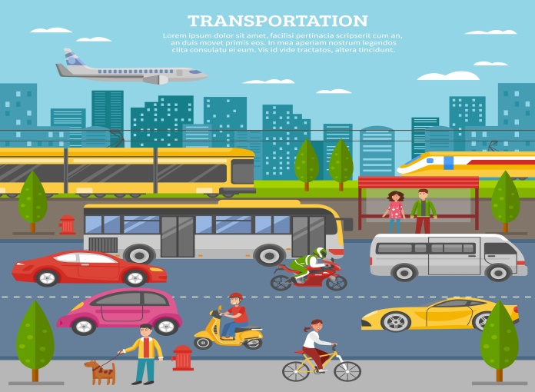

Slide 6

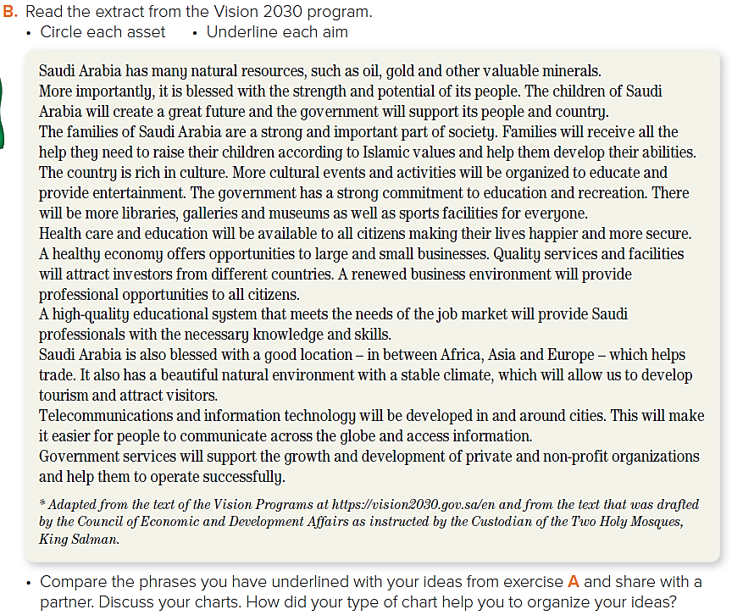

Slide 7




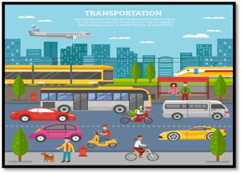

Page:66
Sample answers
Topics | the advantages and benefits of Saudi Arabia
Family and Community | Family has strong relationship and live according to Islamic religion values and laws
Education | many modern schools and universities have been built all over the country
Environment and Natural Resources | S.A is the largest oil producer in the world
Culture and Recreation | Local theaters and public libraries and summer camps
Transportation | There is a good transportation system
Tourism | S.A has a lot of historical & natural places across the country
What can be achieved in the future.
Government will support families to rise their children in many ways
Develop the learning system
to benefit from the other natural resources like gold and other minerals
There will be large museums , galleries, sport facilities…..etc.
Subways in the big cities & public buses
Reform the historical places and make entertainment events in the places to attract tourists

Slide 8
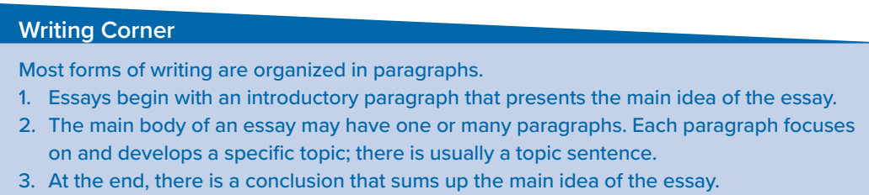
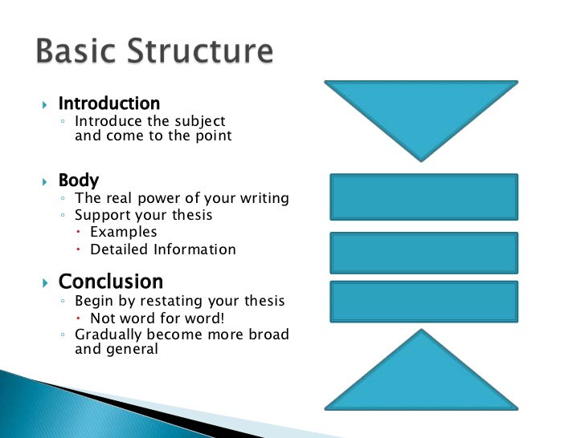

Slide 9
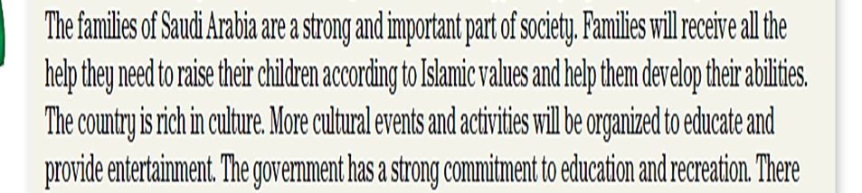
Saudi Arabia is
a wonderful country
that has many assets
and aims
Saudi Arabia became a global country .We are really proud of being Saudi .

Slide 10
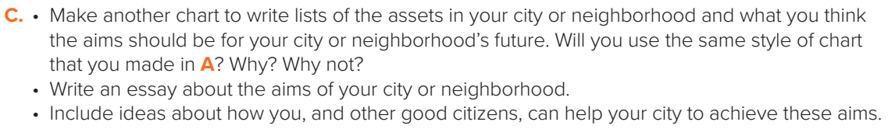
I live in a great city in a wonderful country.
Jeddah is a city with a lot of assets and also a lot of things we can aim towards.

Slide 11
Homework!
Page 128 (J)

Slide 12
