Slide 1

Unit 1
It’s a Good Deal, Isn’t It?

Slide 2

Unit 1
It’s a Good Deal, Isn’t It?

Slide 3

The objectives of the lesson :
At the end of this session, the students will be able to :
Make suggestions

Slide 4

How do we ask for suggestions?
(Should, Could/Can, Why don’t…, Let’s)
How do we respond to a suggestion when we agree?
we say:
OK; That’s a good idea; Sure; All right; or That sounds good.
How do we respond to a suggestion when we disagree?
we say:
Sorry, I can’t; Let’s… instead.

Slide 5
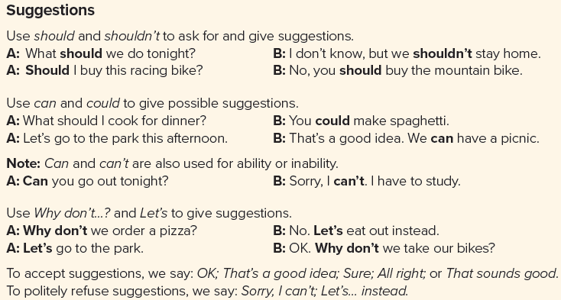

Slide 6


Slide 7
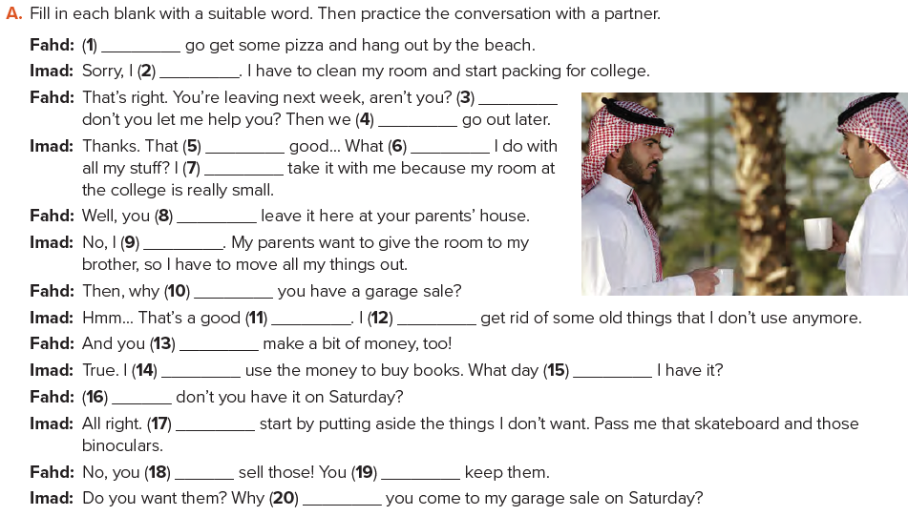
Let’s
can’t
Why
could
sounds
should
can’t
should
can’t
don’t
idea
could
can
can
should
Why
Let’s
shouldn’t
should
don’t

Slide 8
