Slide 1

Unit 1
It’s a Good Deal, Isn’t It?

Slide 2

Unit 1
It’s a Good Deal, Isn’t It?

Slide 3


The objectives of the lesson :
At the end of this session, the students will be able to :
Read a paragraph
Differentiate between past tenses

Slide 4
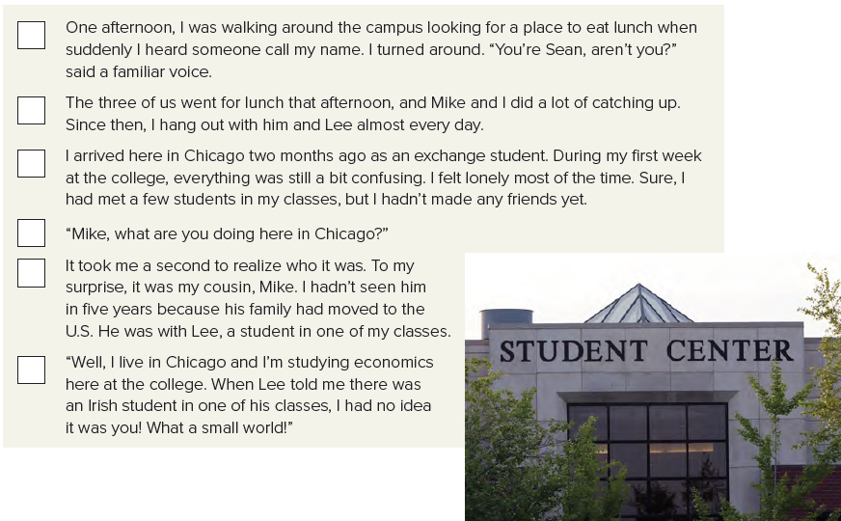
2
6
1
4
3
5

Slide 5

Where is Sean from?
(Ireland)
Why is Sean in Chicago?
(He’s an exchange student.)
Who is Mike?
(Sean’s cousin)
Why was Sean surprised to see him?
(He hadn’t seen Mike in five years.)

Slide 6
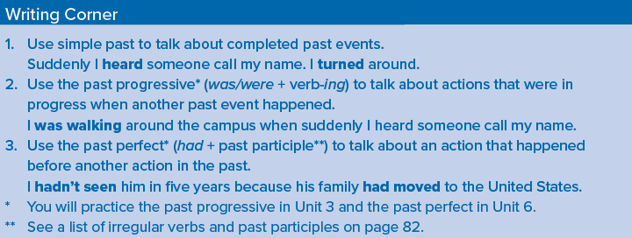

Slide 7
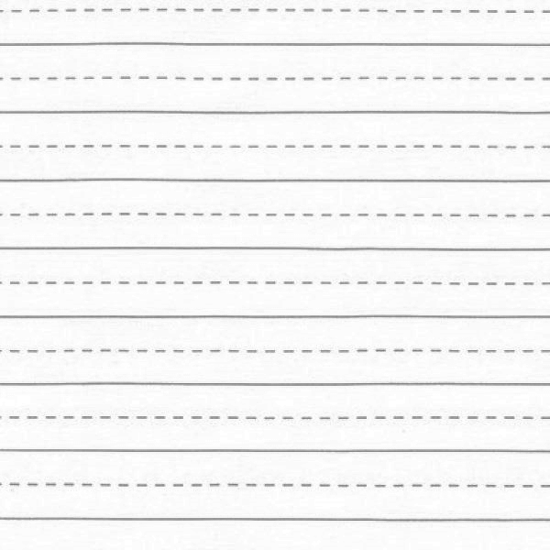

Slide 8
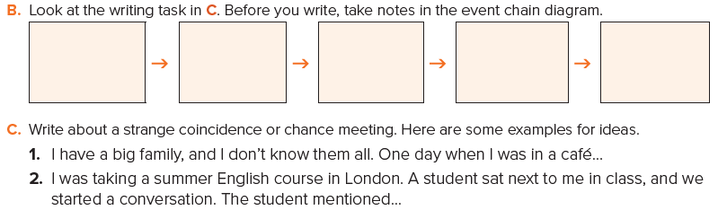

Slide 9


Slide 10

Page 94

