Slide 1

Unit 1
It’s a Good Deal, Isn’t It?

Slide 2
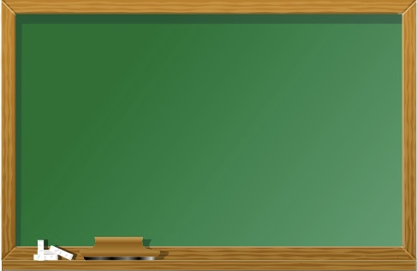
Unit 1
It’s a Good Deal, Isn’t It?

Slide 3
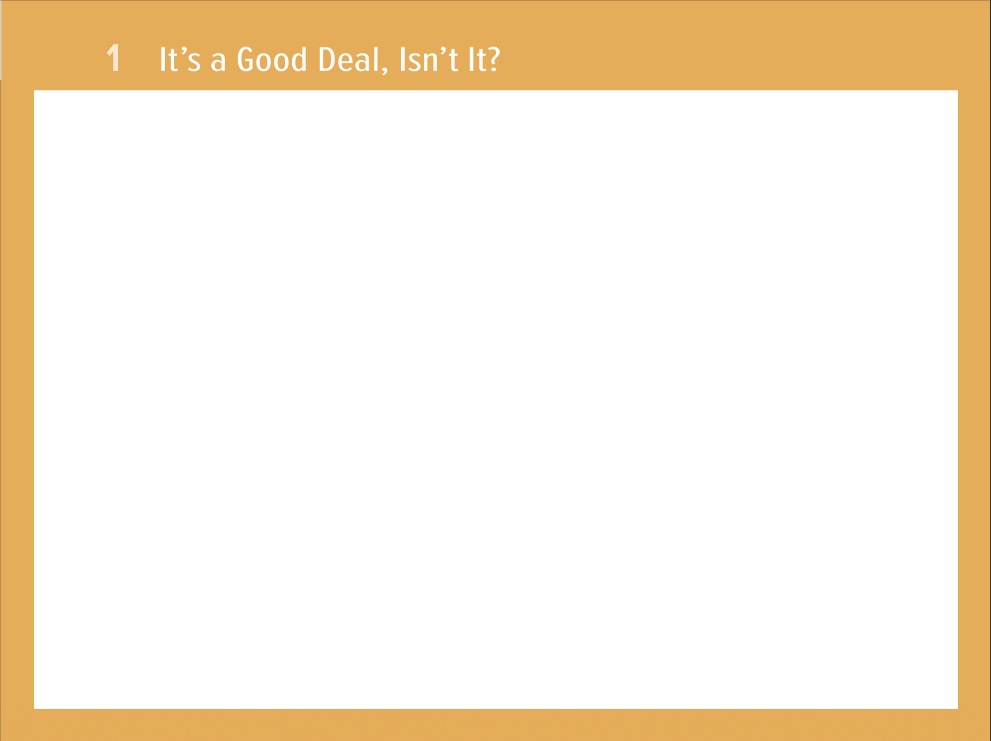
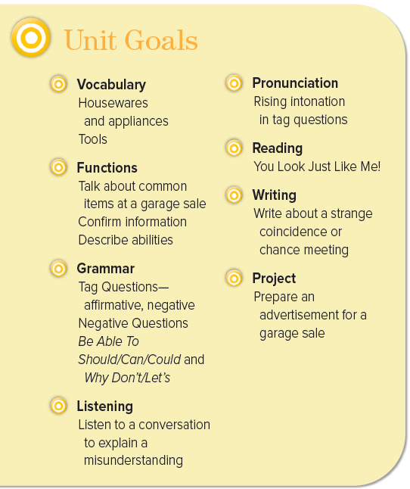

Slide 4

The objectives of the lesson :
At the end of this session, the students will be able to :
List a number of tools
Answer Yes/No questions
Sort tools according to usage

Slide 5

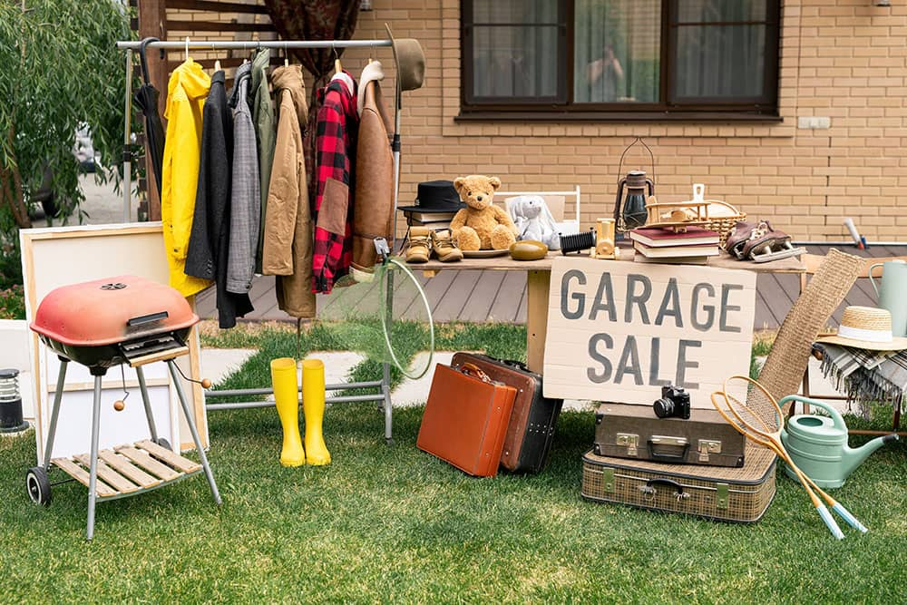
Culture Note
Garage sales, or yard sales, are common in the United States. They are usually held on the weekend. People have garage sales for various reasons: they are going to move and do not want to take everything with them; they do not use the items anymore; they need some money; or they simply want fewer things in their home. People usually post signs around the neighborhood saying when and where the garage sale will be.

Slide 6
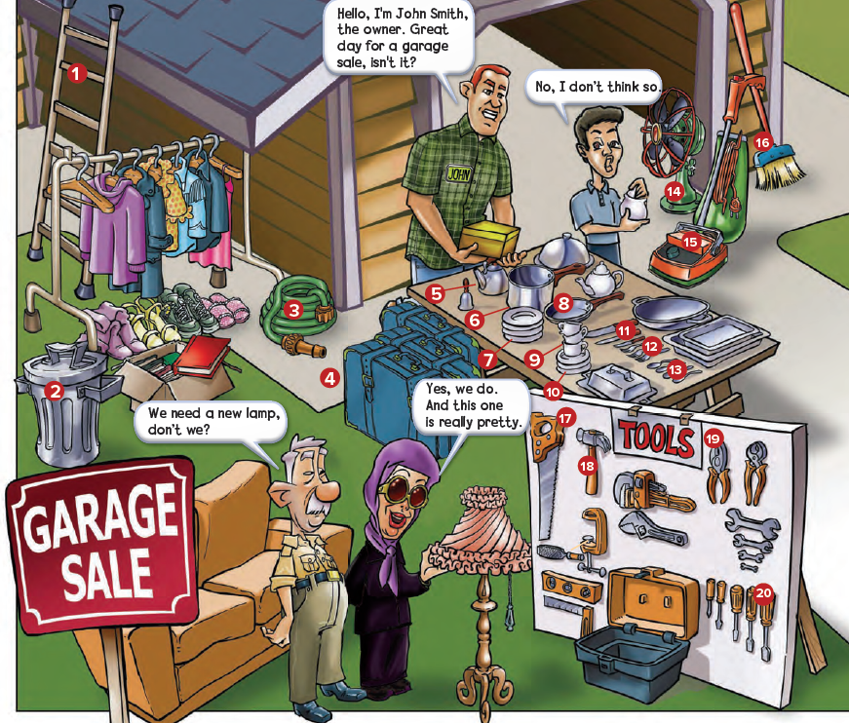
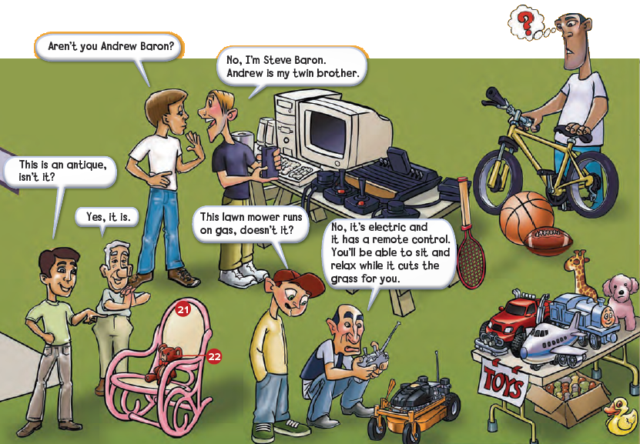
How many people are looking at the things for sale?
What kinds of tools do you see?
What things do you see for use outside the house?
What things do you see for a child?
What appliances do you see?
What kitchen things do you see?

Slide 7

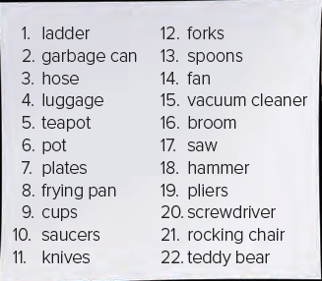

Slide 8
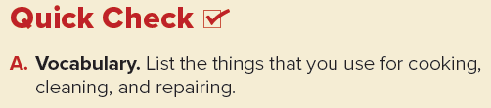
Cooking: pots (and pans), teapot, plates, frying pan, cups, saucers, knives, forks, spoons
Cleaning: broom, vacuum cleaner, hose
Repairing: saw, hammer, pliers, screwdriver

Slide 9
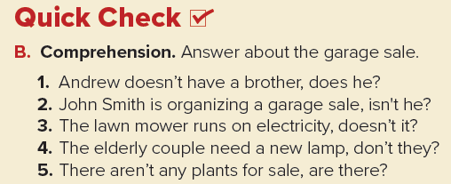
1. Yes, he does.
2. Yes, he is.
3. Yes, it does.
4. Yes, they do.
5. No, there aren’t.

Slide 10
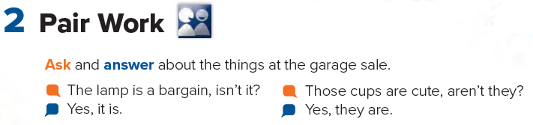

Slide 11

Page 89

