Slide 1

12. Form, meaning & function
Objectives
use the article “the” correctly.

Slide 2
Complete the sentences with a / an / the or - :
1. I swam in ……… river.
2. Have ……… good summer.
3. ……… sun is so bright today.
4. I ate ……… apple in ……… morning.
5. ……… United kingdom is in ……… Europe.
6. Were you in ……… forest ……… week ago.
7. Who helps ……… Jane's mother around the house.
8. ………Tabuk is …… small city in ……… north of S.A.
9. ……… Sam's parents were in ……… mountains ……… last summer.
10. I don't understand why ……… you like watching
keeping up with ……… kardashians
11. There is ……… new mall next to my house. ……… mall was opened last week. It is ……… biggest one.
the
a
The
the
an
The
-
the
a
-
a
the
-
the
-
-
-
the
the
a
the

Slide 3

Grammar
The article

Slide 4
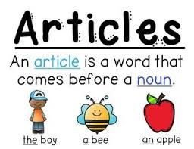
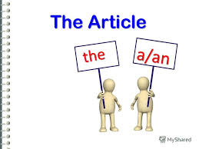

Slide 5
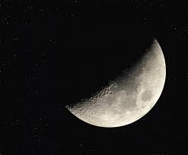
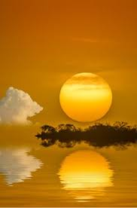
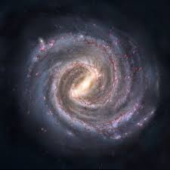
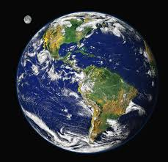
unique

Slide 6
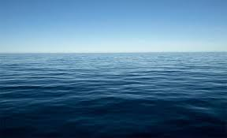
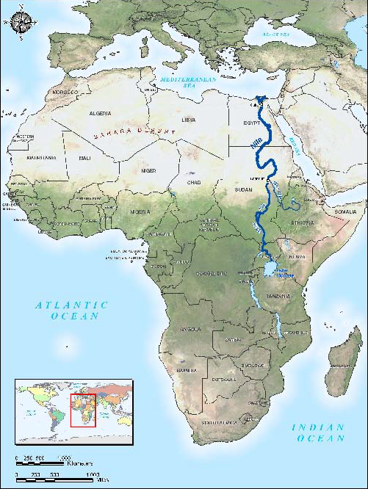
Oceans
Seas
Rivers

Slide 7
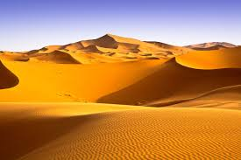
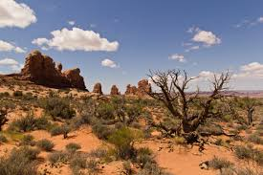
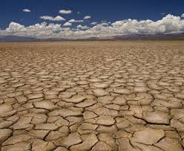
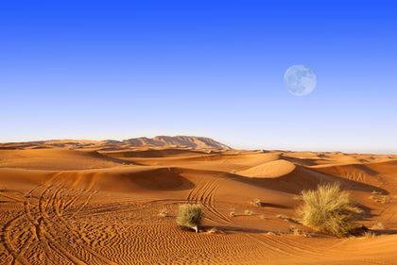
Deserts

Slide 8
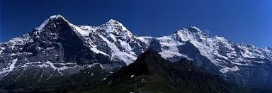
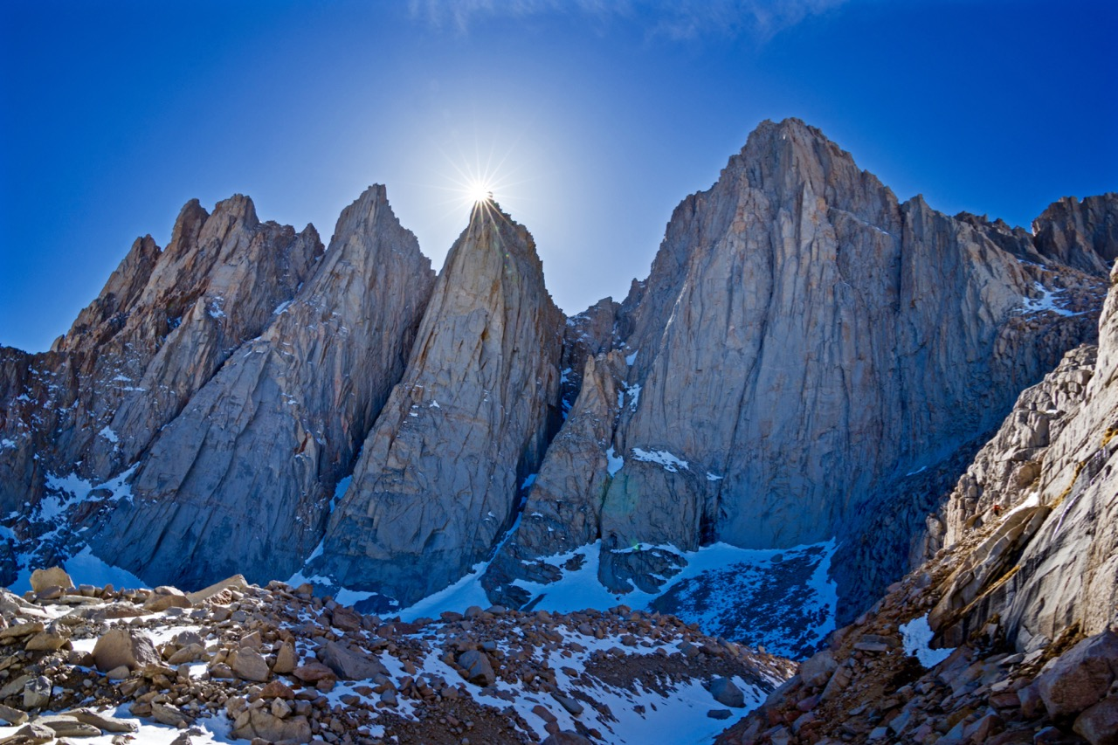
Mountains ranges

Slide 9
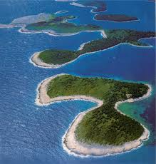

Group of islands
The cardinal points

Slide 10
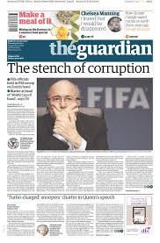
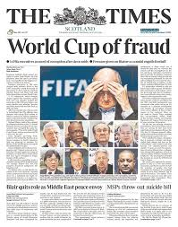
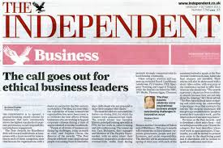
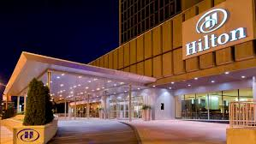
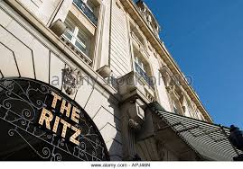
Newspapers
Hotels

Slide 11
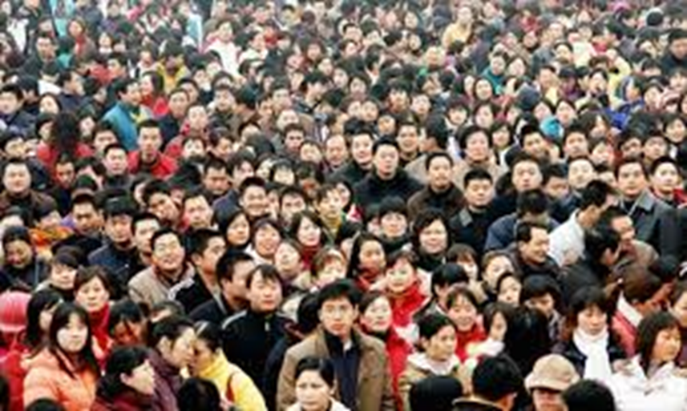

Family
Nations

Slide 12
Read the following
My father bought a house.
The house is near Aziz mall.
The earth looks beautiful from the moon.
The Sahara desert is in Africa.
The pacific is the largest ocean.
The Nile is the longest river in the world.
The united Arab emirates is a modern country.
Jeddah is in the west of Saudi Arabia.
The Chinese are the biggest population.
The Simpson came to see us last night.
The Ritz is a very expensive hotel.

Slide 13
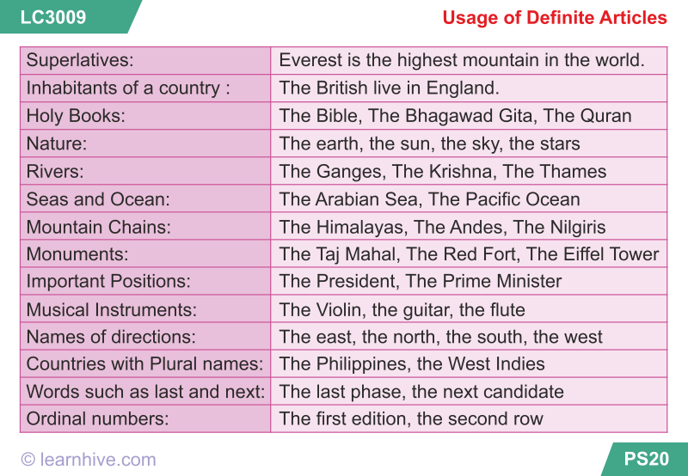

Slide 14
Write the definite article the where necessary.
1. When ____ sun goes down at ____ night, you can see ____ moon and ____ stars.
2. ____ Burj Khalifa in ____ Dubai is ____ tallest building in ____ world.
3. ____ Great Pyramid of ____ Giza is one of ____ Seven Wonders of ____ Ancient World.
4. ____ Calligraphers used ____ Kufic script to write ____ first copies of ____ Holy Qur’an.
5. ____ Last year we went on ____ vacation to ____ island of ____ Penang in ____ Malaysia.
the
-
the
the
-
-
the
the
The
-
the
the
-
-
the
the
-
-
the
-
-

Slide 15
Write the article a, an, or the where necessary.
1. ___ bullet train can travel at ____ speed of 300 km ____ hour. It isn’t as fast as ___airplane, but ____ trip on ____ express train can take __ shorter time.
2. We usually play ___ football in ____ park on ____ Saturday morning. In ____ afternoon, we go for ____ lunch at ____ our favorite restaurant by ____ beach.
The
a
an
the
a
the
a
-
the
the
-
-
-
the

Slide 16
-
a
3. What makes ____ Jeddah ____ global city and one of ____ best places to live in __ Middle East? Is it __ quality of ____ life?
4. ____ Cambridge is surrounded by ____ green areas; ____ quarter of ____ population cycles around ____ town, through ____ parks, and along ____ narrow streets.
5. ____ coral reefs in ____ Red Sea are ____ popular destination for ____ scuba divers
the
the
the
-
-
-
a
the
the
the
the
The
the
a
-

