Slide 1

Do you know where it is?
Unit 6

Slide 2

Writing
Objectives
discuss the topic based on Ss' information
Talk about Saudi Arabia’s vision 2030
Follow the steps to write an easy

Slide 3
Think of the changes that happened in Saudi Arabia in the last 5 years.
What makes Saudi Arabia strong?
What’s new?
How people’s lives have changed?

Slide 4
Work in groups
Make a chart on :
1. The the advantages and benefits of S.A.( assets)
2. What you think it can achieve in the future. (aims)

Slide 5
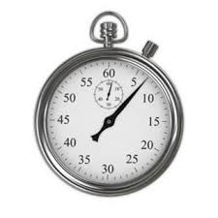
Topics | the advantages and benefits of Saudi Arabia | What can be achieved in the future.
Family and Community
Education
Environment and Natural Resources
Culture and Recreation
Transportation
Tourism

Slide 6
Topics | the advantages and benefits of Saudi Arabia | What can be achieved in the future.
Family and Community | Family has strong relationship and live according to Islamic religion values and laws | Government will support families to rise their children in many ways
Education | many modern schools and universities have been built all over the country | Develop the learning system
Environment and Natural Resources | S.A is the largest oil producer in the world | to benefit from the other natural resources like gold and other minerals
Culture and Recreation | Local theaters and public libraries and summer camps | There will be large museums , galleries, sport facilities…..etc.
Transportation | There is a good transportation system many international airports modern roads ,trains…..etc. | Subways in the big cities & public buses
Tourism | S.A has a lot of historical & natural places across the country | Reform the historical places and make entertainment events in the places to attract tourists

Slide 7

Now read the text and
Circle each asset
Underline each aim.

Slide 8
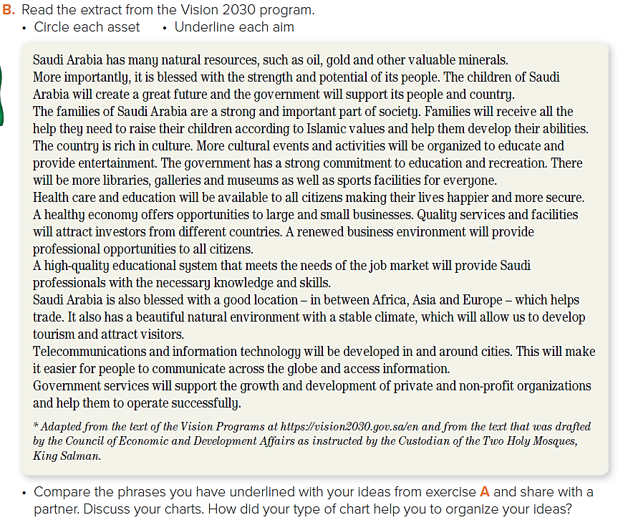

Slide 9
Make another chart to write lists of the assets in your city or neighborhood and what you think the aims should be for your city or neighborhood’s future.
Will you use the same style of chart
that you made in A? Why? Why not?

Slide 10
DON’T FORGET
How do we write an essay?

Slide 11
Introduction
What city are you going to talk about?
Body paragraphs.
What makes it special?
location
history
people
weather
cultural diversity
What can the citizens of Jeddah do to improve it?
How will it change?
Conclusion
Your general opinion of the city.

Slide 12
Introduction
I live in a great city in a wonderful country.
Jeddah is a city with a lot of assets and also a lot of things we can aim towards.
Body paragraphs.
Everything about Jeddah makes it unique. ……
There are so many things that we can do to improve our city. For example ………
The change will be enormous. …………
Conclusion
In general, ……………

Slide 13


