Slide 1
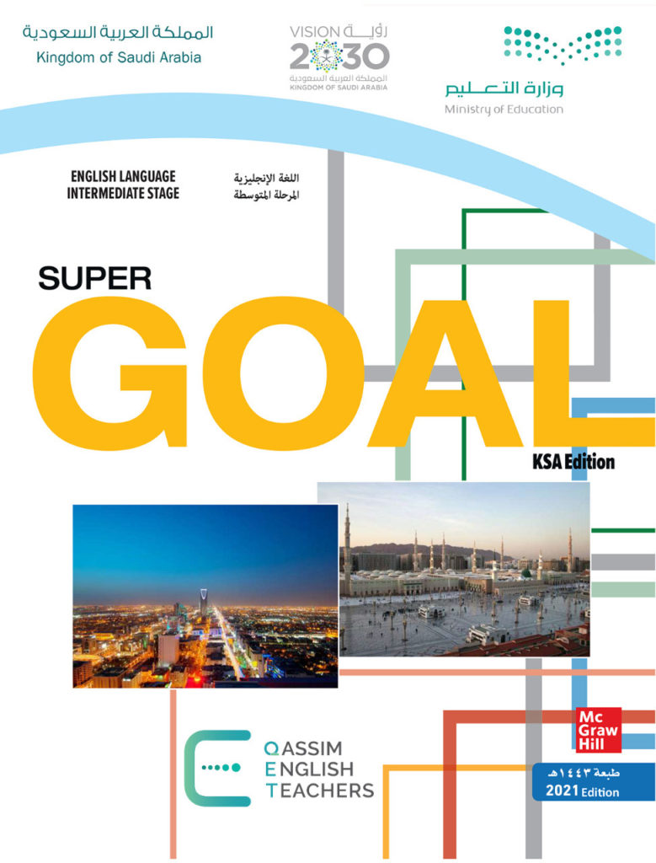
Unit 6
Do you Know Where It Is?
Reading

Slide 2
بسم الله الرحمن الرحيم
Day:
Date:

Slide 3
Learning Objectives
02
04
Correct some information about the text.
Match each paragraph with its main idea.
01
03
05
Present the features of an international city .
Find the meaning of the new words in the text.
Describe some features of Jeddah

Slide 4
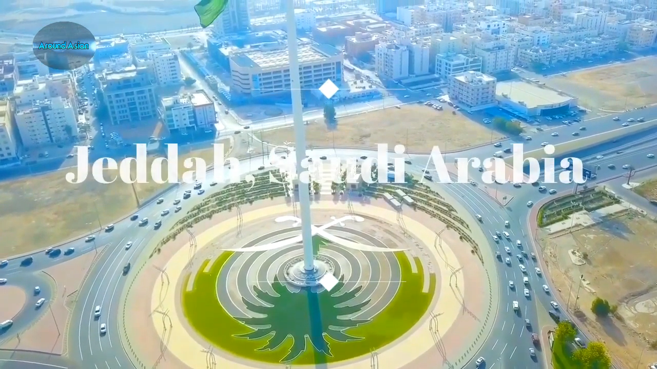

Slide 5
Before reading
-What is the title?
-Scan: What is the passage talking about?
-Do we have subtitles?
-How many pictures are there? Paragraphs? Lines?
-Skim: Find the following in the passage: dates, names, famous places, adjectives
What is your favorite City? Why?
Have you ever visited Jeddah? Where is it?
Page:64

Slide 6
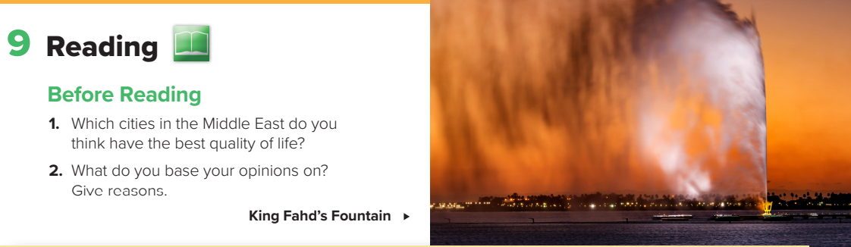
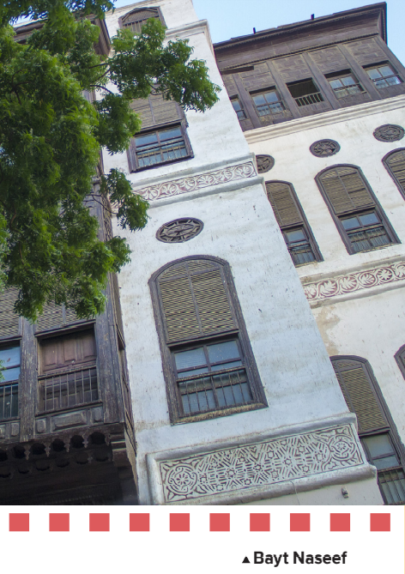
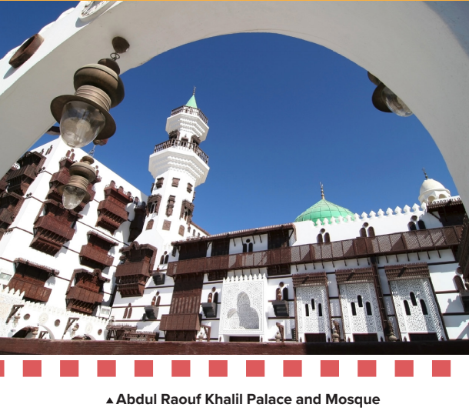
Page:64

Slide 7


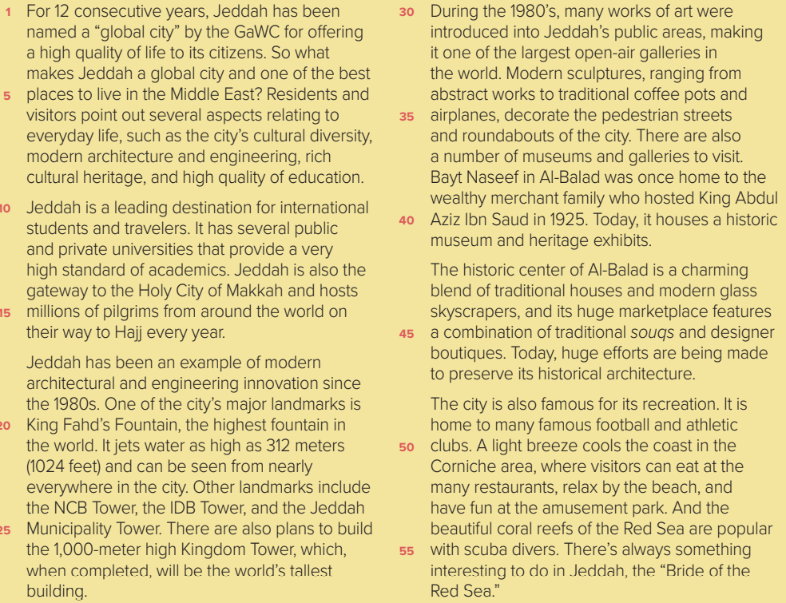
Page:64

Slide 8
Mind-map
Main Idea
Paragraph 1
Paragraph4
Paragraph 6
Paragraph 2
Paragraph 3
Paragraph 5

Slide 9
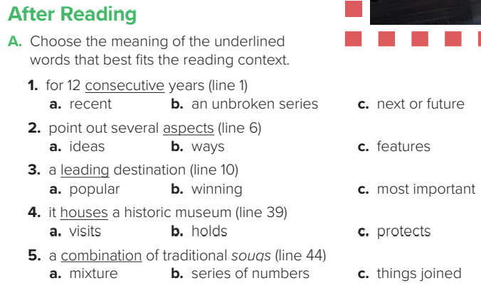
Page:65

Slide 10
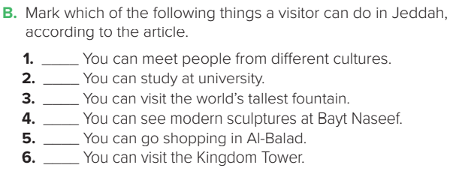
✓
✓
✓
✓
Page:65

Slide 11
After reading
Write three Reasons that makes Jeddah a special place to visit/ live?
Compare Jeddah To Riyadh?
How do you think Jeddah will be after 10 years?

Slide 12
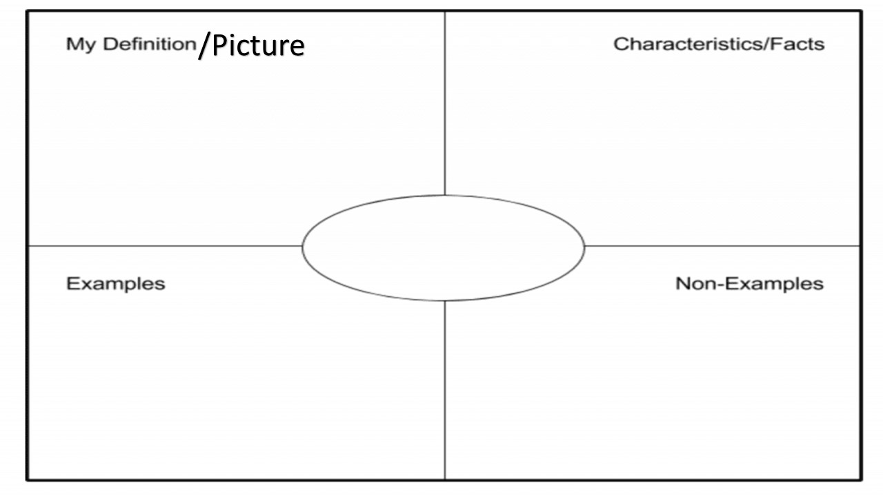
After reading
Jeddah

Slide 13
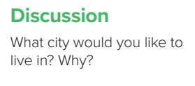
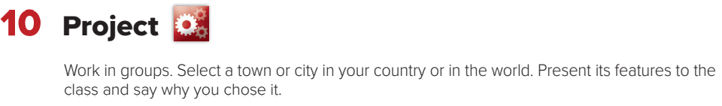
Page:65

Slide 14
Homework!
Page 207

Slide 15
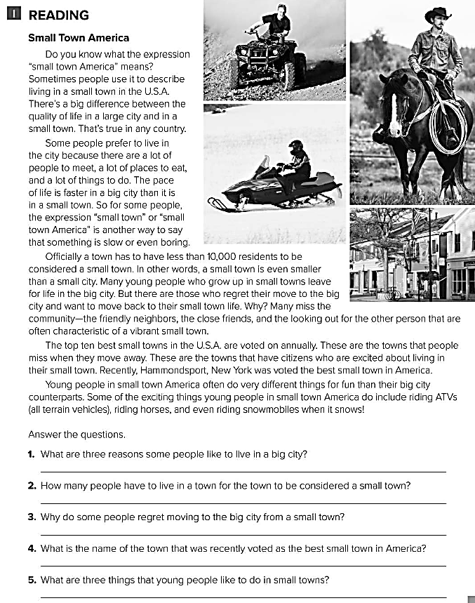
There are a lot of people to meet, a lot of places to eat, and a lot of things to do.
Less than 10,000 people .
because they miss the community of a small town .
Hammondsport , New York .
Riding the ATVs , horses , and the snowmobiles .

