Slide 1

Unit 6
Do you Know Where It Is?
Language in context

Slide 2
بسم الله الرحمن الرحيم
Day:
Date:

Slide 3
Learning Objectives
02
04
Recognize comparative forms in an audio.
Compare one's town with other towns.
01
03
05
Compare places ( cities or towns) to live
use rising intonation in the indirect question
Recognize comparative forms in an audio.

Slide 4
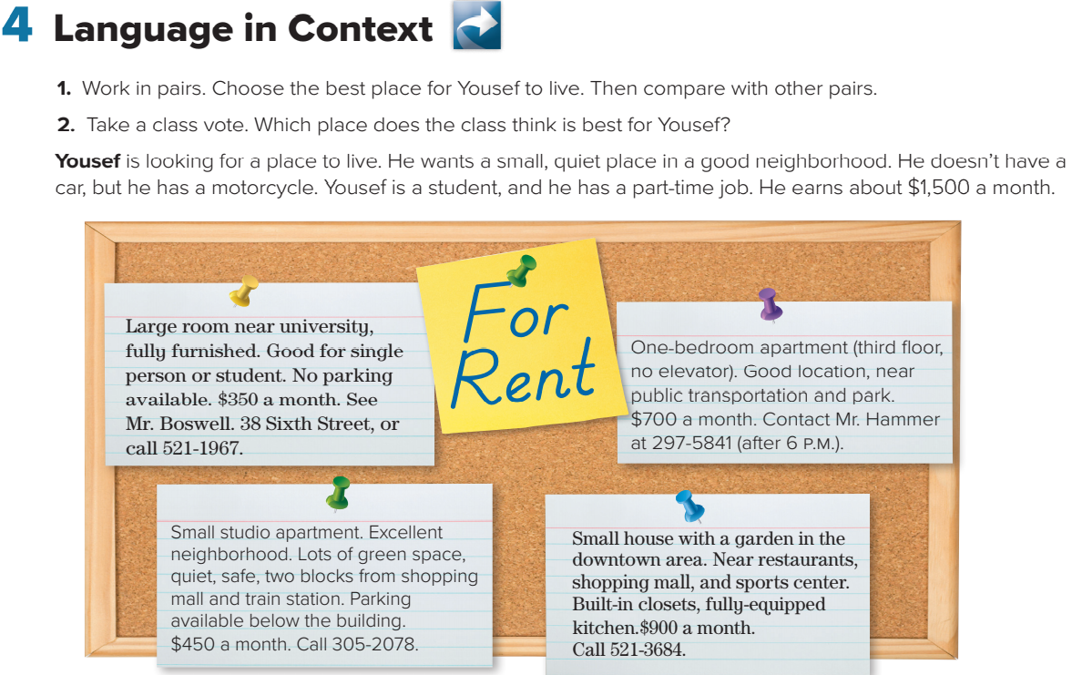
Page:62

Slide 5

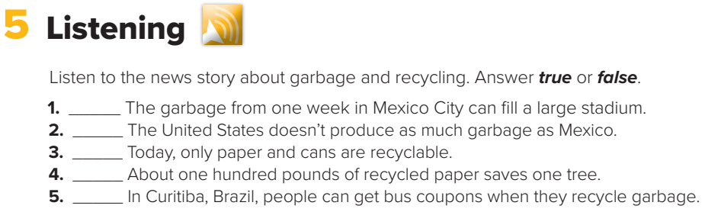
true
false
false
true
true
Page:62

Slide 6
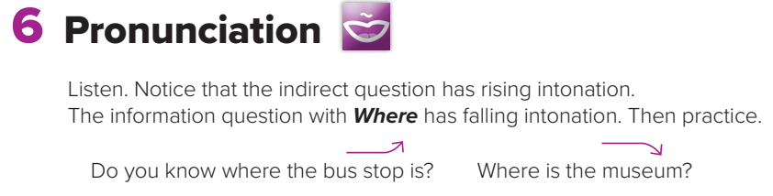
Page:62

Slide 7
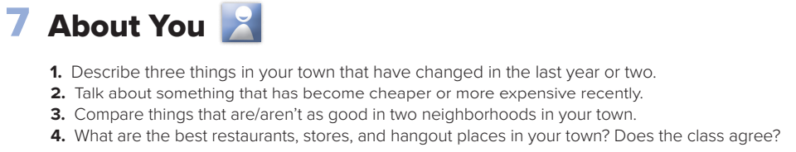
Page:62

Slide 8
Homework!
Page 205

Slide 9
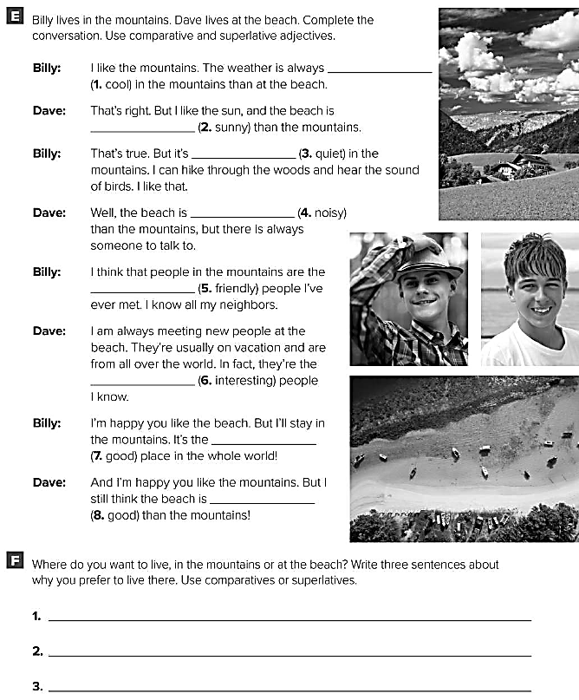
cooler
sunnier
quieter
noisier
friendliest
most interesting
best
better
I prefer to live in the mountains because the weather is cooler.
I prefer to live in the mountains because the air is cleaner .
I prefer to live in the mountains because the people are friendlier .

