Slide 1

Unit 6
Do you Know Where It Is?
Grammar

Slide 2
بسم الله الرحمن الرحيم
Day:
Date:

Slide 3
Learning Objectives
02
04
distinguish between long & short adj.
Make comparisons correctly
01
03
05
identify the comparative and superlative e forms
Compare using as…as
Ask indirect questions

Slide 4
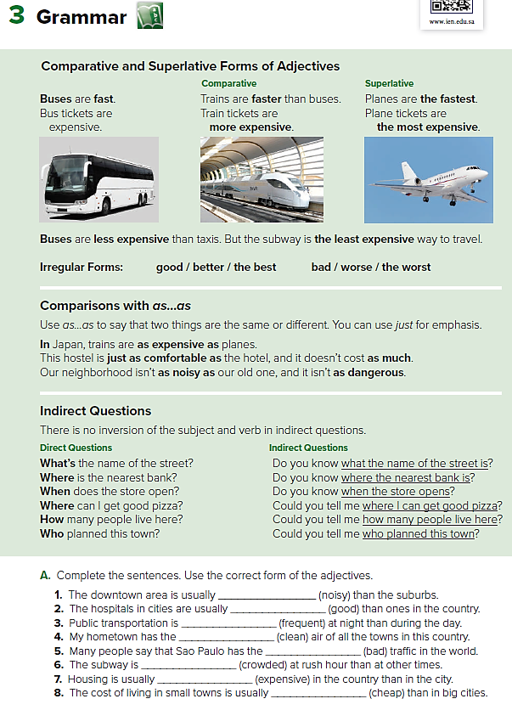
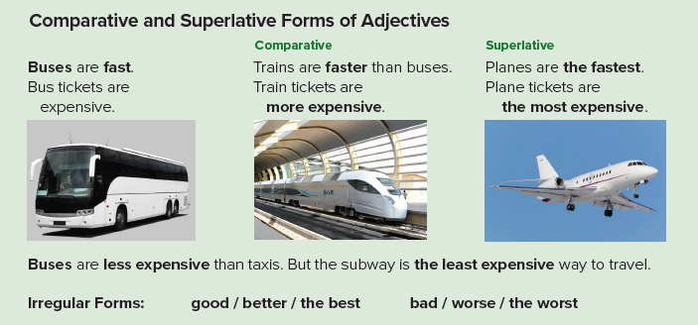
Pages:60 & 61

Slide 5
To compare Two people or things, we have to notice the adjective
( Is it long or short ?)
Long Adjectives | Short Adjectives
1- more + adj + than e.g. dangerous Planes are more dangerous than cars. | 1- adj + er than e.g. fast faster than cars. Planes are
To compare Three or more people or things, we have to notice
the adjective. ( Is it long or short ?
Long Adjectives | Short Adjectives
1- the most + adj e.g. dangerous Planes are the most dangerous. | 1- the + adj + est e.g. fast Planes are the fastest.

Slide 6

Less and the least are the opposite of more and the most.
It is used with 1- long and 2- short adjectives.
the least ……. | less …. than
the least + adj e.g. dangerous 1- Planes are the least dangerous. e.g. safe 2- Planes are the least safe. | less + adj + than e.g. dangerous 1- Planes are less dangerous than cars. e.g. safe 2- Planes are less safe than cars.
We have irregular adjectives which are :
good ➔ better than ➔ the best
bad ➔ worse than ➔ the worst

Slide 7



Slide 8
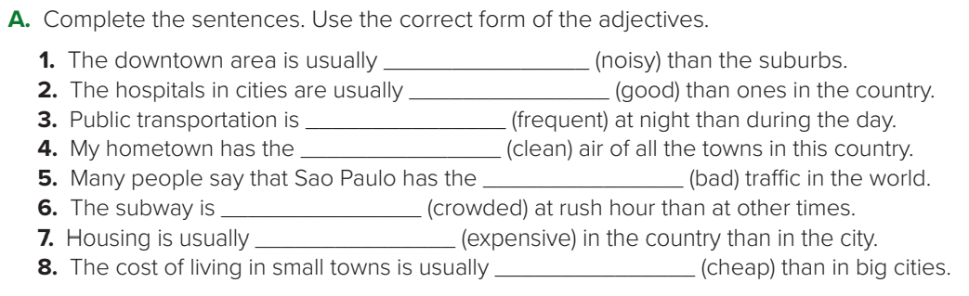
noisier
better
less frequent
cleanest
worst
more crowded
less expensive
cheaper

Slide 9



BIG
The cow is bigger than the cat, but the elephant is the biggest of them all.

Slide 10

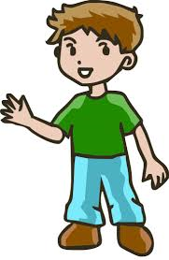
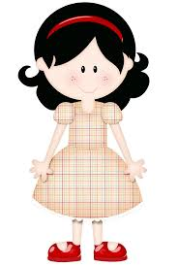
Old
TIM
ANNA
LORA
Tim is older than Lora, but Anna is the oldest of them all.

Slide 11
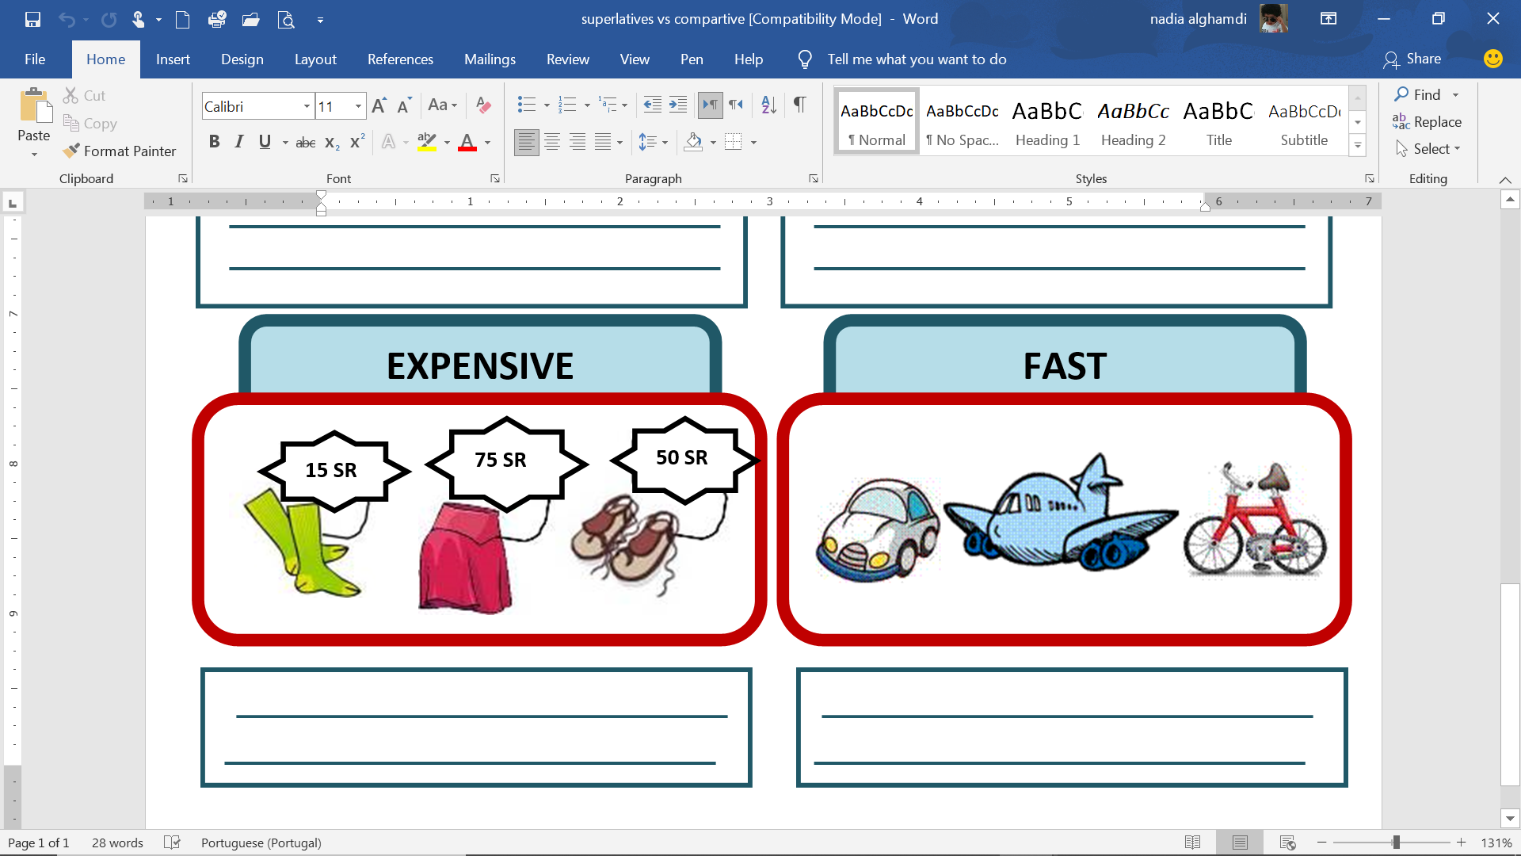
Expensive
The shoes are more expensive than the socks, but the skirt is the most expensive of them all.

Slide 12
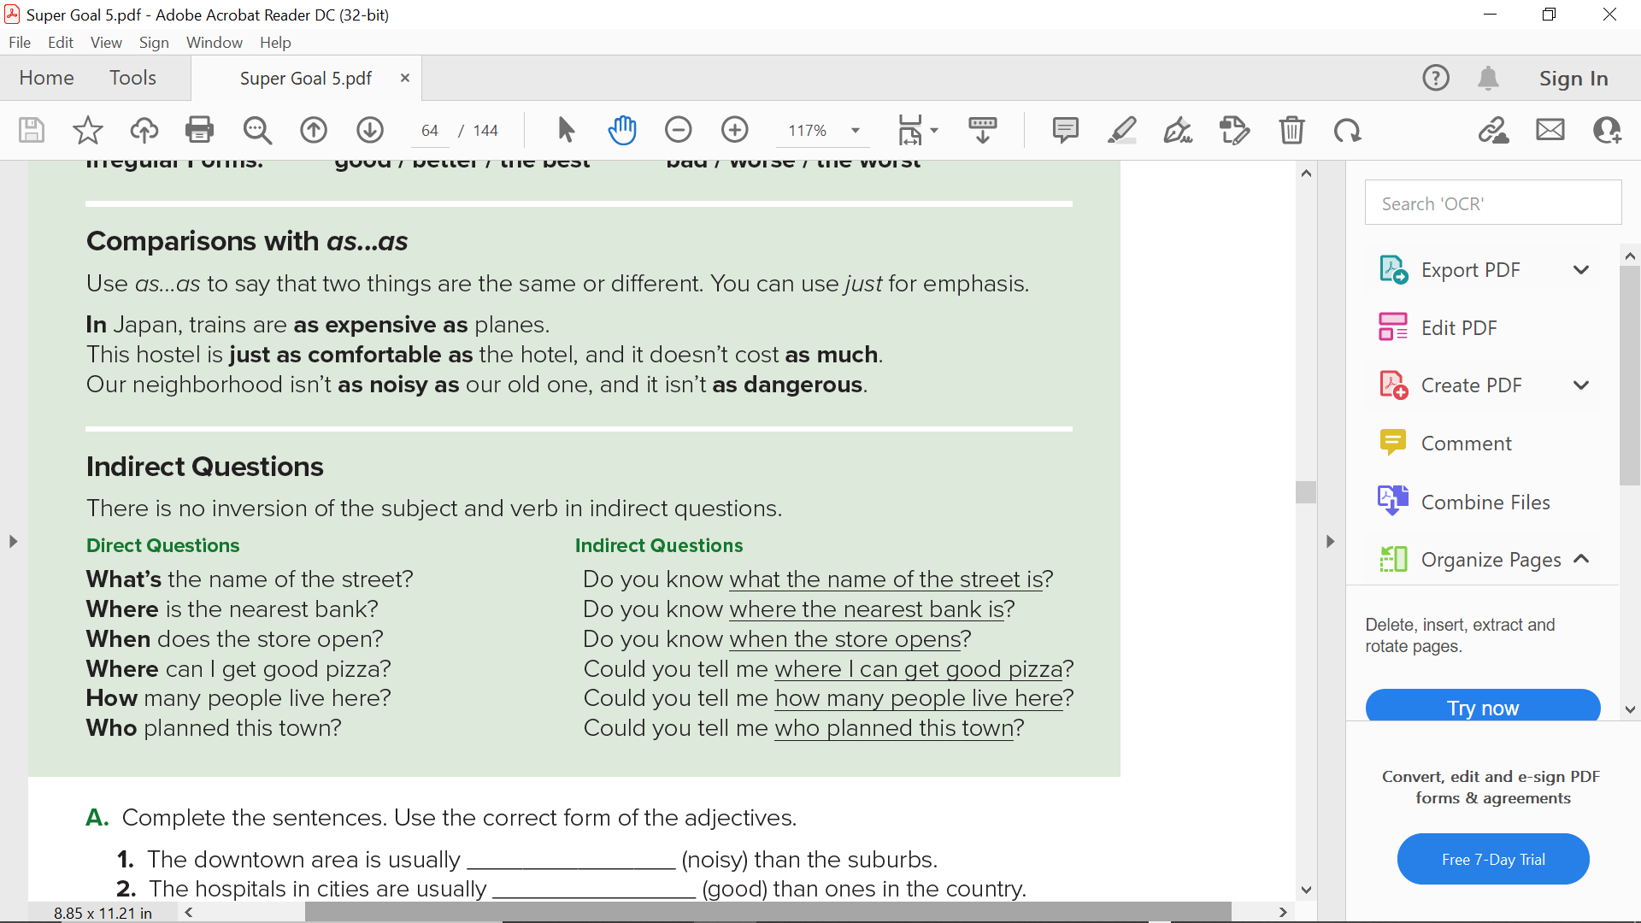

Slide 13
“ as …… as” = the same
It is used with long and short adjectives.
 as + adj + as
 We add not when it is not the same.
not + as + adj + as
Long Adjectives | Short Adjectives
e.g. beautiful 1- She is as beautiful as her sister. 2- She is not as beautiful as her sister. | e.g. happy 1-I am as happy as you. 1- 2- I am not as happy as you.

Slide 15
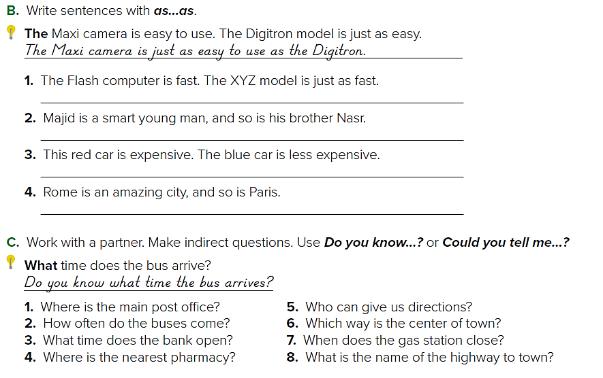
The XYZ model is as fast as the Flash computer.
Majid is as smart as his brother Nasr.
The blue car isn’t as expensive as the red car.
Paris is as amazing as Rome.

Slide 16
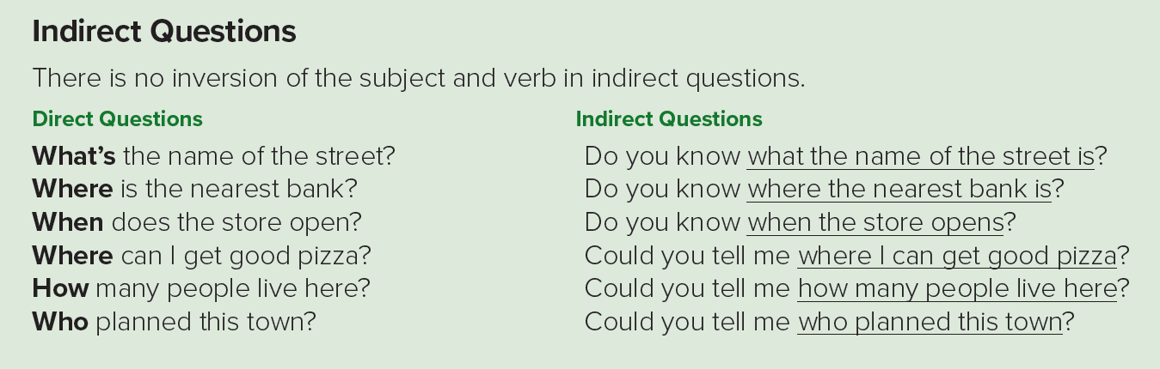

Slide 17
What's an indirect question?
Indirect questions are a more polite way to ask for information or make requests.
Here are a few common question phrases for indirect questions:
Can/Could you tell me…? Do you know…? Would you mind…? …..etc.
Forming indirect questions
Direct question: Where is the supermarket?
1. Start with the question phrase ➔ Do you know….
2- Change the order of the question ➔ Where the supermarket is
Indirect Question: Do you know Where the supermarket is ?

Slide 18


Slide 19
1. Do you know where the main post office is? / Could you tell me where the main post office is?
2. Do you know how often the buses come? / Could you tell me how often the buses come?
3. Do you know what time the bank opens? / Could you tell me what time the bank opens?
4. Do you know where the nearest pharmacy is? / Could you tell me where the nearest pharmacy is?

Slide 20
5. Do you know who can give us directions? / Could you tell me who can give us directions?
6. Do you know which way the center of town is? / Could you tell me which way the center of town is?
7. Do you know when the gas station closes? / Could you tell me when the gas station closes?
8. Do you know what the name of the highway to town is? / Could you tell me what the name of the highway to town is?

Slide 21
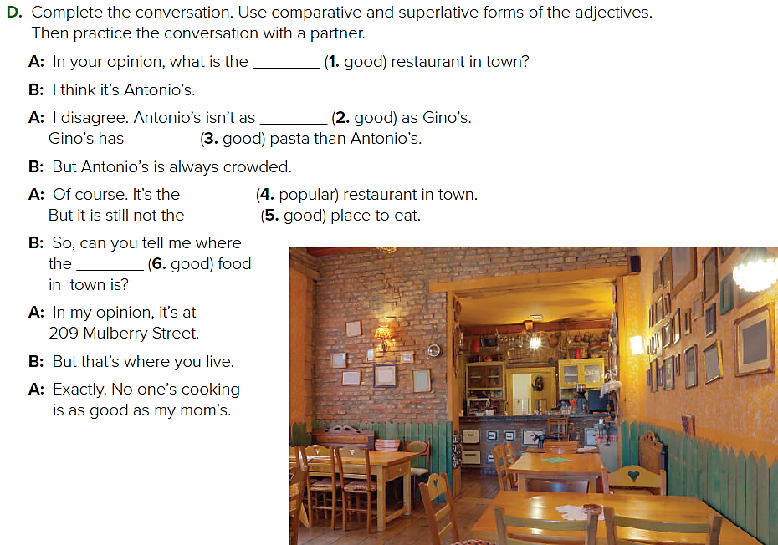
best
good
better
most popular
best
best

Slide 22
Homework!
Page 204

Slide 23
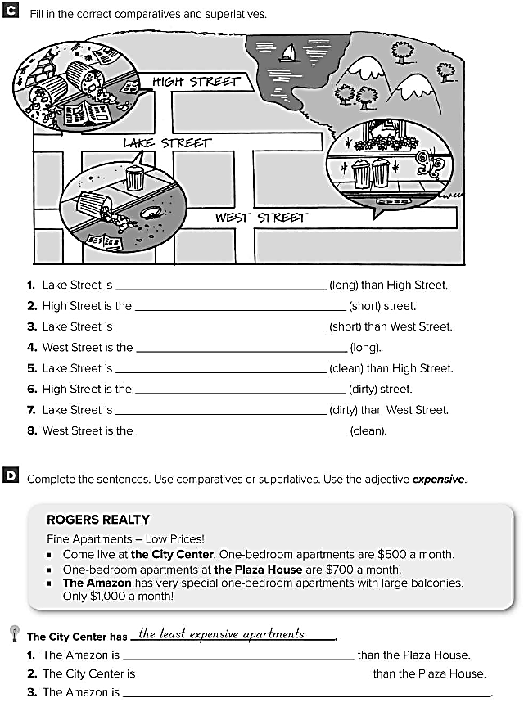
longer
shortest
shorter
longest
cleaner
dirtiest
dirtier
cleanest
more expensive
less expensive
the most expensive

