Slide 1





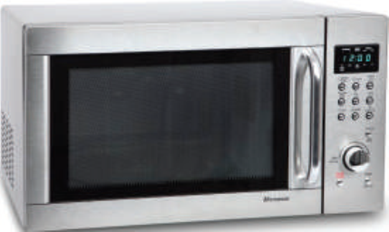
Since When?

Slide 2

8. Conversation
Objectives
Identify Contractions of have
Answer some questions through listening.
Use since and for in answering questions about themselves
Guess the meaning of new words.
Listen for specific information in a conversation

Slide 3
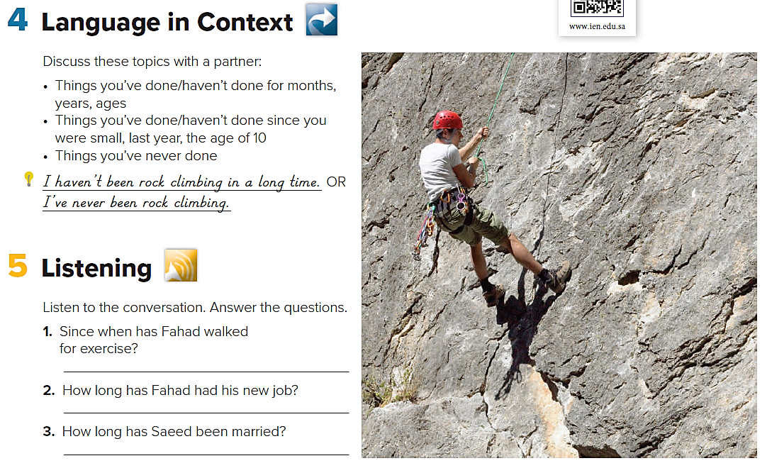
Language in Context
What have you done lately?
What haven’t you done lately?

Slide 4

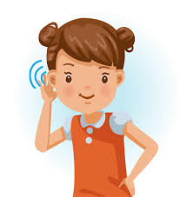
Listening
Listen to the conversation. Answer the questions.
1.Since when has Fahad walked for exercise?
2. How long has Fahad had his new job?
3. How long has Saeed been married?
Fahad has walked for exercise since he had his heart problem.
Fahad has had his new job for six months.
Saeed has been married for almost a year.

Slide 5


Slide 6
Pronunciation
Listen. Notice the contractions of have.
Then practice.
How’ve you been?
Where’ve you been?
What’ve you done?

Slide 7
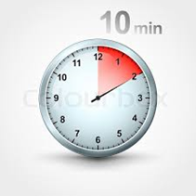
About You
1. How long have you studied English?
2. How long have you played a sport or had
a hobby?
3. How long have you had any of these items:
computer, laptop, digital camera, scooter,
cell phone?
4. How long have you gone to school?
5. How long have you lived in your house?
6. How long have you known your best friends?

Slide 8
1. I have studied English for 7 years.
2. I have played tennis since I was 8 .
3. I have had my laptop for 10 years.
I have had my cell phone since 1436.
4. I have gone to school for 9 years .
5. I have lived in my house since I was born.
6. I have known my best friends since 2013.

Slide 9
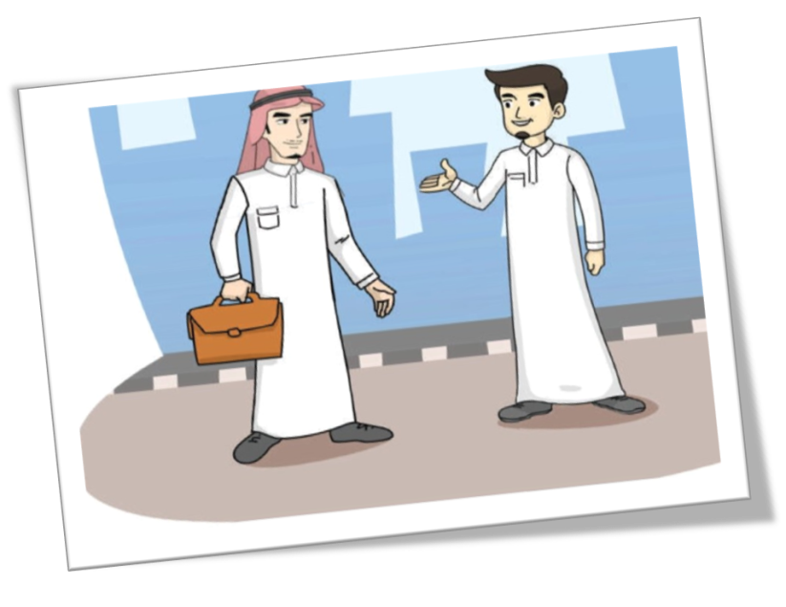
Conversation
How many people are there?
How old are they?
What do you think the relationship between them?
They haven’t seen each other for along time. What are they going to talk about?

Slide 10

Fadi: Hi. This is a surprise.
Adnan: Hi there. Long time no see.
Fadi: Yeah. We haven’t seen each other for about… er…
Adnan: Five years. Since high school.
Fadi: Has it been that long?
Adnan: Yeah. So, how are you doing?
Fadi: Great. I’m working in a bank. I’ve been in the
accounting department for a year now.
And you haven’t changed at all.
Adnan: Well, you have. You’re looking more, well,
serious. I suppose you’re happy with your job?
Fadi: Yes, very much so.
Adnan: This is good, as it is important to like one’s job.
Fadi: And what have you been up to?
Adnan: I’ve taken over my father’s restaurant. And I got married last
year.
Fadi: Really? Congratulations! I’m getting married next month. I
wanted to finish college and start a career before I settled down.

Slide 11
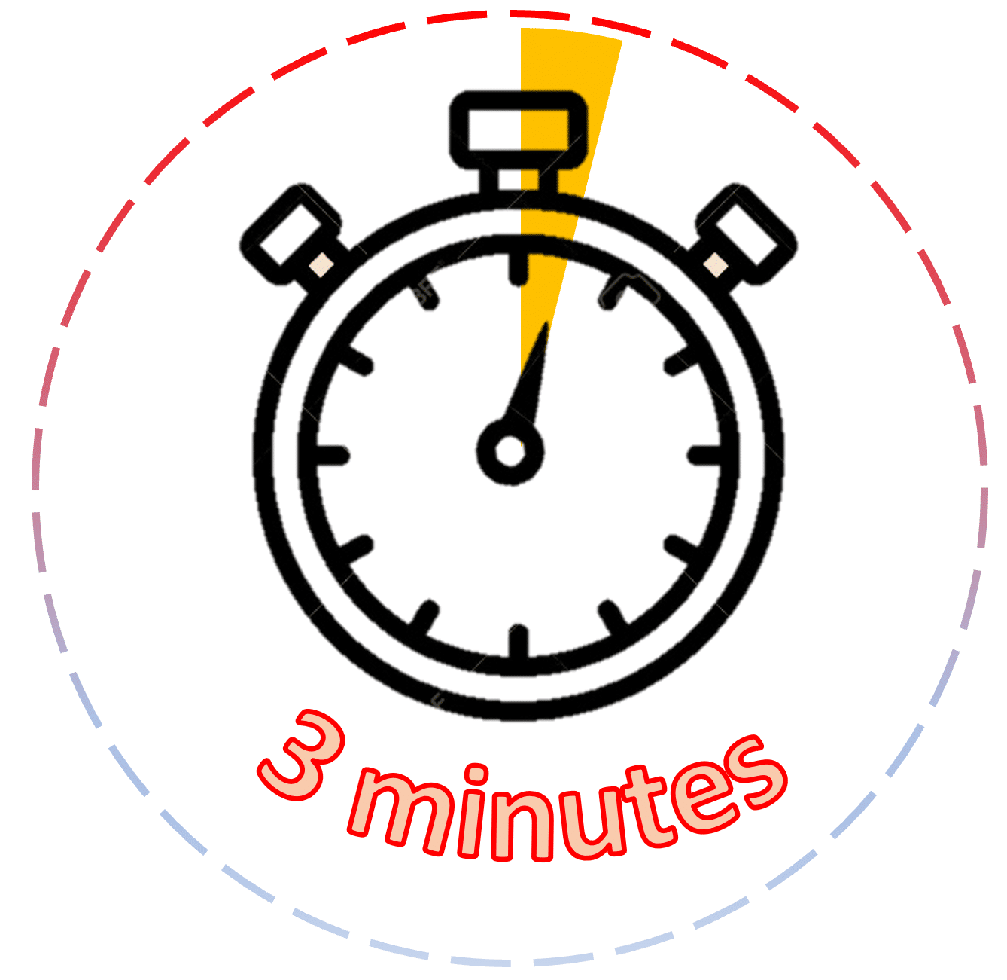
Choose the correct word to complete each sentence:
[ congratulation - serious - settle down - accounting ]
What's up - why does everyone look so …………………………?
One day I’ll want to ……………………… and make a family.
…………………………, you won the first prize in the drawing competition.
The ……………………… office checked off each worker’s dues every month.
serious
settle down
Congratulation
accounting

Slide 12
About the Conversation
How long has it been since Adnan and Fadi have seen each other?
2. Have they changed a lot?
3. Where is Fadi working?
4. How long has Fadi been working in a bank?
5. How long has Adnan been married?
They haven’t seen each other for five years/since high school.
Adnan hasn’t changed at all, but Fadi looks more serious.
Fadi is working in a bank.
Fadi has been working in a bank for a year.
Adnan has been married for about a year.

Slide 13
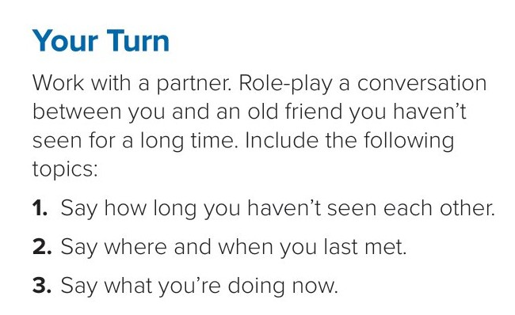

Slide 14


