Slide 1


Slide 2


Slide 3

Unit 5

Slide 4

1.Listen and discuss
Objectives
Name inventions which they use every day.
Talk about inventions.
Listen for specific information in the text.
Answer some questions.

Slide 5
What did you use while getting ready to school today?
Which of these devices do you think were invented with in the last 100 years?
How long do you think these inventions has been around?
How has these things changed people’s lives?
Which of them can’t you live without?

Slide 7
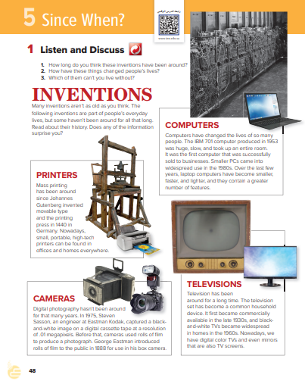
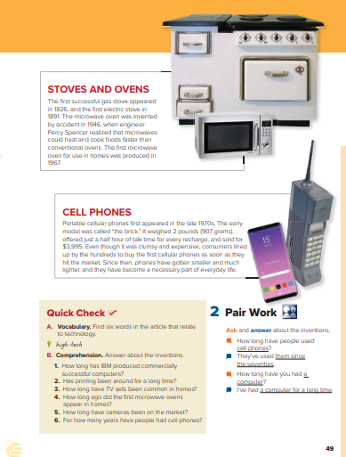


Slide 8
Can you guess the meaning of the following words;
clumsy
device
conventional
household
portable
widespread
digital

Slide 9

Find 6 words in the article that relate to technology.
High-tech
device
screens
invention
printer
computer
recharging
laptop
digital
Pcs
Television
megapixels

Slide 10

Now go to your book page 49 answer exercise B.
Comprehension [ 1 – 6 ]
3m.

Slide 11
IBM has produced commercially successful
printers since 1953/for about 60 years.
1. How long has IBM produced commercially
successful computers?
2. Has printing been around for a long time?
3. How long have TV sets been common in homes?
4. How long ago did the first microwave ovens
appear in homes?
5. How long have cameras been on the market?
6. For how many years have people had cell
phones?
2. Printing has been around since 1440/for almost
six hundred years.
3. TV sets have been common in houses since the
1960s/for more than 50 years.
4. The first microwave oven appeared in homes
about 45 years ago.
5. Cameras have been on the market for more than
120 years/since 1888.
6. People have had cell phones for about 35 years.

Slide 12
Pair Work
Ask and answer about the inventions.
* How long have people used cell phones?
They’ve used them since the seventies.
* How long have you had a computer?
I’ve had a computer for a long time.

Slide 13
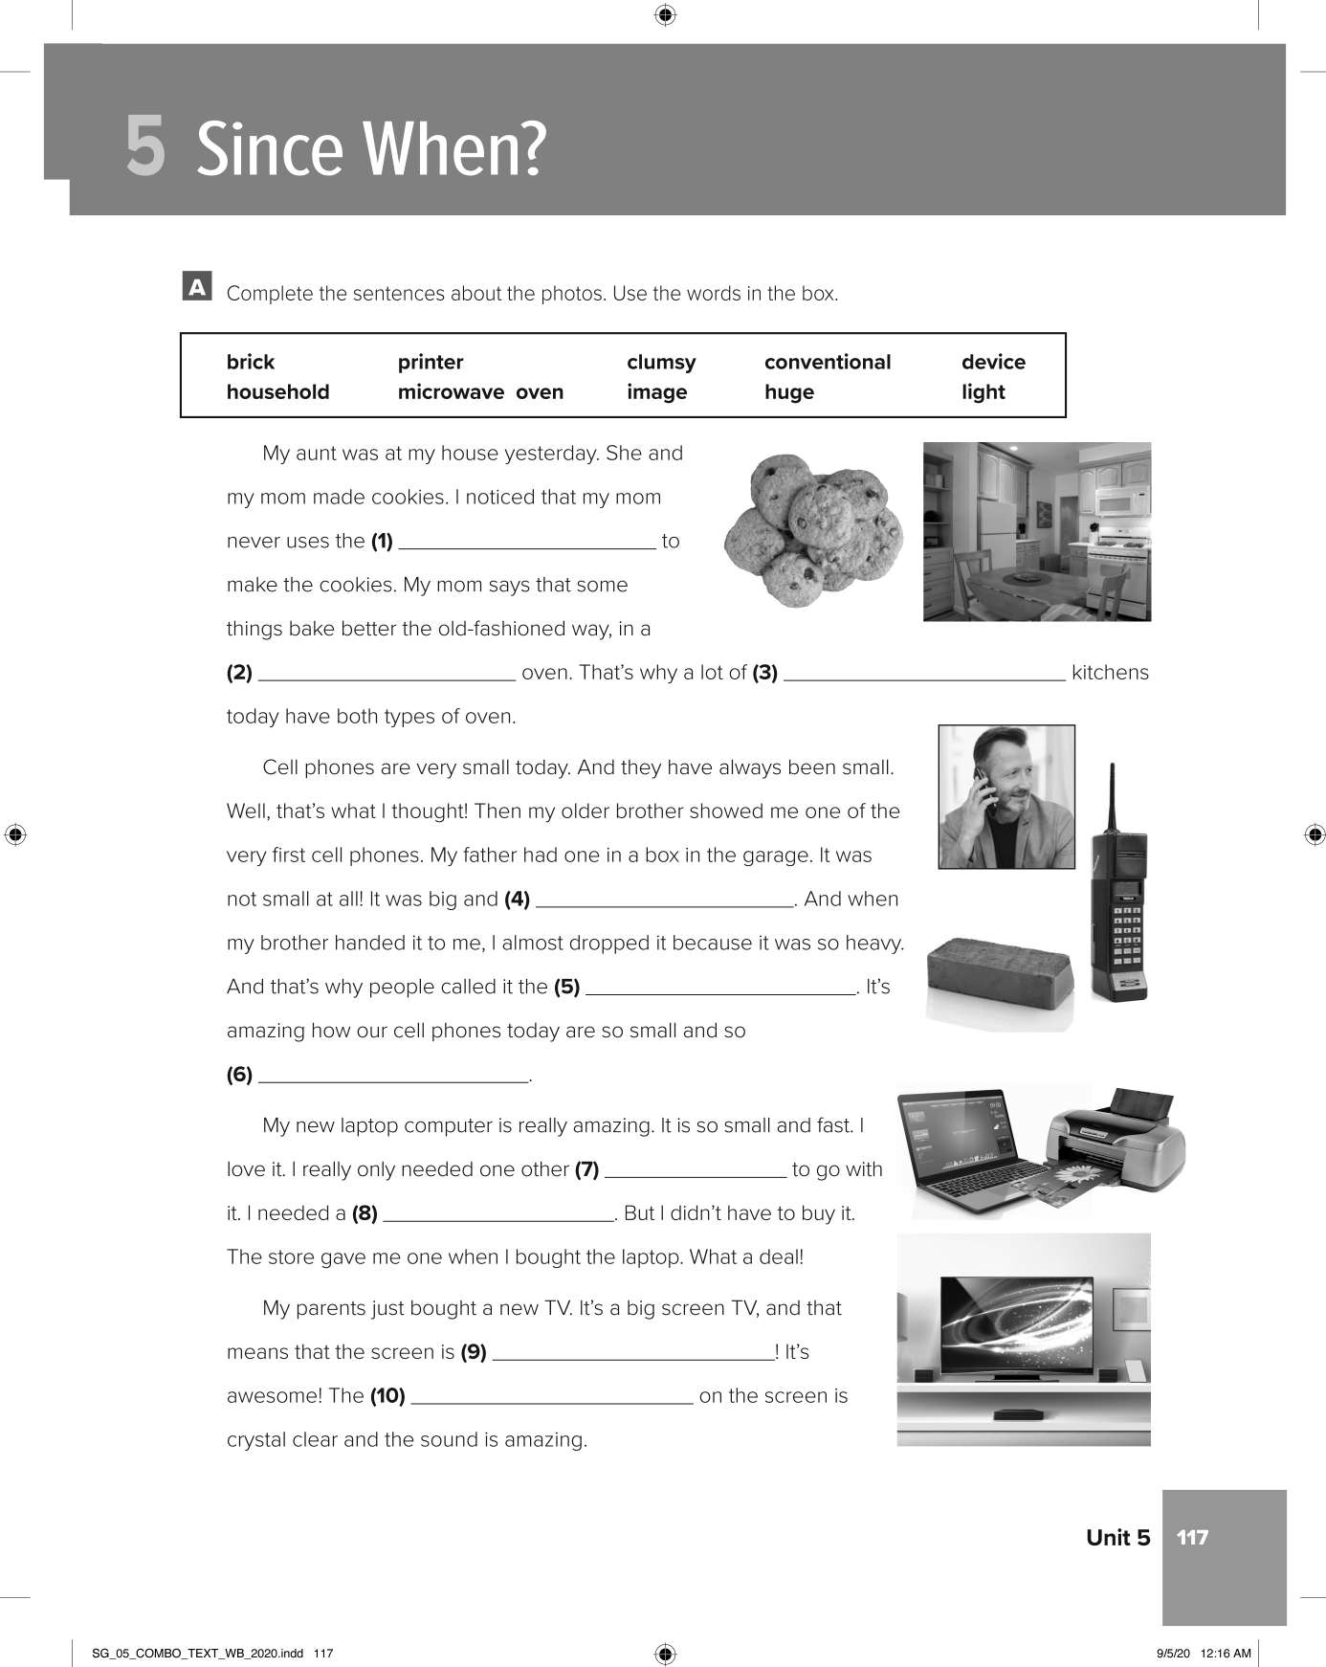
W. B. p. 179
microwave
conventional
household
clumsy
brick
light

Slide 14
device
printer
huge
image

Slide 15


Slide 16

Present Perfect simple

Slide 17
3. Grammar
Objectives
Form sentences in the present perfect.
Change sentences into questions.
Differentiate between the present perfect & past simple.
talk about old habits using (have/haven't) .

Slide 18
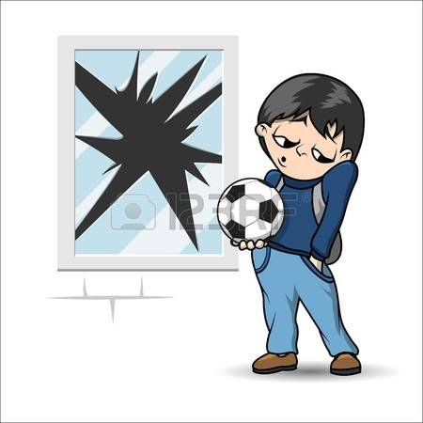
What has he done?

Slide 19
What has he done?
He
has
broken
the window.
Change into negative?
He
has
not
broken
the window
He
hasn’t
broken
the window.

Slide 20
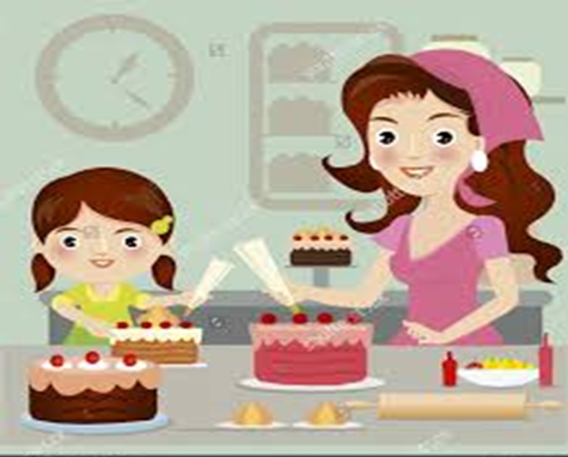
What have they done?
They
have
baked
a cake.
Change into negative?
They
have
not
baked
a cake.
They
have
n’t
baked
a cake.

Slide 21
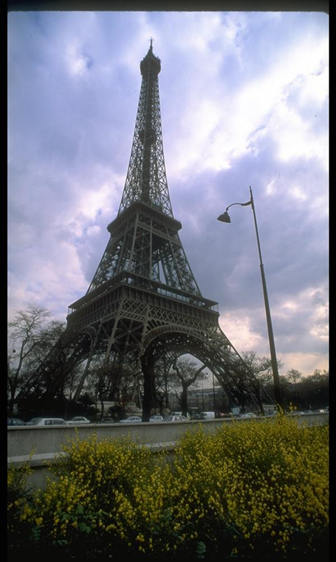
Where has Amal been?
Amal
has
been
to Paris already.
Change into negative?
Amal
has
not
been
to Paris.
Amal
has
n’t
been
to Paris.

Slide 22
She
He
It
Has
They
We
You
I
Have

Slide 23

Present perfect
has / have
V3
played
She
He
It
They
We
You
I
watched
seen
taken
cut
been

Slide 24

Short from :
She has she’s
They have they’ve

Slide 25
Choose the correct word:
I have just[ start – started – starting ] a new computer course.
We[ have had – has had– had] 2 exams so far.
I [ has – have – am ] been to London twice.
They haven’t [ go – went – gone ] to school yet.
[ She – You – We ] has read the book before.

Slide 26
Form a Yes / No question.
He has broken the window.
Has
he
ever
broken the window?
Yes,
has.
he
No,
he
hasn‘t.

Slide 27
Form a Yes / No question.
They have baked a cake.
Have
they
ever
baked a cake?
Yes,
they
have.
No,
they
haven‘t.

Slide 28
Form a Yes / No question.
Amal has been to Paris.
Has
Amal
ever
been to Paris?
Yes,
she
has.
No,
she
hasn‘t.

Slide 29

Past simple
Present Perfect
simple

Slide 30
What has he done?
He
has
broken
the window
already.
What did he do?
He
broke
the window
yesterday.

Slide 31
What have they done?
They
have
just
baked
a cake.
What did they do?
They
baked
a cake
2 hours ago.

Slide 32
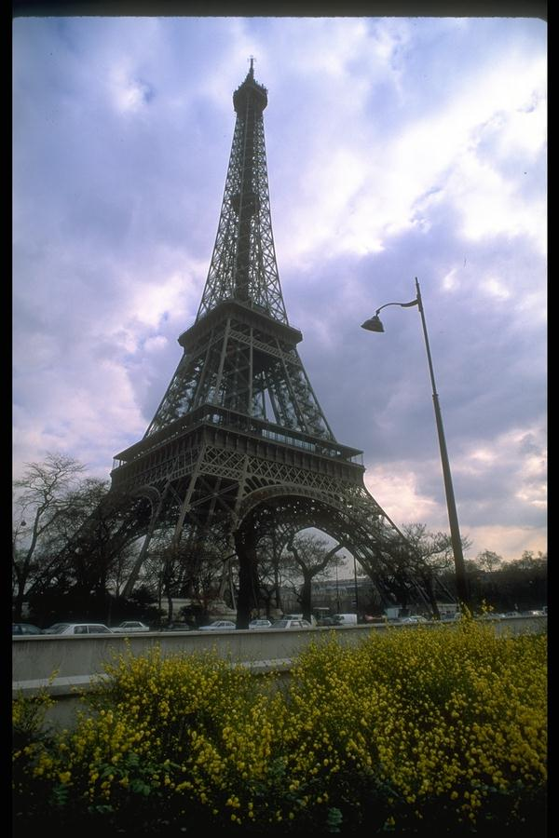
Where has Amal been?
Amal
has
been
to Paris
twice.
Where did Amal go?
Amal
went
to Paris
last year.

Slide 33
Past simple
Present Perfect simple
happened in the past at a definite time
Happened in the past, but we don’t know when
V2
has / have + V3
Ever / never / before / yet just / so far / always / already / once / since / for
Yesterday / ago / last / in

Slide 34

P. B. p. 51
1. have tried
6. built
2. invented
7. appeared
3. kept
8. have preserved
4.imported
9. became
5. put
10. have cooled

Slide 35

Present perfect
for & since

Slide 36
What time is it?
I came to school at 6:30.
When did you come to school?
It’s 11:30 now

Slide 37
How long
has
been
Amal
at school ?
6:3o 11:30
Amal
has been
at school
for
5 hours.
since
6:30.

Slide 38
Noura is helping her Mom. She started cleaning the house at 9:00 in the morning. It’s 11:00 now.

Slide 39
How long
has
been
Noura
cleaning the house ?
9:00 11:00
Noura
has been
cleaning the
house
for
2 hours.
since
9:00.

Slide 40
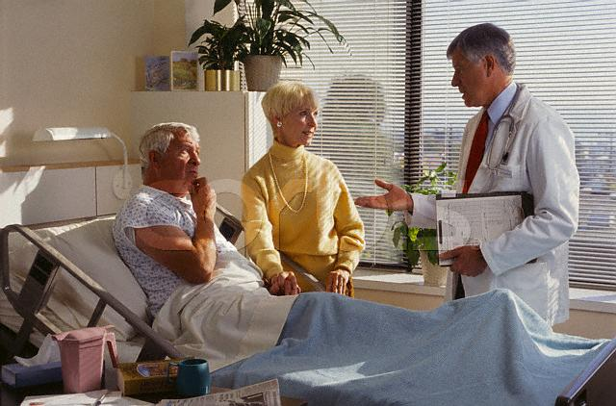
It’s Monday today and I was admitted last Friday.

Slide 41
How long
has
been
he
at the hospital ?
Friday Monday
He
has been
at the hospital
for
3 days .
since
Friday.

Slide 42
How long
For
Since
a year
2 days
4 months
9 hours
7:00
1428 H
Friday
Safer

Slide 43
Complete with “ since” or “ for”:
since
I have worked late …………… April.
2. She has been my friend …......... 6 months.
3. I have gone to school ………… a year.
4. He has been married to her ….…………
last year.
5. She has been at the center ………………
8:30.
for
for
since
since

Slide 44
Now change them into negative:
Amal has been at school for 5 hours.
Amal hasn’t been at school for 5 hours.
Noura has been cleaning the house since 9:00.
Noura hasn’t been cleaning the house since 9:00.
They have been at the hospital for 3 days.
They haven’t been at the hospital for 3 days.

Slide 45
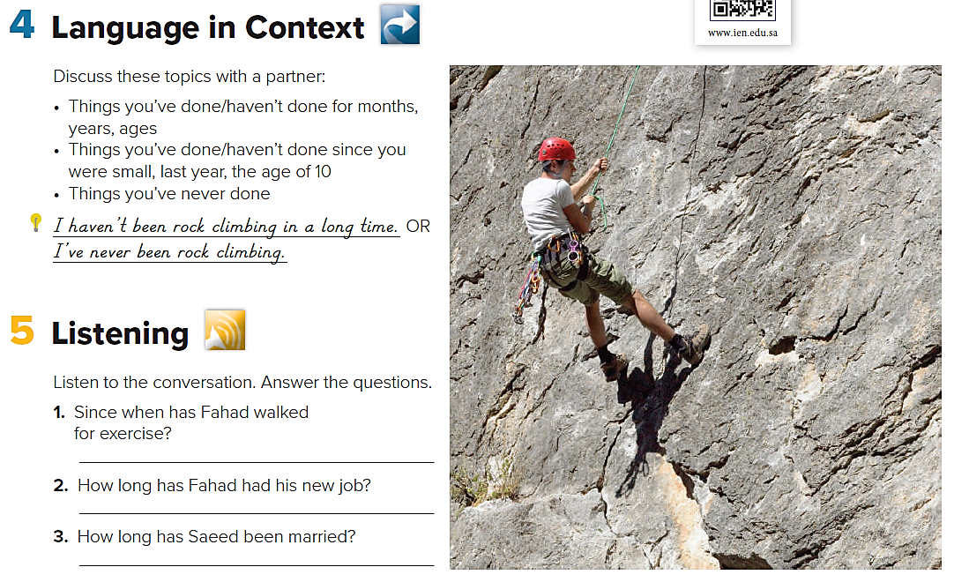
Language in Context
What have you done lately?
What haven’t you done lately?

Slide 46
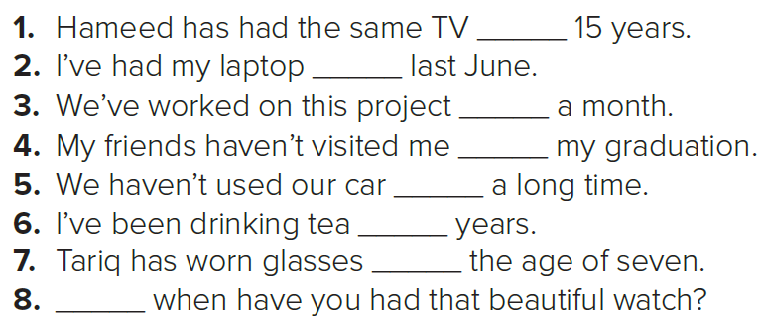
P. B. p. 50
for
since
for
since
for
for
since
Since

Slide 47
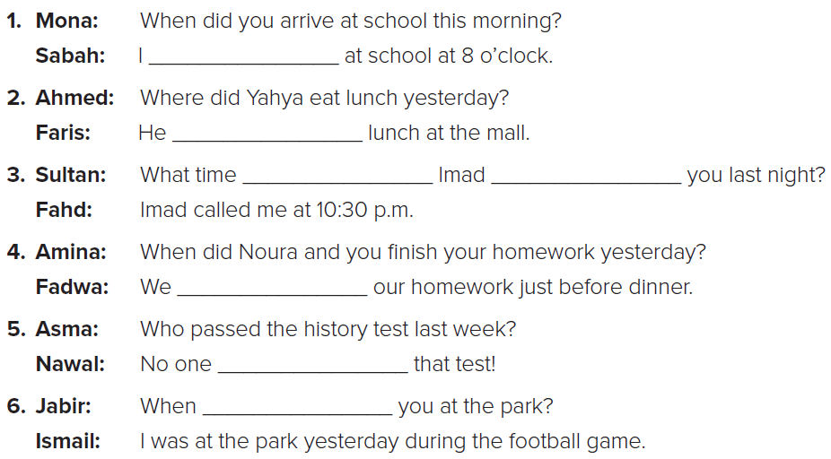
W. B. p. 118
arrived
had
did
call
finished
passed
were

Slide 48

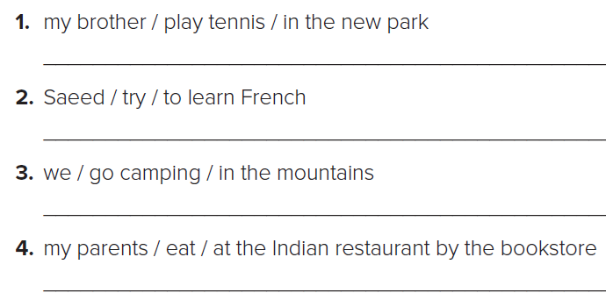
W. B. p. 118
My brother has played tennis in the new park.
Saeed has tried to learn French.
We have gone camping in the mountains.
MY parents have eaten at the Indian restaurant by the bookstore.

Slide 49

W. B. p. 118
1. Has your brother played tennis in the new park?
2. Has Saeed tried to learn French?
3. Have you gone camping in the mountains?
4. Have your parents eaten at the Indian restaurants by the bookstore?

Slide 50
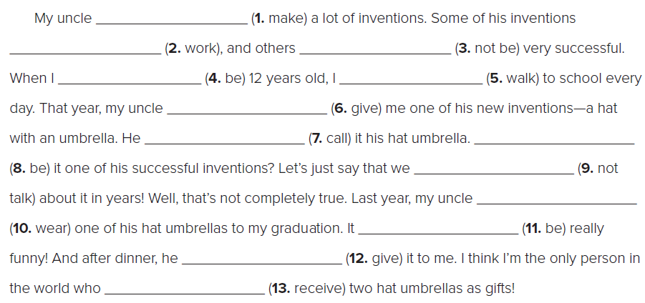
W. B. p. 118
has made
have worked
haven’t been
was
walked
gave
was
called
haven’t talked
wore
was
gave
has received

Slide 51

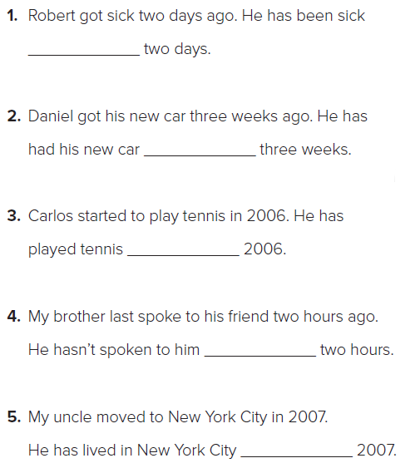
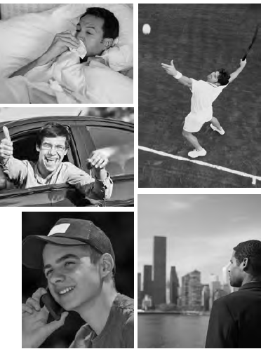
W. B. p. 118
for
for
since
for
since

Slide 52
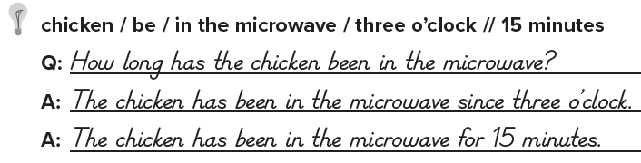
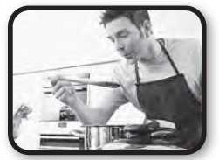
W. B. p. 118

Slide 53
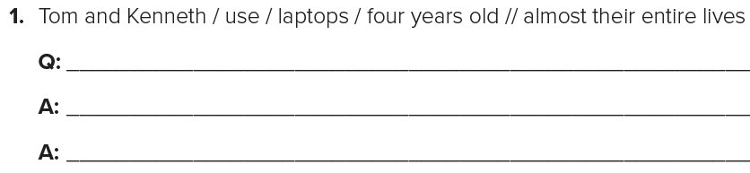
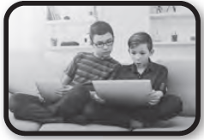
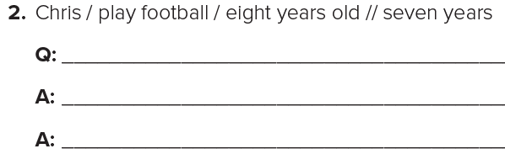
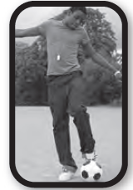
W. B. p. 118
How long have Tom and Kenneth used laptops?
Tom and Kenneth have used laptops since they were four years old.
Tom and Kenneth have used laptops for almost their entire lives.
How long has Chris played football?
Chris has played football since he was eight years old.
Chris has played football for seven years.

Slide 54
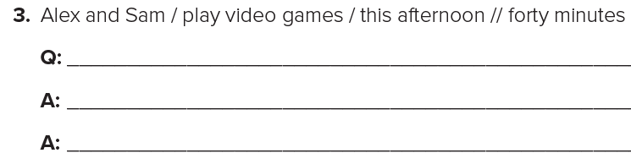
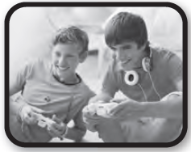
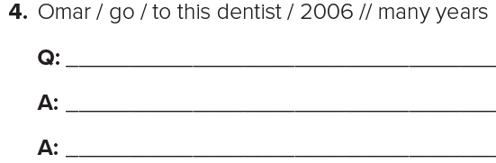
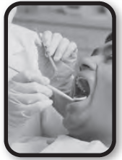
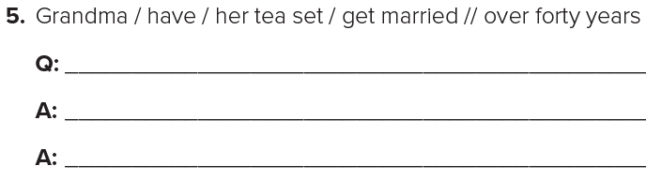

How long have Alex and Sam played video games?
Alex and Sam have played video games since this afternoon.
Alex and Sam have played video games for four hours.
How long has Omar gone to this dentist?
Omar has gone to this dentist since 2006.
Omar has gone to this dentist for many years
How long has Grandma had her tea set?
Grandma has had her tea set since she got married.
Grandma has had her tea set for over forty years.

