Slide 1

Unit 5
Since when?
Revision

Slide 2
بسم الله الرحمن الرحيم
Day:
Date:
Inventions

Slide 3
Choose the correct answer:
  She [ has – have – does ] learnt sign language already.
  They [ has – have – does ] heard the news already.
  Laila [ write – wrote – has written ] the answers yesterday.
  He [ didn't – hasn't – doesn't ] use the dictionary yet.
  Edward [ visit – visited – has visited ] the special needs center already.
  Have you ever [ seen – see – saw] the Eiffel tower?

Slide 4
Choose the correct answer:
7- My brother has ( paly – played – playing ) tennis in the park.
8-Saeed has tried to learn French ( since – for – to ) 2019.
9-Sara has lived in New York City ( since – for – to ) three years .
10- How long have you ( use – used – using ) this laptop?
11-The cake is ( make – made – making ) by Noura.
12- The store was ( open – opened – opens ) by Ali.

Slide 5
Choose the correct answer:
13. We have taken a break [ for – since – when ] 2:30.
14. She has known Noura for [ a year – 1420 H – 9:30 ].
15. They have been at our house [ for – since – when ] 3 hours.
16. Bananas [ are adored - was adored – were adored ] by monkeys.
17. The squirrel [are chased -was chased –has been chased ] by the dog yesterday.
18. The money [is counted -was counted – has been counted ] by the cashier twice so far.

Slide 6
Correct the underlined mistakes:
1. He ( work ) as a clerk for 3 years.
He has worked as a clerk for 3 years.
2. They have ( drive ) to Abha.
They have driven to Abha.

Slide 7
Make it negative:
We have visited the museum.
We have not visited the museum.
2. He has seen that movie.
He has not seen that movie.

Slide 8
Ask Yes/No Questions:
They have taken a course.
Have they taken a course?
2. She has written an essay.
Has she written an essay?

Slide 9
Ask questions using “How long”?
She has known her friend for ten years.
How long has she known her friend?
2. They have lived in London since 2007.
How long have lived in London?

Slide 10
Change into passive:
Ali changed the flat tire 2 hours ago.
The flat tire was changed by Ali.
2. I have baked a cake already..
A cake have been baked.

Slide 11
Write the word in its correct place:
Congratulations –digital –recharge –brick –device -inventions
1. ……………………… have made our lives easier.
You don't need films for ……………… cameras.
…………………………….., you won the first prize in the drawing competition.
4. I have to …………………… my cell phone every 12 hours.
5. Earlier cell phones models were called ………………… because they were so heavy.
Inventions
digital
Congratulations
recharge
brick

Slide 12
Match words with meanings:
1- settle down |  | a- stop in the middle
2- technique |  | b- succeed in doing something
3- interrupt |  | c- a new way of doing things
4- miniature |  | d- get married
5- accomplish |  | e- small model
6- innovation |  | f- a way of doing something
3
5
6
1
4
2

Slide 13
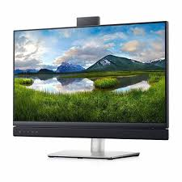
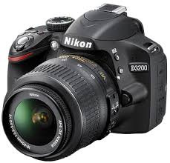
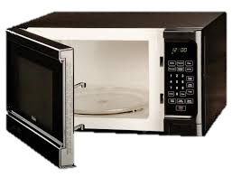
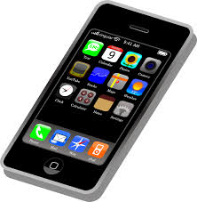
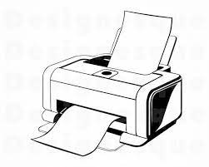
Identify the following objects:
Congratulations –digital –recharge –brick –device -inventions
screen
Camera
microwave
Cell phone
printer

