Slide 1
Oral examinations
1st semester

Slide 2
1st grade
Dear student
Pick a card
👇🏼
1
2
3
4
5
6

Slide 3


Good morning
Nice to meet you
Where are you from ?
How do you spell your first name ?
When is your birth date ?
What’s that ?

Slide 4

Good morning
Nice to meet you
Where are you from ?
How do you spell your first name ?
When is your birth date ?
What’s that ?

Slide 5
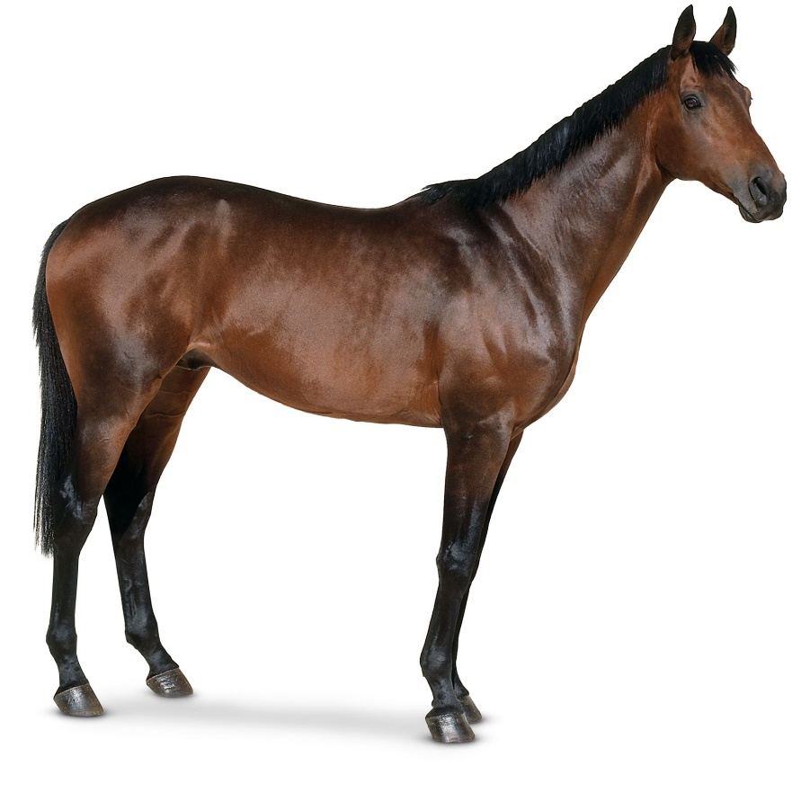
Good morning
Nice to meet you
Where are you from ?
How do you spell your first name ?
When is your birth date ?
What’s that ?

Slide 6
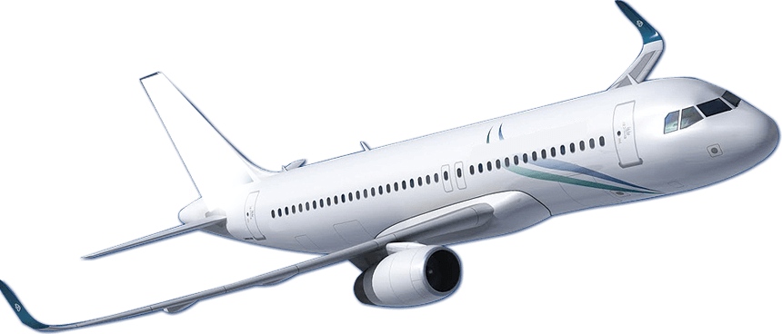
Good morning
Nice to meet you
Where are you from ?
How do you spell your first name ?
When is your birth date ?
What’s that ?

Slide 7
Good morning
Nice to meet you
Where are you from ?
How do you spell your first name ?
When is your birth date ?
What does it mean ?

Slide 8

Good morning
Nice to meet you
Where are you from ?
How do you spell your first name ?
When is your birth date ?
What’s this country ?

