Slide 1
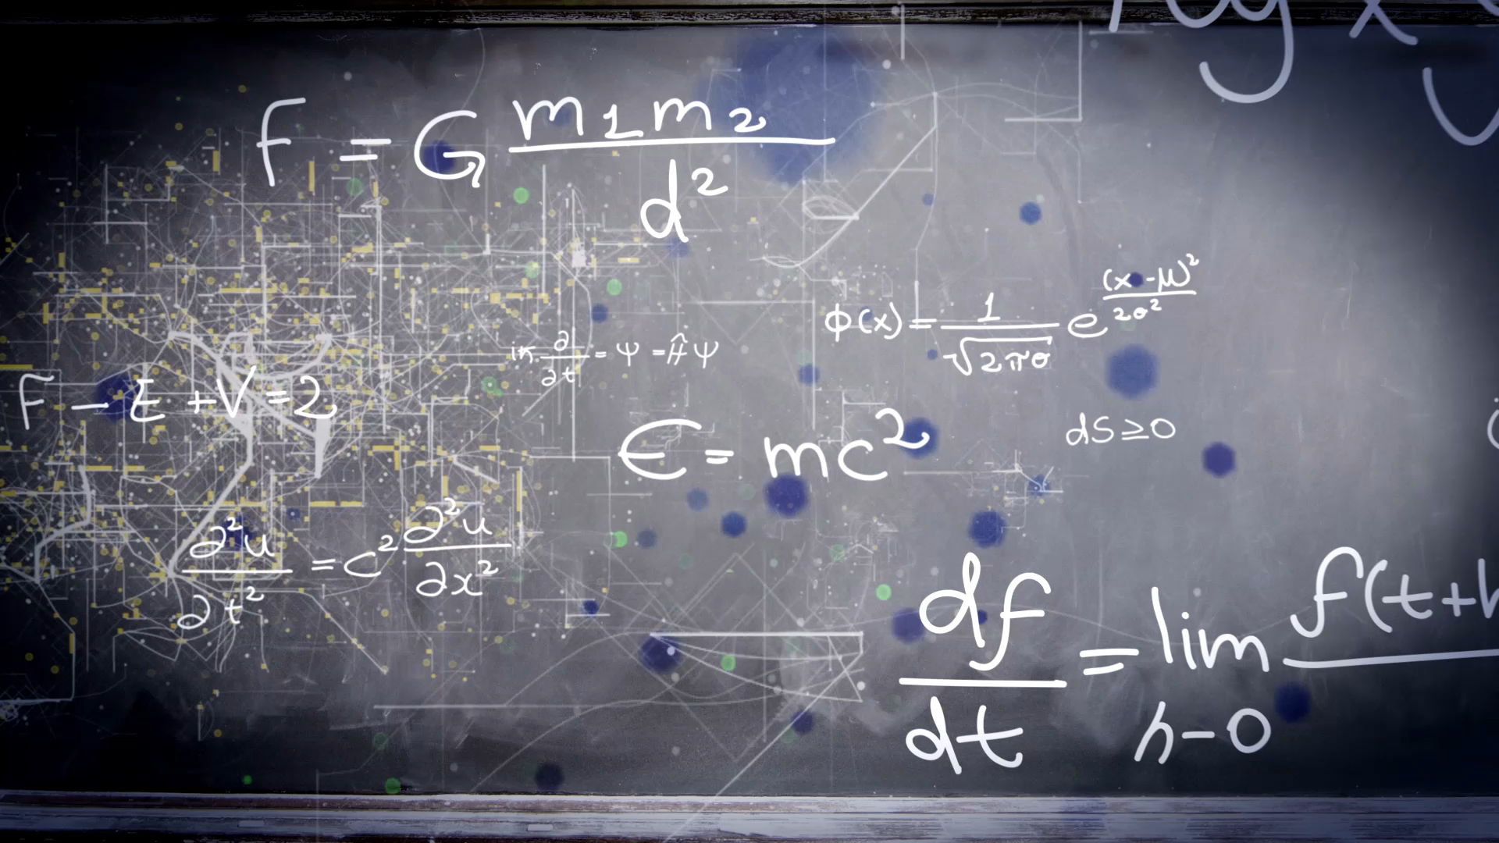
Unit 4 Around the world
Workbook pages (199 – 202)

Slide 2
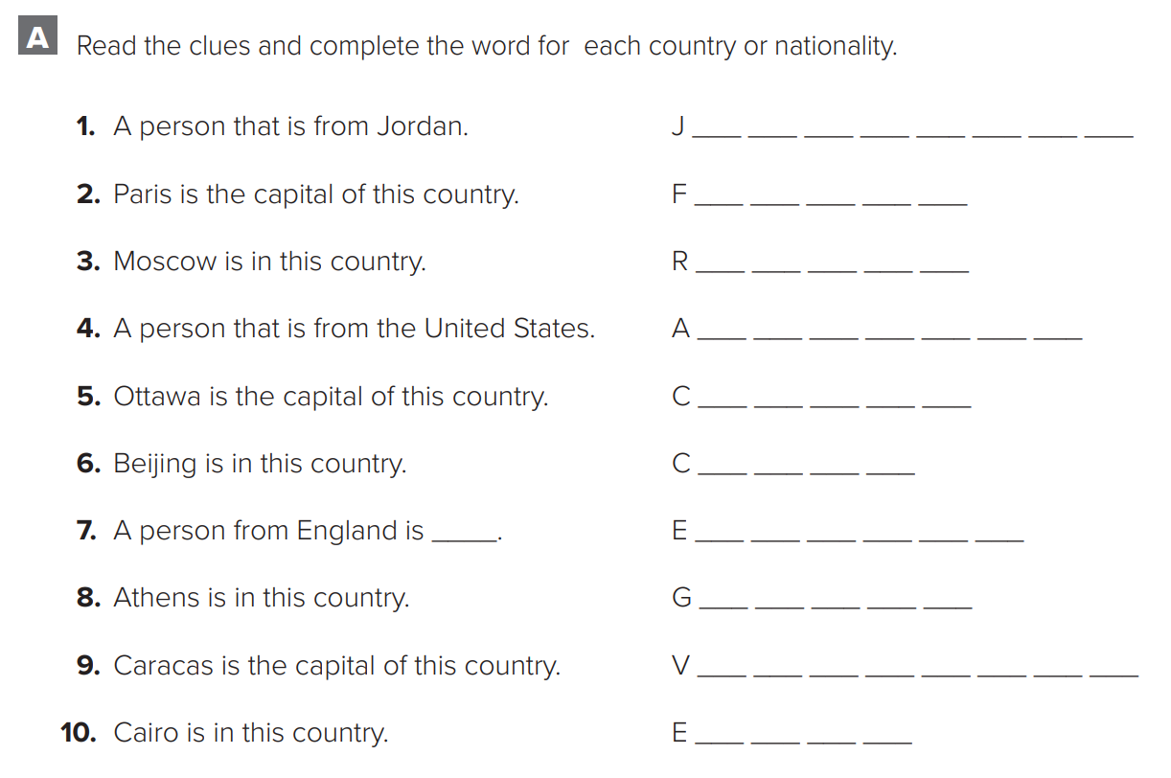

p.199
o
r
d
a
n
i
a
n
r
a
n
c
e
u
s
s
i
a
m
e
r
e
c
a
n
a
n
a
d
a
h
i
n
a
n
g
l
i
s
h
r
e
e
c
e
e
n
e
z
u
e
l
a
g
y
p
t

Slide 3
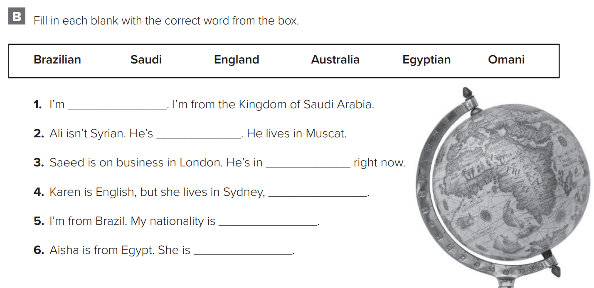

p.199
Saudi
Omani
England
Australia
Brazilian
Egyptian

Slide 4
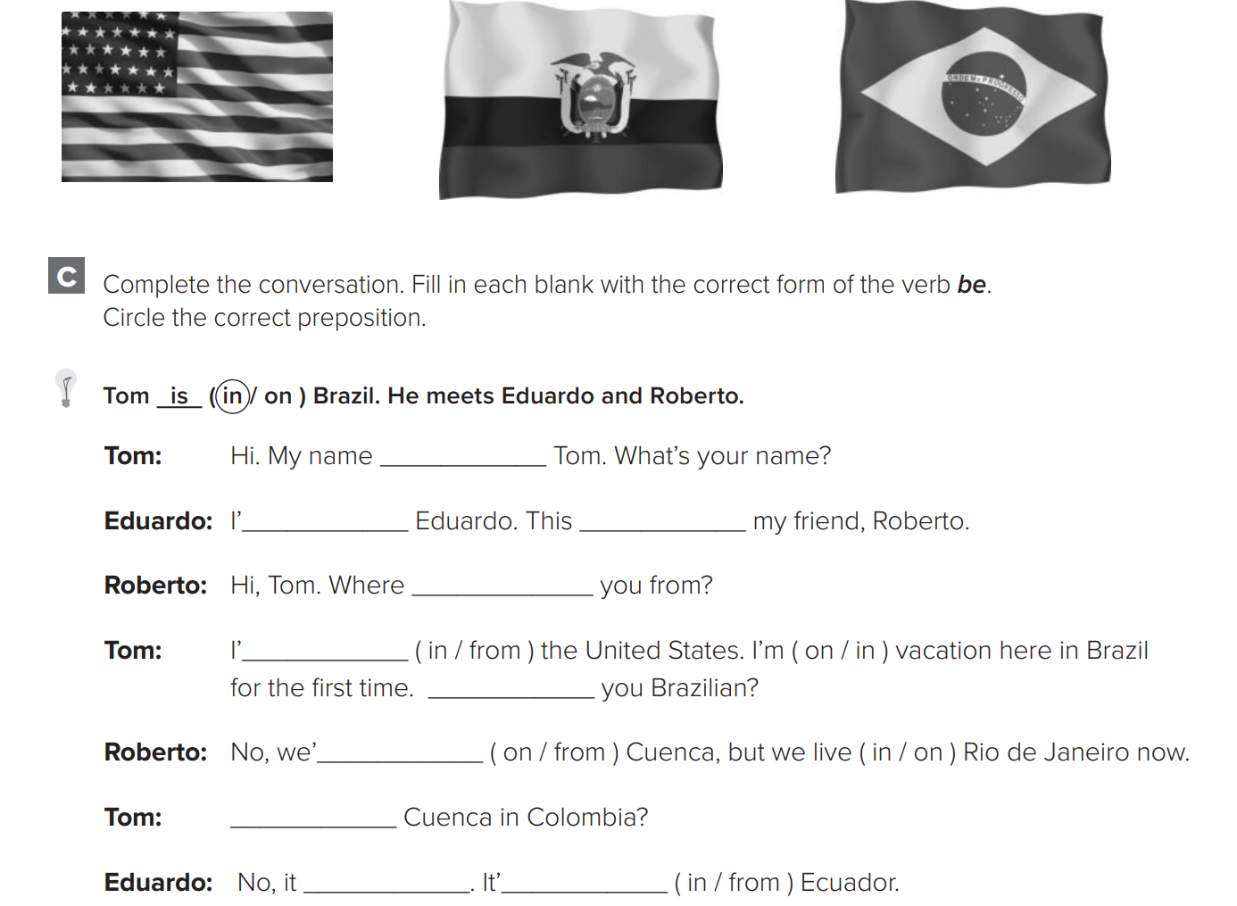

p.200
is
m
is
are
m
Are
re
Is
isn’t
is

Slide 5

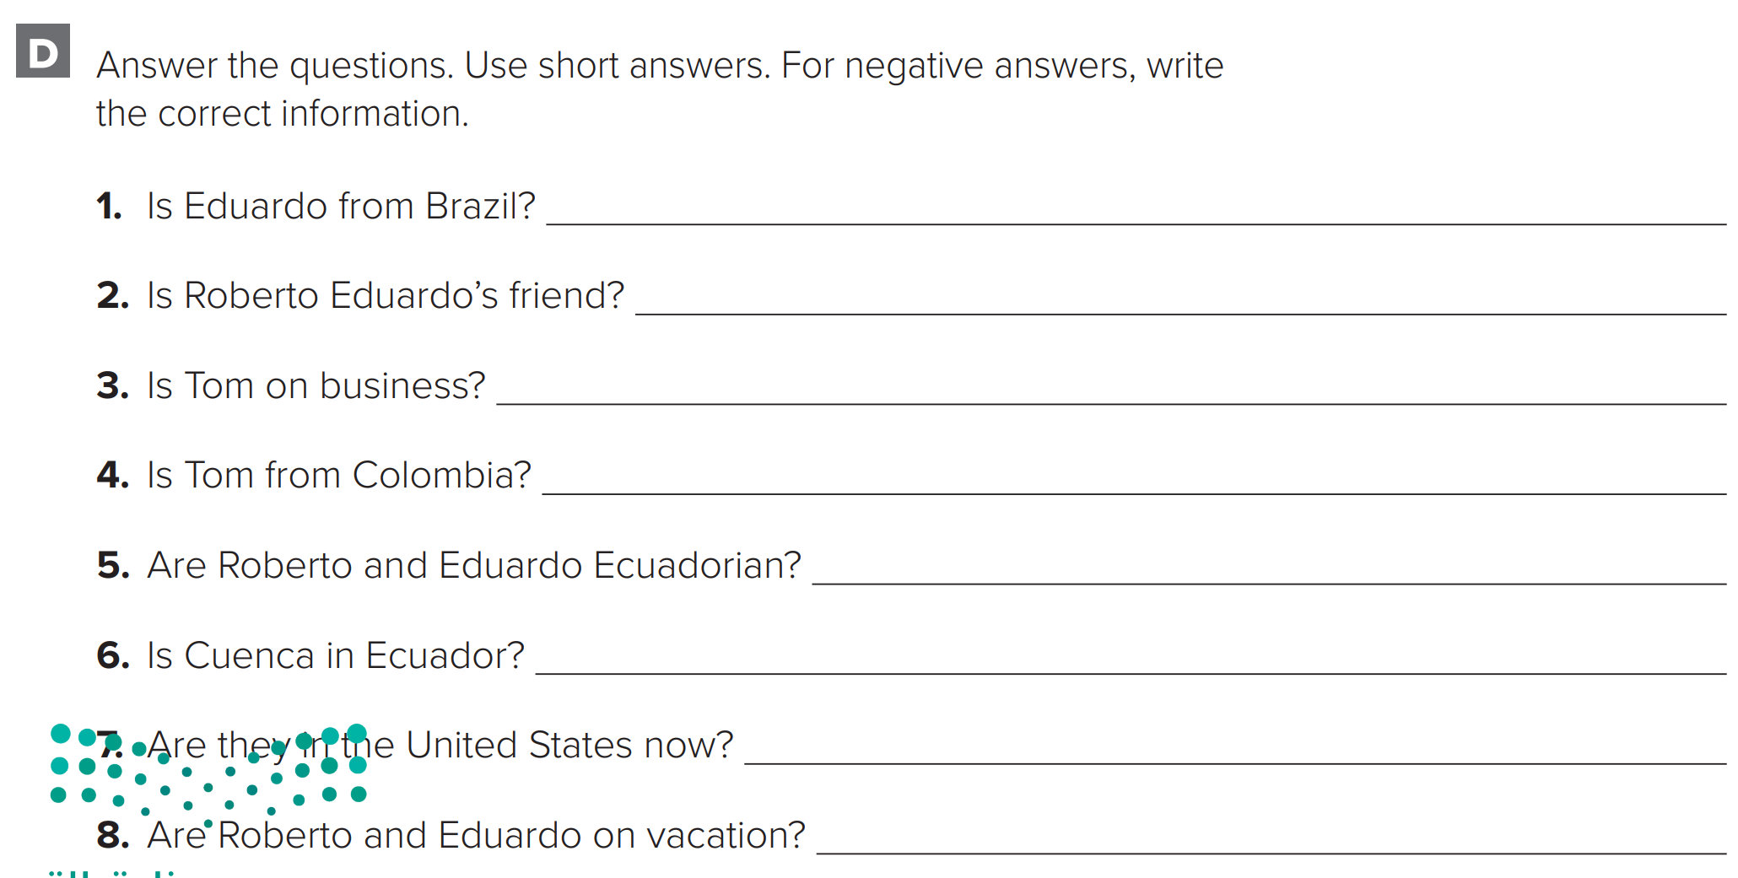
p.200
No, he isn’t. He is from Ecuador.
Yes, he is.
No, he isn’t. He’s on vacation.
No, he isn’t. He’s from the United States.
Yes, they are.
Yes, it is.
No, they aren’t. They are in Brazil now.
No, they aren’t. They live in Rio de Janeiro

Slide 6
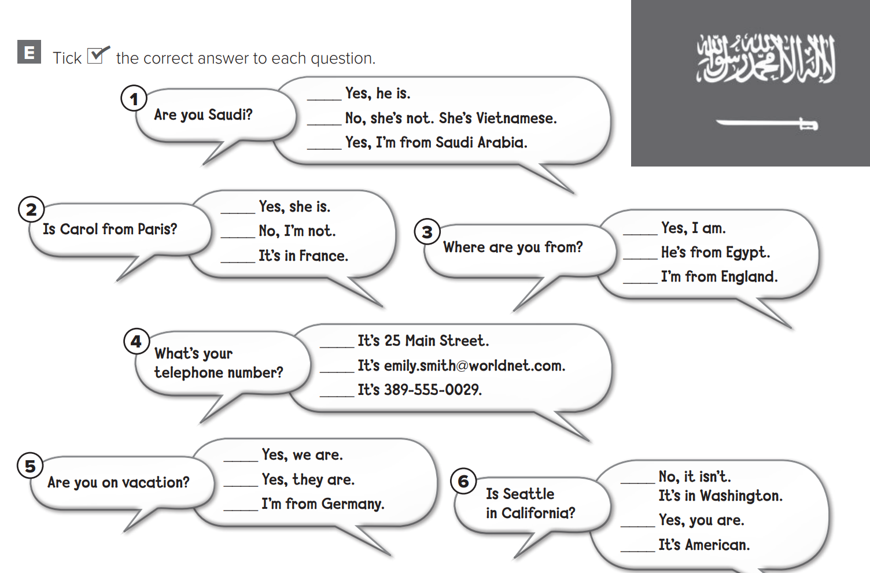


p.201

Slide 7
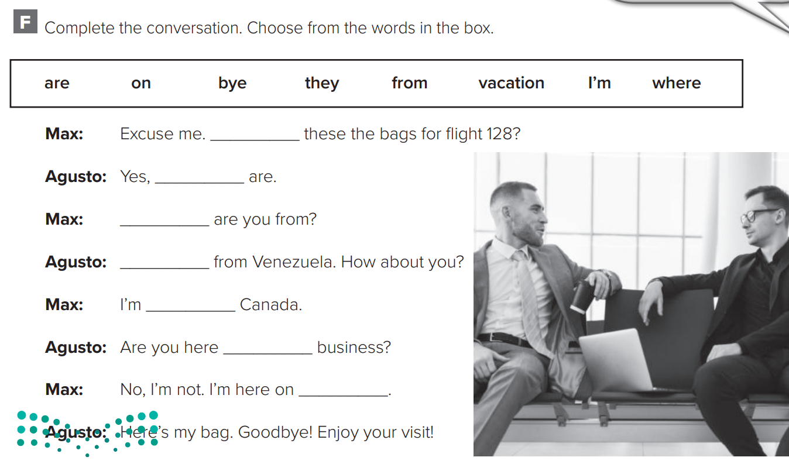
p.201
Are
they
Where
I’m
from
on
vacation

Slide 8
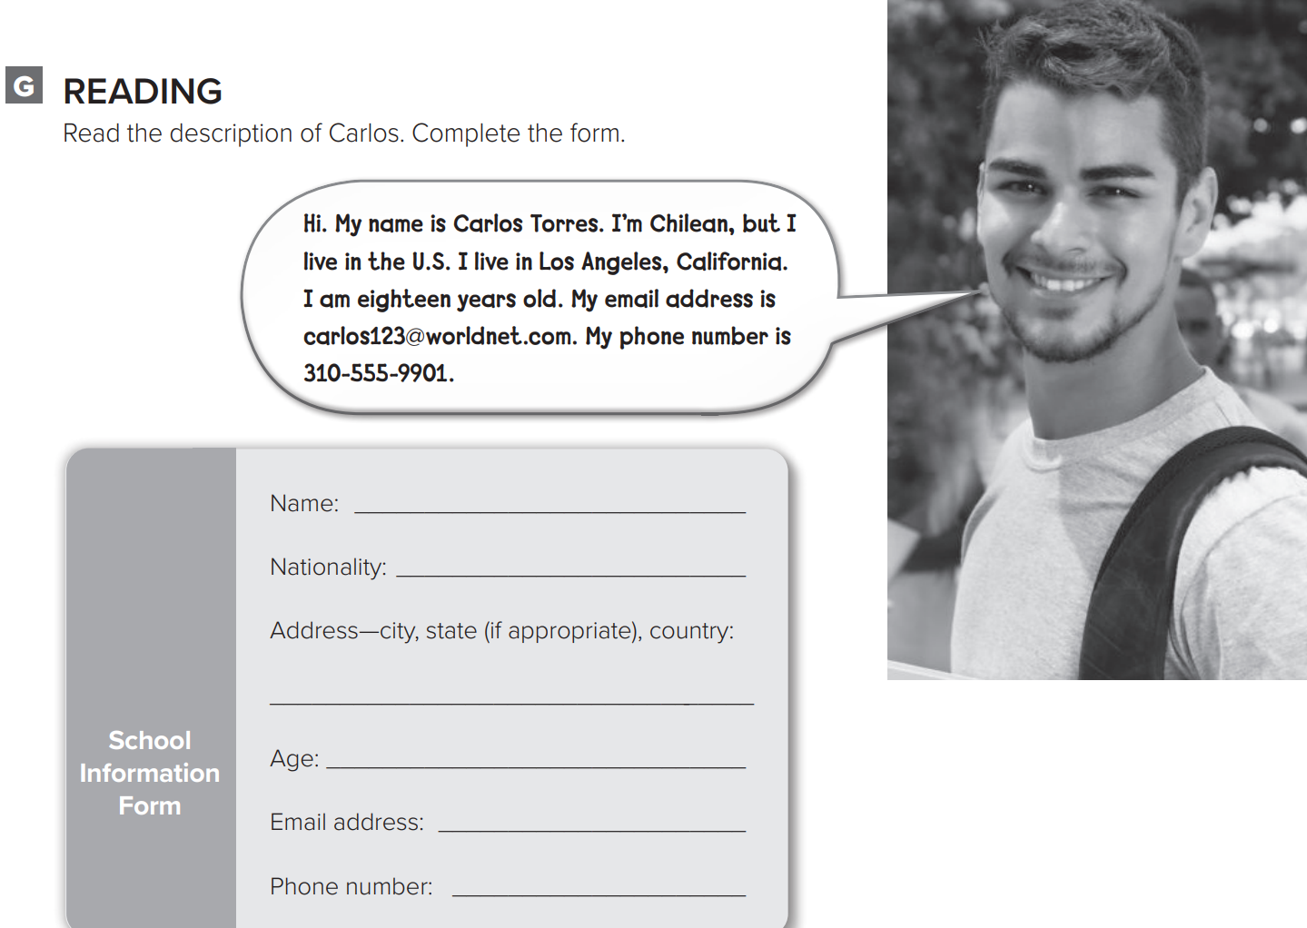

p.202
Carlos Torres
Chilean
Los Angeles, California, U.S
18
carlos123@worldnet.com
310-555-9901

Slide 9
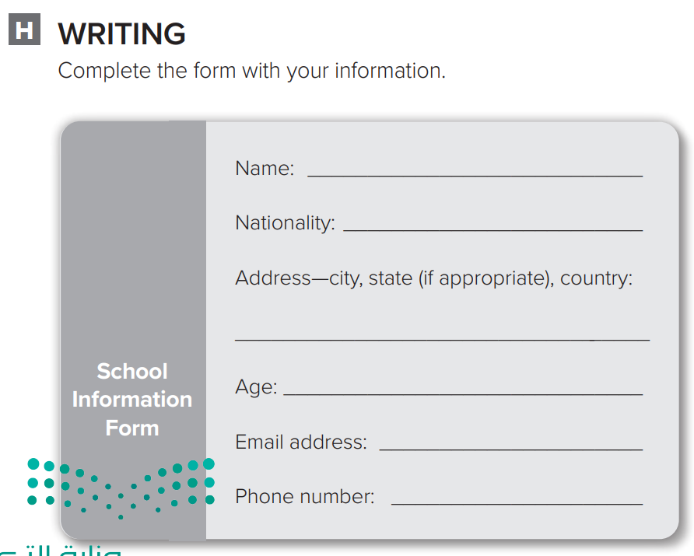
p.202

