Slide 1




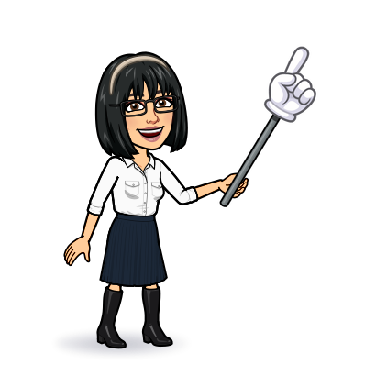

9 project
10 writing
11 form, meaning & function
Today:
Date:
- -1445
Page 40-41
By: Dalal Al-Juaid

Slide 2


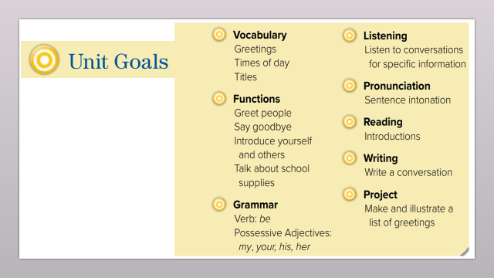
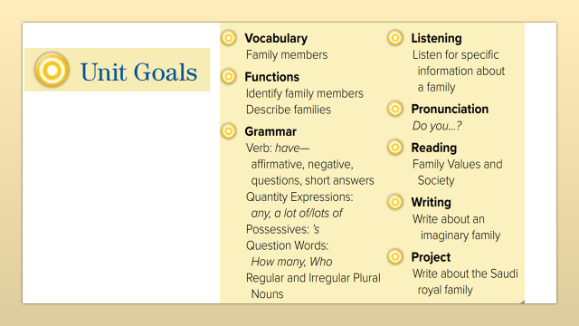
fill in a chart after reading for specific information
write a paragraph about your family
Warm up
use regular and irregular plural nouns

Slide 3
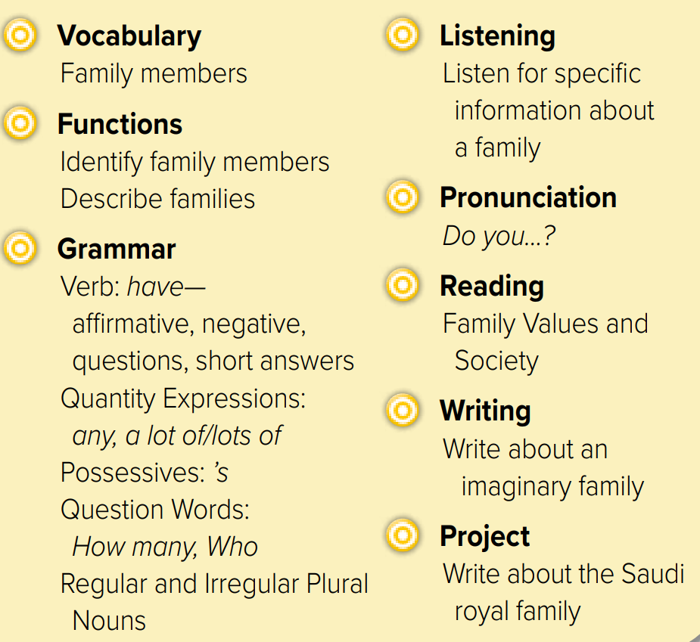
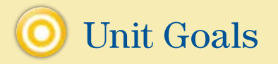

Slide 4
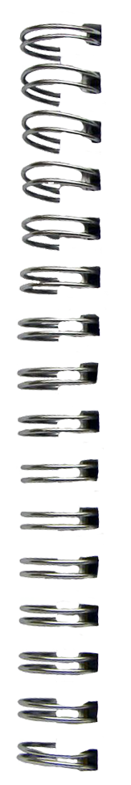
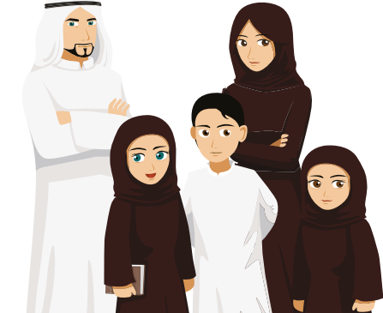





Revision
People
families
nephew
#
#
aunt

Slide 5


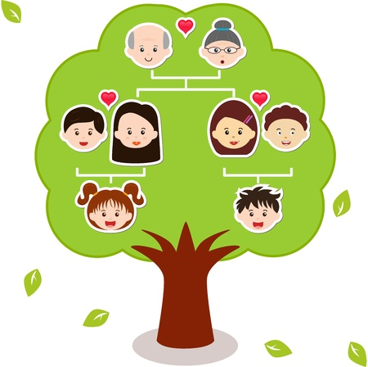

What is this ?

Slide 6

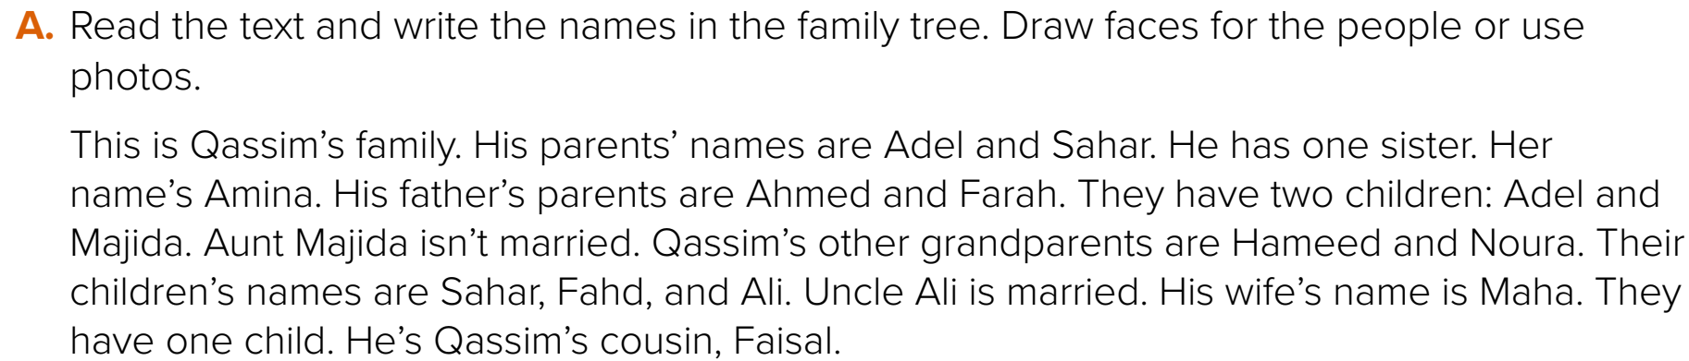
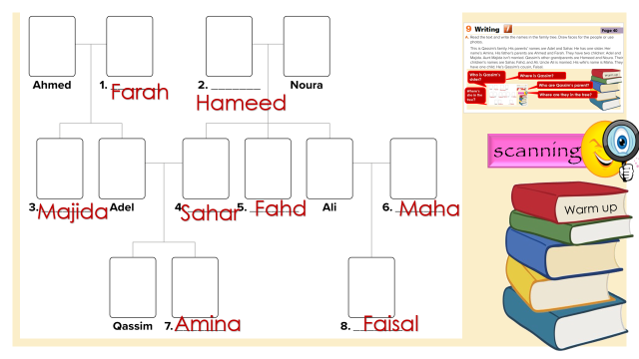
Page 40
Who is Qassim’s sister?
Where is Qassim?
Warm up
Who are Qassim’s parent?
Where’s she in the tree?
Where are they in the tree?

Slide 7
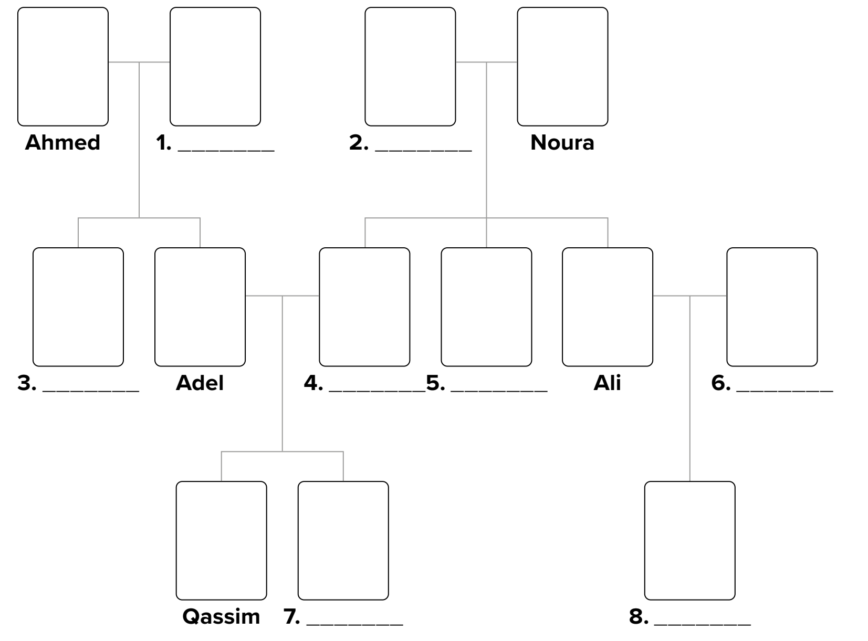

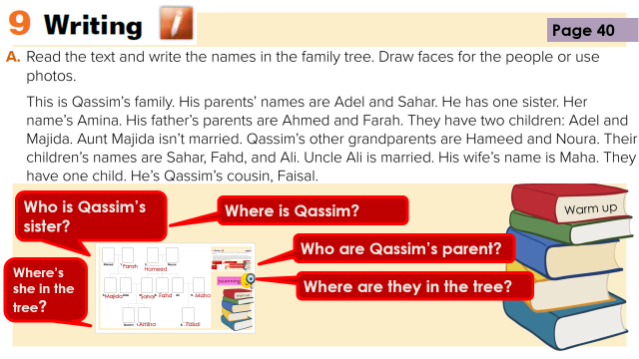
Farah
Hameed
scanning
Majida
Sahar
Fahd
Maha
Warm up
Amina
Faisal

Slide 8
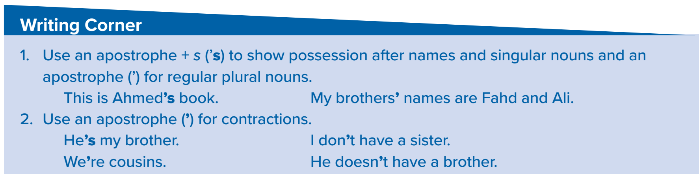




The book for Maha
Maha’s book
apostrophe
The book for the girl
The girl’s book
The book for the girls
The girls’ book
Warm up
He is
He’s
I do not
I don’t

Slide 9

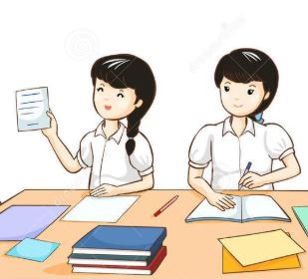

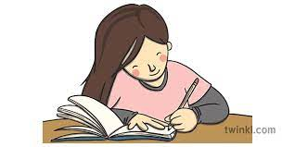


Think pair share

Slide 10
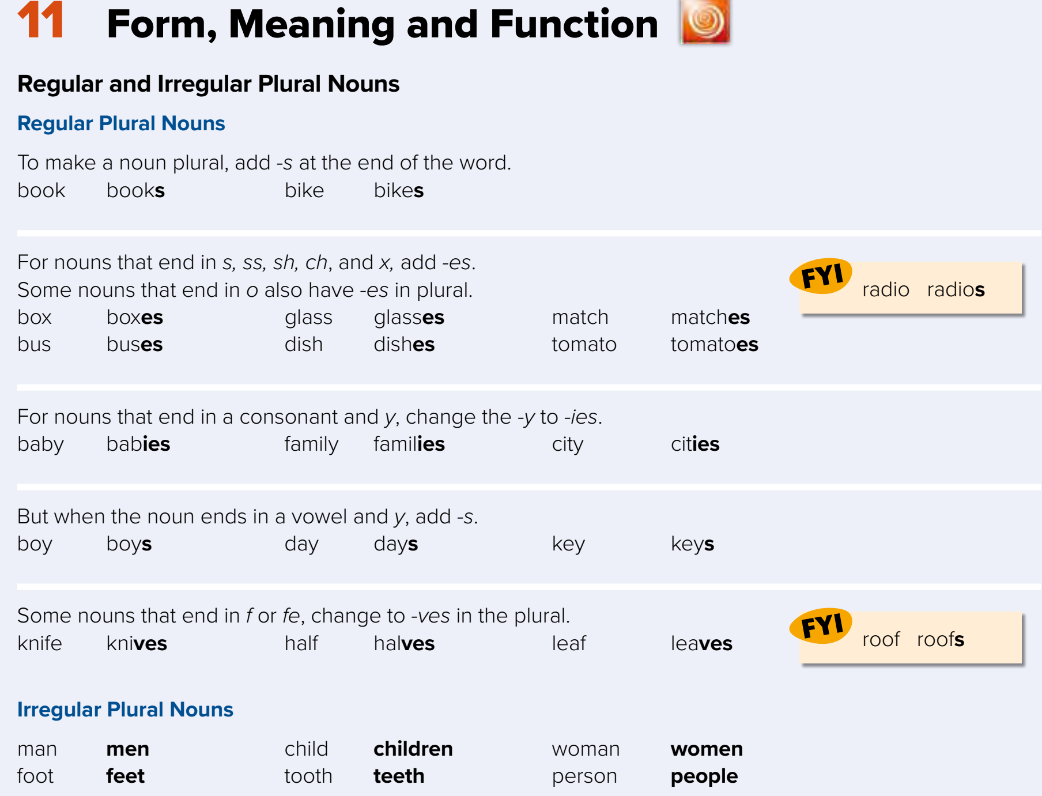






















Page 41

Slide 11

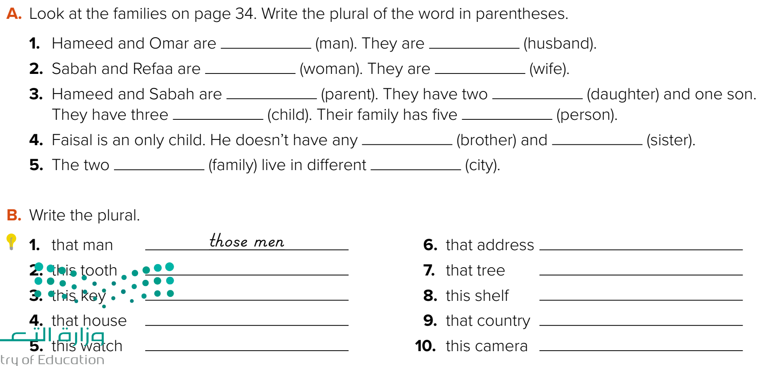
men
husbands
women
wives
parents
daughters
children
people
brothers
sisters
families
cities
Warm up
these teeth
these keys
those houses
these watches

Slide 12


Lets play
Warm up

Slide 13





page 206 Ex(I - J)
for practice writing
Warm up

Slide 14
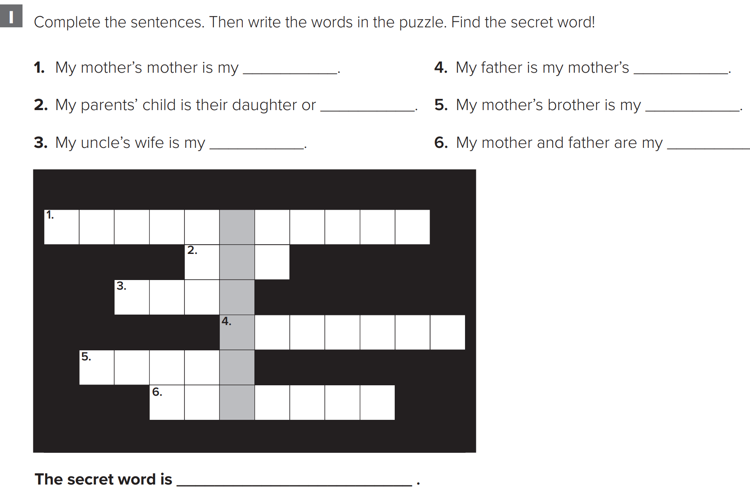
p.206
grandmother
husband
son
uncle
aunt
parents
Warm up
mother

Slide 15
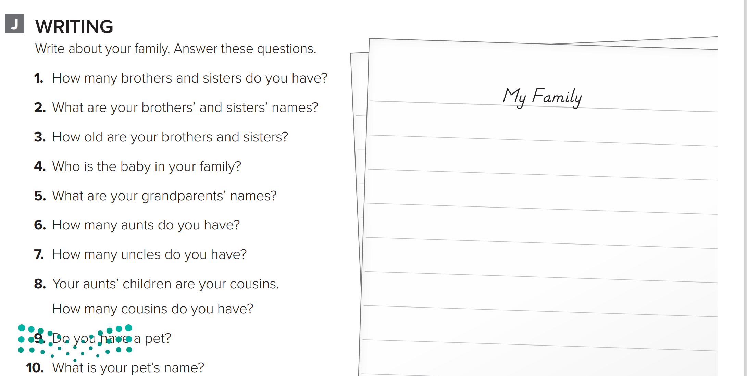
p.206
My family is big. I have one brother and two sisters. My brother’s name is Faisal. My sisters’ names are Wa’ad and Maha. Faisal is eight years old. Asma is twelve years old, and Maha is seventeen years old. Faisal is the baby in my family. My grandfathers’ names are Ali and Abdullah. My grandmothers’ names are Aisha and Noura. I have three aunts and four uncles. I have twelve cousins. I have a pet. It’s a cat. My cat’s name is Lulu.
Warm up

