Slide 1
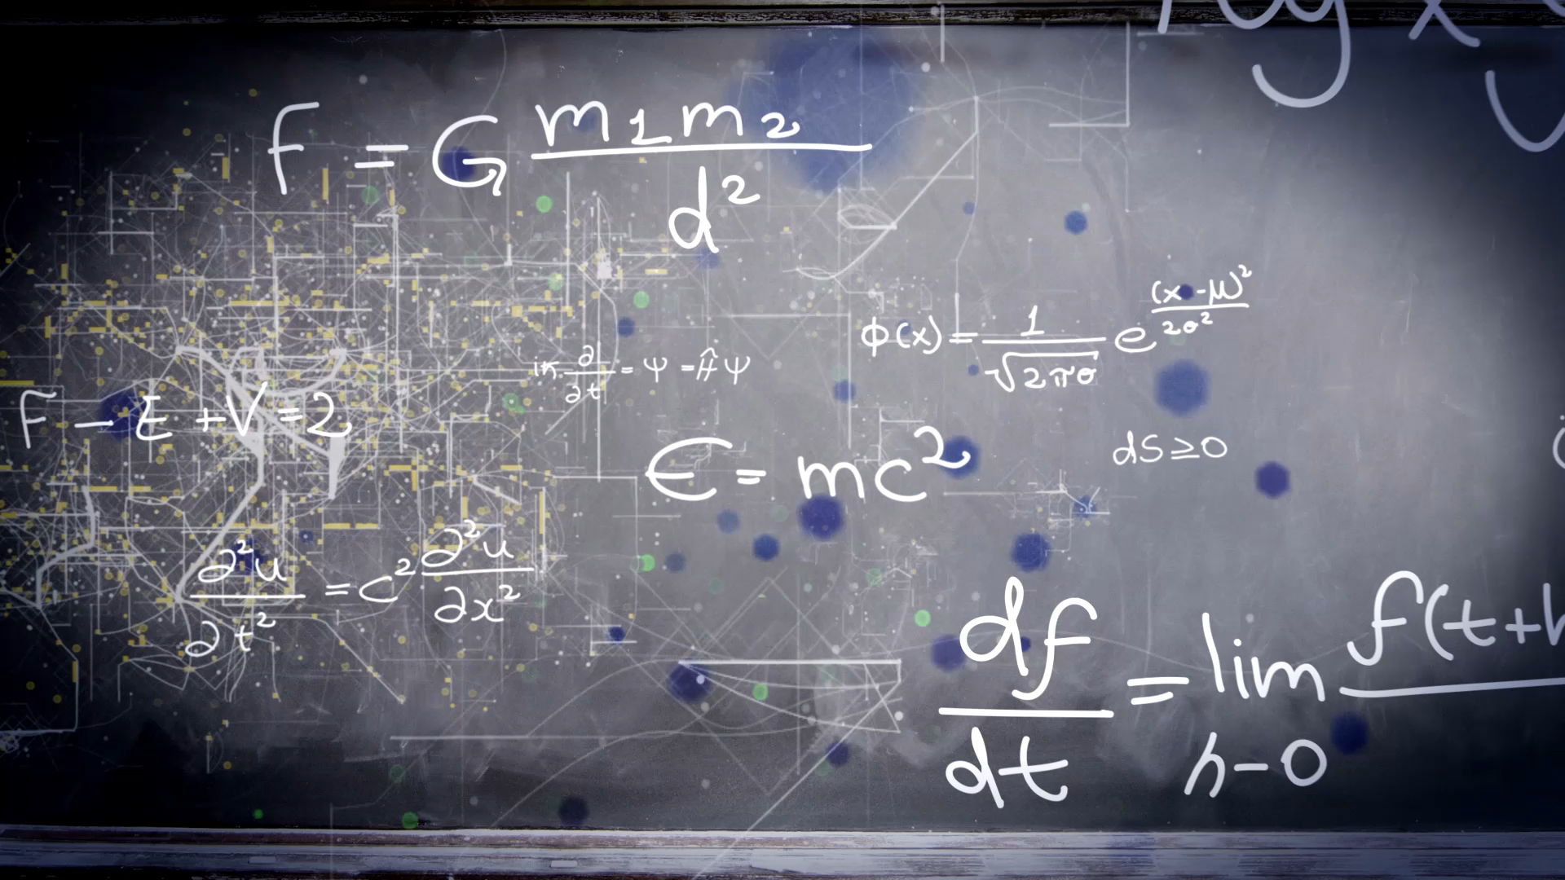
Unit 4 favorite pastimes
Workbook pages (197 – 200)

Slide 2
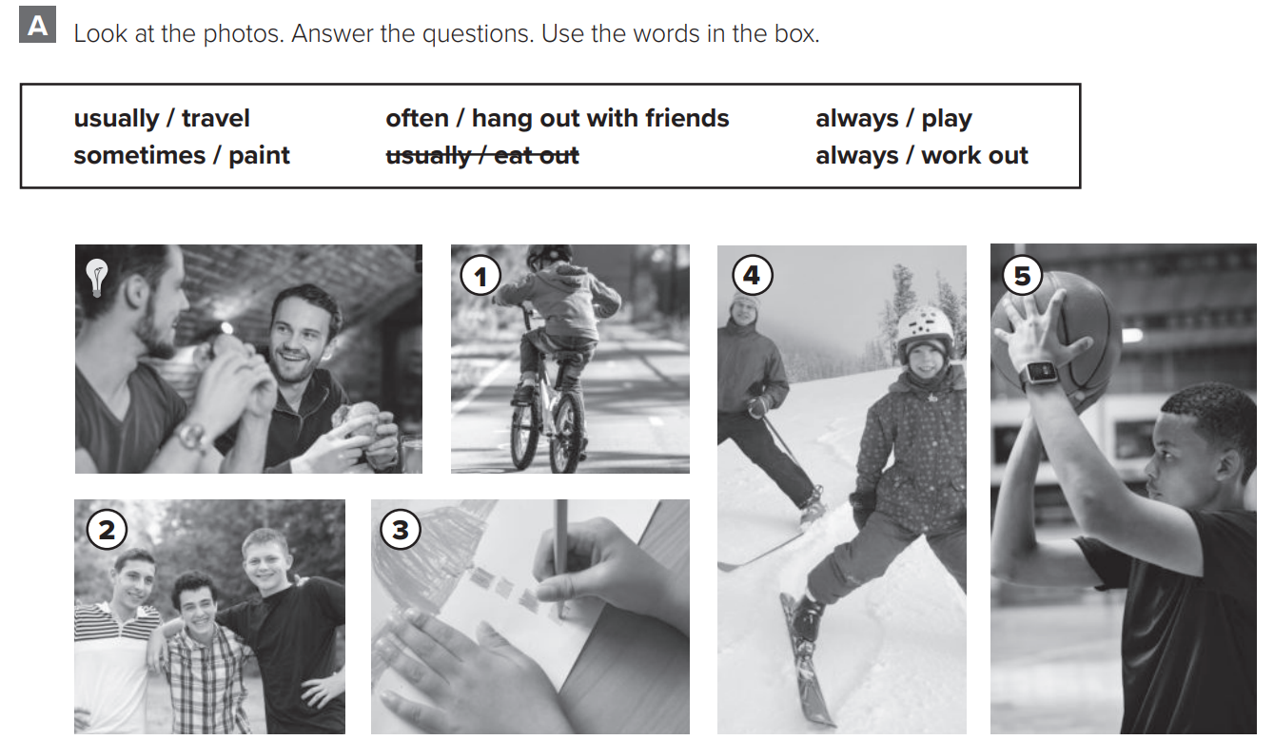
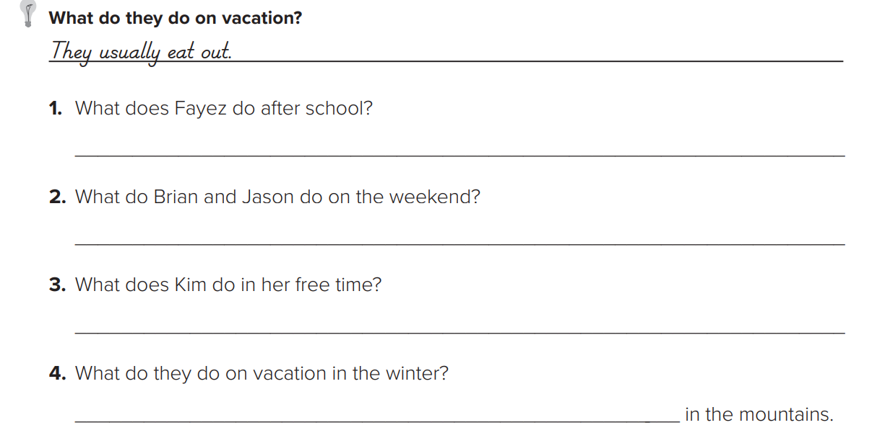

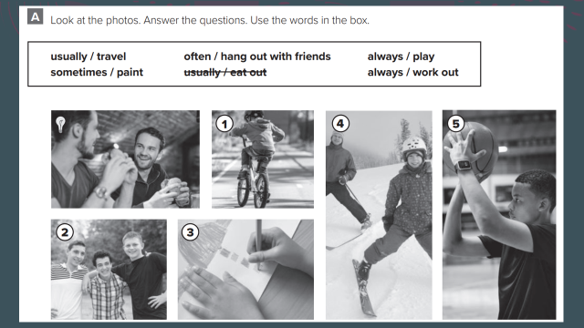
p.197
He always works out.
They often hang out with friends.
She sometimes paints.
They usually travel

Slide 4
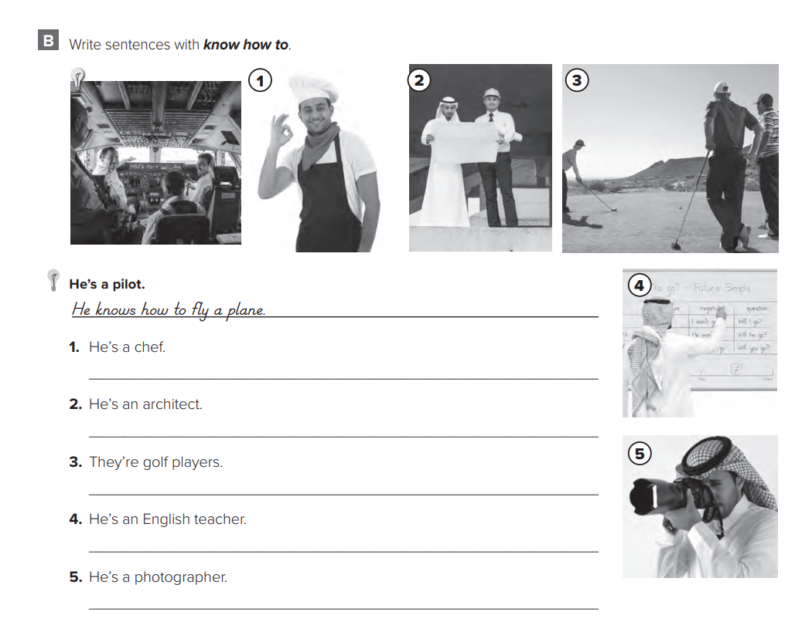

p.198
He knows how to cook.
He knows how to design houses.
They know how to play golf
He knows how to speak English.
He knows how to take photos.

Slide 5
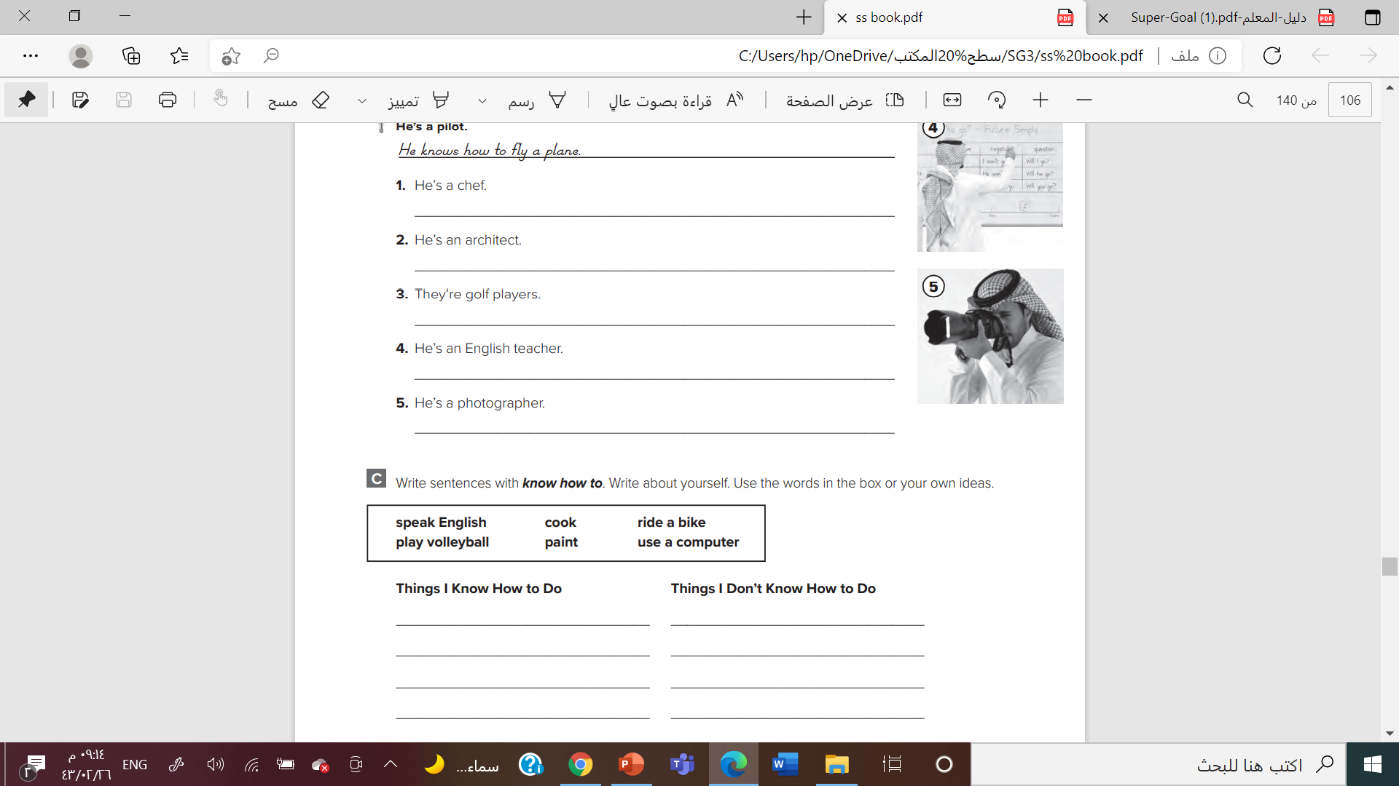

p.198

Slide 6
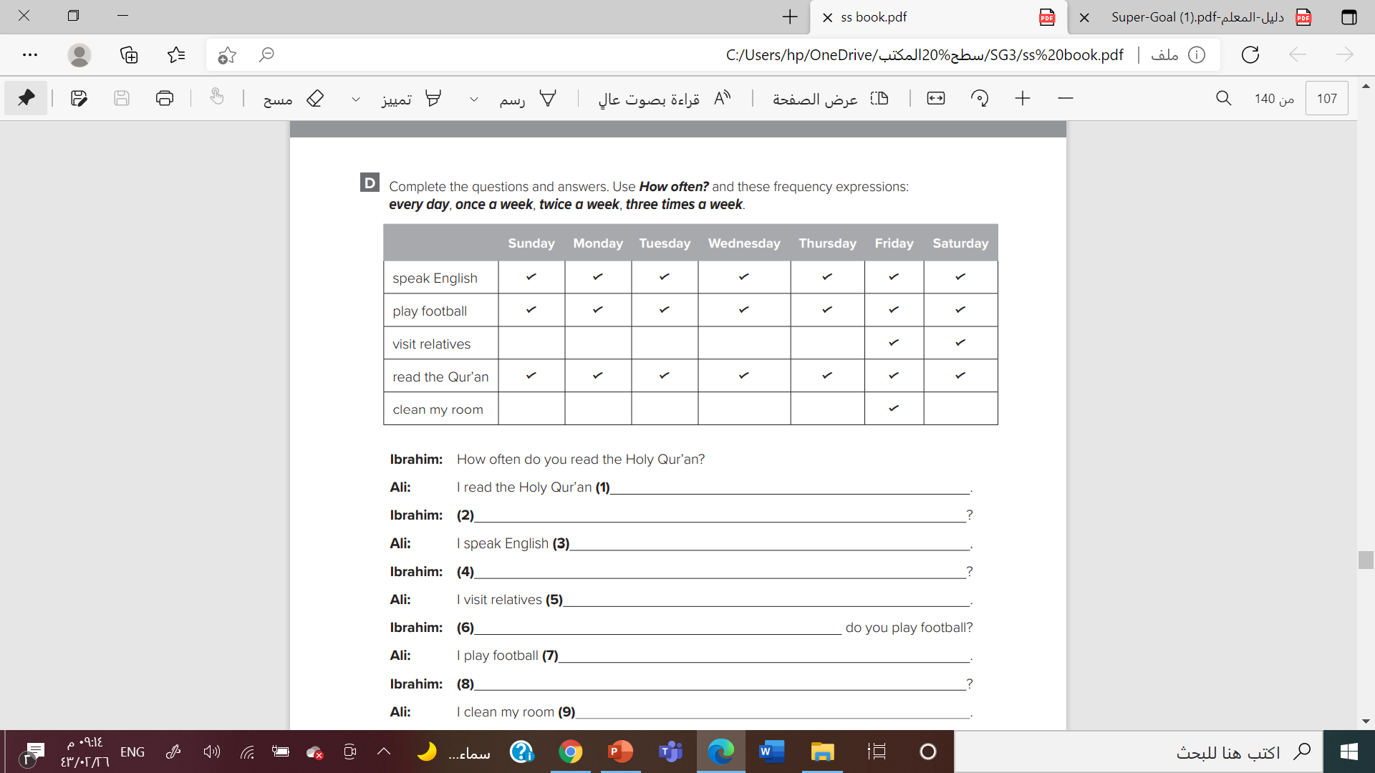

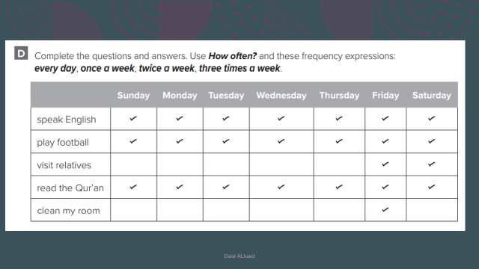
p.199
Every day
How often do you speak English
everyday
How often do you visit (your) relatives
Twice a week

Slide 8
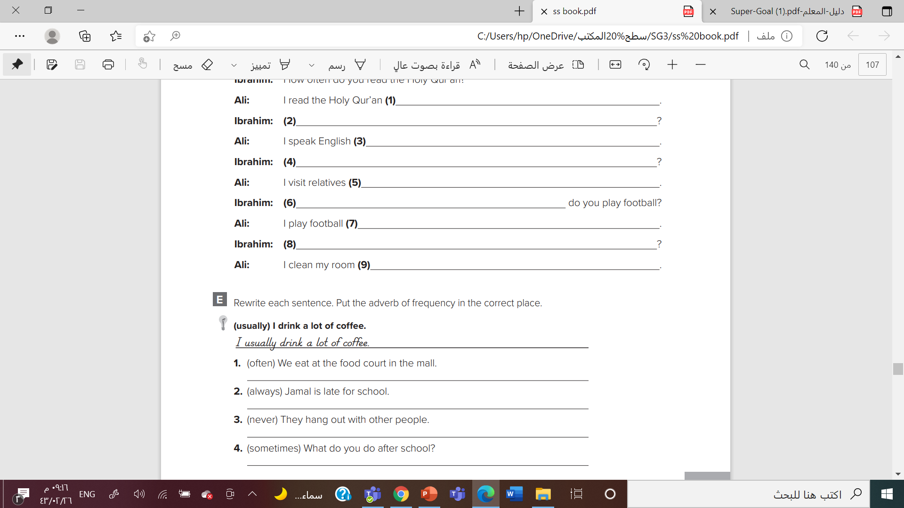

p.199
We often eat at the food court in the mall.
Jamal is always late for school.
They never hang out with other people.
What do you sometimes do after school?

Slide 9
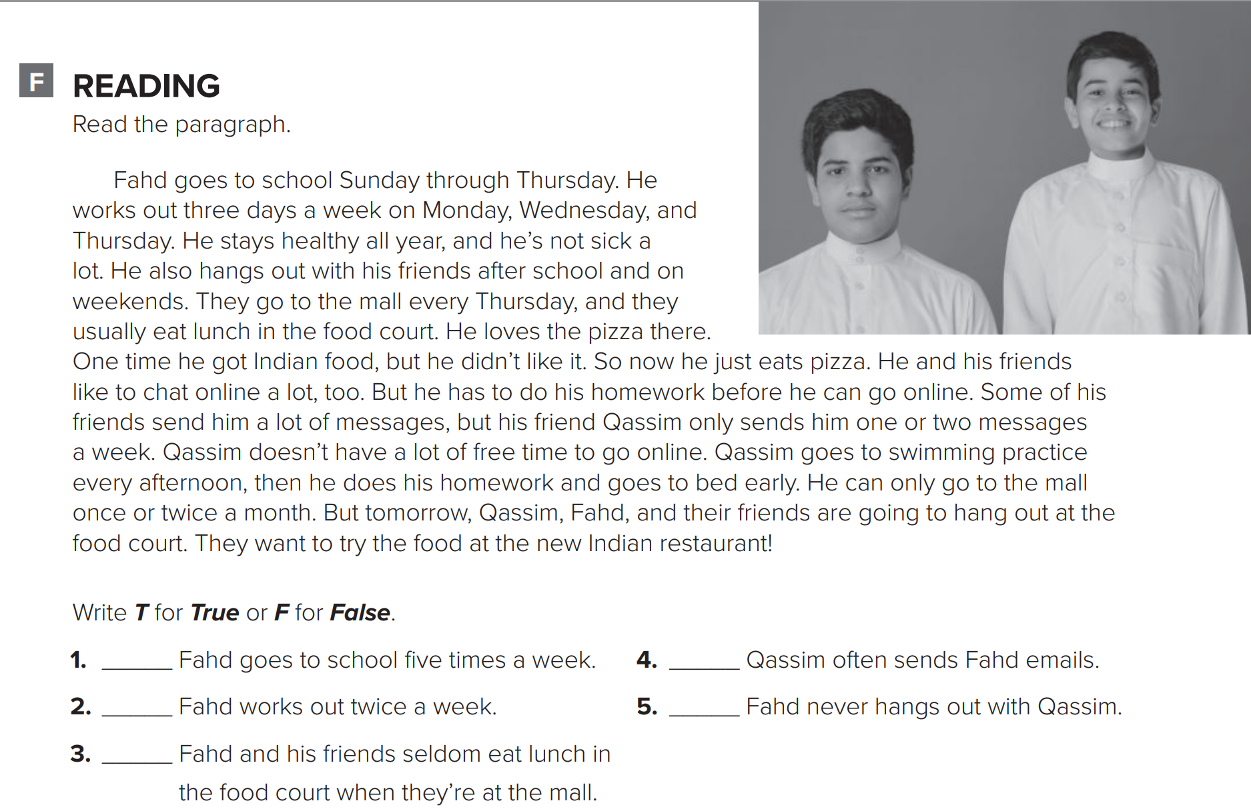
p.200
T
F
F
F
F

Slide 10
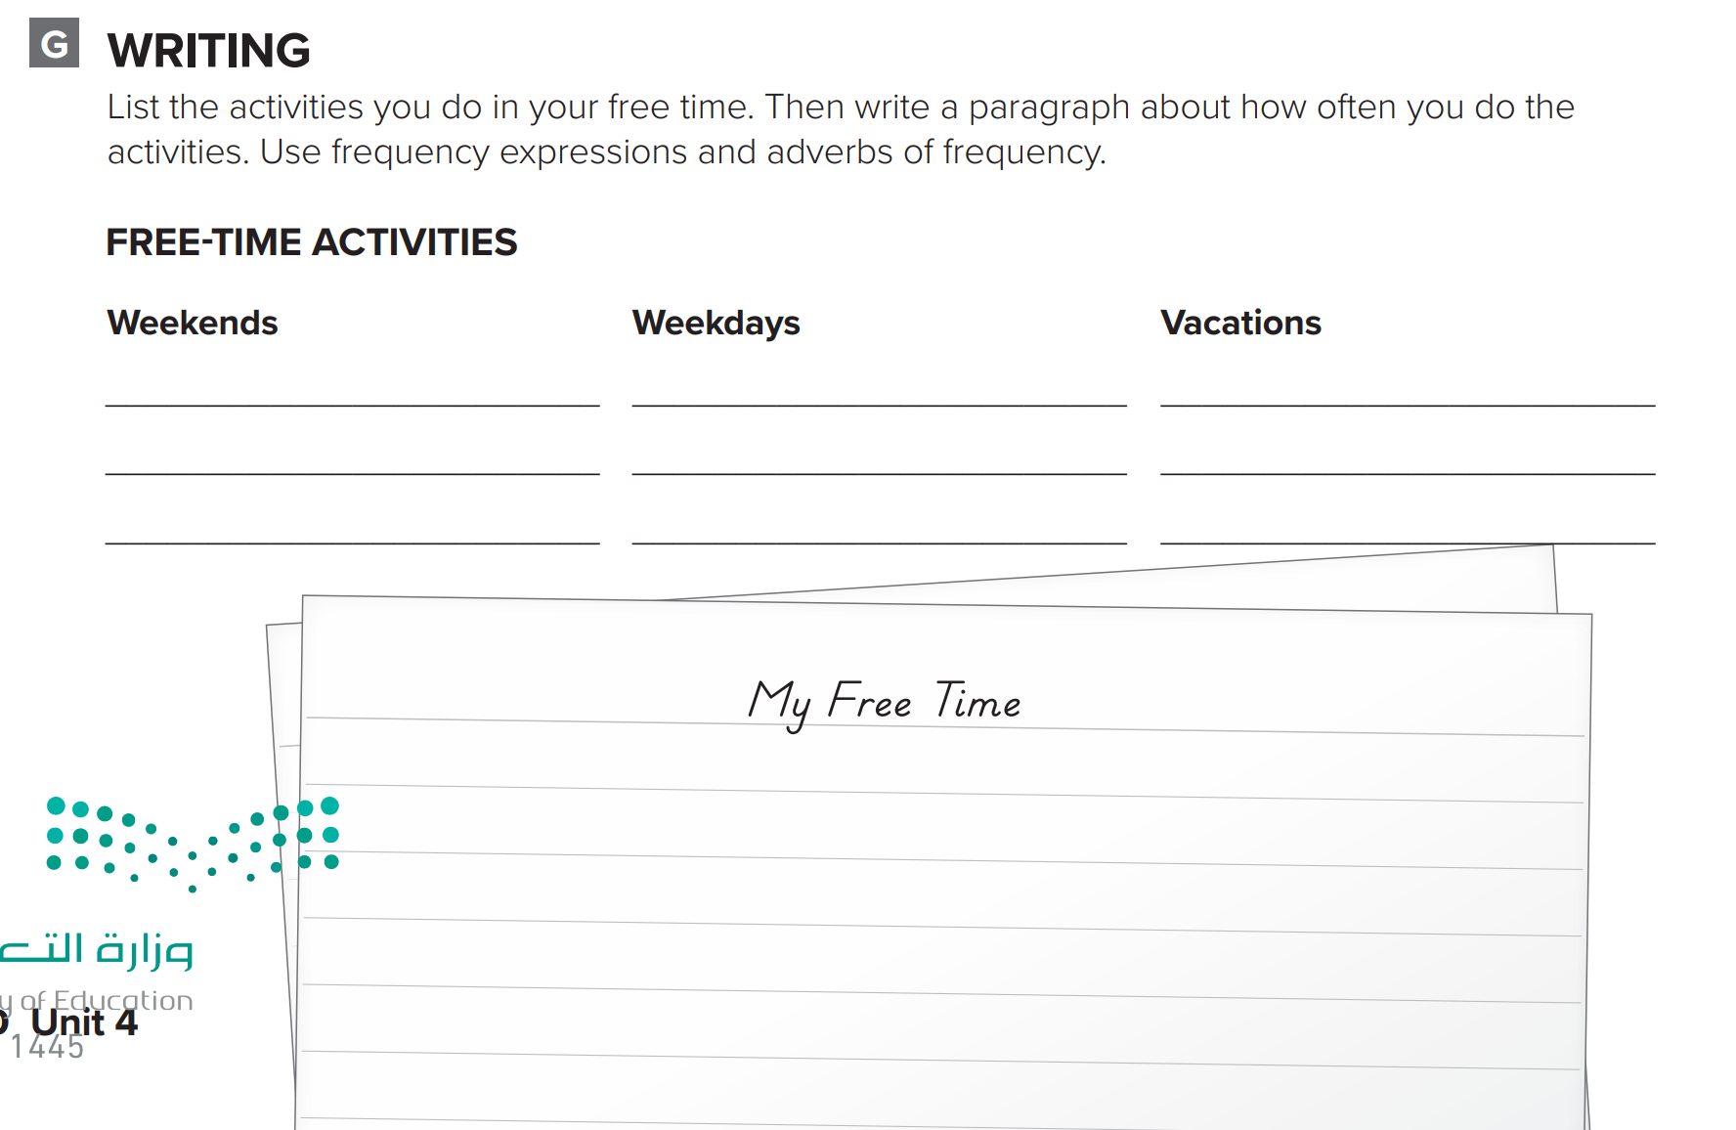

p.200
Answers will vary.

