Slide 1
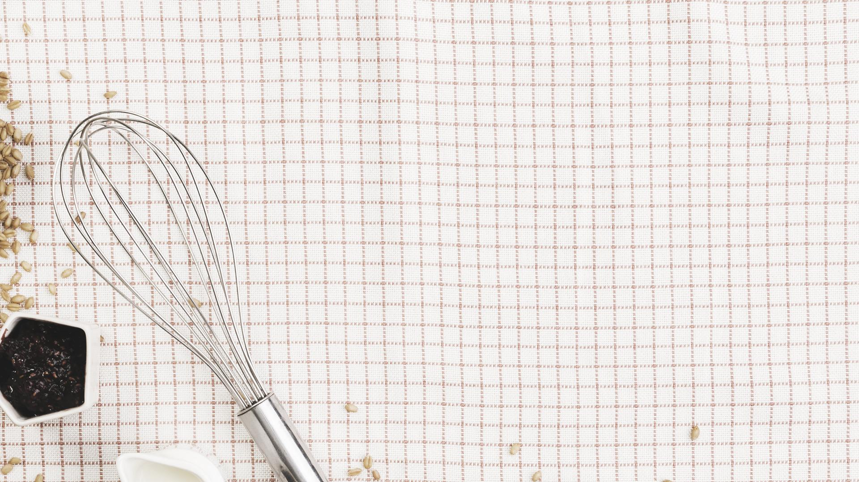
U 5
Is There Any Ice Cream?
Grammar p 42

Slide 2

01
03
To listen for specific information from a meal order
To provide clarification of Count/Noncount nouns in the context of food
02
04
To provide Expressions of Quantity: Some/Any and Partitives
To distinguish the Plural endings:
/s/, /z/, /əz/

Slide 3

Do you remember ( a – an ) How can we use them?

Slide 4
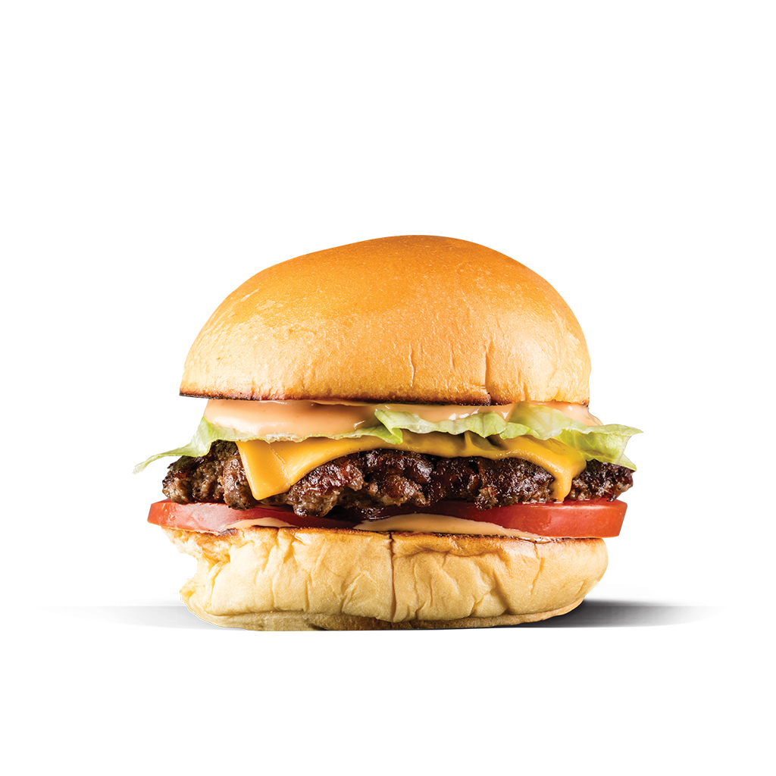
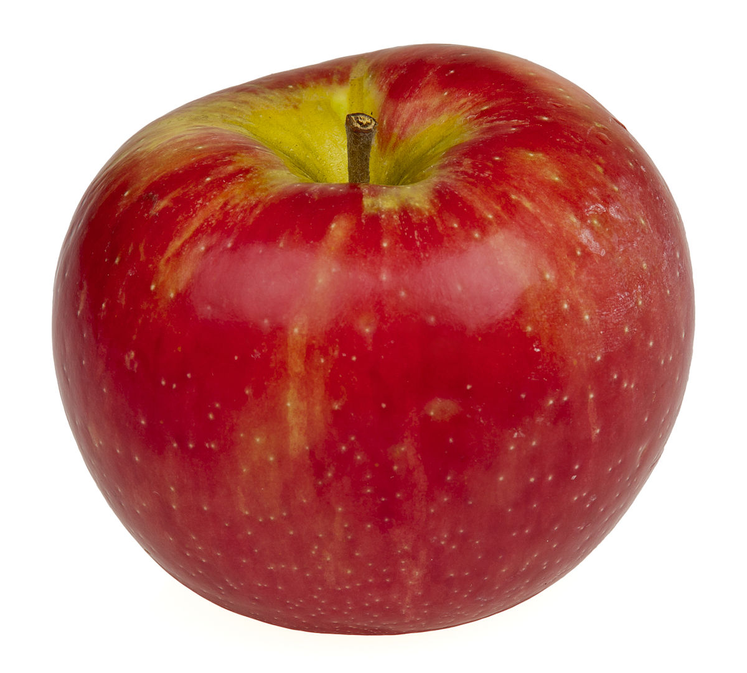

What can you see? Use a - an
An apple
A book
A burger

Slide 5
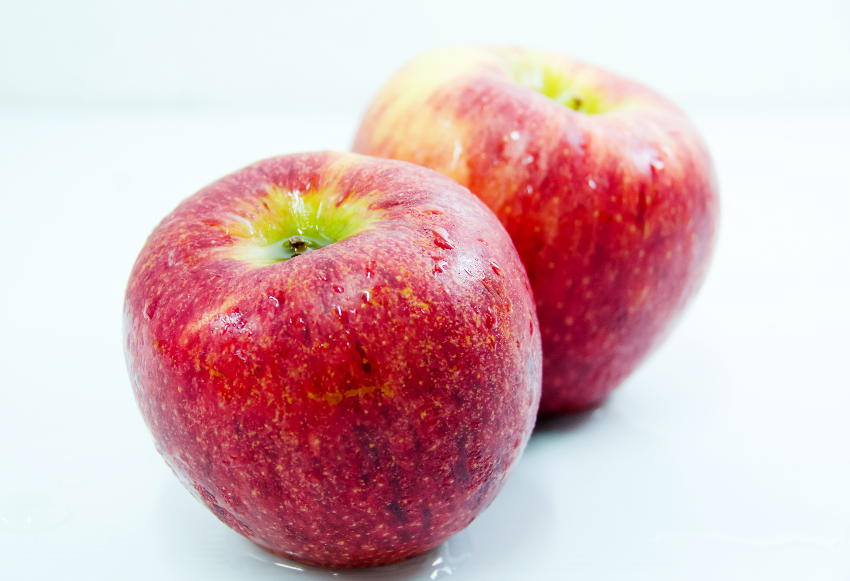

Say the plural form of each noun.
Two apples
Books
Three burgers

Slide 6


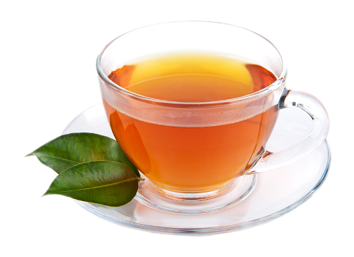
Tea / a cup of tea

Slide 7
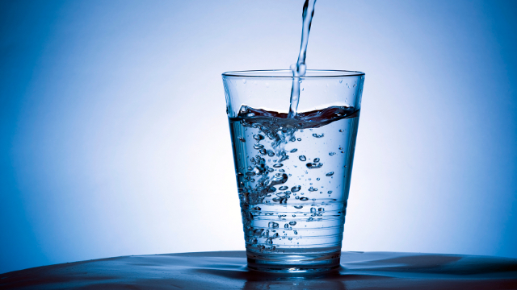
water / a glass of water

Slide 8
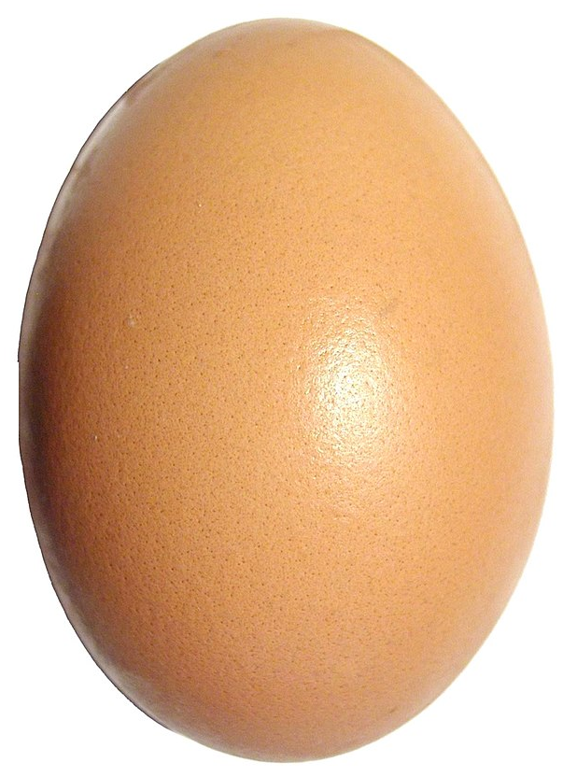

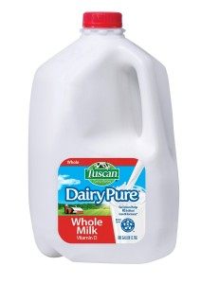
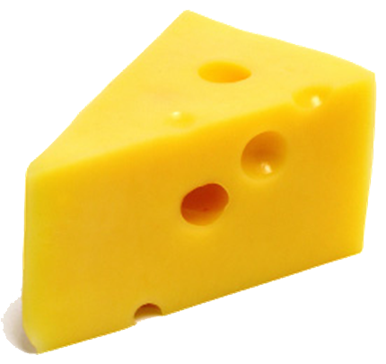
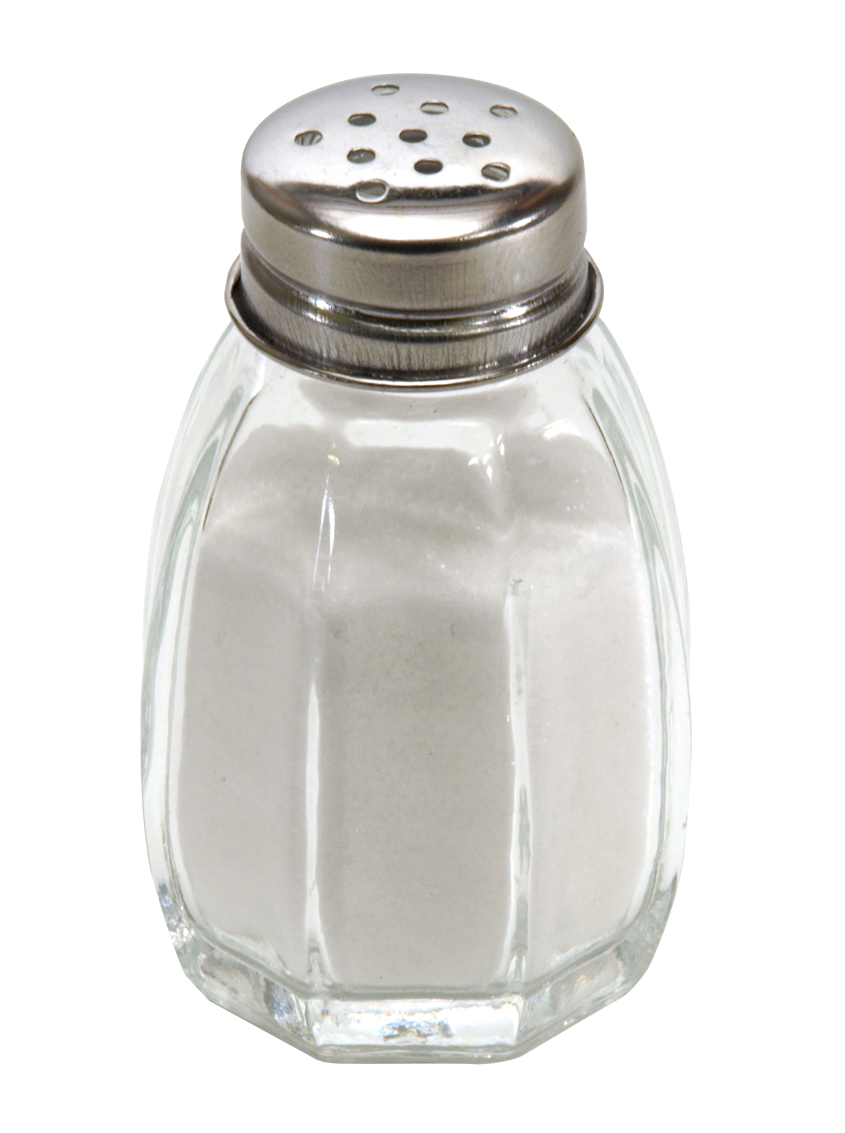
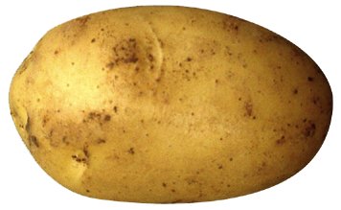
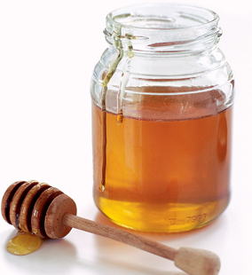
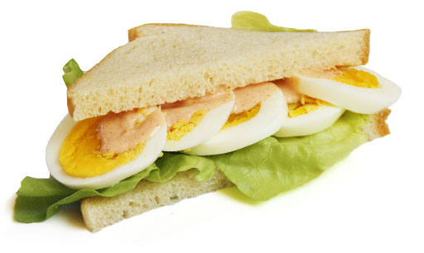
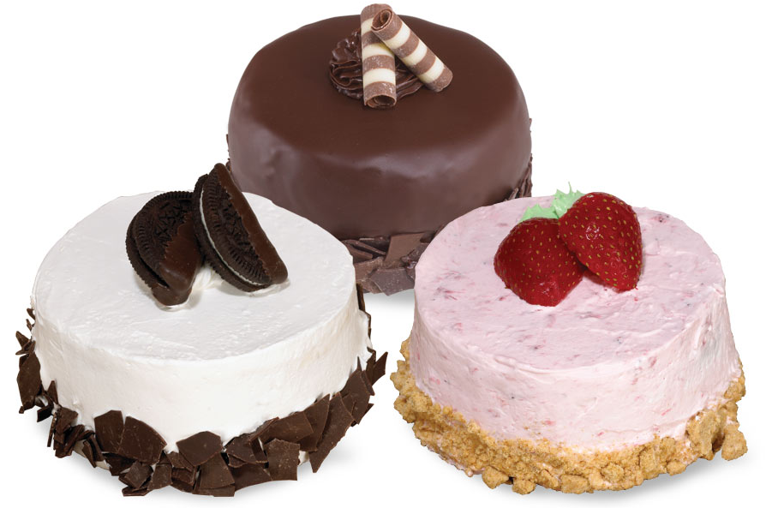
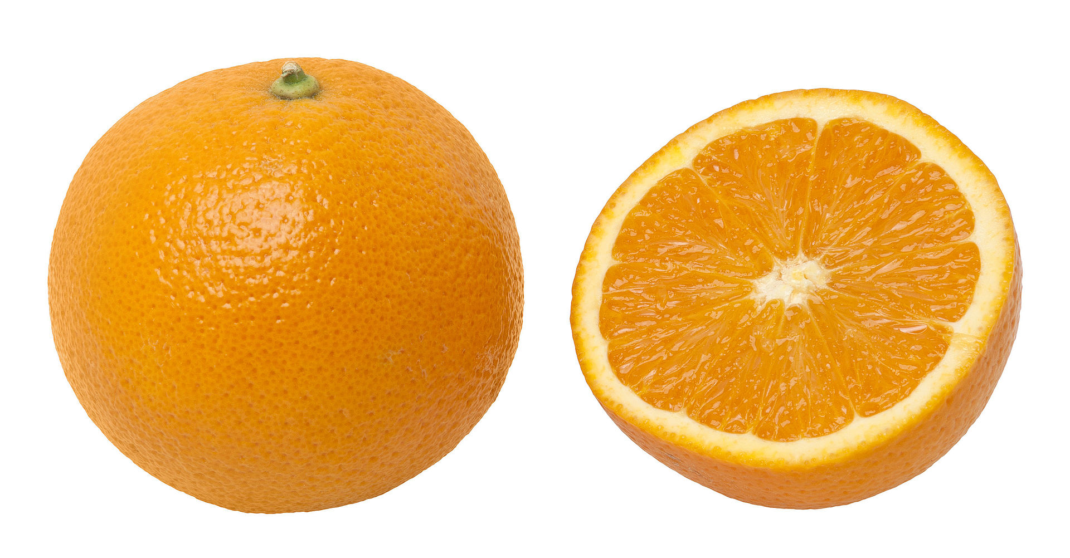
Count nouns
Noncount nouns

Slide 9
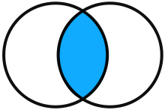
Some
Any
With affirmative statements.
There is some juice
with negative statements and in questions
There is not any juice.
Is there any juice?
With
noncount nouns
and With
plural nouns
sometimes some
is used in
questions
for offers.

Slide 10
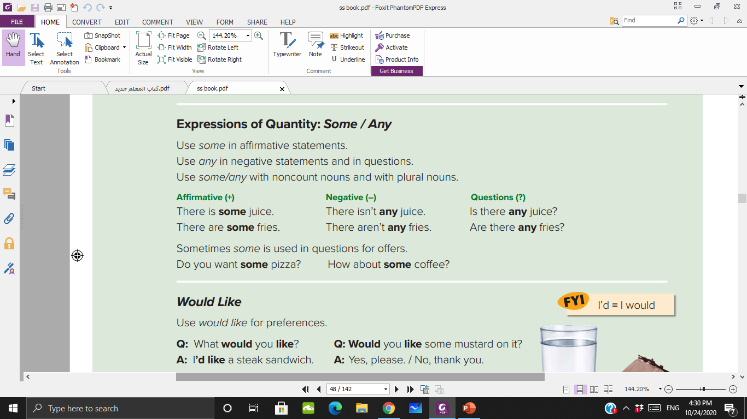

Slide 11
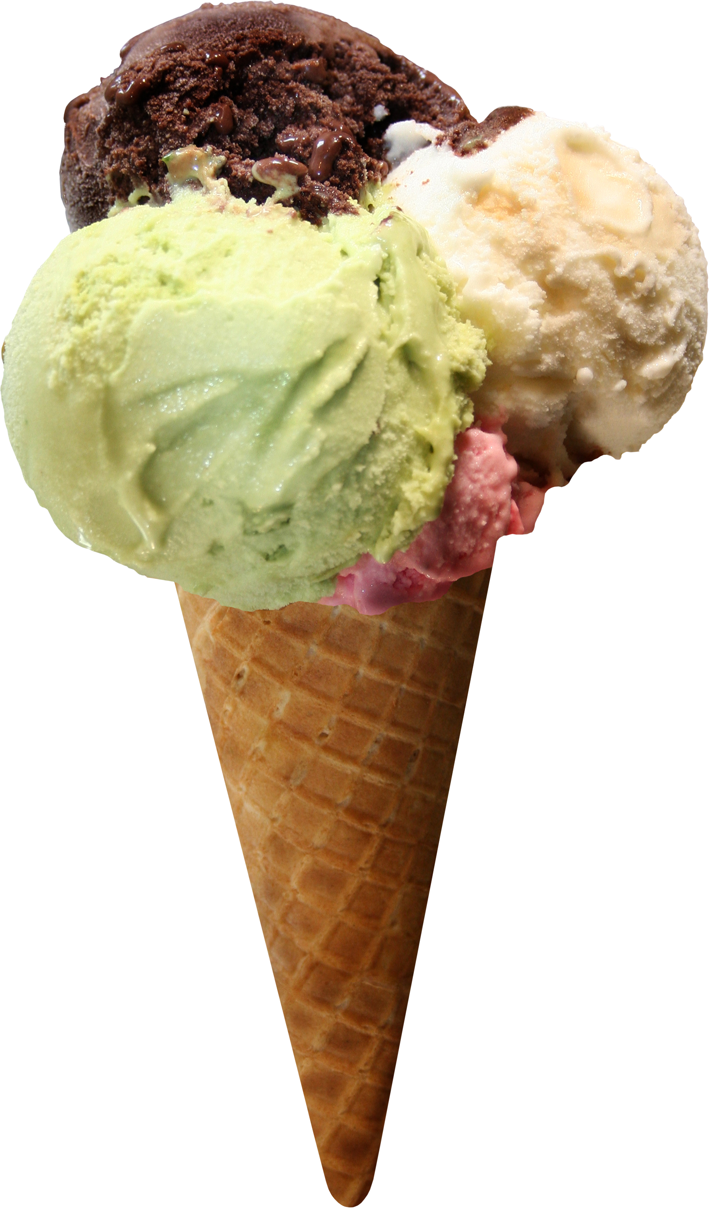
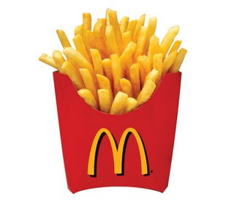
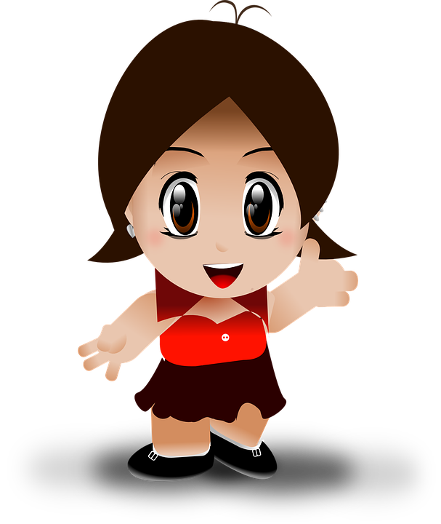

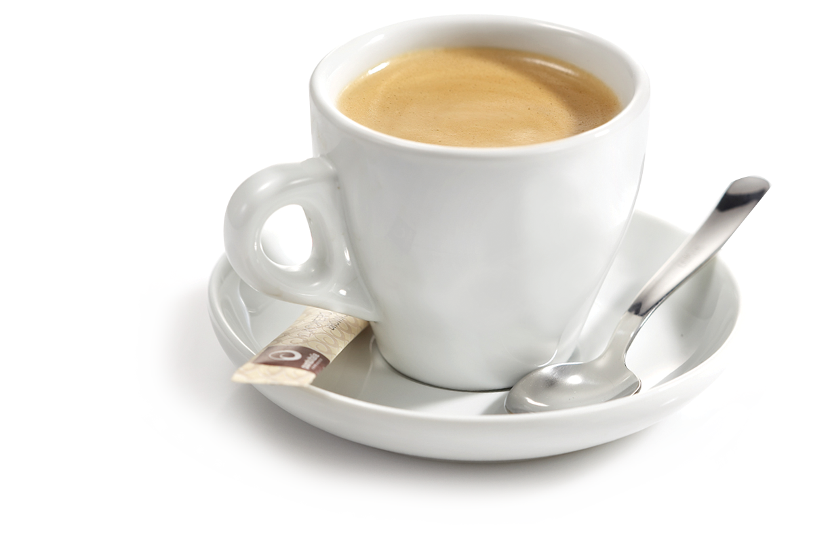

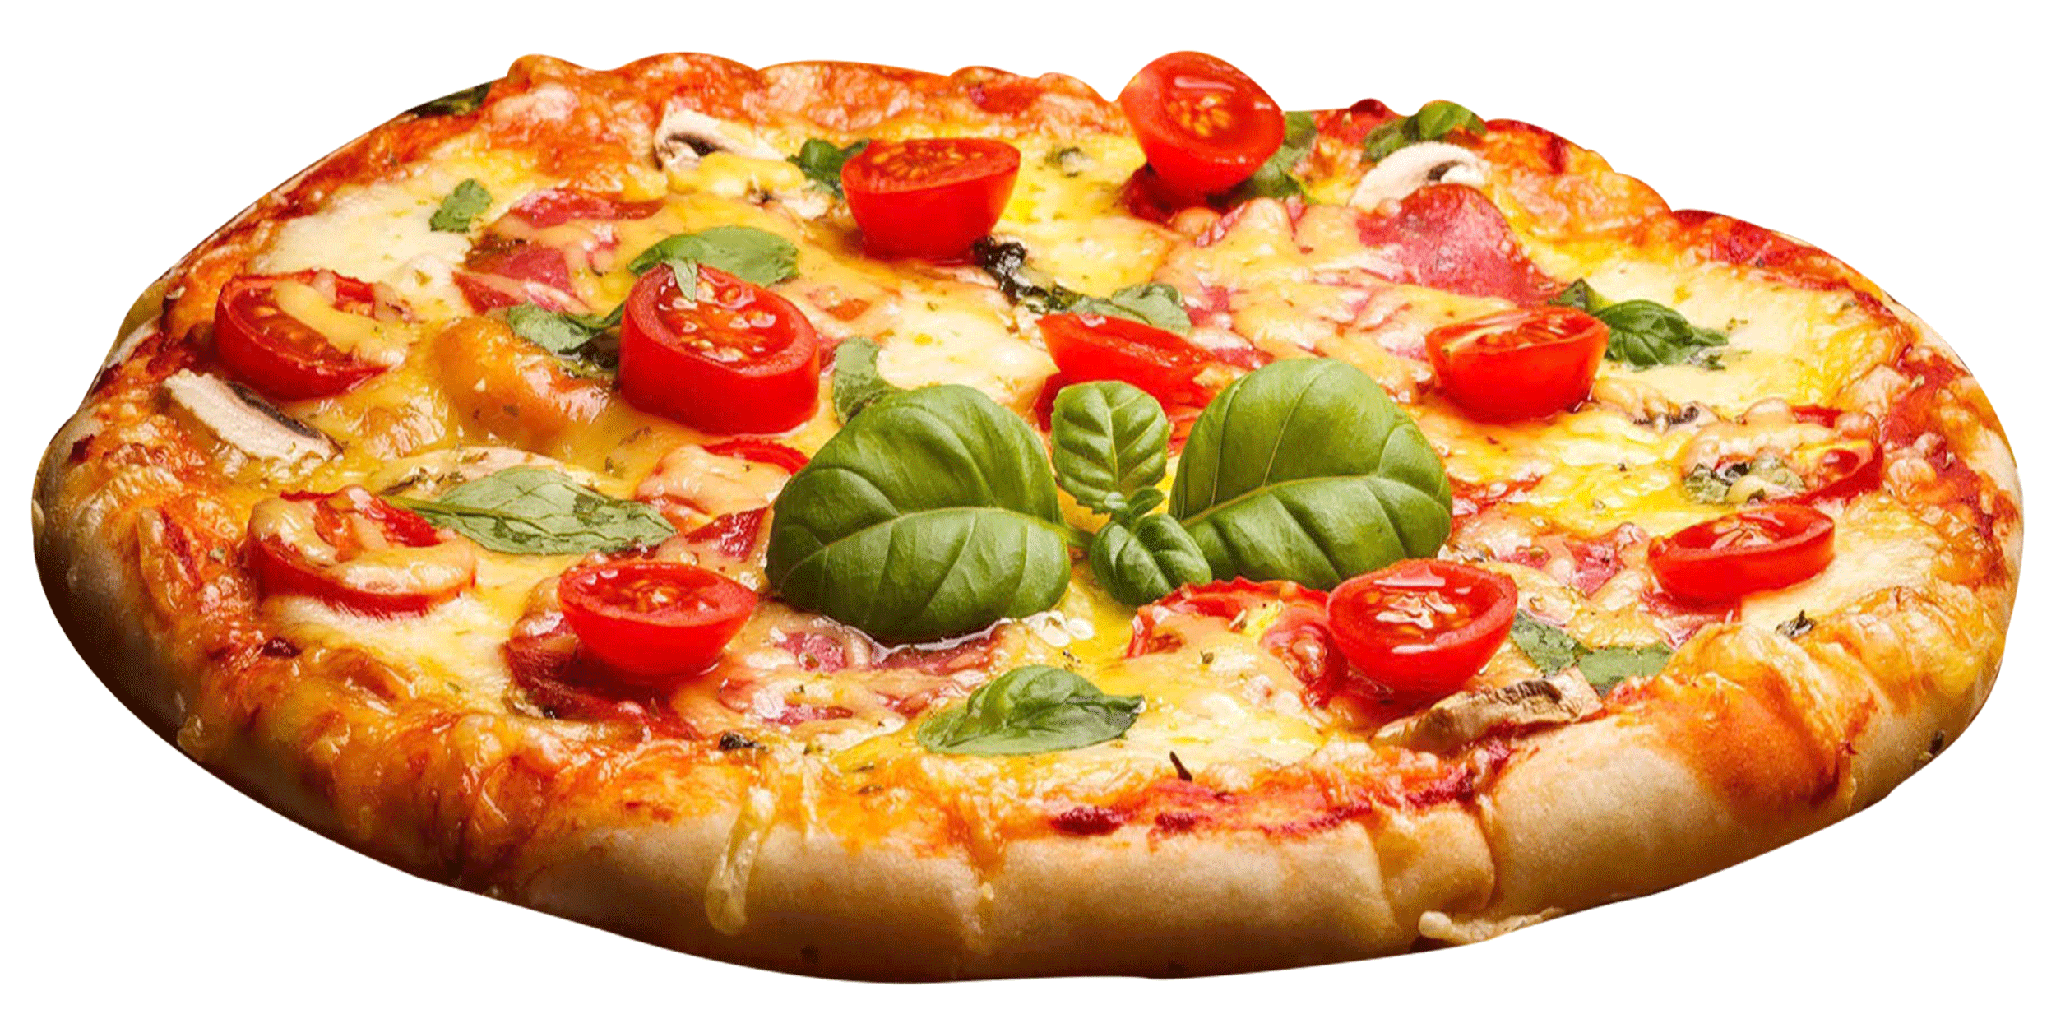
Use ( some – any )
Offer

Slide 12
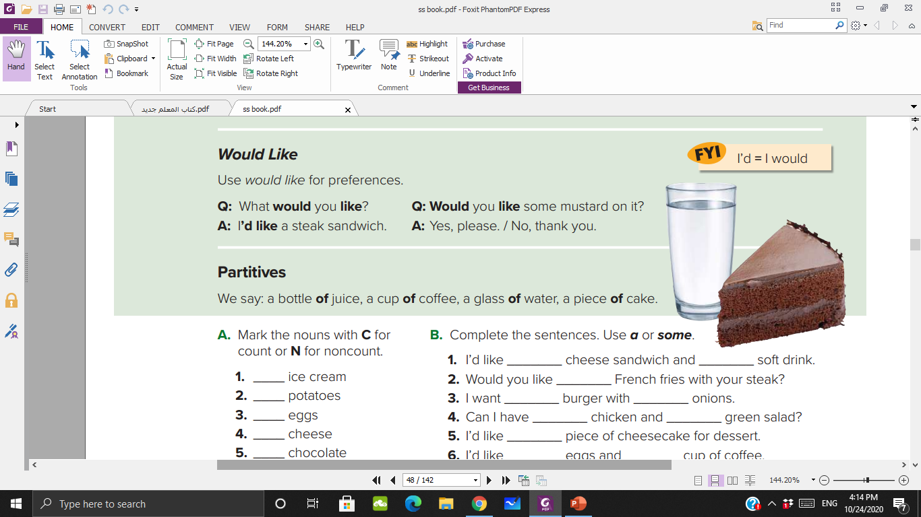

Slide 13
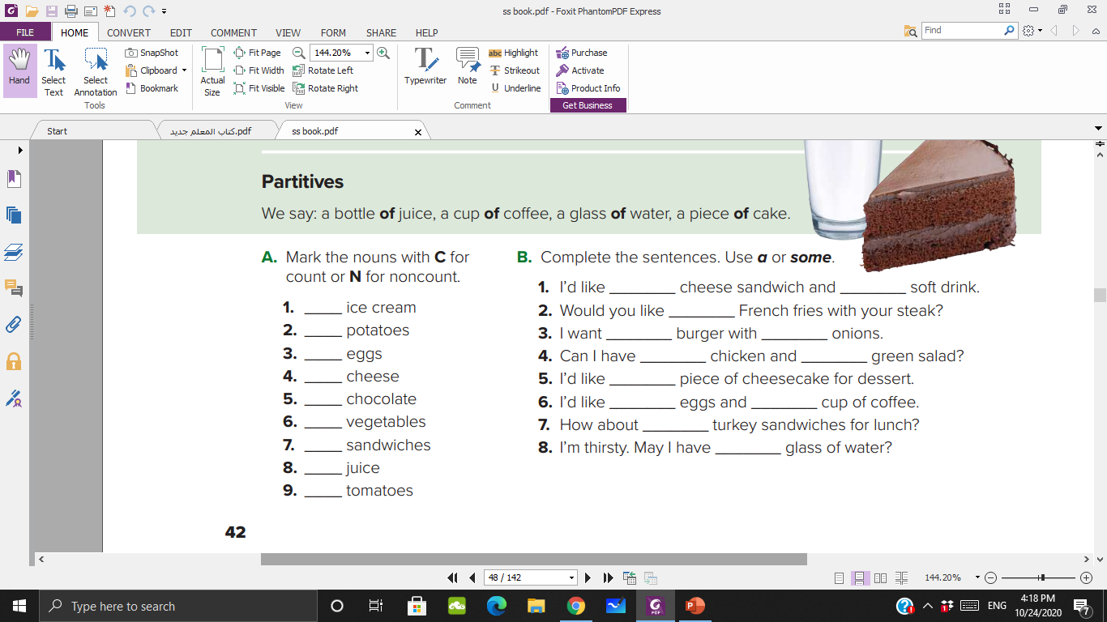
a
a
N
some
C
a
some
C
some
a
N
a
N
some
a
C
some
C
a
N
N

Slide 14
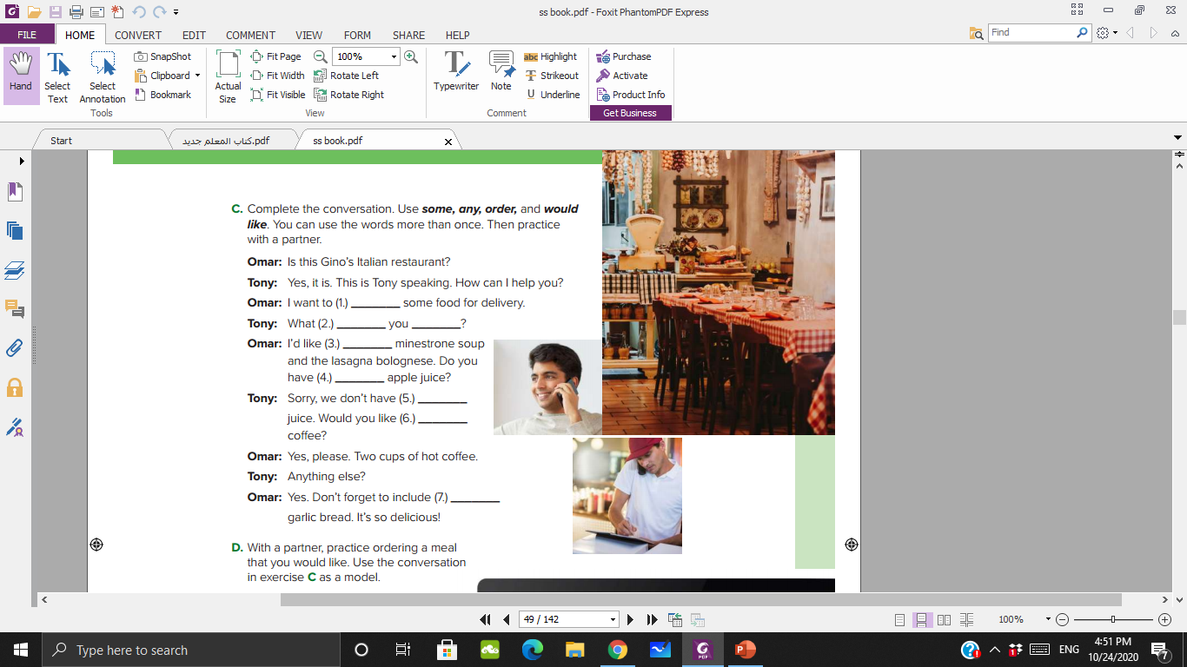
order
would
like
some
any
any
Some/any
some

Slide 15
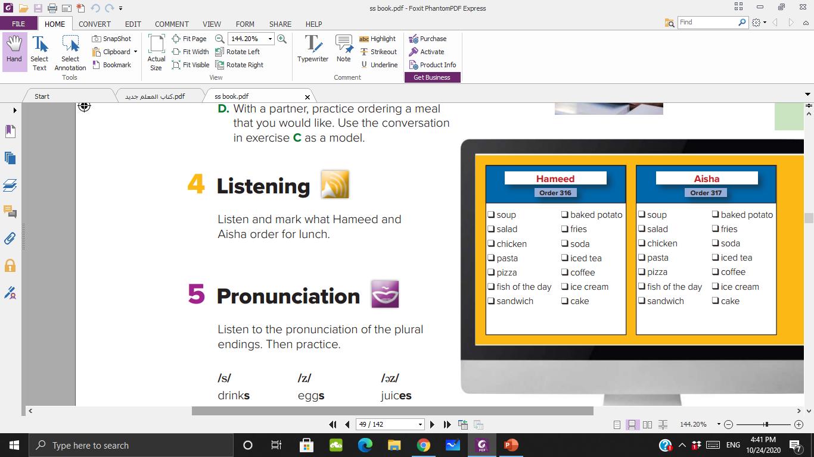


Slide 16
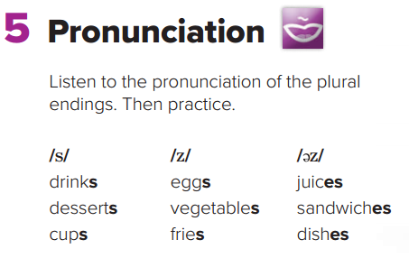

Slide 17
Workbook p 108-109

