Slide 1
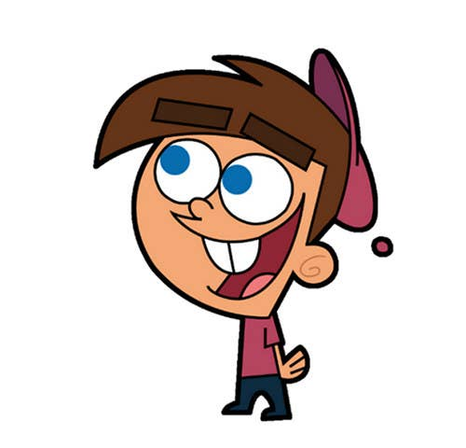


Welcome to class
T.Hanan Allaheeb

Slide 2


Slide 3
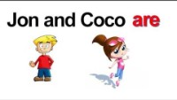

Slide 4

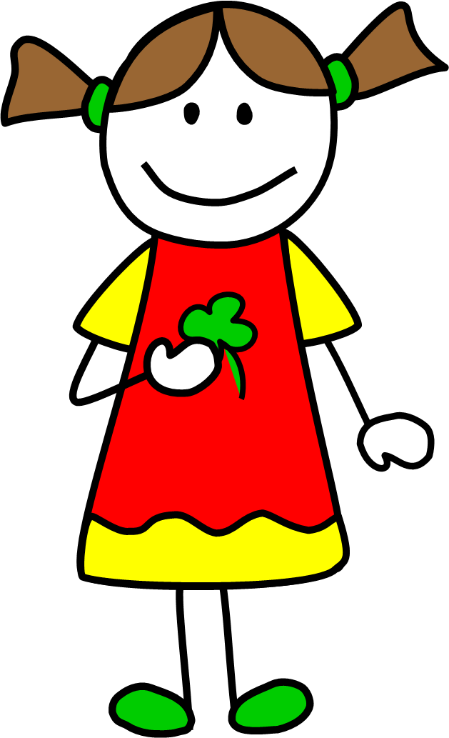


I , she ,he , it,
we , they ,you

Slide 5
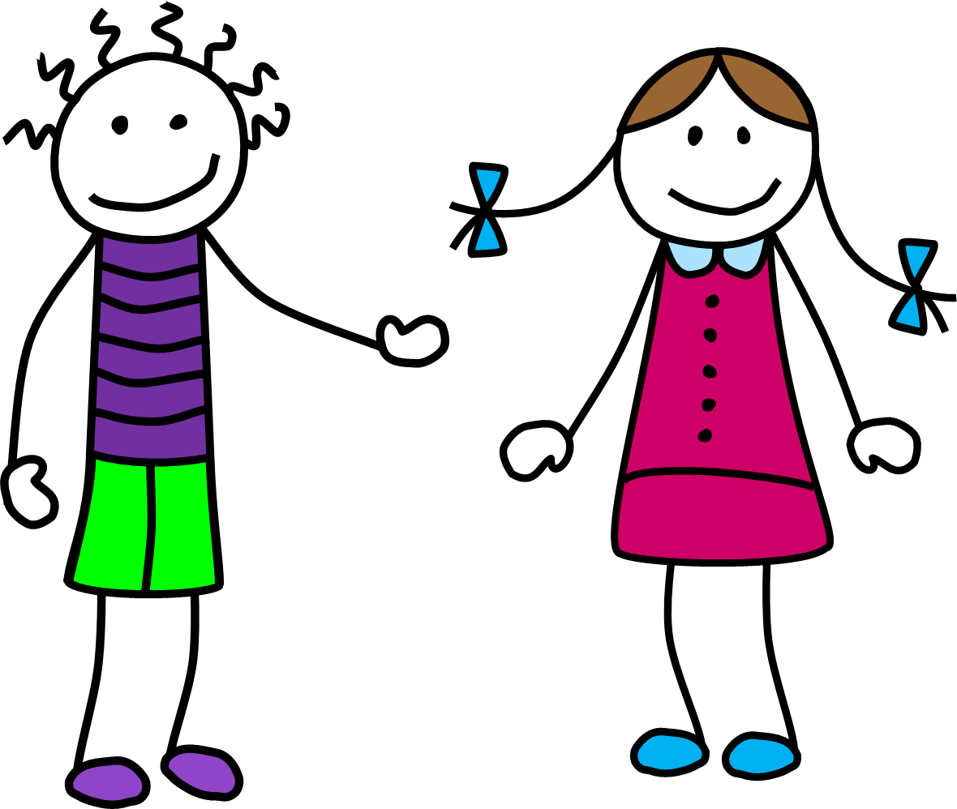

I , she ,he , it,
we , they ,you

Slide 6
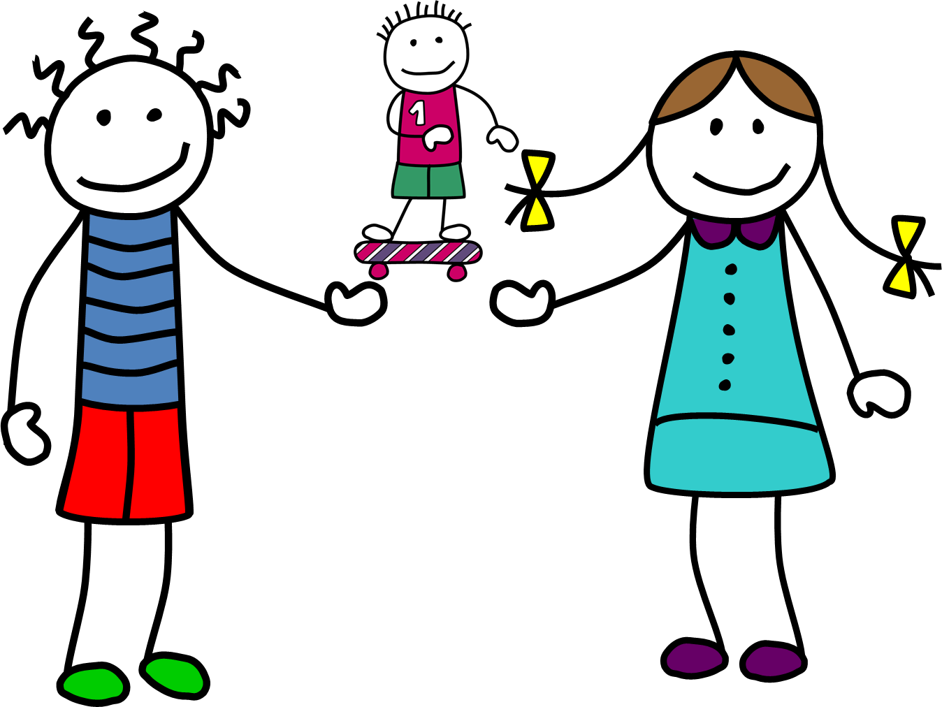

I , she ,he , it,
we , they ,you

Slide 7
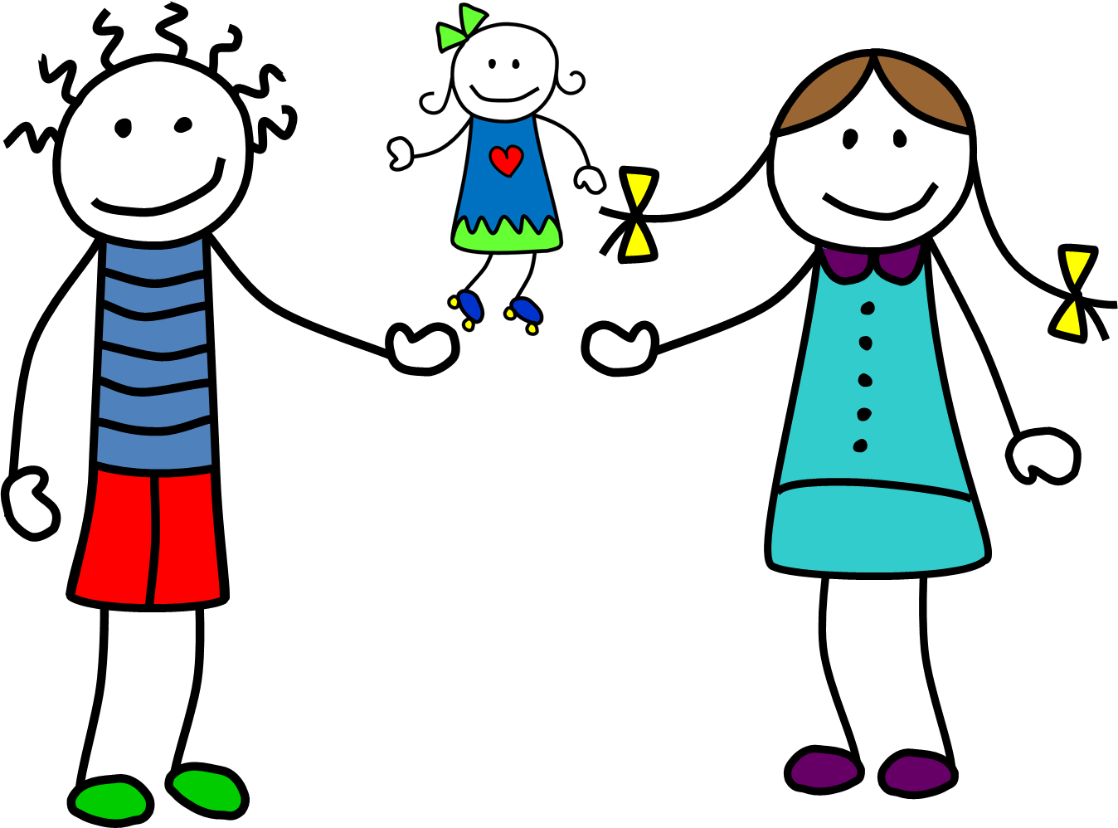


Slide 8
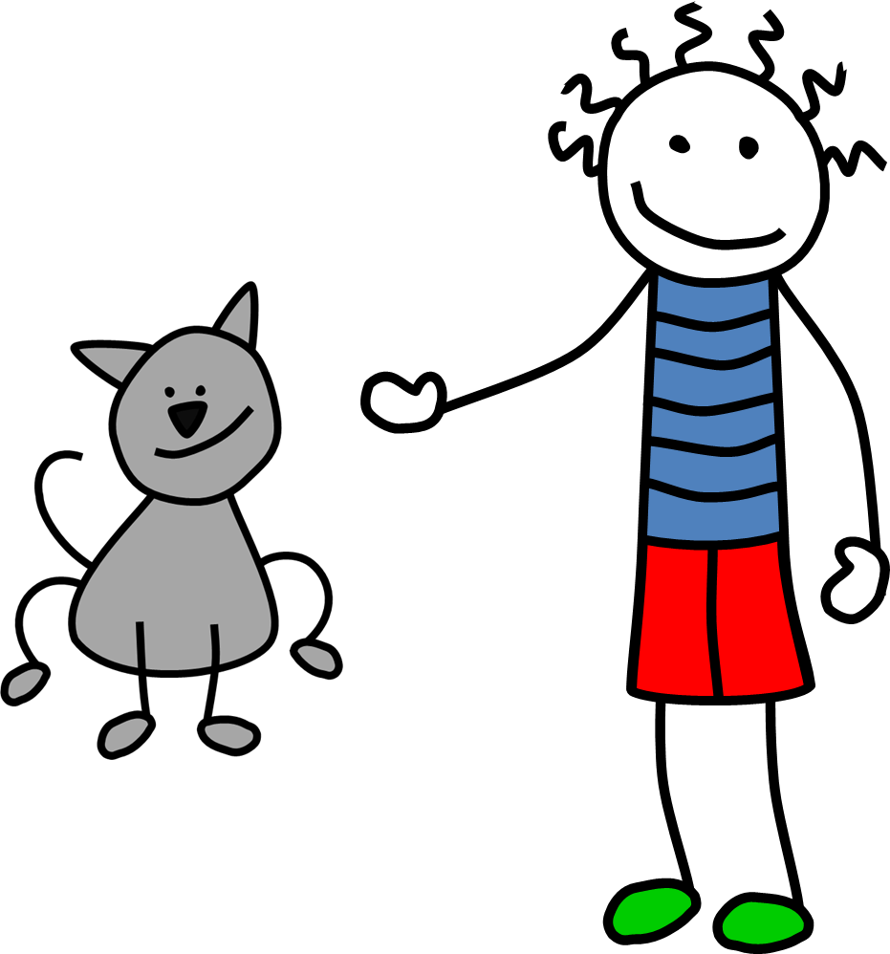

I , she ,he , it,
we , they ,you

Slide 9
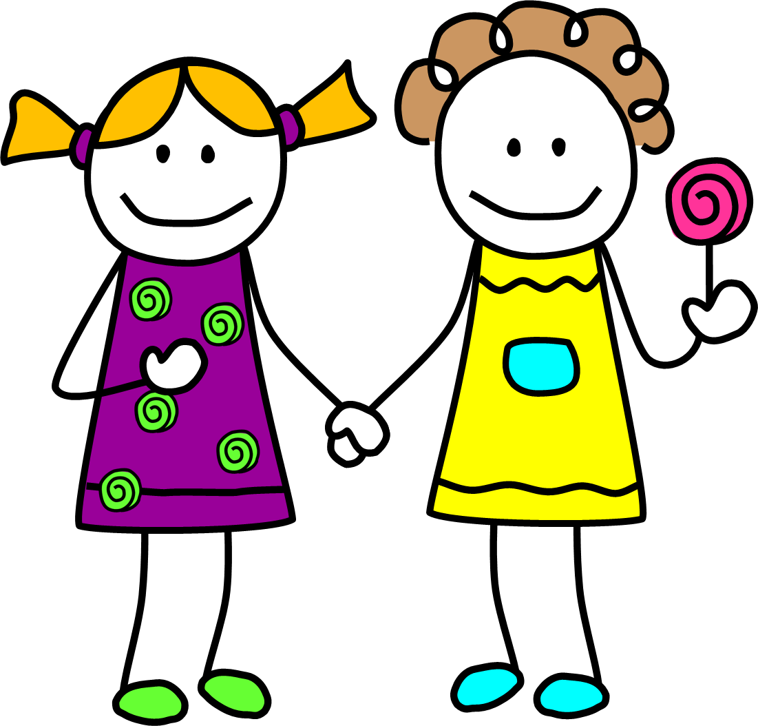


Slide 10
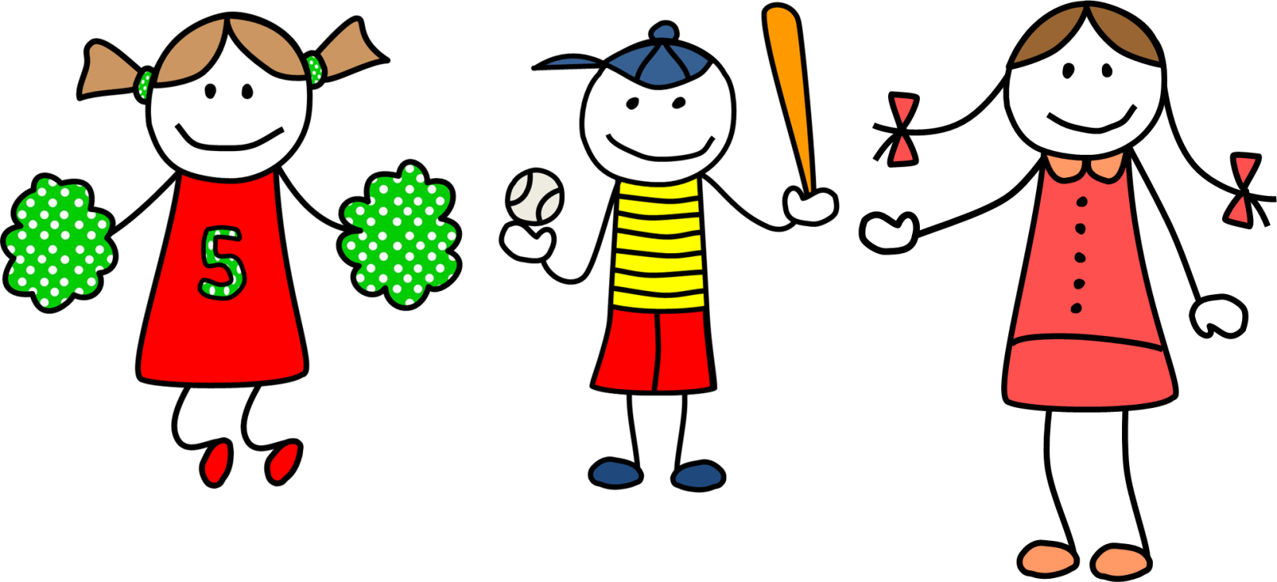
I , she ,he , it,
we , they ,you

Slide 11
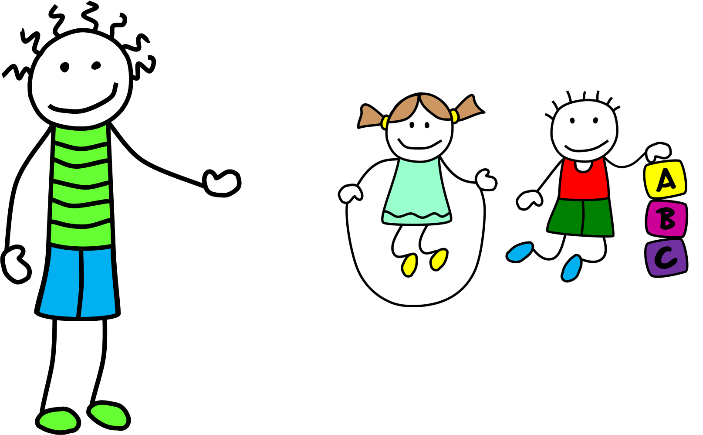

I , she ,he , it,
we , they ,you

Slide 12

Things we do

Slide 13
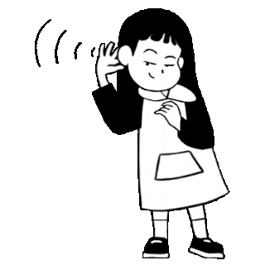
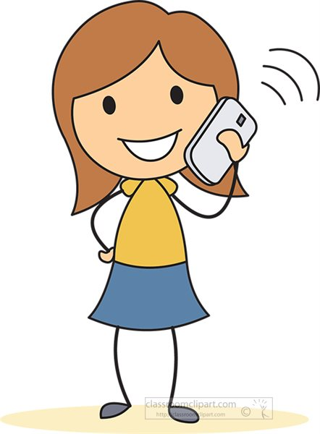

Listen
Doing homework
speaking

Slide 14
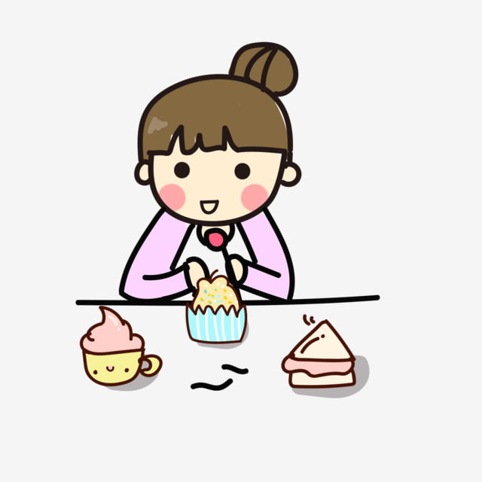
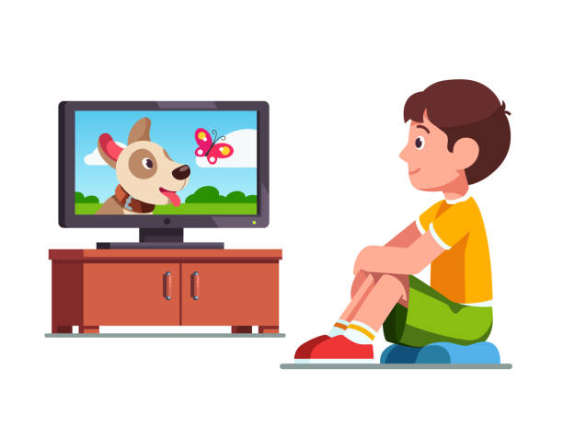
Listen
eating snacks
Watching TV

Slide 15
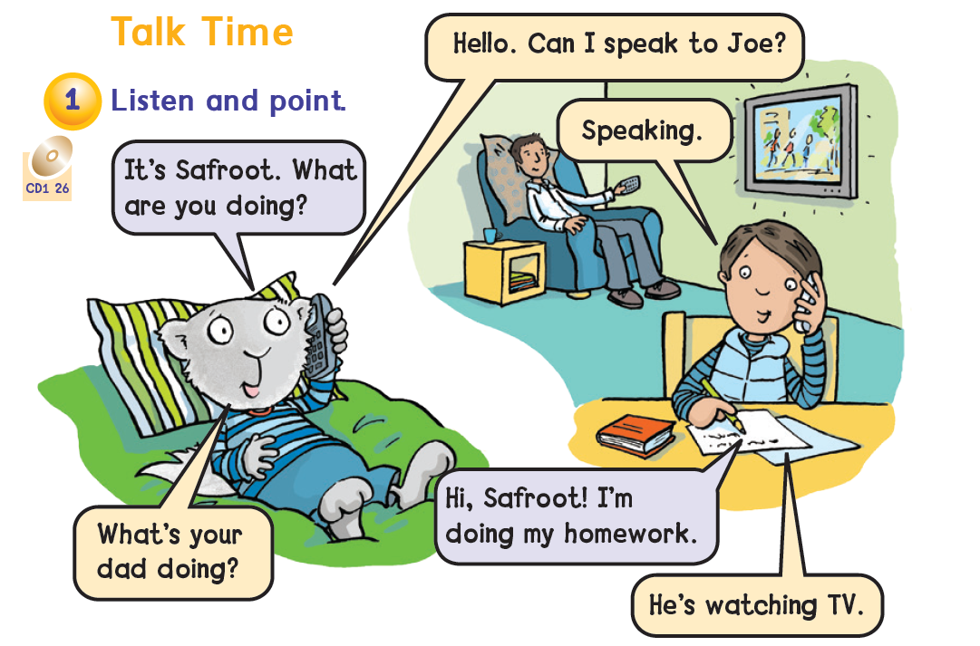

Page 20

Slide 16
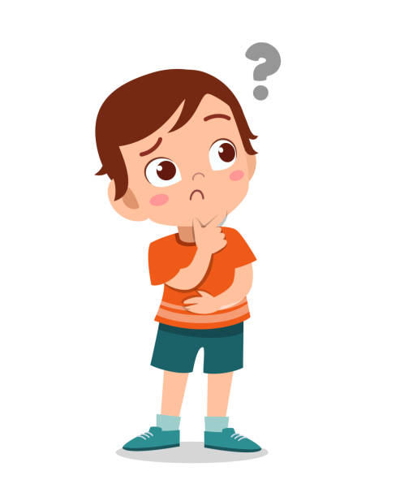
What are you doing?
I`m …………………

Slide 17
What is she doing?
She`s …………………

Slide 18

What is he doing?
He`s …………………

Slide 19

What are they doing?
They`are …………………

Slide 20
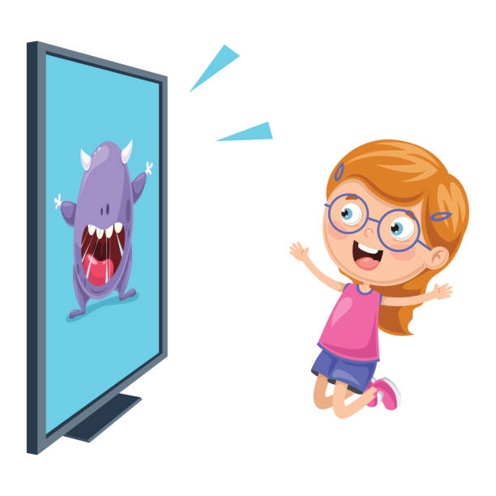
What are you doing?
… …………………

Slide 21
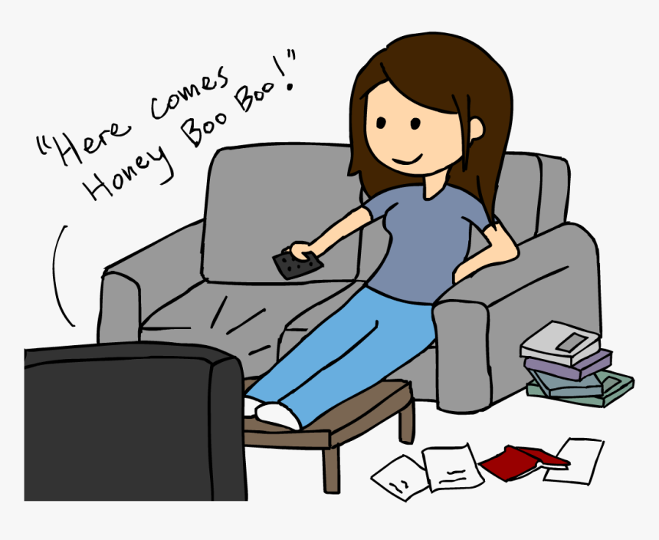
What is she doing?
………………………

Slide 22
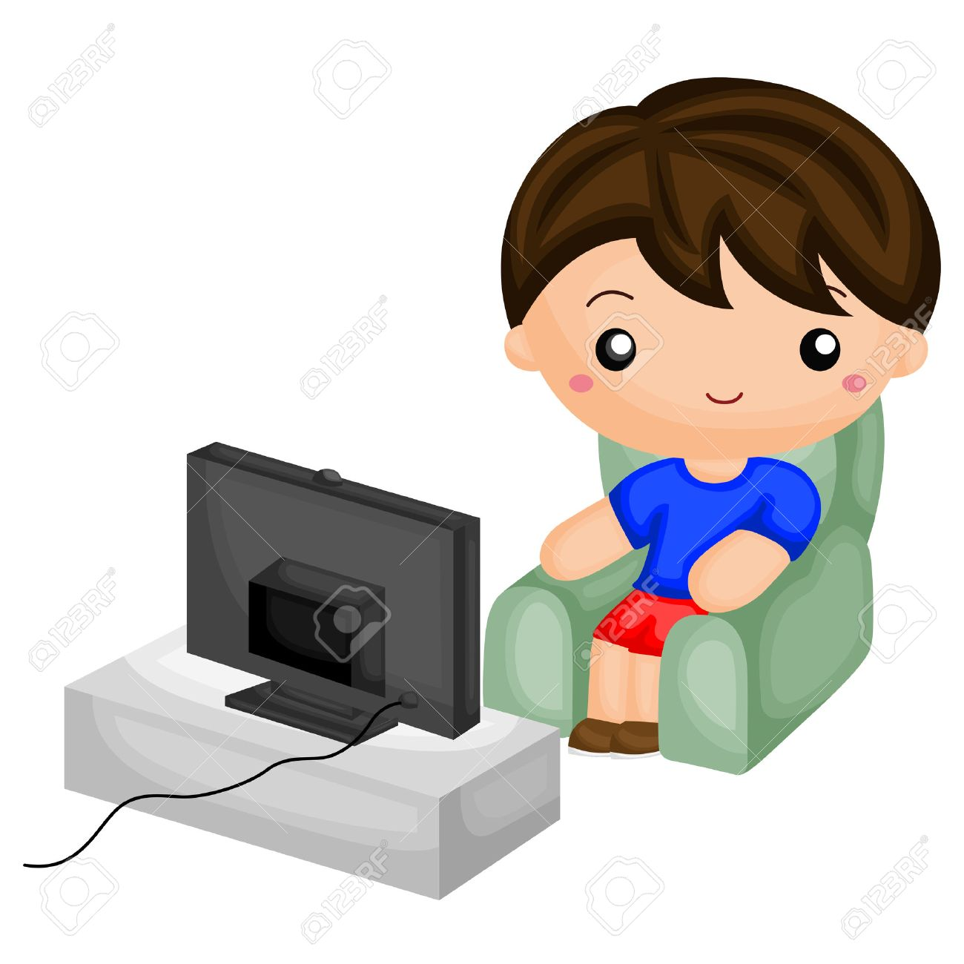
What is he doing?
………..…………

Slide 23
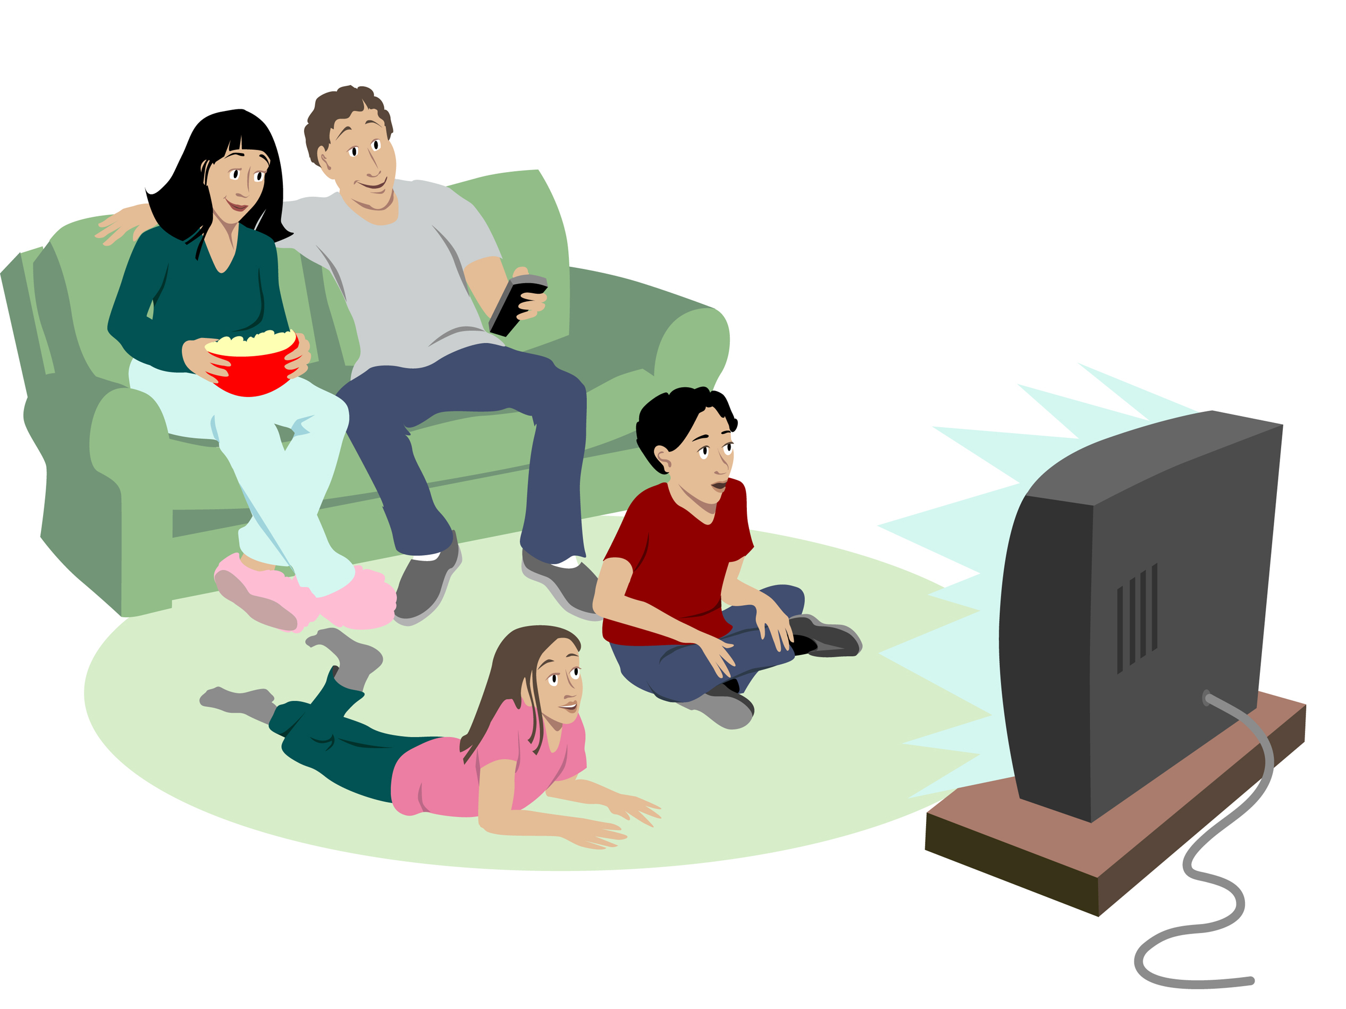
What are they doing?
……………………

Slide 24


Slide 25
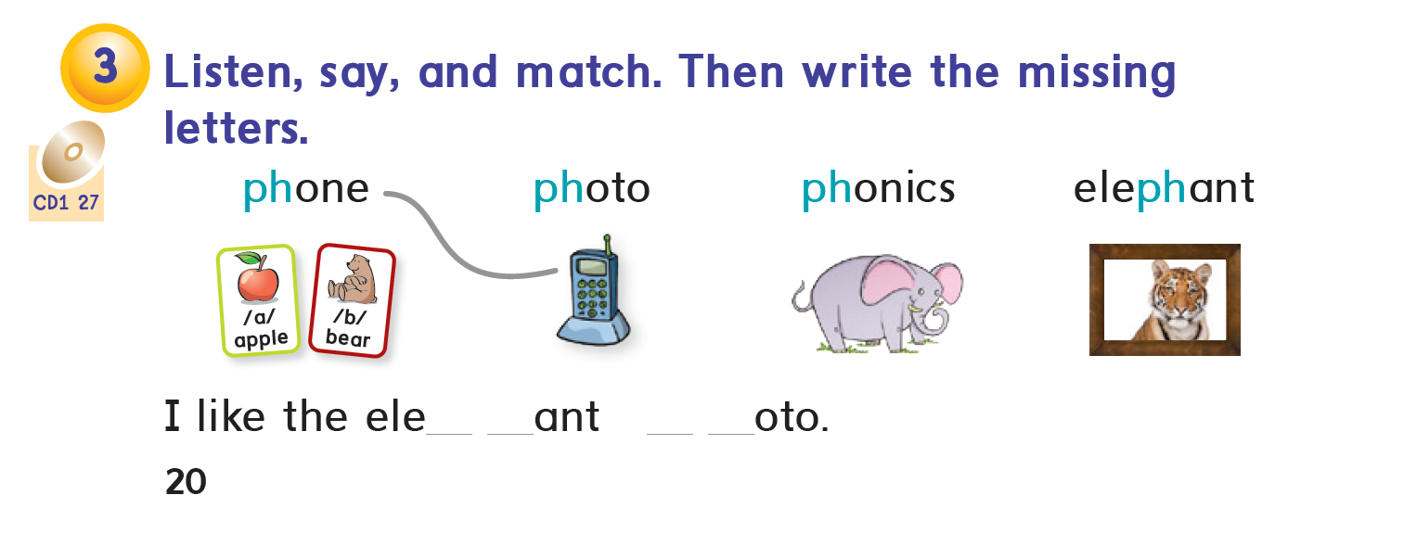

Slide 26

https://www.liveworksheets.com/gt2406222ds
https://www.liveworksheets.com/lo2406253mn

Slide 27


