Slide 1



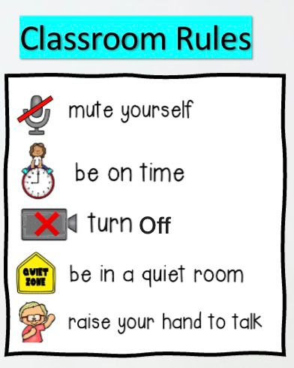



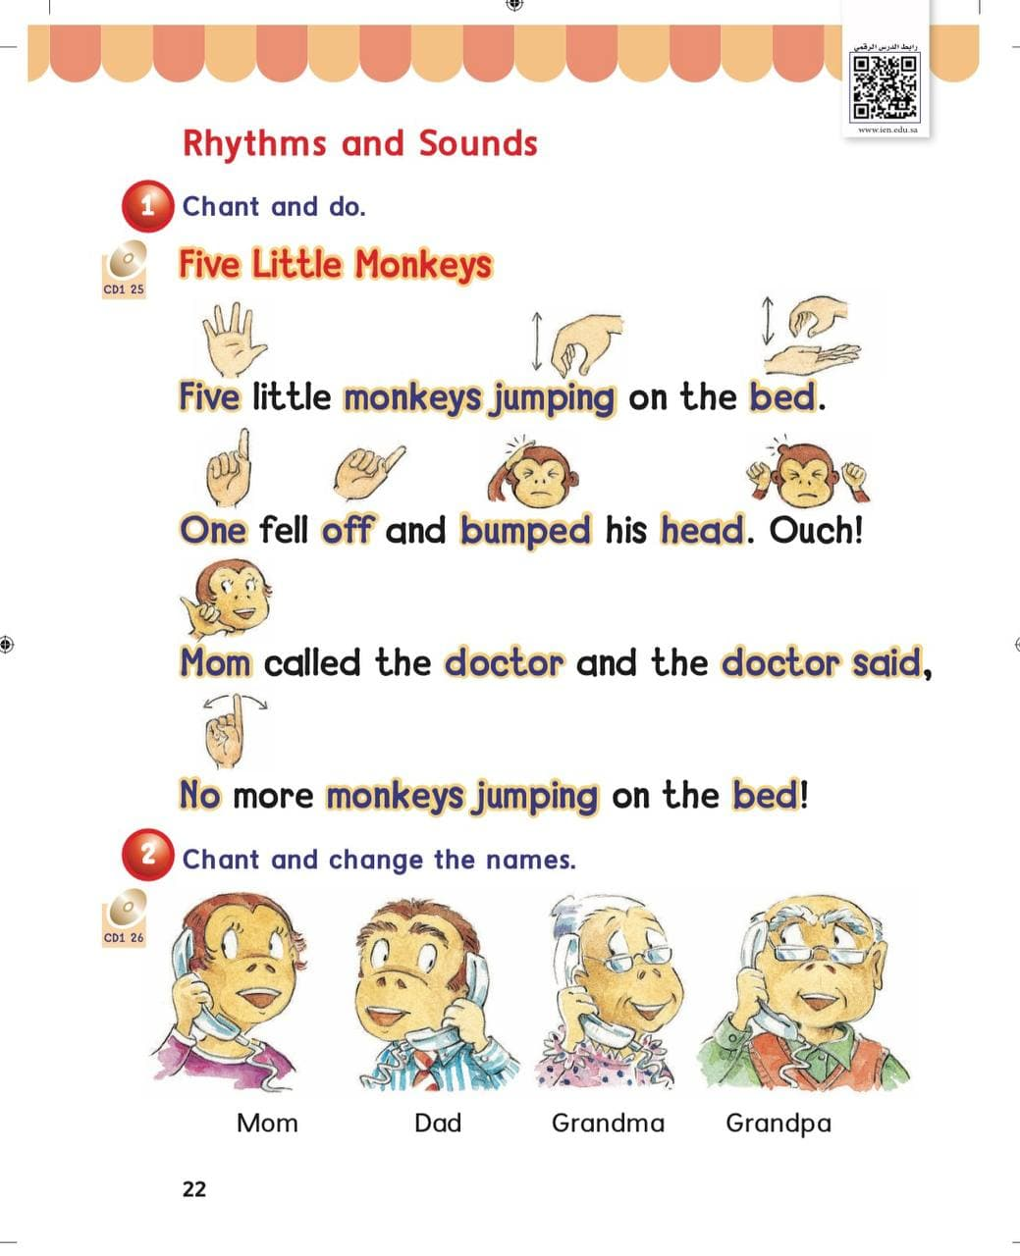
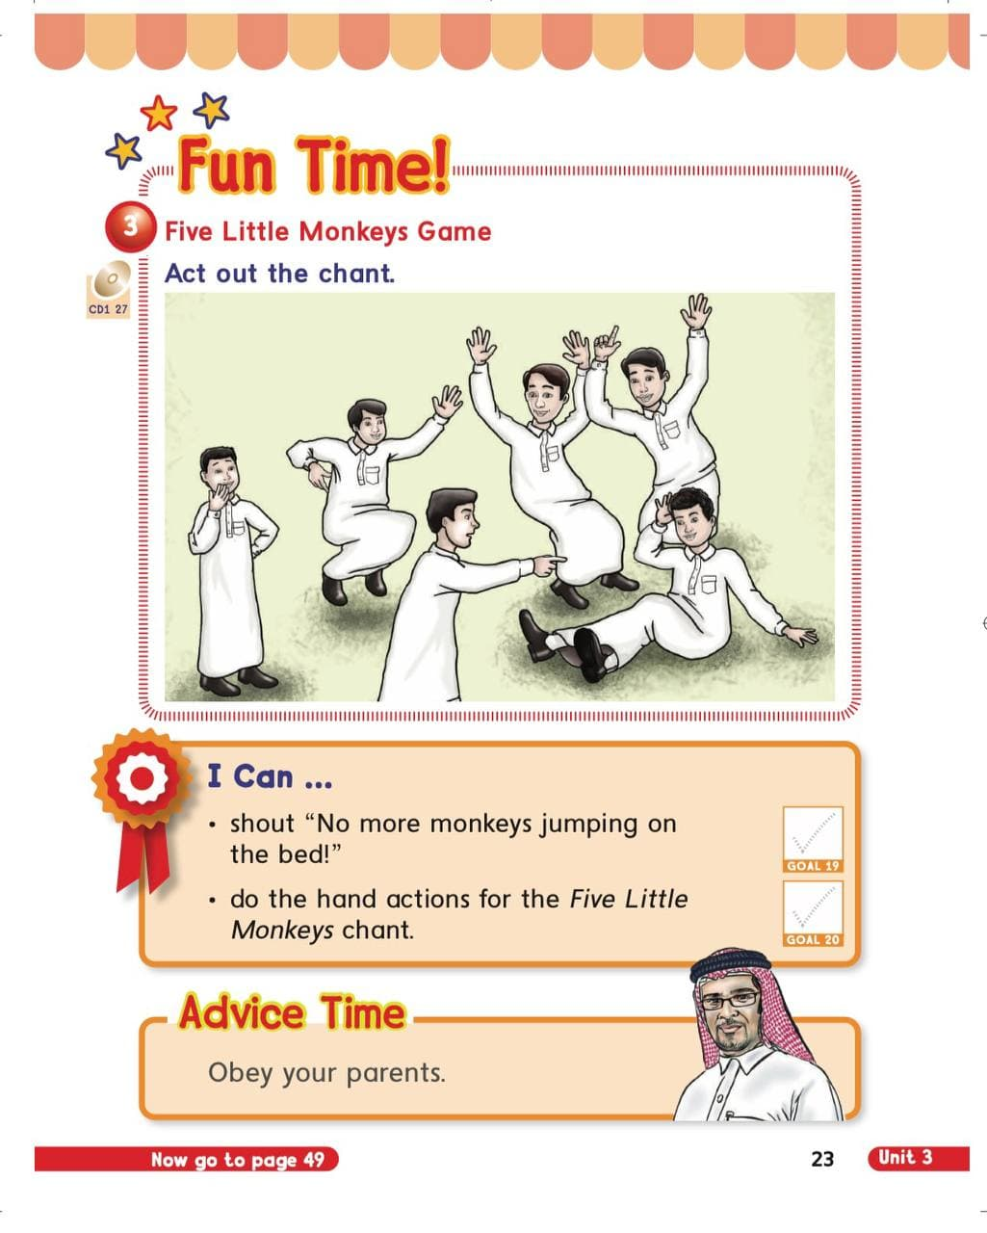

















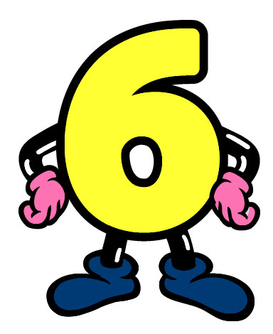
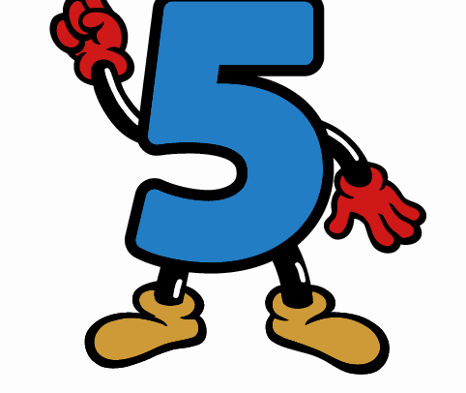


KSA National Anthem
Unit 3 : My Family
Warm up
Wednesday
Lesson 2: Rhythms and Sounds
Main lesson
Fun Time
P: 22
P: 23
work book
Moral Goal

Slide 2


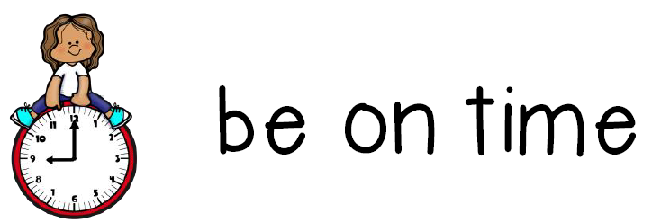




KSA National Anthem
Classroom Rules
Warm Up
Main lesson
Fun Time
work book
Moral Goal

Slide 3
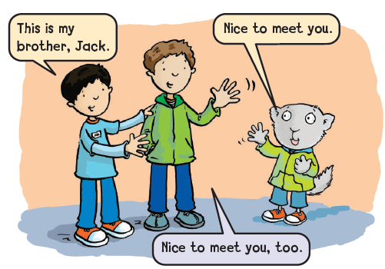
KSA National Anthem
Classroom Rules
Warm up
Main lesson
Fun Time
work book
Moral Goal

Slide 4

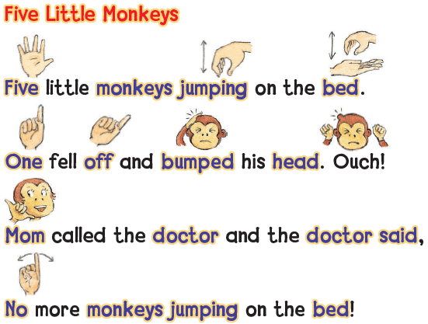
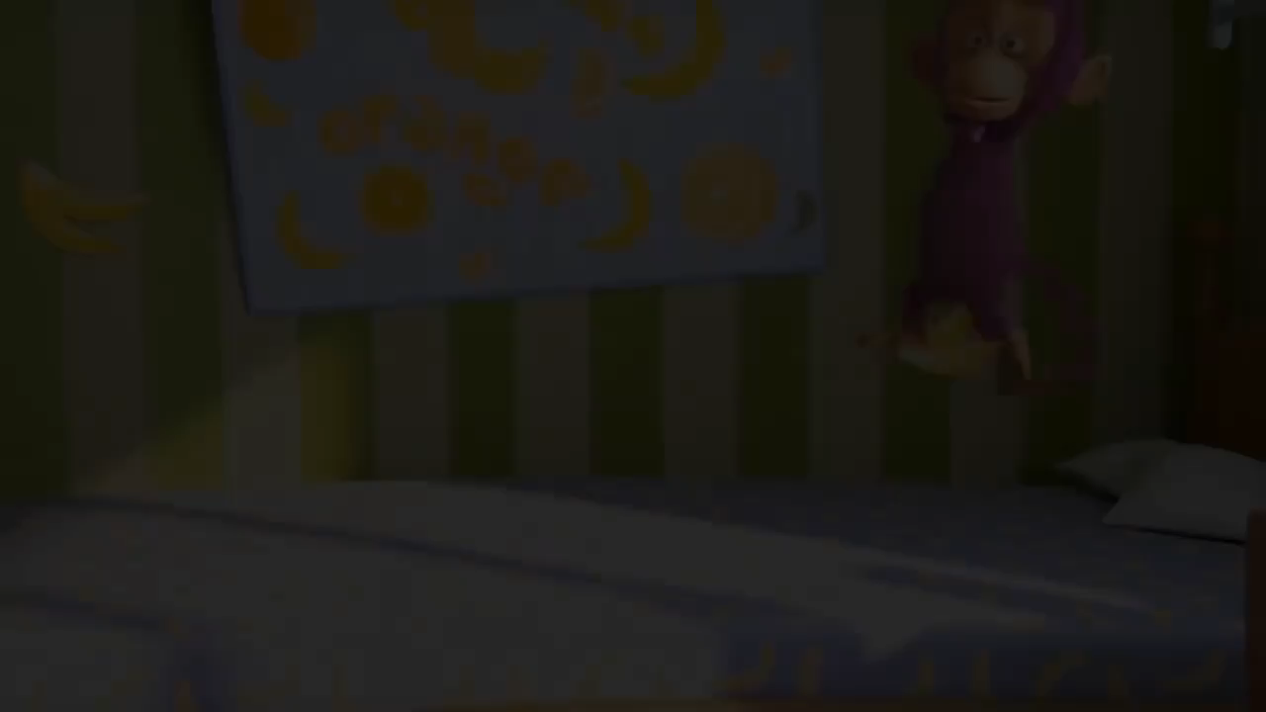

KSA National Anthem
Chant and do.
Classroom Rules
Warm up
Main lesson
Fun Time
work book
Moral Goal

Slide 5


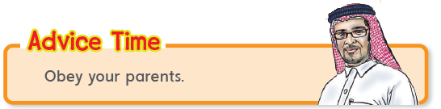

KSA National Anthem
Classroom Rules
Warm up
Main lesson
Fun Time
Work book
Moral Goal
أطع والديك دائما

Slide 6

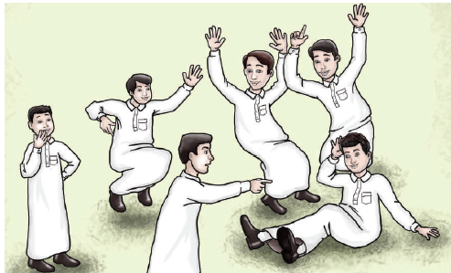

وقت المرح
KSA National Anthem
3
Classroom Rules
Warm up
Five Little Monkeys Game
Act out the chant .
Main lesson
Fun Time
work book
Moral Goal

Slide 7
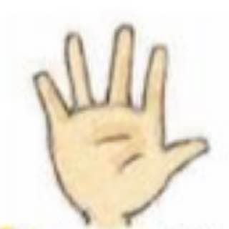
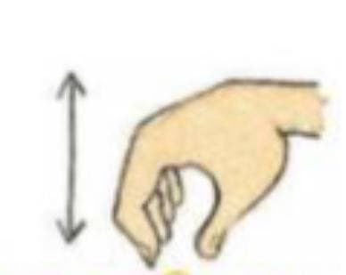
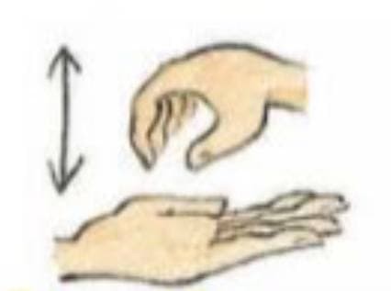
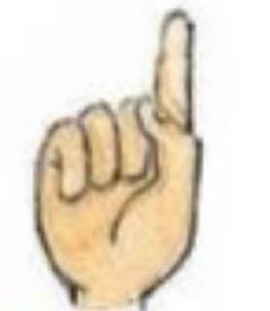
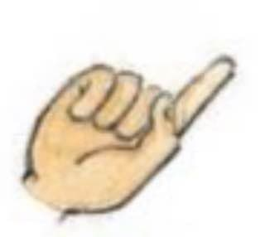
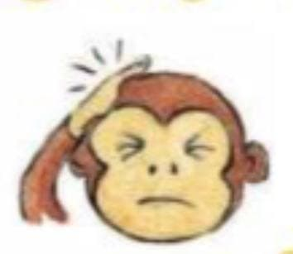
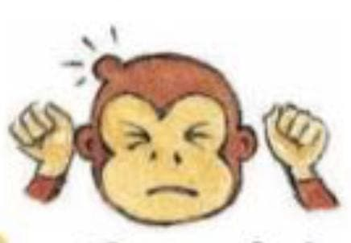
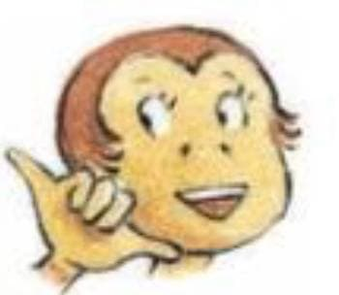
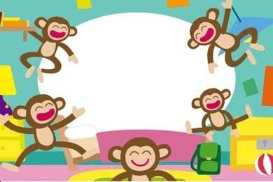
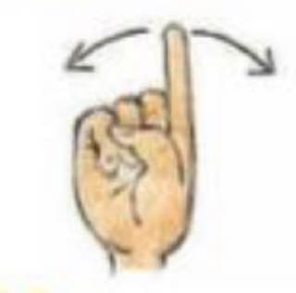
KSA National Anthem
Classroom Rules
Warm up
Main lesson
Fun Time
work book
Moral Goal

Slide 8
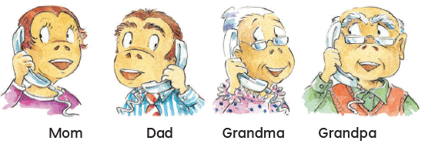

KSA National Anthem
Classroom Rules
Warm up
Main lesson
Fun Time
work book
Moral Goal
Chant and change the names
ردد الأنشودة مع تغيير الأسماء
2

Slide 9
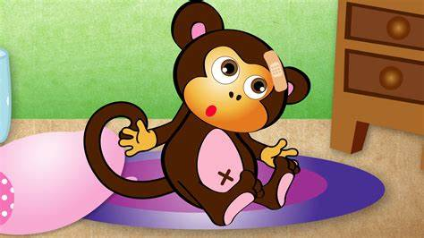
KSA National Anthem
What happened to him?
Classroom Rules
Warm up
Main lesson
1- bumped his hand
1-bumped his hand
Fun Time
work book
2-bumped his head.
Moral Goal
2- bumped his head.

Slide 10
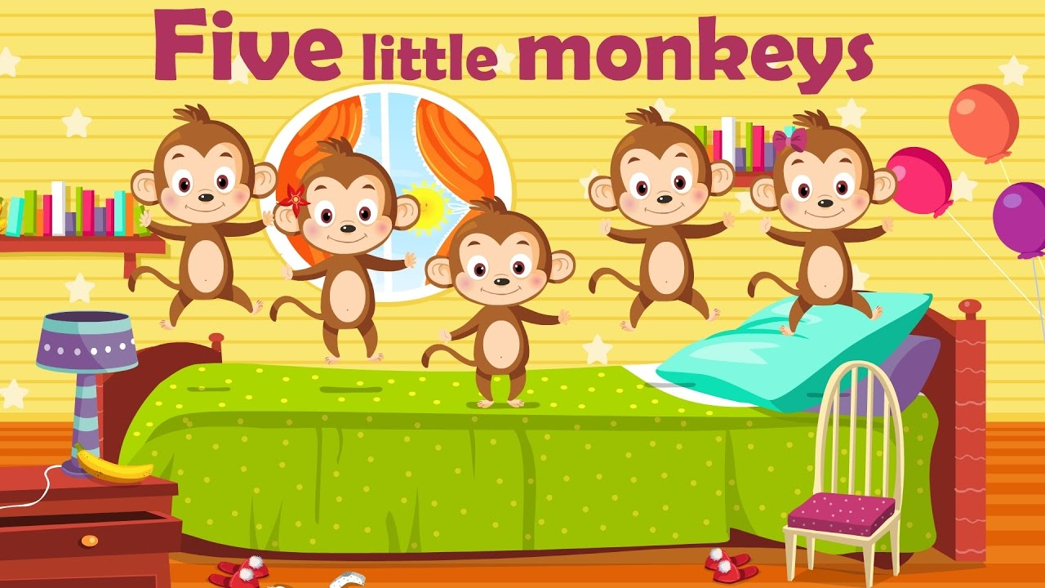
KSA National Anthem
What are they doing?
Classroom Rules
Warm up
1- jumping on the bed
Main lesson
1- jumping on the bed
Fun Time
work book
2- jumping on the book
2- jumping on the book
Moral Goal

Slide 11
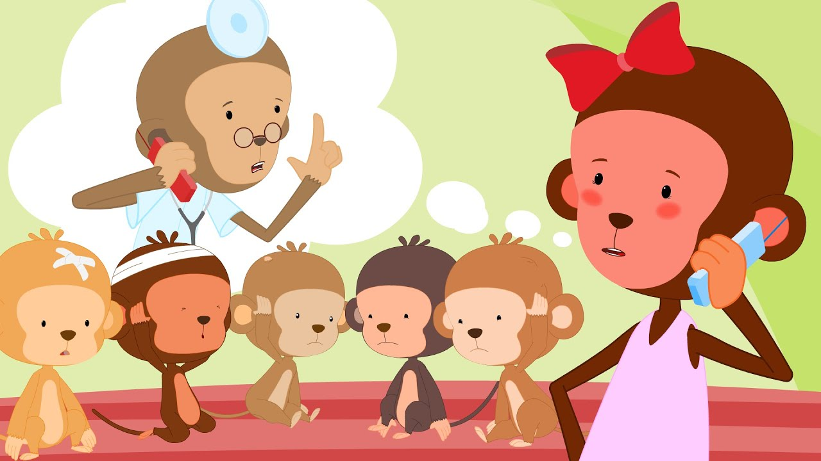
KSA National Anthem
What did the mother do?
Classroom Rules
Warm up
1- Called the
Father
Main lesson
1- Called the
Father
Fun Time
work book
2- Called the
doctor
Moral Goal
2- Called the
doctor

Slide 12


KSA National Anthem
The Doctor said
(……………)
Classroom Rules
Warm up
Main lesson
Fun Time
No more monkeys jumping on the bed!
work book
Moral Goal
Complete

Slide 13
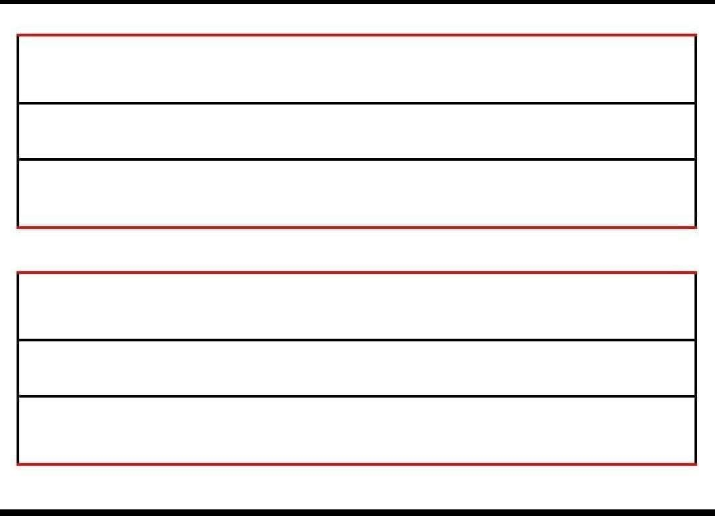
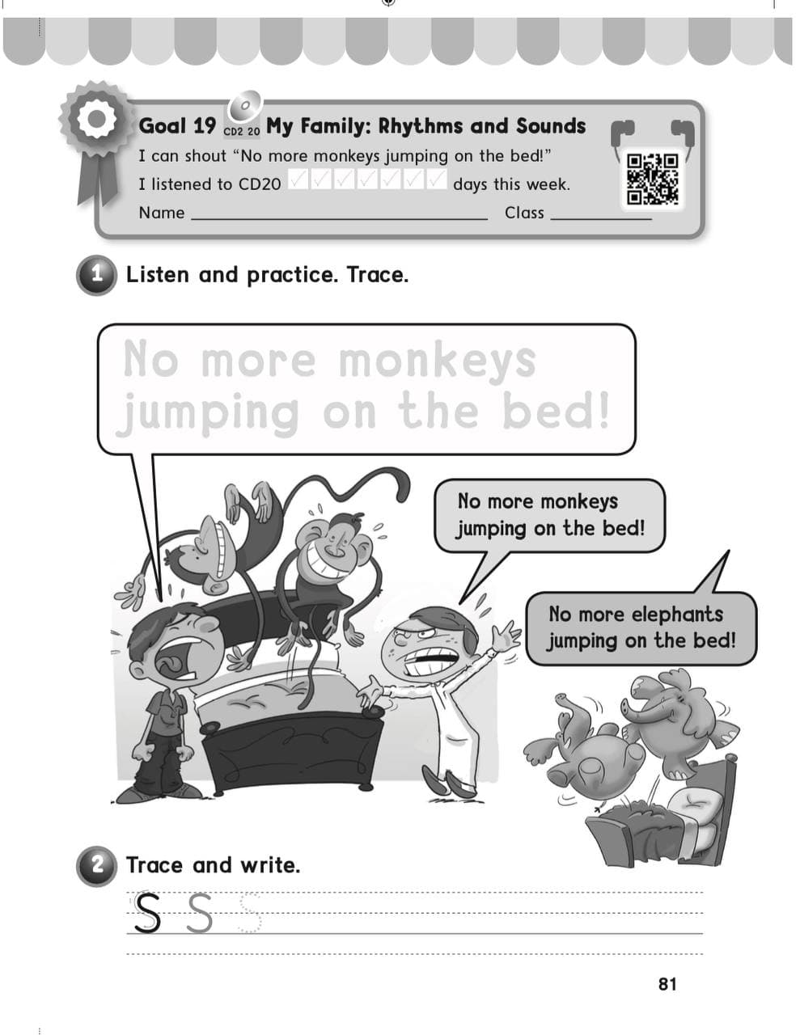
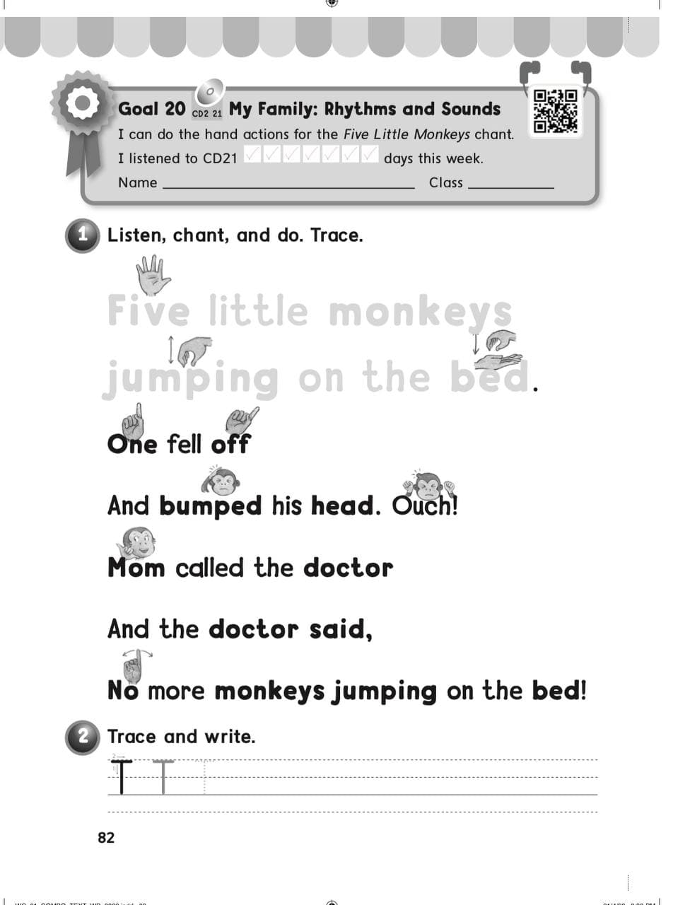
KSA National Anthem
Classroom Rules
Warm up
Main lesson
Fun Time
work book
Moral Goal
P: 81 / 82

Slide 14
