Slide 1



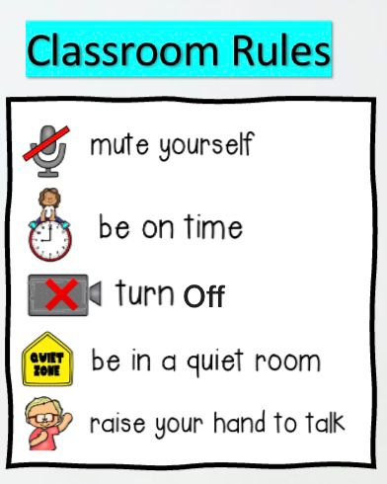



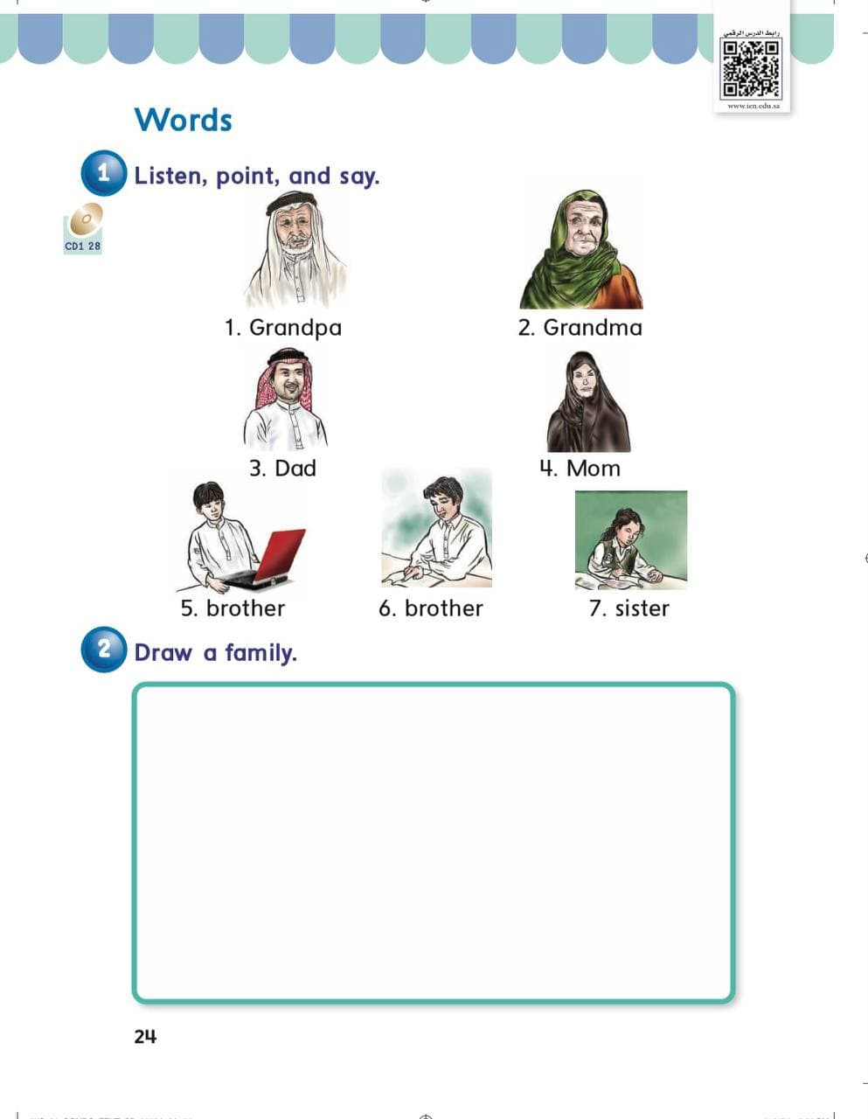
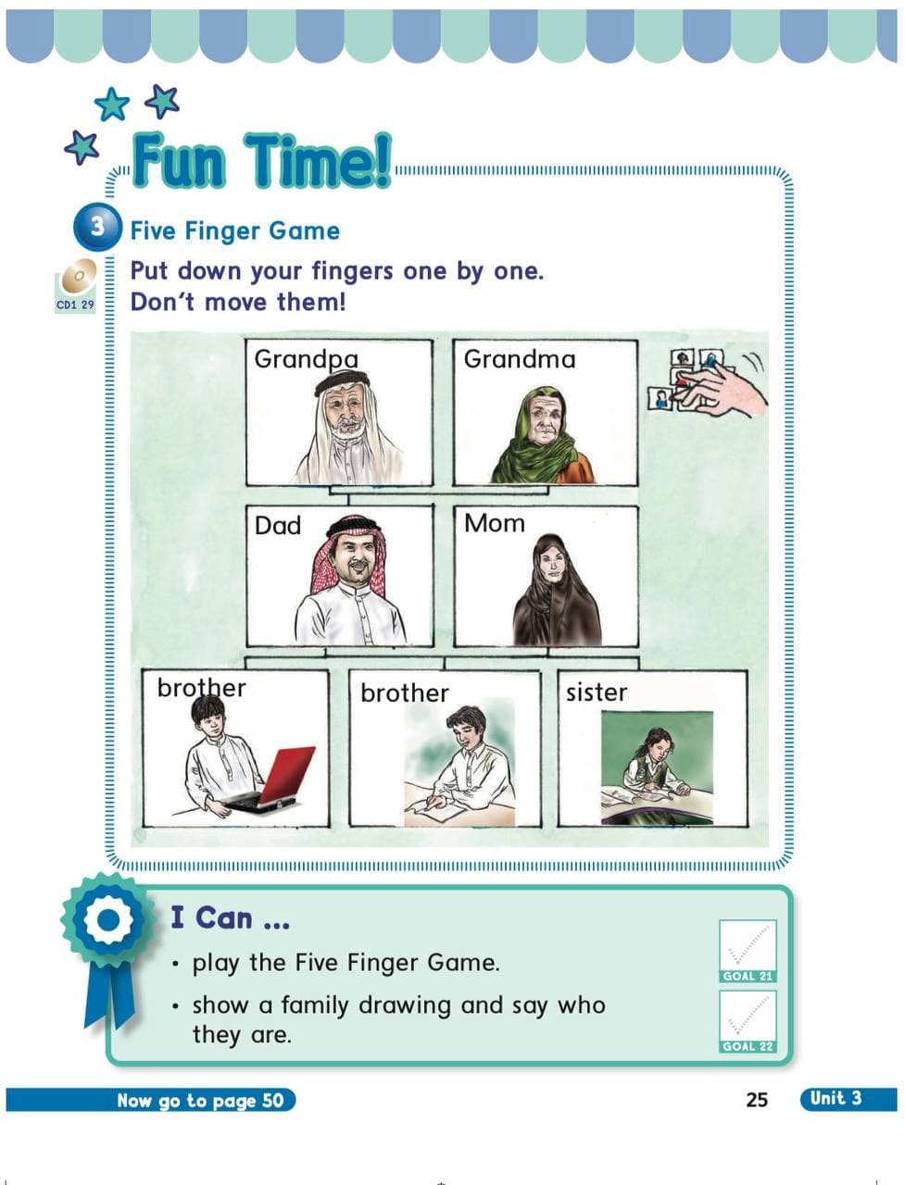





















KSA National Anthem
Unit 3 : My Family
Warm up
Monday
Lesson 3: Words
Main lesson
Fun Time
P: 24
P: 25
work book
Moral Goal

Slide 2







KSA National Anthem
Classroom Rules
Warm Up
Main lesson
Fun Time
work book
Moral Goal

Slide 3
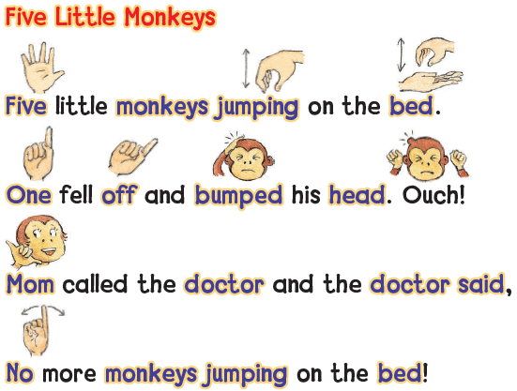
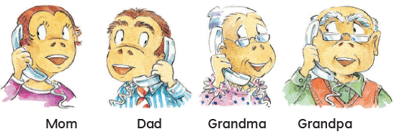
KSA National Anthem
Classroom Rules
Warm up
Main lesson
Fun Time
work book
Moral Goal

Slide 4
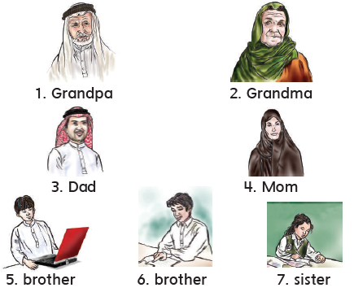
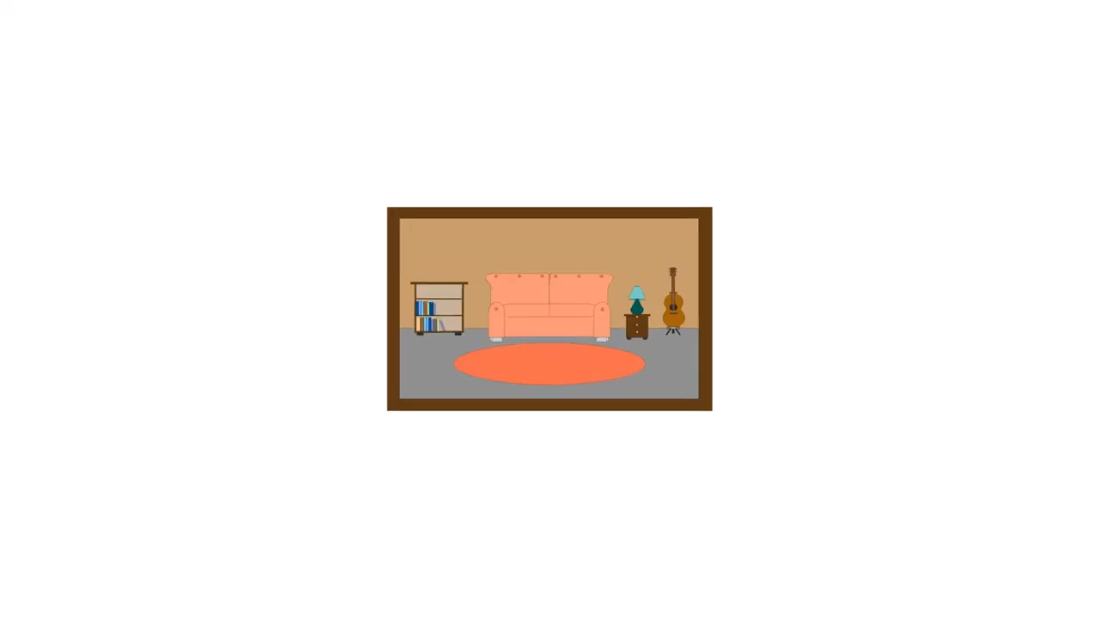

KSA National Anthem
Listen , point , and say
استمع ثم تابع الكلمة واقرأها
Classroom Rules
1
Warm up
Main lesson
Fun Time
work book
Moral Goal

Slide 5
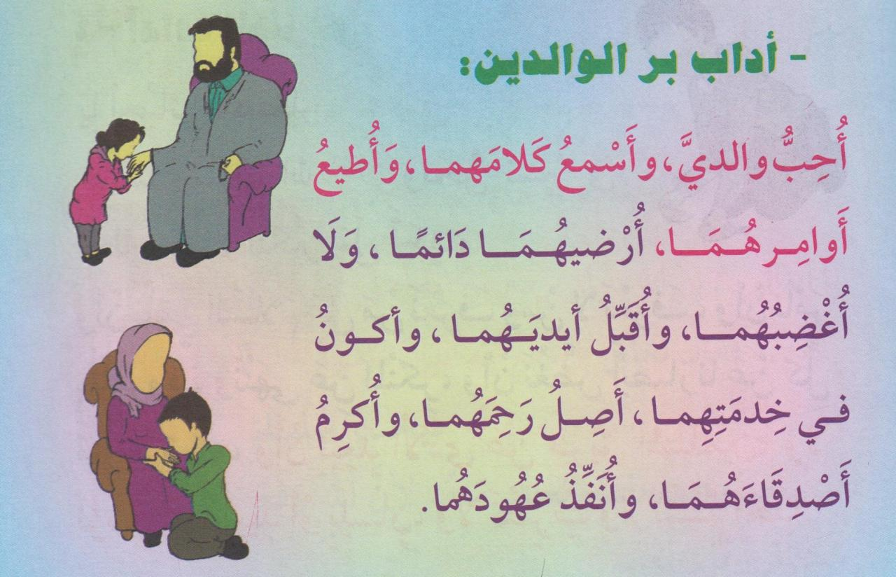

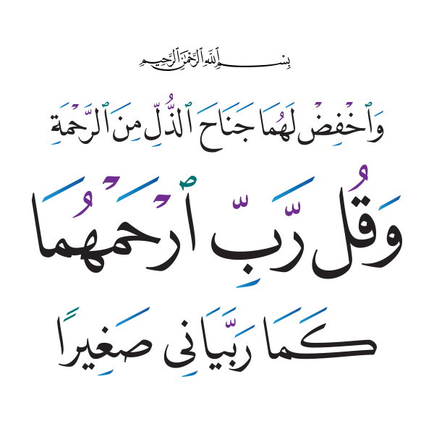
KSA National Anthem
Classroom Rules
Warm up
Main lesson
Fun Time
Work book
Moral Goal

Slide 6


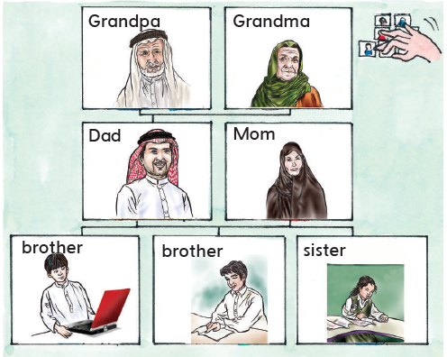

KSA National Anthem
Classroom Rules
Warm up
Five Finger Game
Put your fingers one by one .
Don’t move them !
3
Main lesson
Fun Time
work book
Moral Goal

Slide 7


KSA National Anthem
Classroom Rules
Draw a family
ارسم صورة للعائلة
2
Warm up
Main lesson
Fun Time
work book
Moral Goal

Slide 8
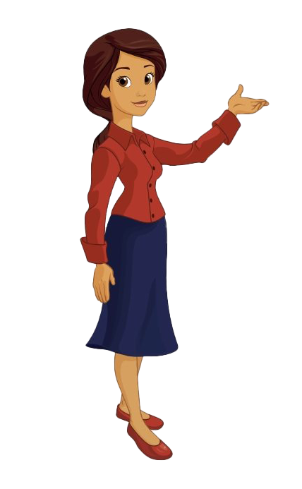
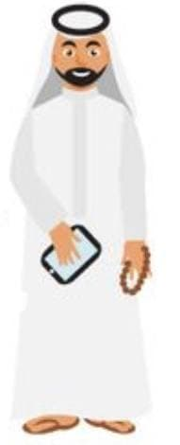
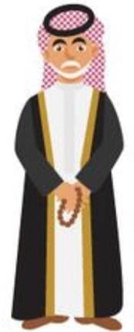
KSA National Anthem
Classroom Rules
My name is
My dad’s name is
My grandpa’s name is
Warm up
Main lesson
Wafa
Odaha
Ali
Fun Time
work book
Moral Goal

Slide 9
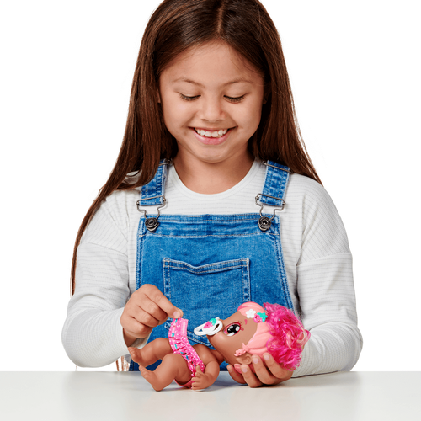
KSA National Anthem
Classroom Rules
Warm up
Main lesson
This is
my baby sister
Reem
Fun Time
work book
Moral Goal

Slide 10
KSA National Anthem
Classroom Rules
Warm up
What’s your dad’s name?
Main lesson
Fun Time
work book
Moral Goal

Slide 11
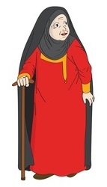
KSA National Anthem
Who is this?
Classroom Rules
Warm up
Main lesson
Fun Time
This is my
grandma
work book
Moral Goal

Slide 12

KSA National Anthem
Classroom Rules
Warm up
Main lesson
Fun Time
work book
Moral Goal

Slide 13
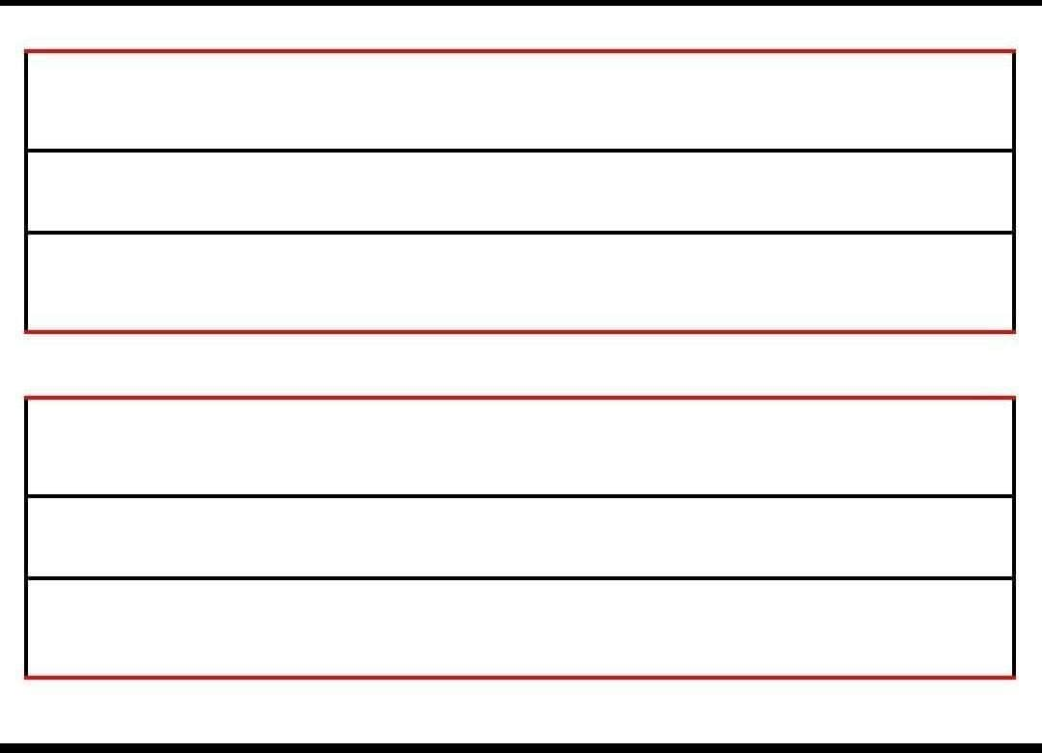
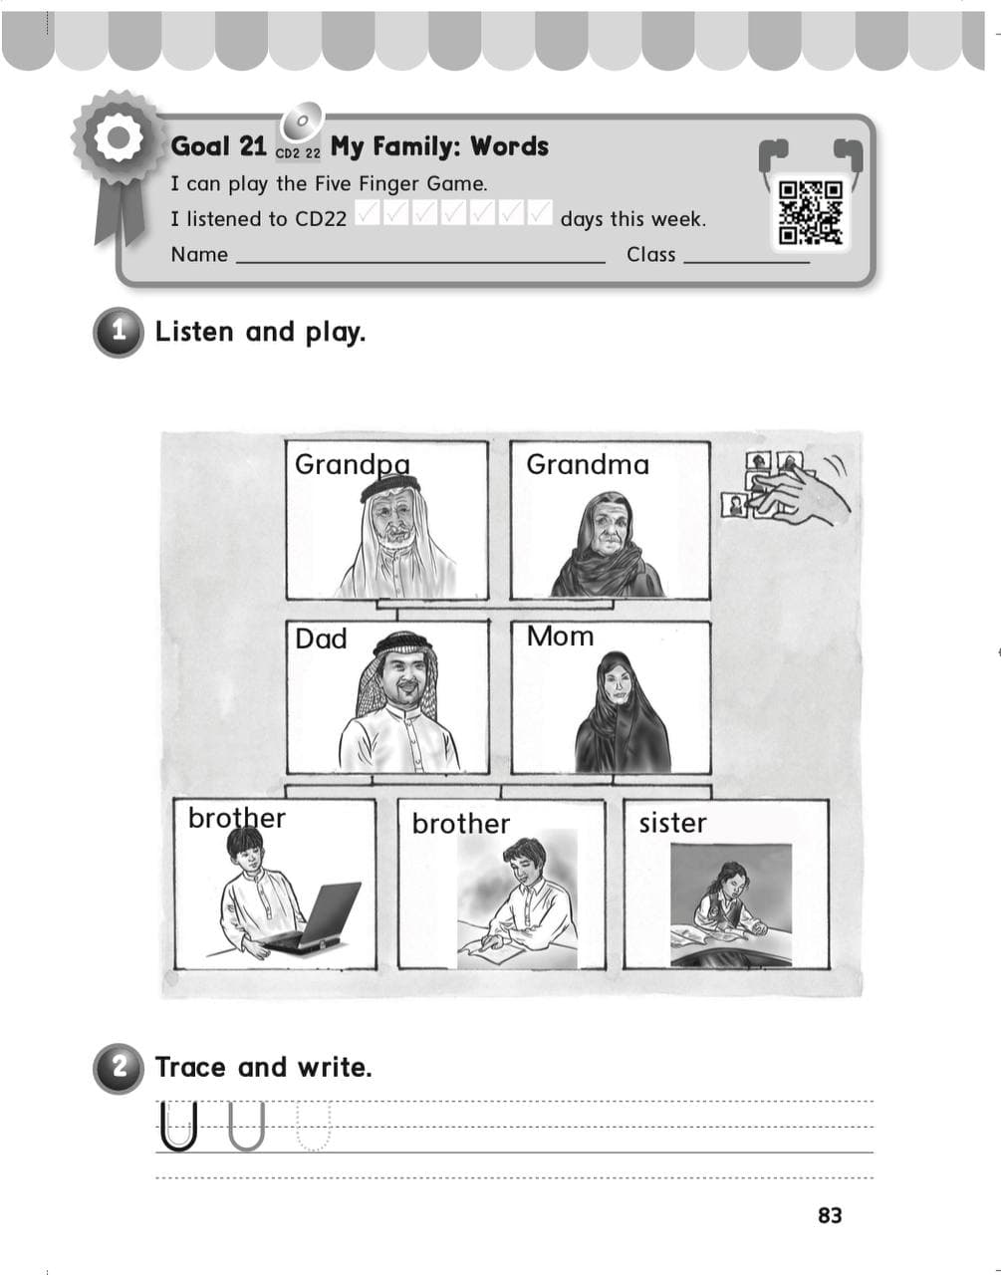
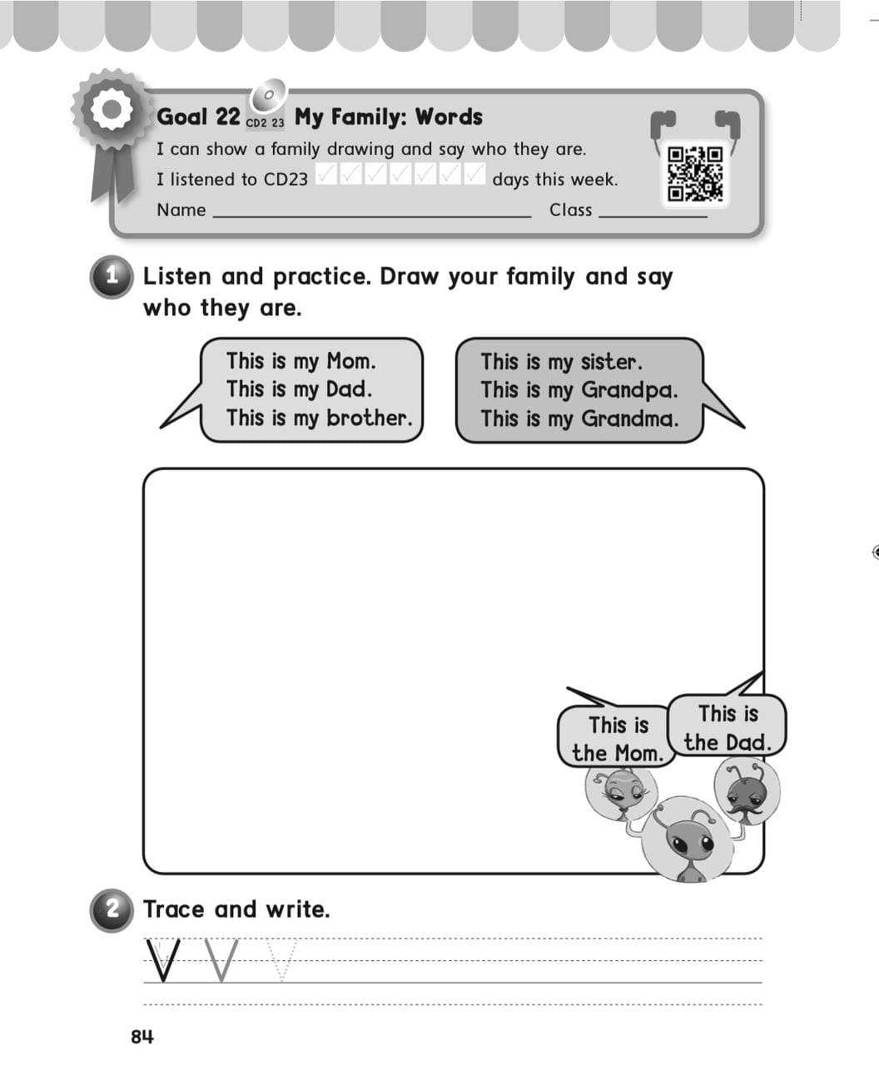
KSA National Anthem
Classroom Rules
Warm up
Main lesson
Fun Time
work book
Moral Goal
P: 83 / 84

Slide 14
