Slide 1



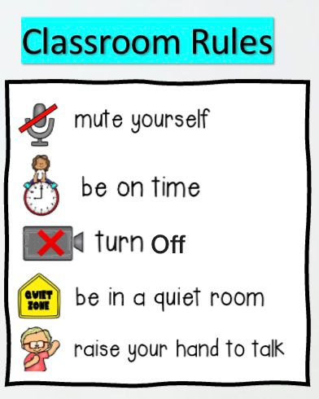



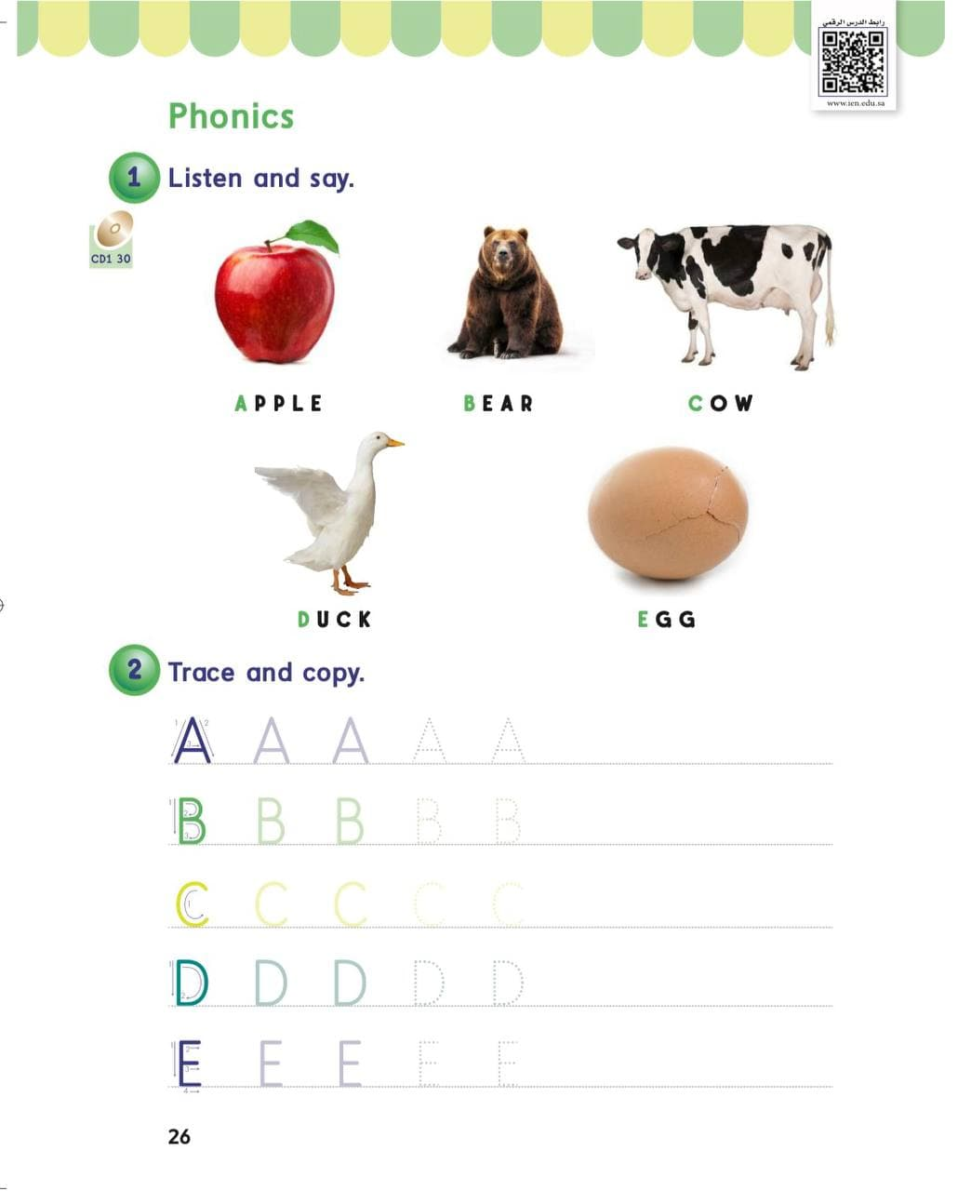
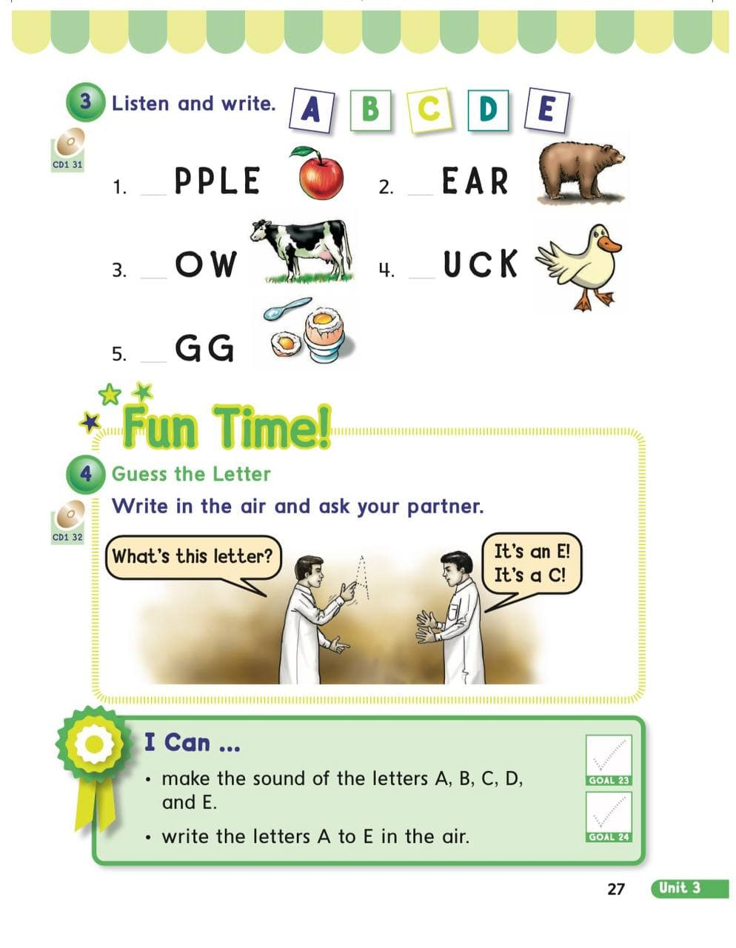





















KSA National Anthem
Unit 3 : My Family
Warm up
Wednesday
Lesson 4: Phonics
Main lesson
Fun Time
P: 26
P: 27
work book
Moral Goal

Slide 2







KSA National Anthem
Classroom Rules
Warm Up
Main lesson
Fun Time
work book
Moral Goal

Slide 3
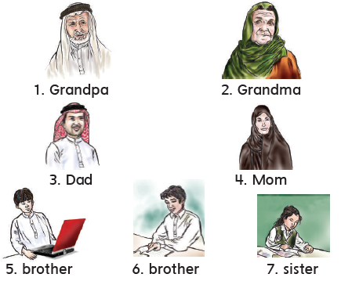
KSA National Anthem
Classroom Rules
Warm up
Main lesson
Fun Time
work book
Moral Goal

Slide 4
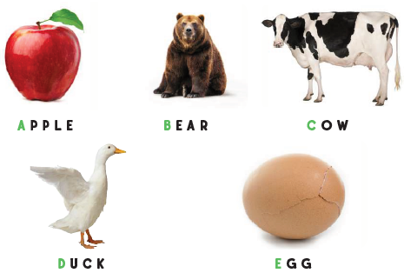
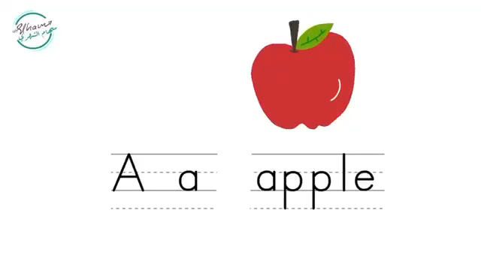

KSA National Anthem
Classroom Rules
1
Listen and say
استمع ثم ردد
Warm up
Main lesson
Fun Time
work book
Moral Goal

Slide 5
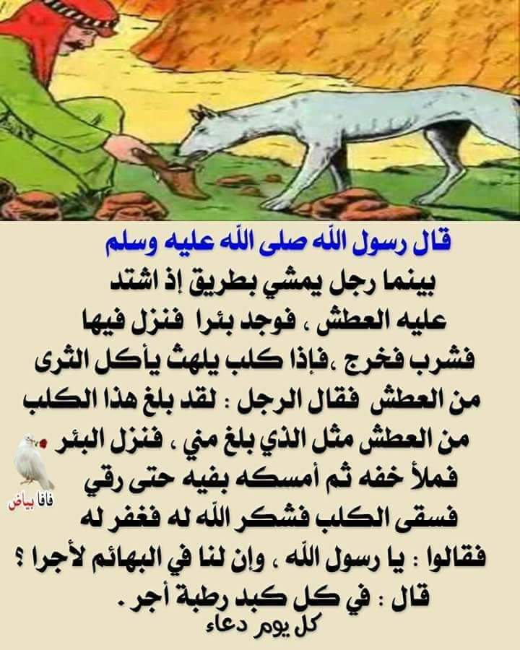
KSA National Anthem
Classroom Rules
الرفق بالحيوان
من أسباب المغفرة
Warm up
Main lesson
Fun Time
Work book
Moral Goal

Slide 6

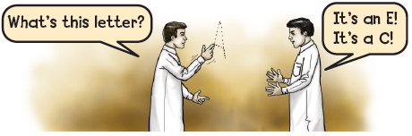

KSA National Anthem
Classroom Rules
Warm up
Guess the letter
Write in the air and ask your partner .
Main lesson
3
Fun Time
work book
Moral Goal

Slide 7
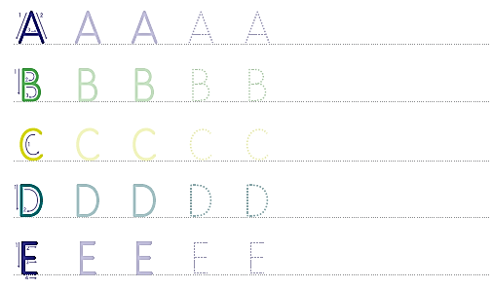
KSA National Anthem
Classroom Rules
2
Warm up
Trace and copy
Main lesson
A A A A
Fun Time
work book
B B B B
Moral Goal
C C C C
D D D D
E E E E

Slide 8
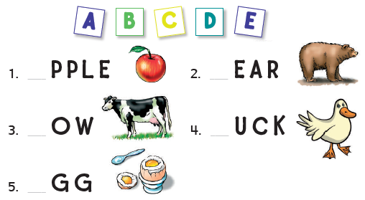

KSA National Anthem
Classroom Rules
3
Listen and write
استمع ثم اكتب
Warm up
Main lesson
Fun Time
work book
A
B
Moral Goal
C
D
E

Slide 9
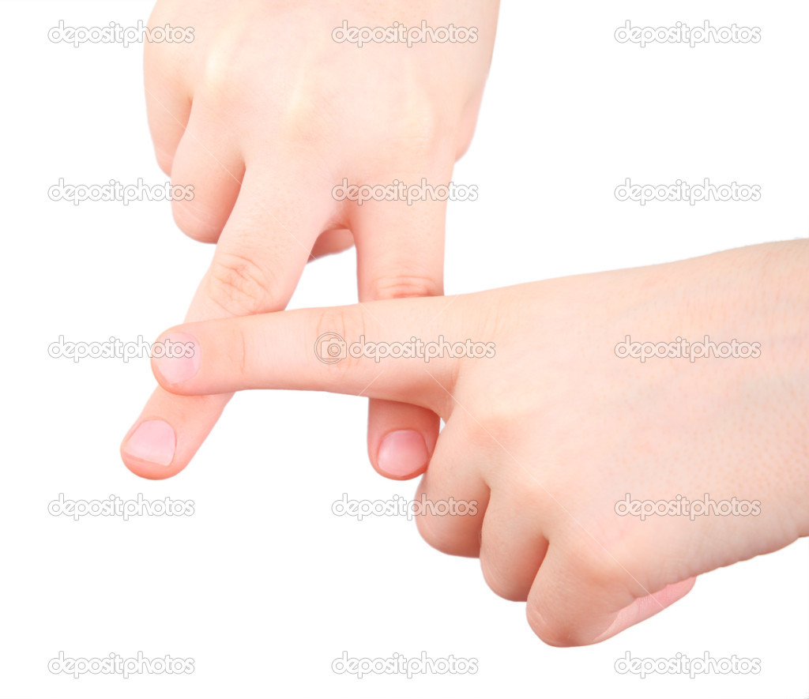
Guess the letter
KSA National Anthem
Guess the letter
Classroom Rules
Warm up
Main lesson
A
Fun Time
work book
Moral Goal

Slide 10
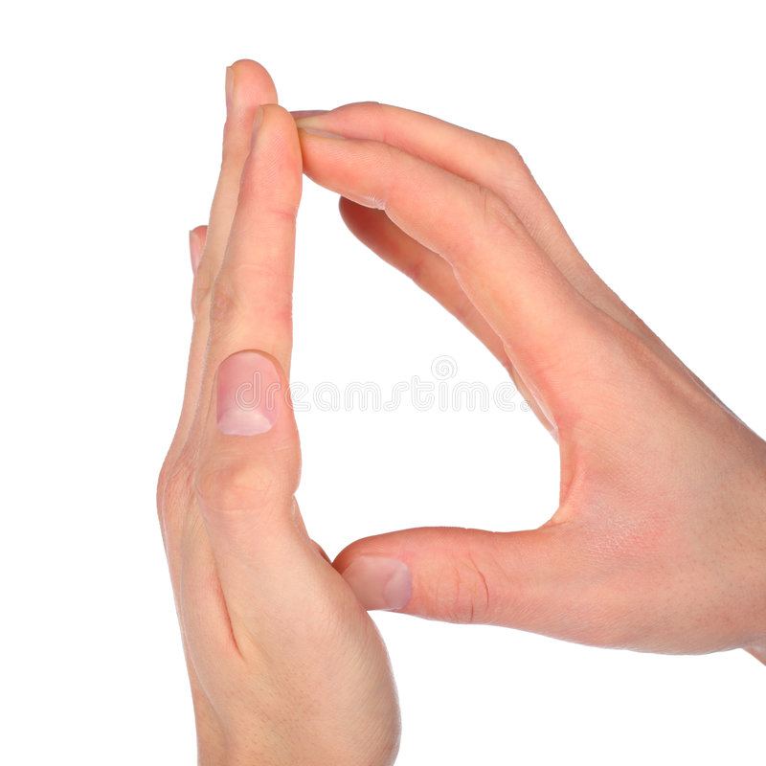
Guess the letter
KSA National Anthem
Classroom Rules
Warm up
Main lesson
D
Fun Time
work book
Moral Goal

Slide 11
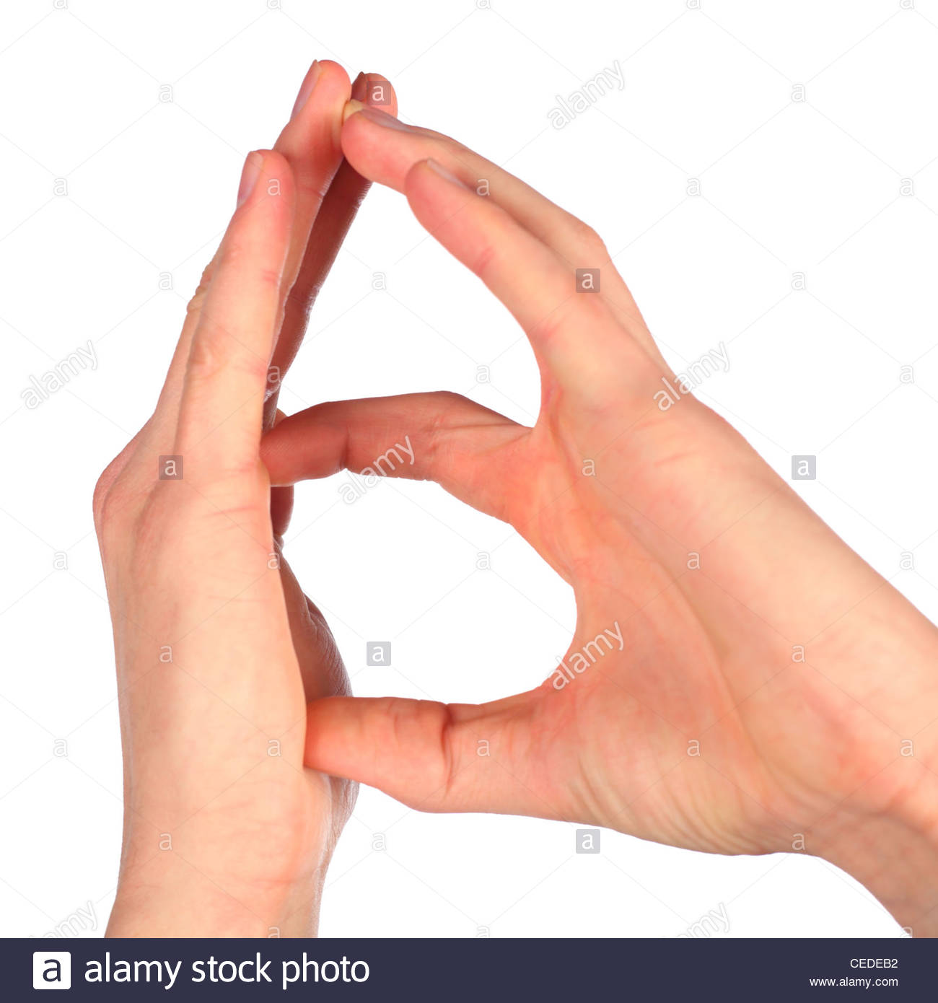
Guess the letter
KSA National Anthem
Classroom Rules
Warm up
Main lesson
B
Fun Time
work book
Moral Goal

Slide 12
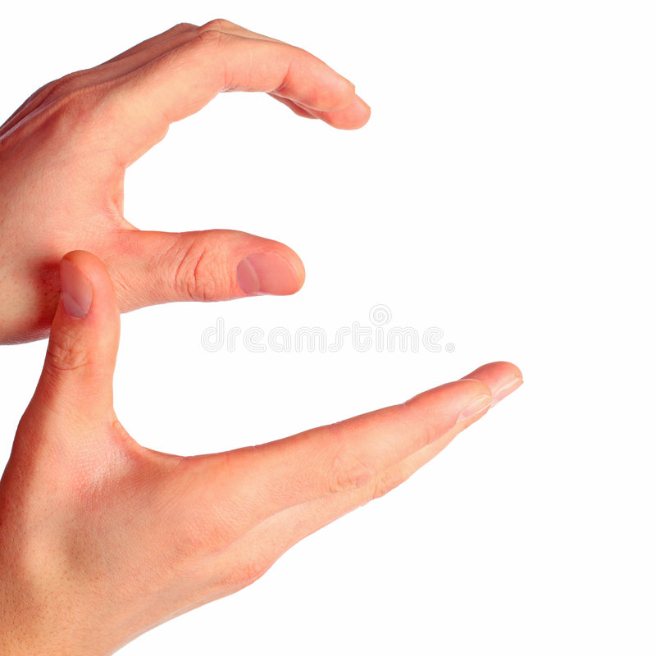
Guess the letter
KSA National Anthem
Classroom Rules
Warm up
Main lesson
E
Fun Time
work book
Moral Goal

Slide 13
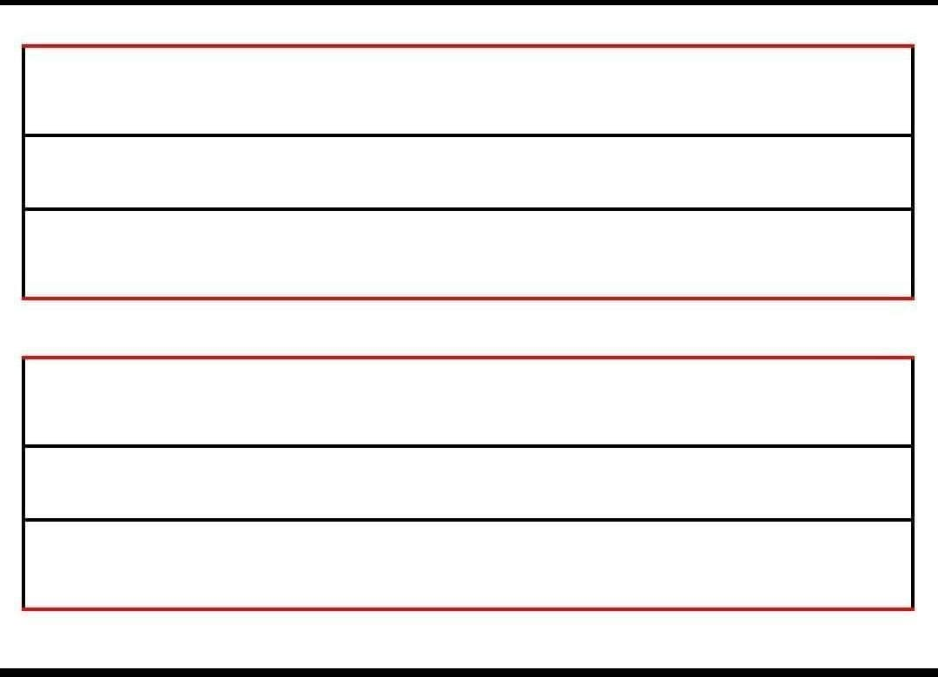
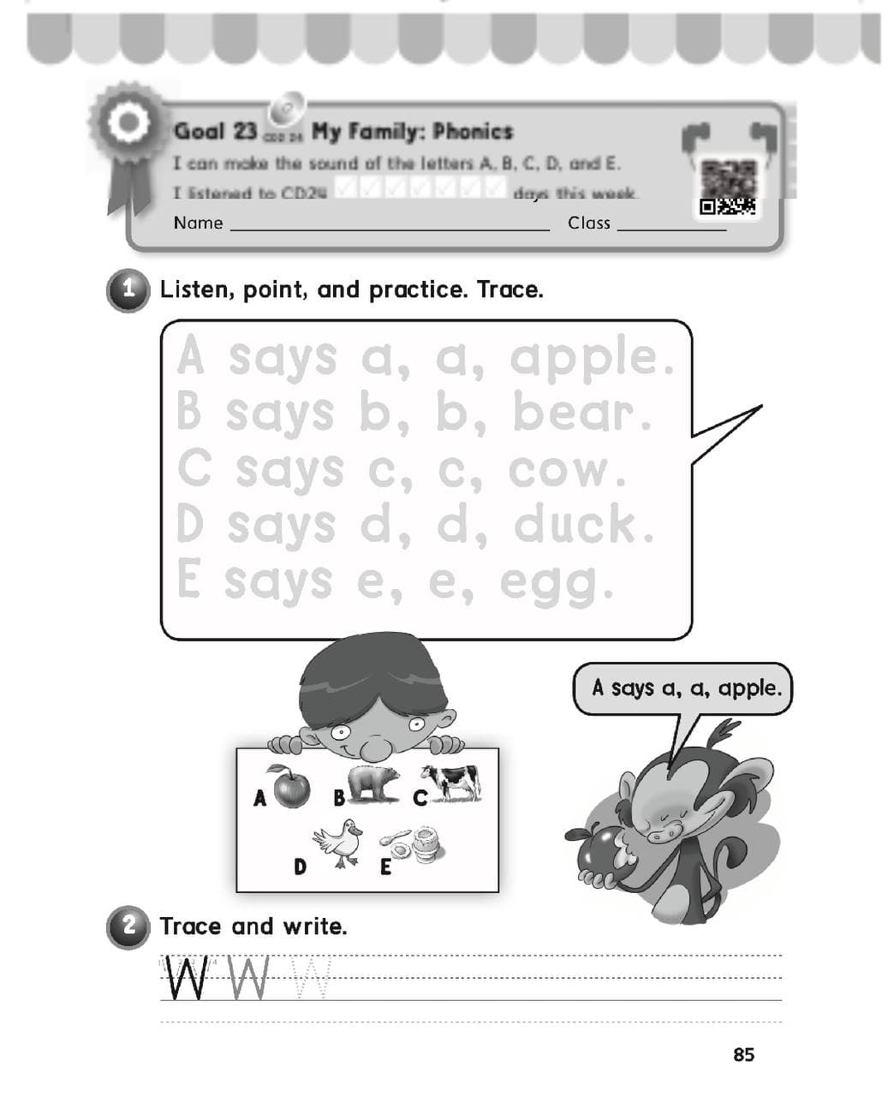
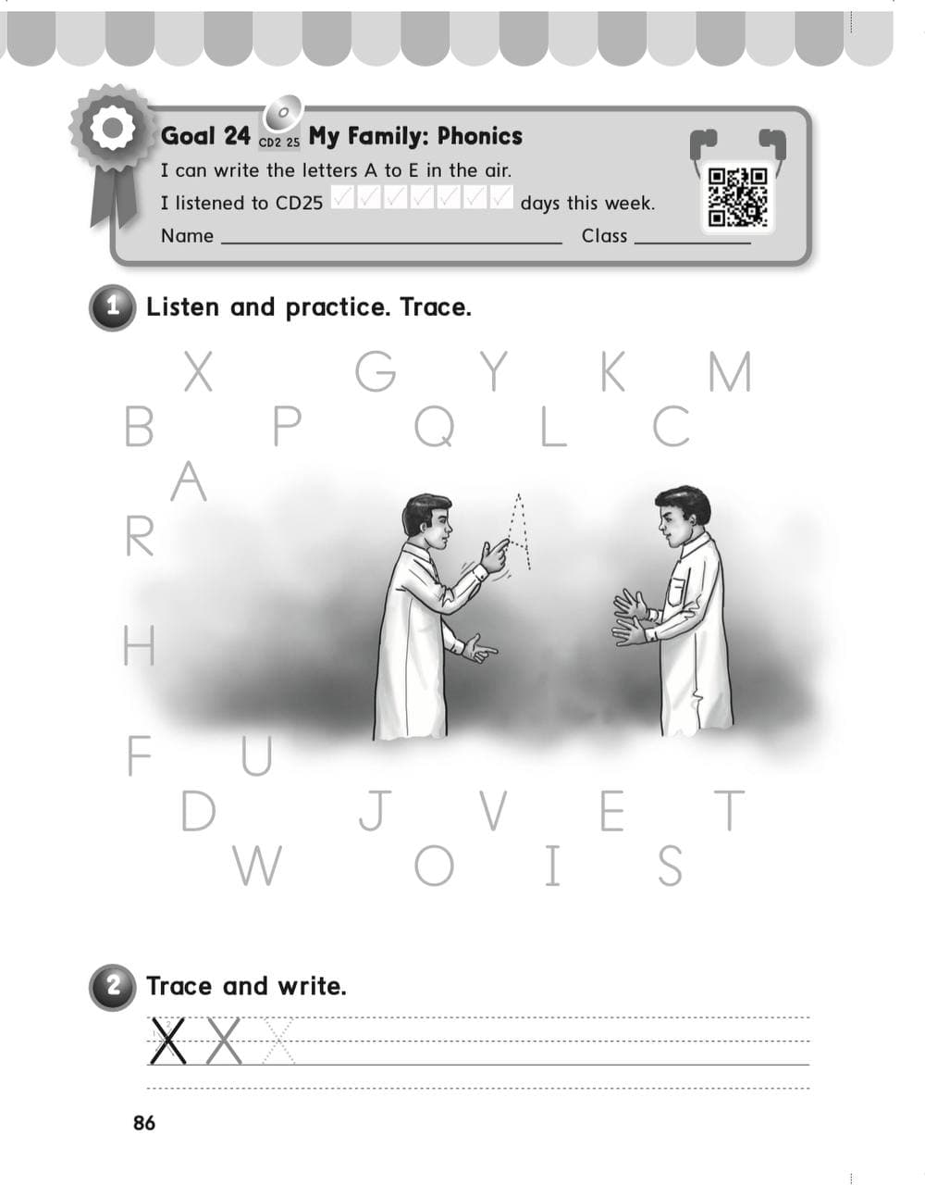
KSA National Anthem
Classroom Rules
Warm up
Main lesson
Fun Time
work book
Moral Goal
P: 85 / 86

Slide 14
