Slide 1
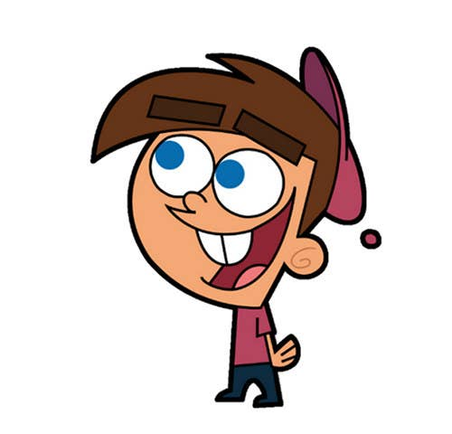


Welcome to class
T.
Mohamad
Zaid

Slide 2
Day
Sunday
Date
2nd OCT 2022
Subject
We can 3
Unit
2 Sea Animals
Lesson
2 Grammar in Action

Slide 3

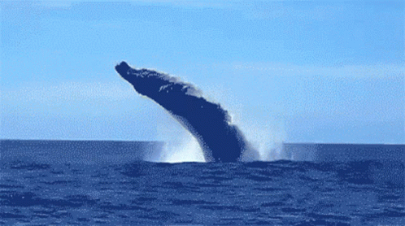
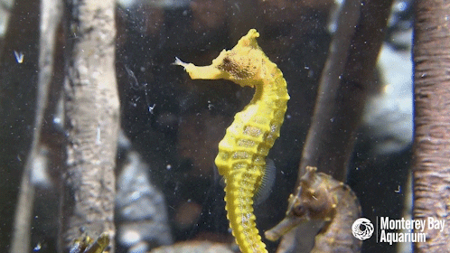
Revision for the previous unit :
What is this?
What is this?

Slide 4
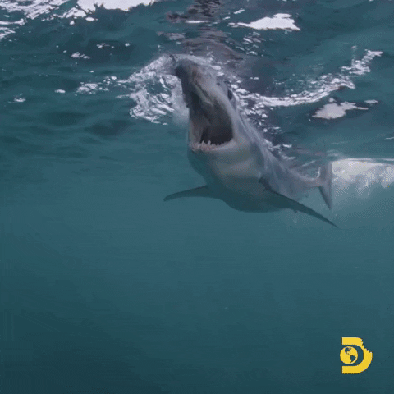
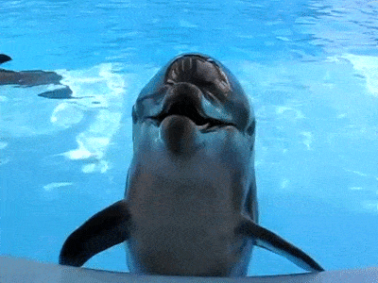
Revision for the previous unit :
scary
cute
Sharks are ……….
Dolphin is ………..

Slide 5





PAGEs 12 , 13

Slide 6


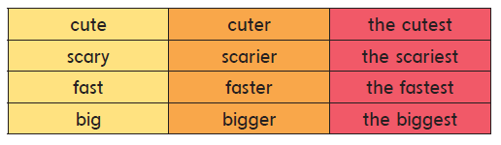
Grammar in Action
Listen , point and say

Slide 7

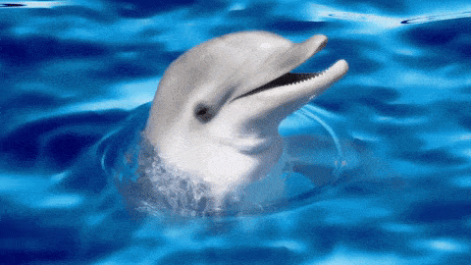
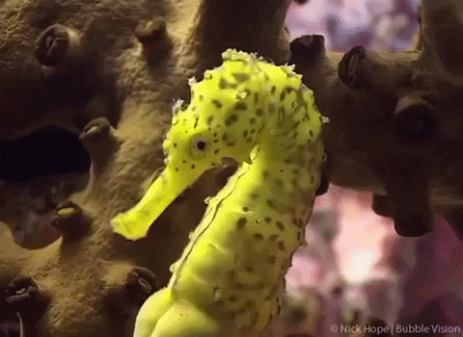
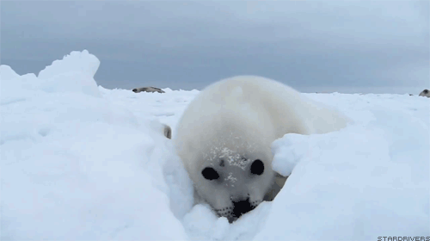
I think
a dolphin is cute
a seahorse is cuter than dolphin
a baby seal is the cutest

Slide 8

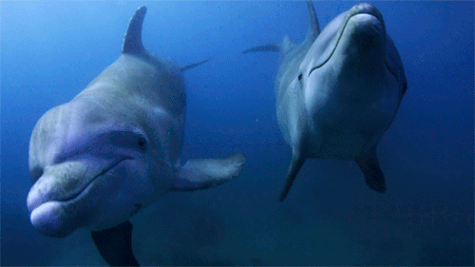
I think
Whales are fast
sharks are faster than whales
Dolphins are the fastest

Slide 9


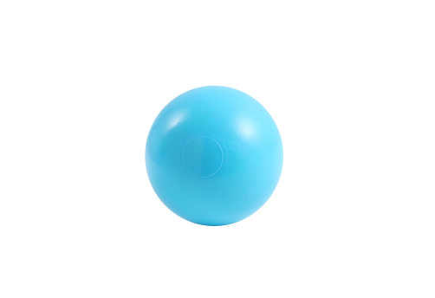
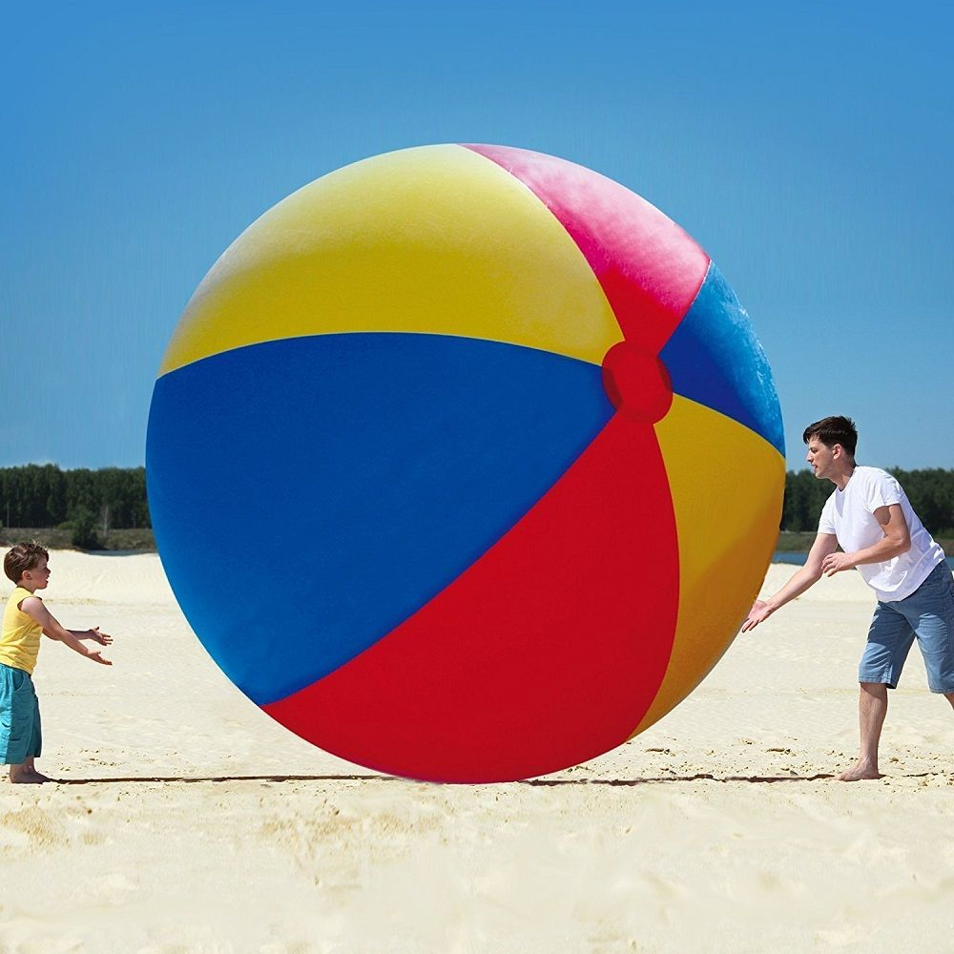
I think
ball is big
this ball is bigger than that ball
this ball is the biggest

Slide 10
I think
big
bigger than
the biggest
scary
scarier than
the scariest
fast
faster than
the fastest
cute
cuter than
the cutest
tall
taller than
the tallest

Slide 11

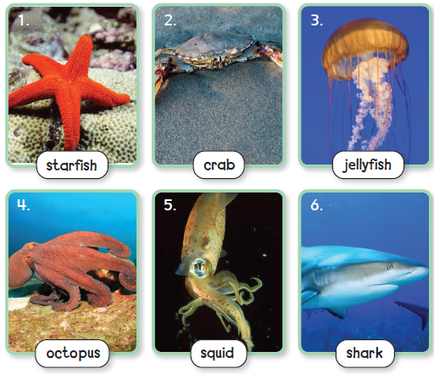

Three hints game
Can you listen to three hints and guess which sea animal it is ?

Slide 12
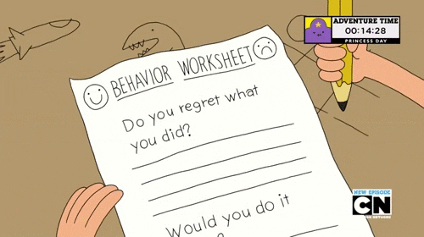


https://www.liveworksheets.com/lg2373766lk

Slide 13



https://wordwall.net/resource/21596184

Slide 14


Open your workbook
Pages

Slide 15


Home work at

Slide 16


