Slide 1
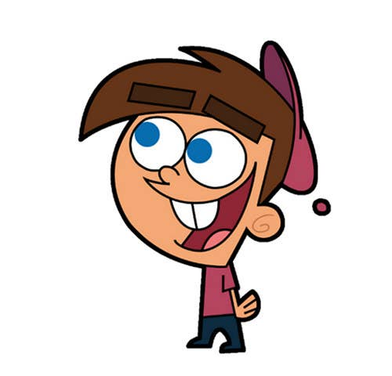


Welcome to class
T.Hanan Allaheeb

Slide 2
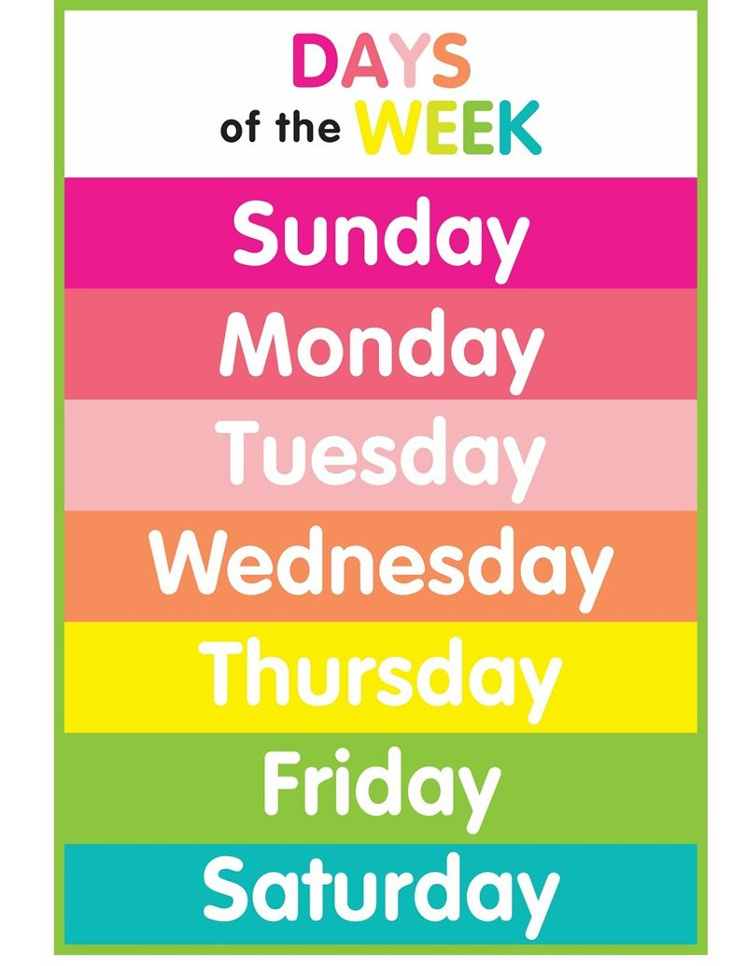
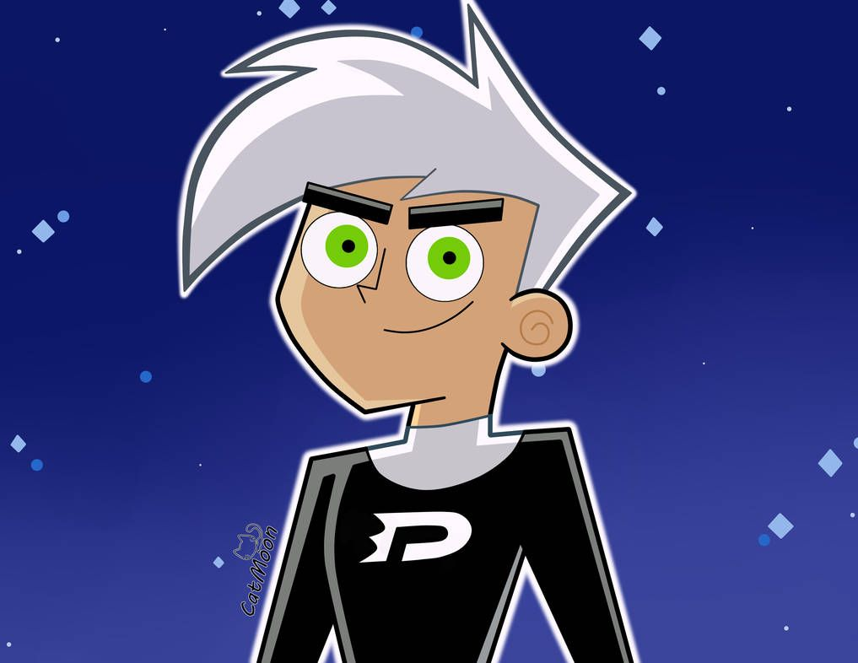
Say the days of the week

Slide 3


W hat day is it today?
It`s…………………..

Slide 4
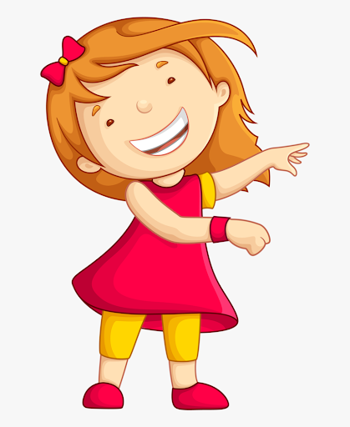

p 8

Slide 5


P
Sea animals
Sea

Slide 6


P
A sea horse
dolphins

Slide 7
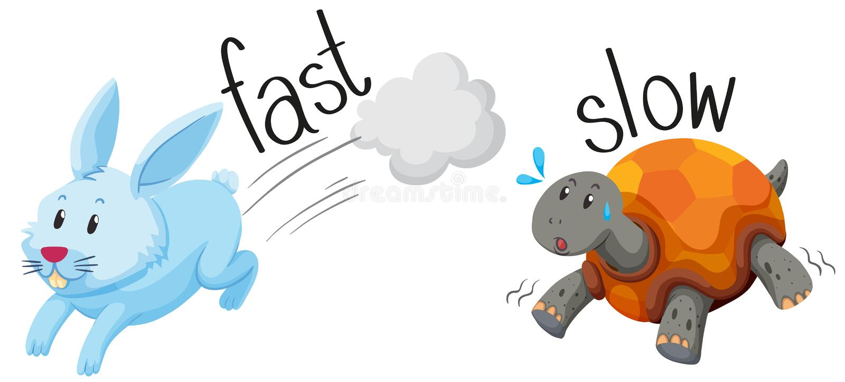
p 8
Adjectives

Slide 8
P
Fast or slow
Fast or slow
A sea horse is …….
Dolphins are …...

Slide 9
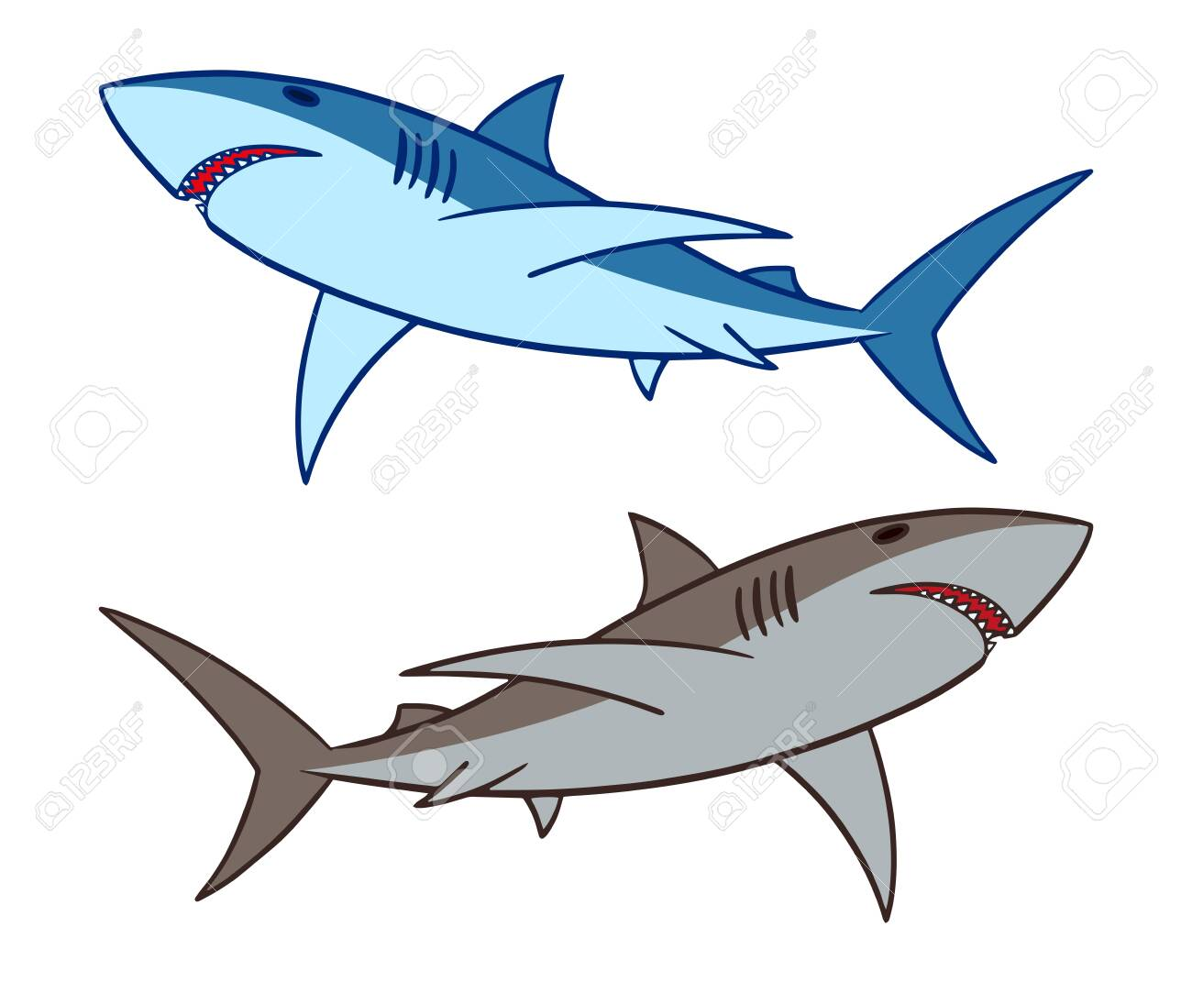
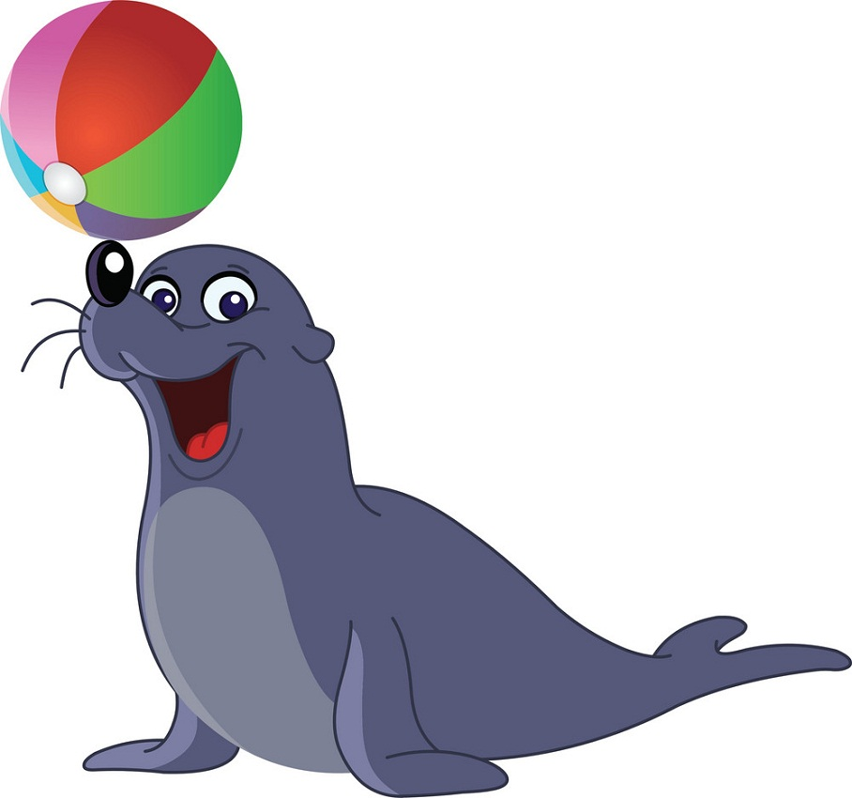
P
Sharks
seals

Slide 10


Cute
Adjectives
scary

Slide 11
P
cute or scary
cute or scary
seals are …….
Sharks are …….

Slide 12

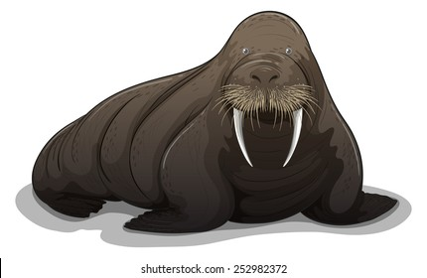
P
A whale
A walrus

Slide 13
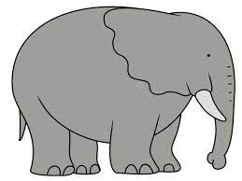
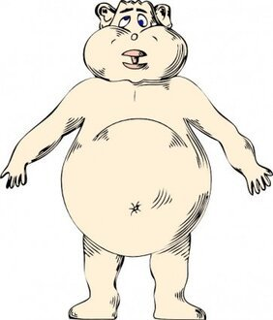
Big
Adjectives
Fat

Slide 14
P
big or fat
big or fat
A whale is …….
A walrus is …….

Slide 15
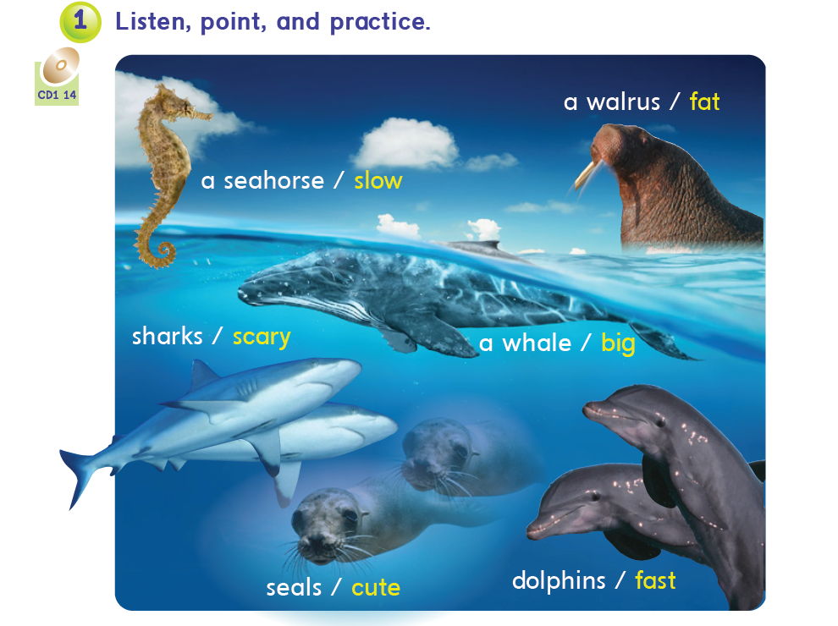

p 10

Slide 16
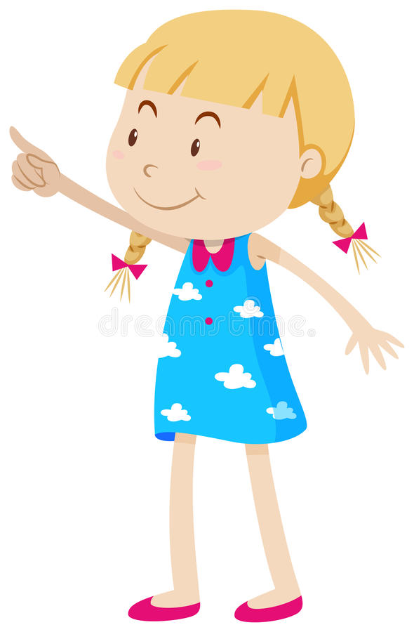


Slide 17
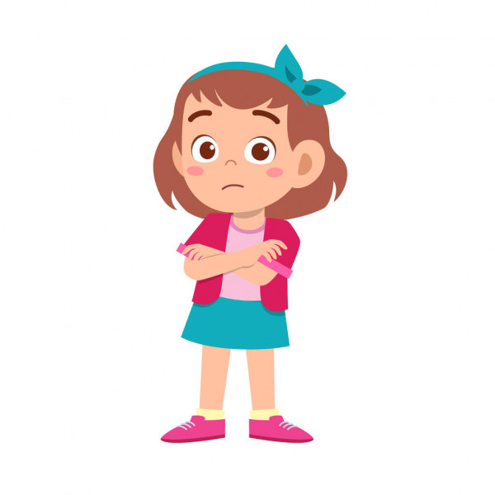
What`s that?
It`s a …………..

Slide 18
What`s that?
…………..

Slide 19
What are those?
They`re …………..

Slide 20
What`s those?
…………..

Slide 21
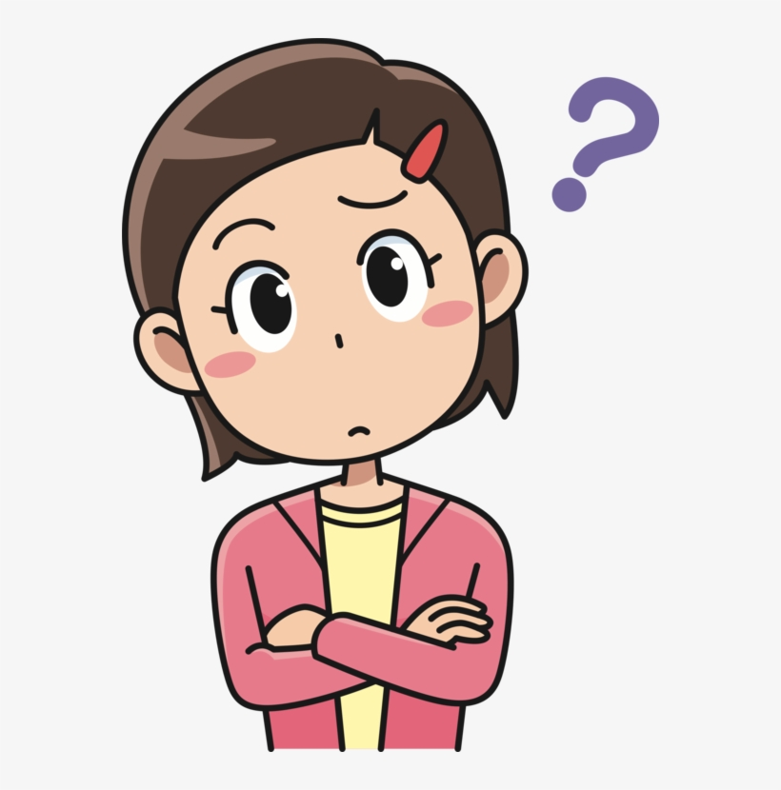

…………………..
I think a seal is cute

Slide 22
…………………..
I don`t think a seal is big.

Slide 23
…………………..
…………………

Slide 24



