Slide 1
Unit 4
The World of TV
Reading
Mega Goal 3.1
Done by: Entisar Al-Obaidallah

Slide 2
Lesson Objectives
01
Identify
02
Read
03
Answer
04
Distinguish
True or False
questions about
the passage
Between two
TV films or
documentaries
the formula of deductive stories on TV.
The passage for specific
information

Slide 3
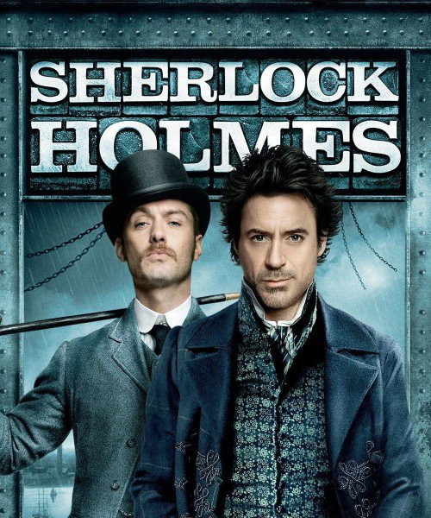
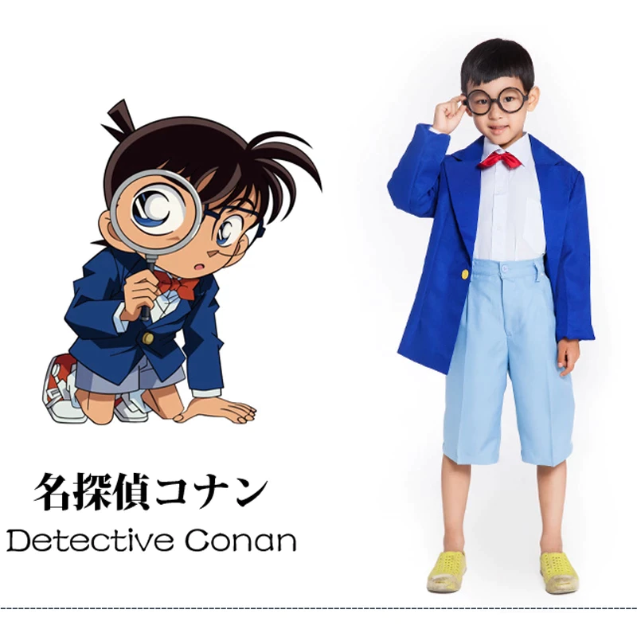
Warm up
What does the word detective mean ?
A detective is someone whose job is to
discover what has happened in a crime or other situation and to find the people
involved.
Name some of the, most famous detective
you know?

Slide 4
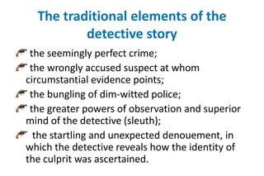

Warm up
Brainstorm a list of
elements in a detective
story.

Slide 5

Open
student’s book
p.(60)

Slide 6

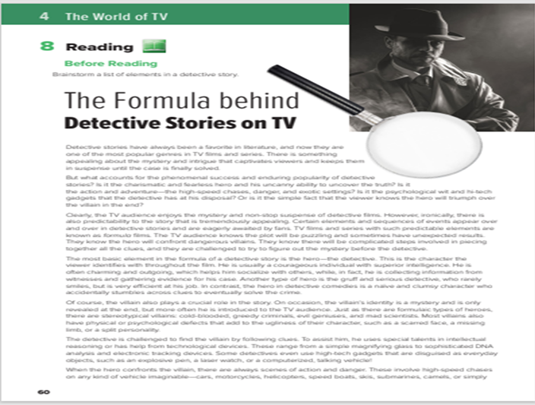
Reading
What is the title of the passage?
The Formula behind Detective Stories on TV
How many paragraphs are there?
There are 8 paragraphs
What does the photo show?
It shows a detective

Slide 7
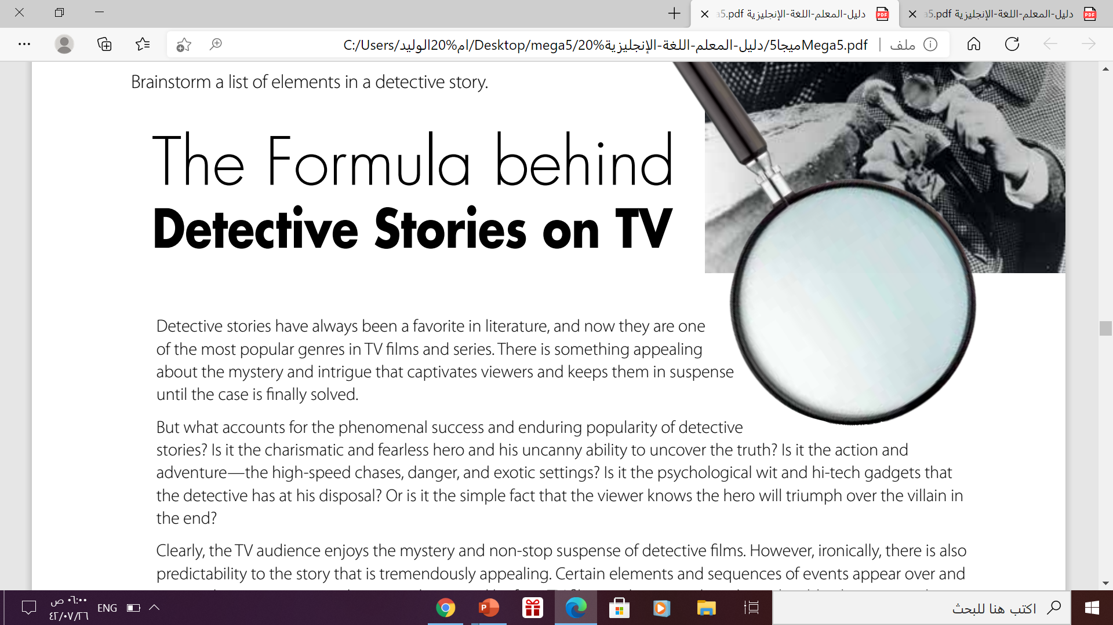


Reading
What is the meaning of “ appealing”?
It is the synonym of “ attractive”

Slide 8
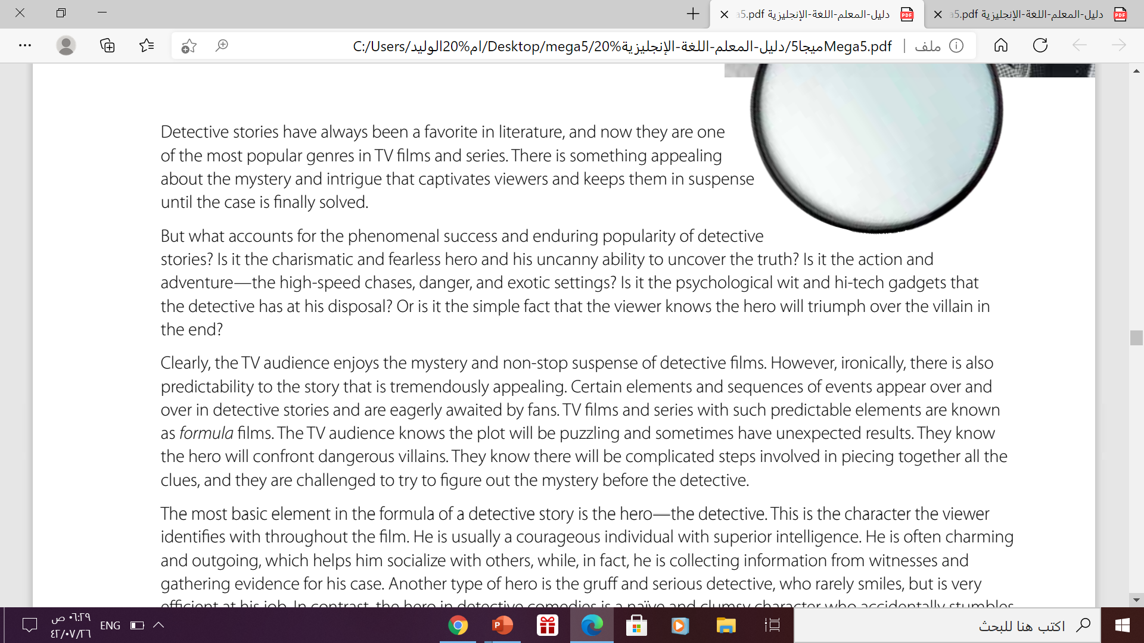
Reading
what accounts for the phenomenal success and enduring
popularity of detective stories?
1- the charismatic and fearless hero and his uncanny ability to uncover the truth
2-the action and adventure—the high-speed chases, danger, and exotic settings
3-the psychological wit and hi-tech gadgets
4-fact that the viewer knows the hero will triumph over the villain in the end

Slide 9
Reading
Why are detective stories ironic?
the TV audience enjoys the mystery and non-stop suspense of detective films. However, ironically, there is also
predictability to the story that is tremendously appealing.

Slide 10
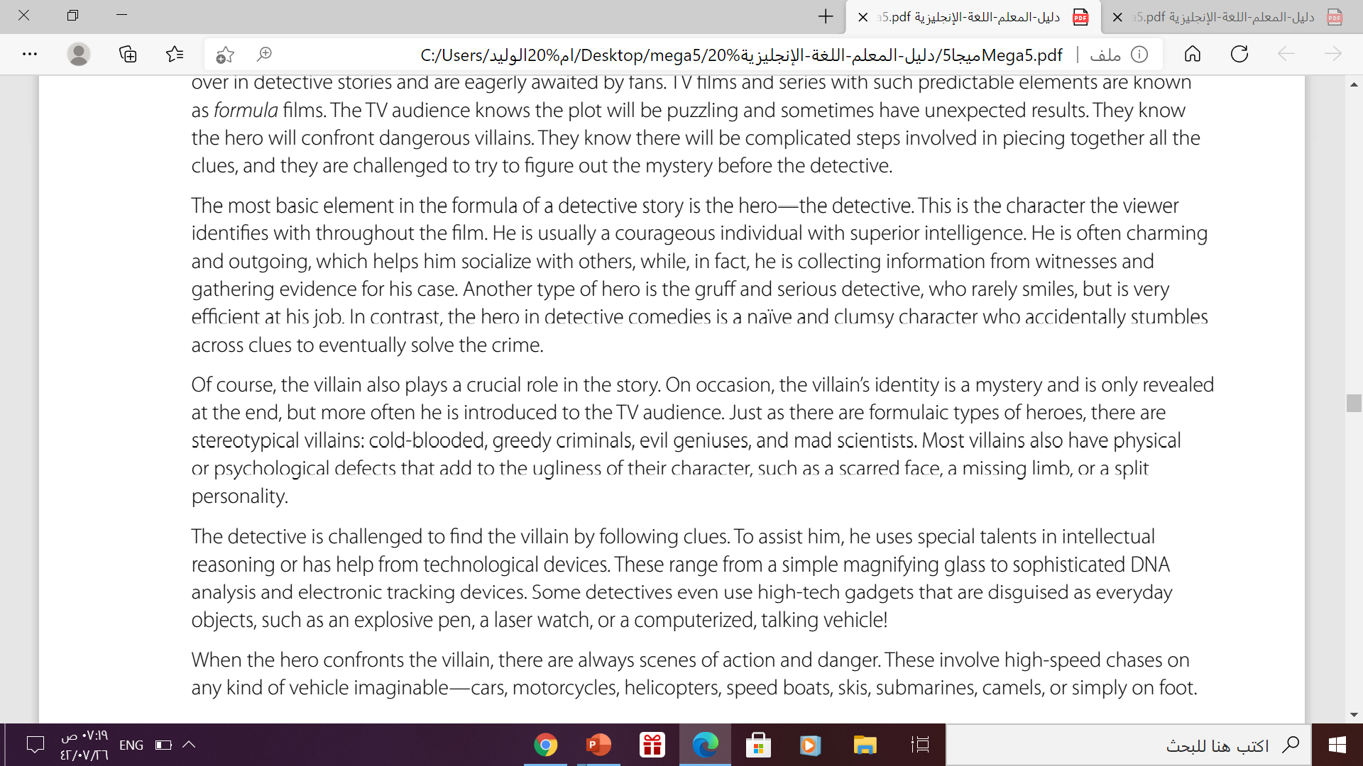


Reading
What is the most basic element in the formula of a detective stories ?
It is the hero – the detective .
What are the characteristics of the hero ?
He is usually a courageous individual with superior intelligence. He is often charming and outgoing

Slide 11
Reading
What kind of villains are there?
There are stereotypical villains: cold-blooded, greedy
criminals, evil geniuses, and mad scientists.

Slide 12
Reading
What are the kinds of special talents that assist the detective?
a simple magnifying glass to sophisticated DNA
analysis and electronic tracking devices and use high-tech
gadgets

Slide 13
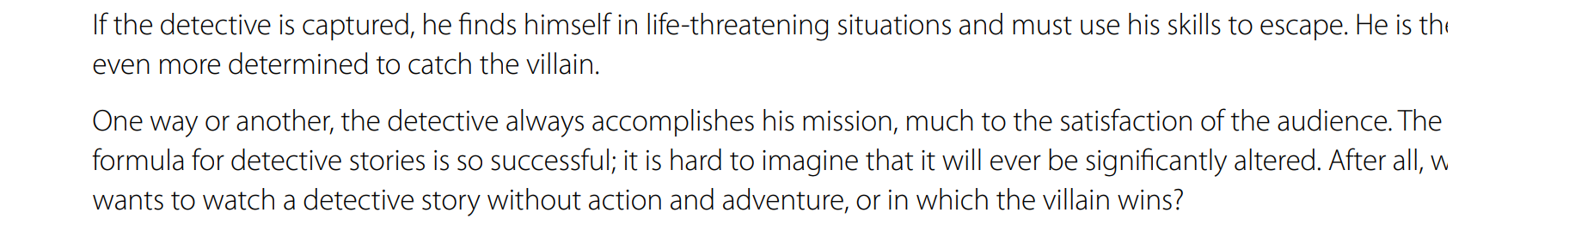
Reading
What does happen to the detective if he is captured ?
He use his skills to escape and even more
determined to catch the villain.

Slide 14
Reading
Brainstorm a list of
elements in detective story
Mystery and intrigue
Predict and solve the case
The hero
The villain
  Technological devices to solve the mystery
Action and danger ( confronting & escaping)

Slide 15
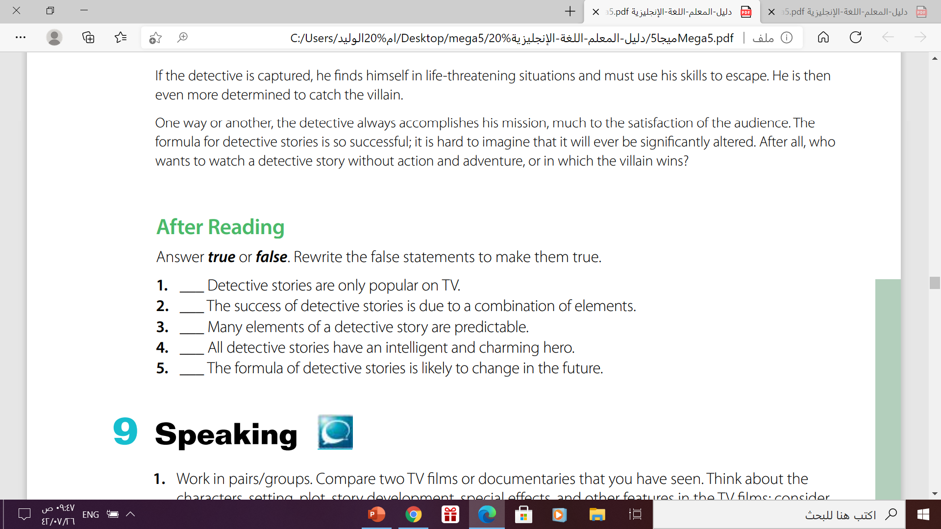
After Reading
False
True
True
False
False

Slide 16
Homework
workbook , exercise (I)
p.(255)

Slide 17

From the Holy Quran

Slide 18
From The Holy Quran

Slide 19
Quick Chick
https://wordwall.net/play/12339/442/109

Slide 20
Thanks!

