Slide 1
Unit 4
The Art of Advertising
Mega Goal 1.1
Language in Context + Conversation
Done by: Entisar Al-Obaidallah

Slide 2
Lesson Objectives
01
02
03
04
05
06
Check
Match
Practice
general knowledge
products to their phrases
reading consonant+vowel and consonant + consonant
Listen
Use
Describe
For specific information
Real Talk phrase correctly
unusual new gadget using their own words

Slide 3
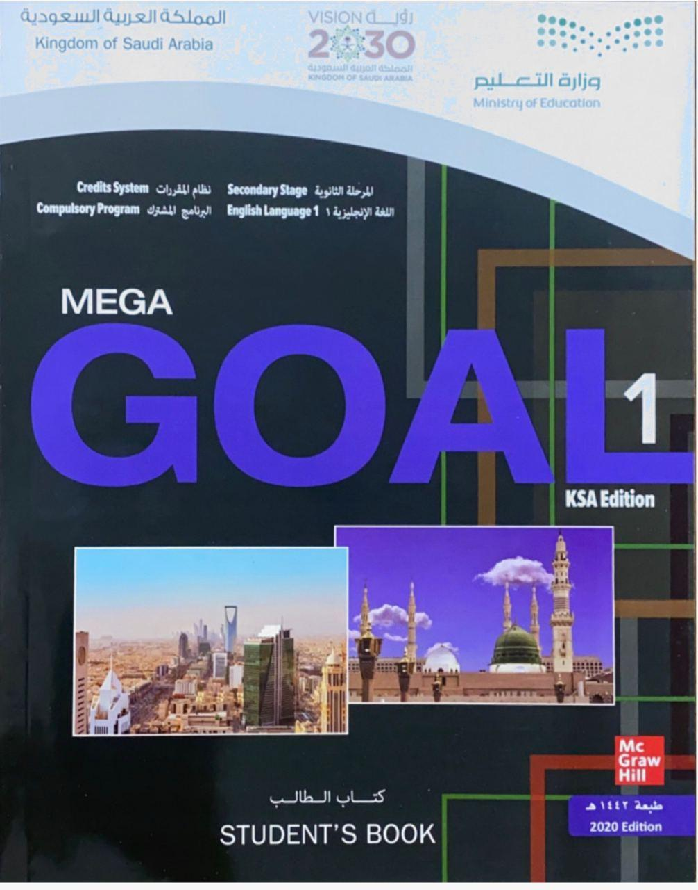
Open
Your student’s book , p. (53)

Slide 4
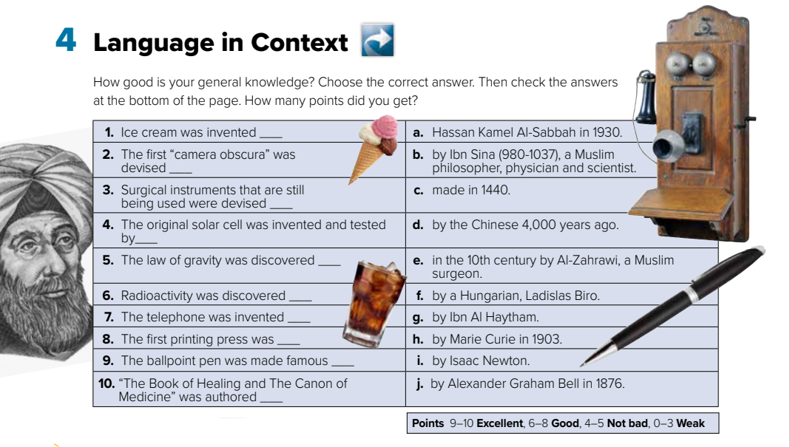
d
g
e
a
i
h
j
c
f
b

Slide 5
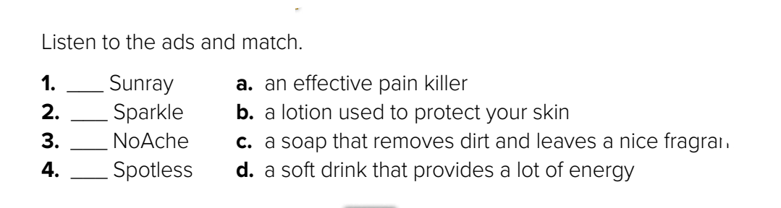






b
d
a
c

Slide 6
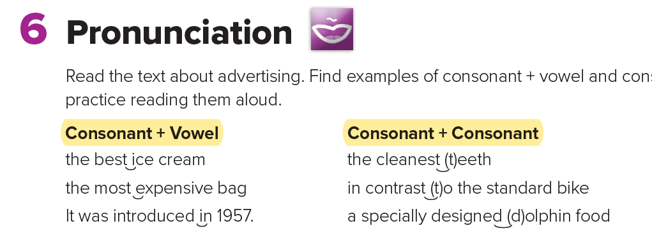
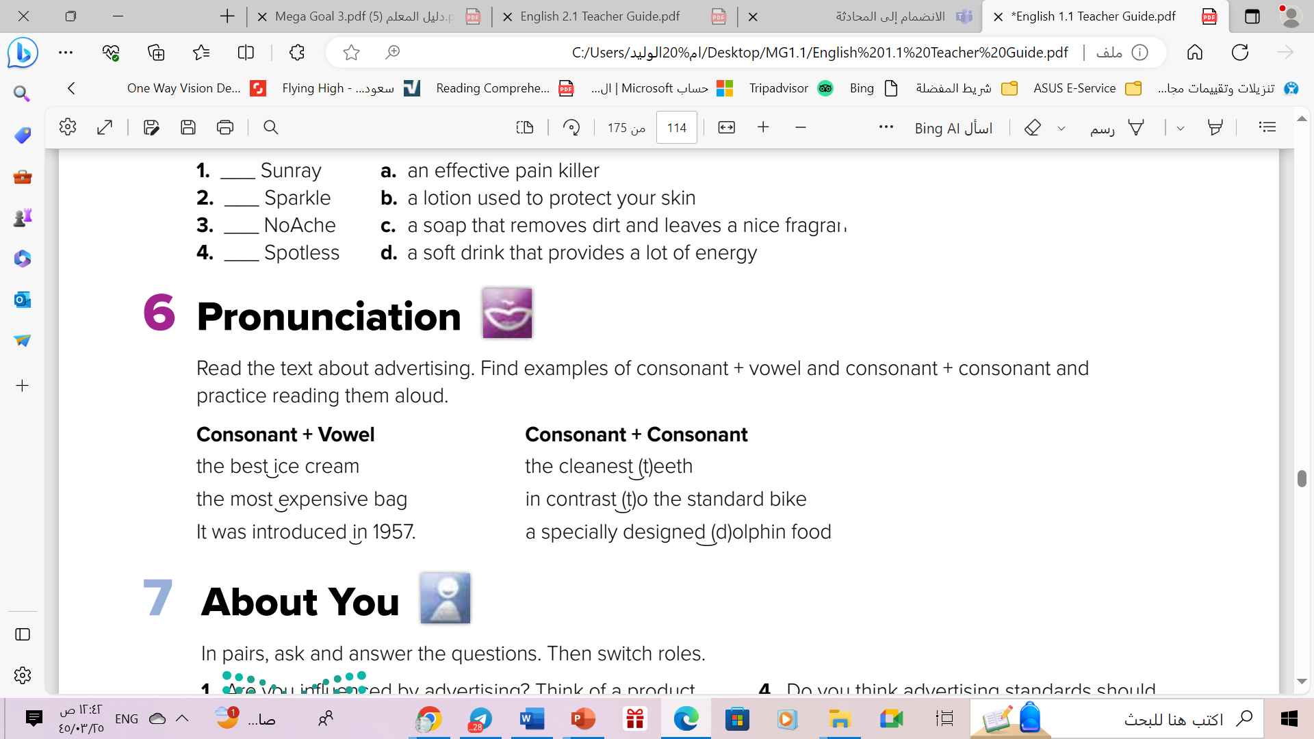
Consonant + Vowel
when one word ends in a consonant sound and the next word begins in a vowel sound, we link the two sounds together without a pause in (gap) between them
Consonant + Consonant
when the same consonant sound is at the end of one word and at the start of the next, it pronounced once, but it sounds longer

Slide 7
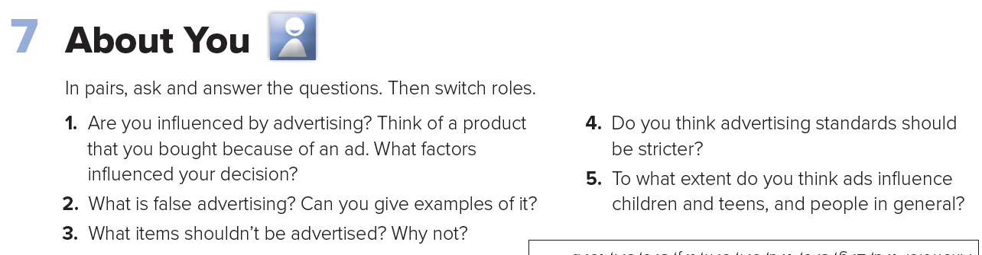
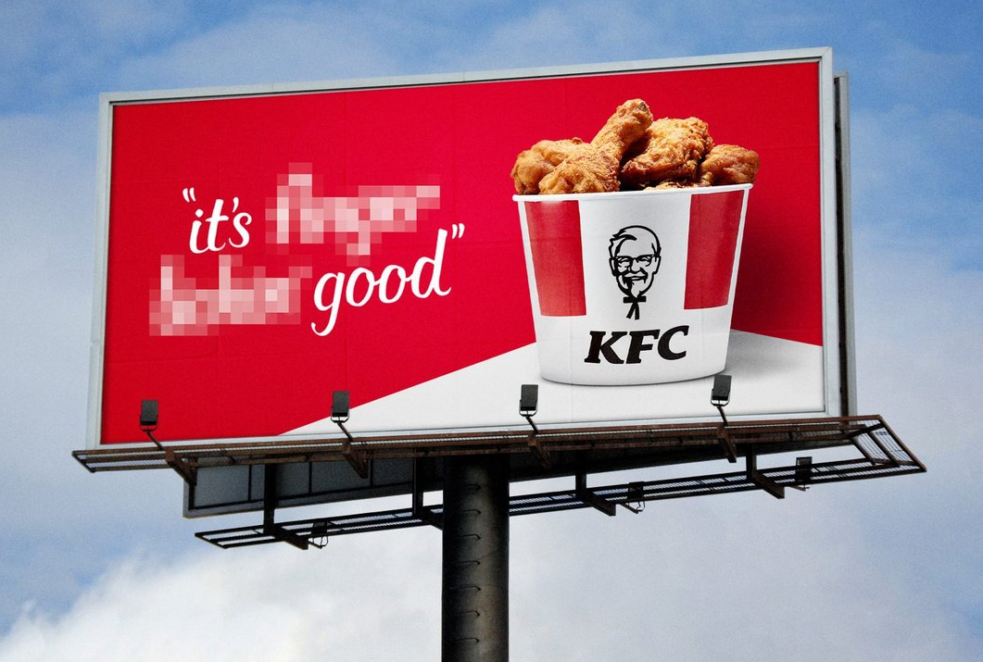

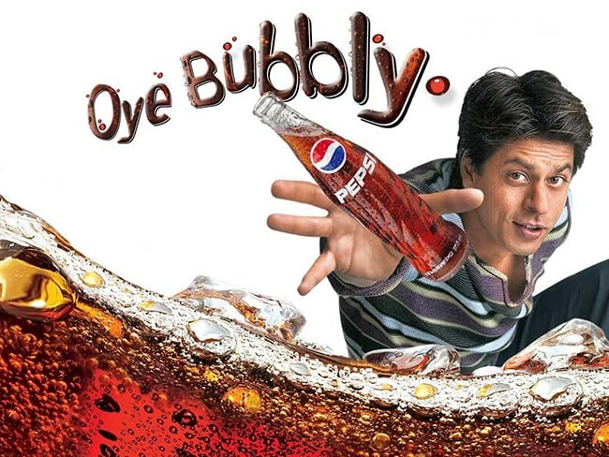


Slide 8
Open
Your student’s book , p. (53)

Slide 9
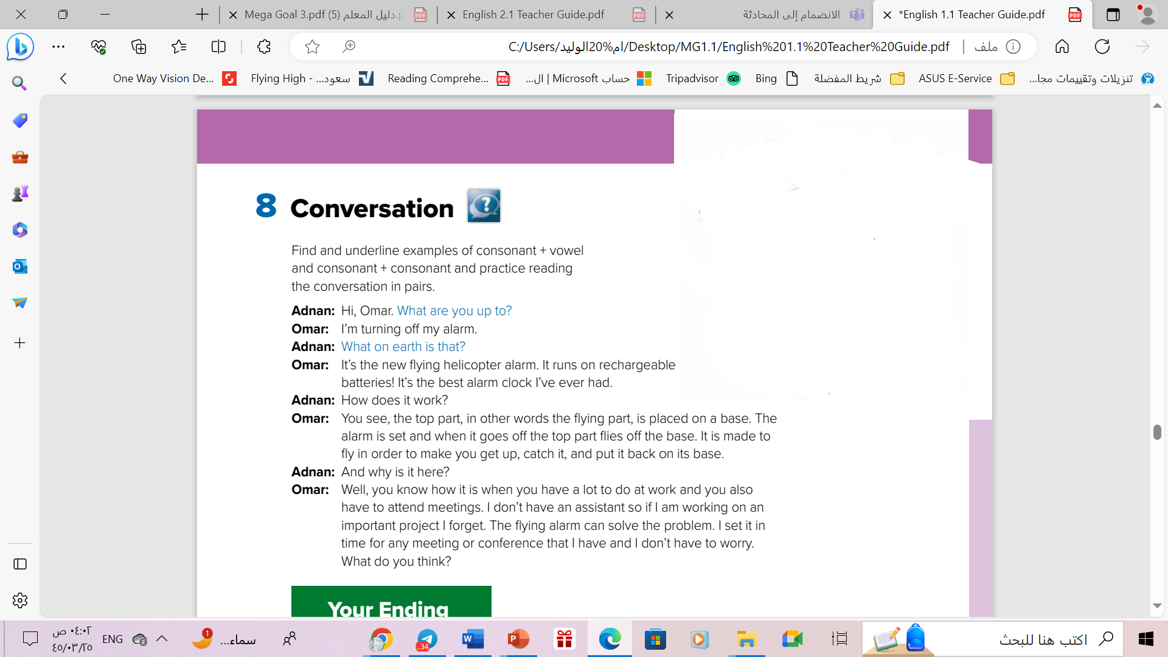
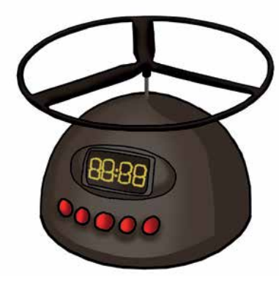
Scanning
How many persons are there ?
a gadget
Who are they ?
an alarm
What does the picture show ?
What is the gadget’s kind?

Slide 10
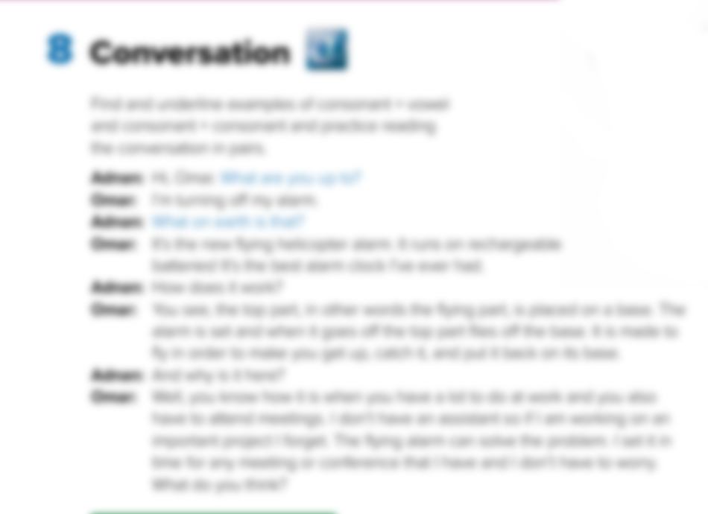

Read along as u listen

Slide 11
What power does the flying helicopter alarm use to run?
On rechargeable batteries
How does it work
When the alarm goes off, the flying part flies off the base
How does it work
It reminds him of what he has to do

Slide 12
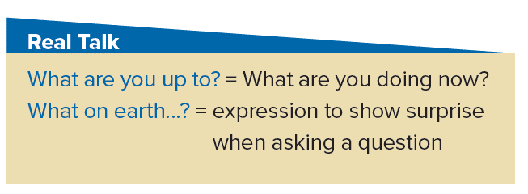
Read the words and their meaning:

Slide 13

Who says ………
What are you up to?
Who says ………
What on earth…?
Who says ………
What on earth…?
Adnan
Adnan
Adnan

Slide 14
Why does he says ………
What on earth…?
He is unfamiliar with a flying helicopter alarm
and thinks it’s a little strange

Slide 15

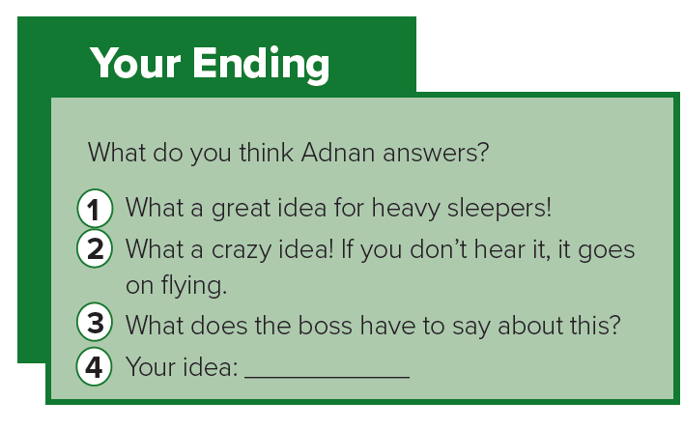

Listen and choose an ending
Write your ending here

Slide 16
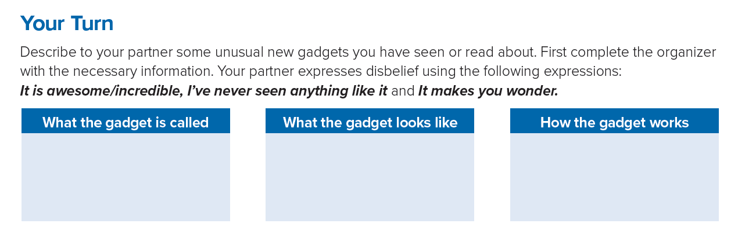
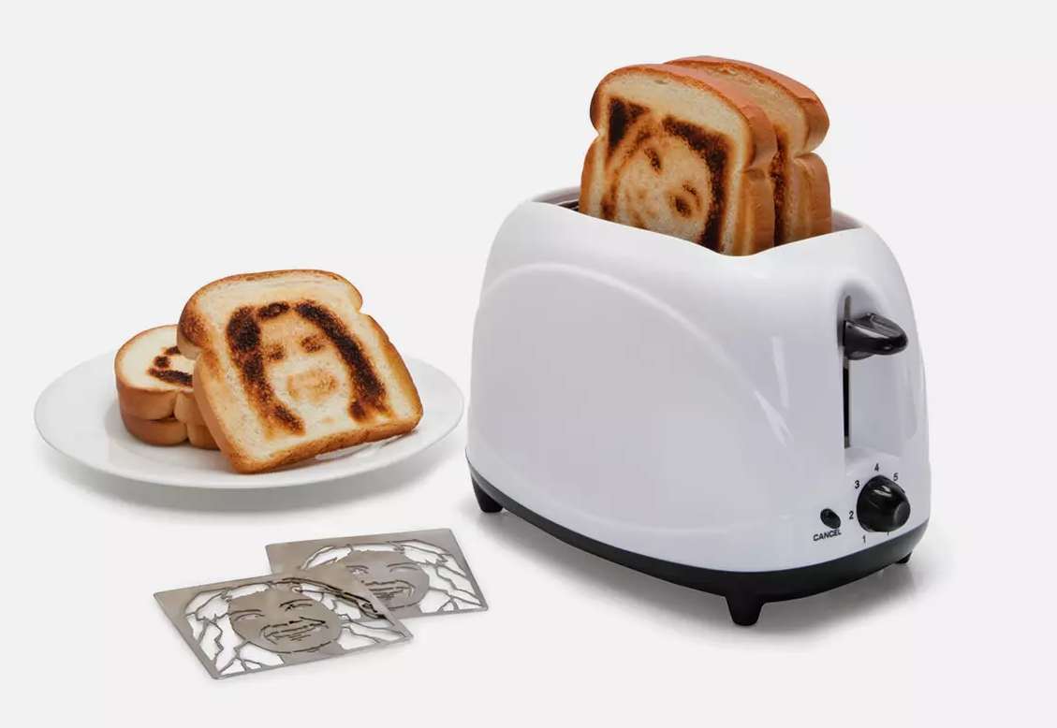
It uses laser technology, like a printer, to print your face onto the toast.
Selfie Toaster
small box

Slide 17
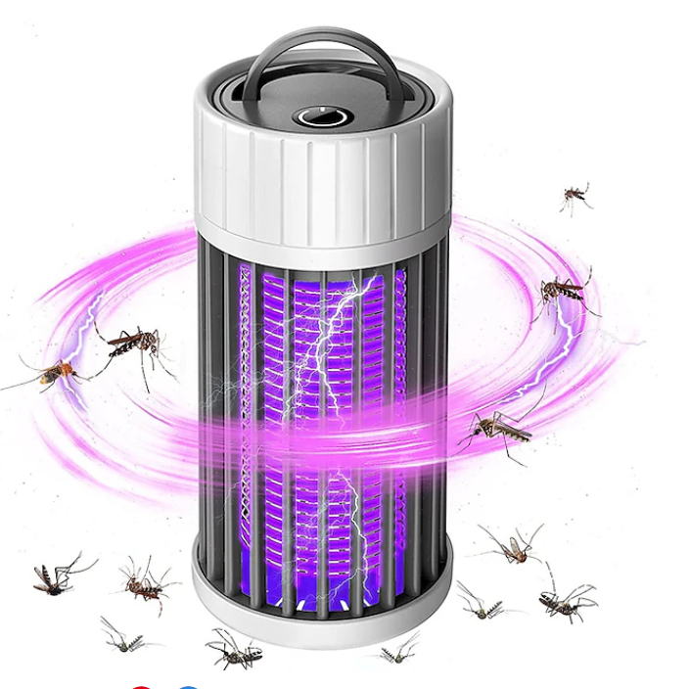
Flies protector
small box
Make sounds to
bother flies.

Slide 18
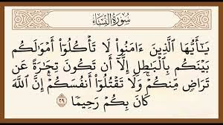
From the
Holy Qur'an

Slide 19
Homework
Workbook p.(252) ,
exercise ( D)

Slide 20

Thanks

