Slide 1


Slide 2
What Will They Think of Next?
Reading
Speaking

Slide 3
Goals:
Find names for space resorts
1
2
Answer some questions about the text
Explain the meanings of new words
3
Correct information about the text
4
Match the main idea with the paragraph
5
Identify the type of people with possibility for space tourism
6
List the people who travel to space
7
8
Discuss the advantages and disadvantages of space tourism

Slide 4
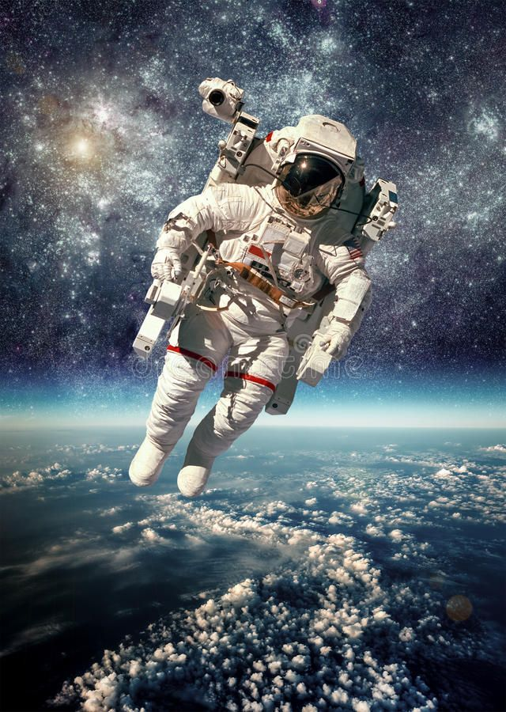
Reading

Slide 5


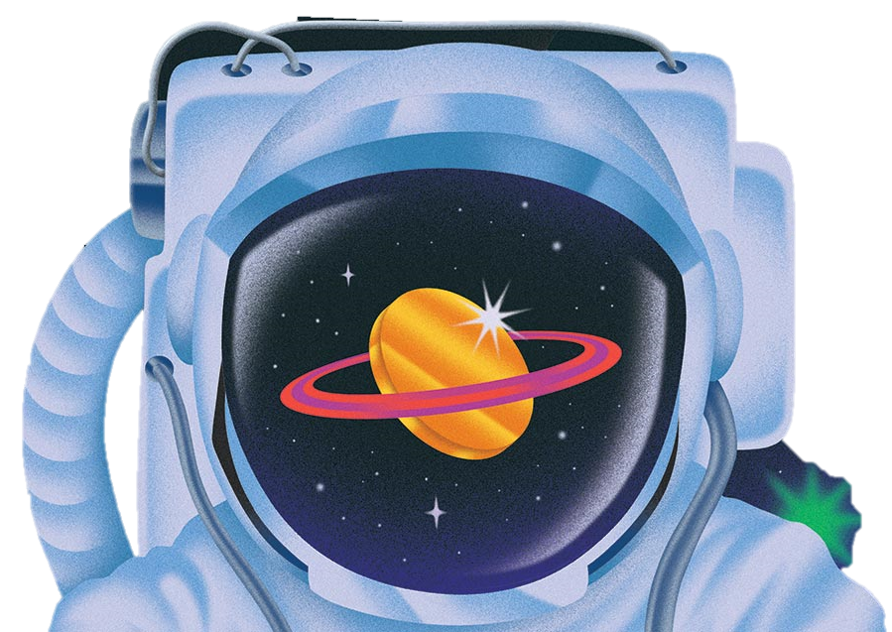


What is space tourism
when ordinary people visit space for vacation
Do you think space tourism will become common in your lifetime?

Slide 6
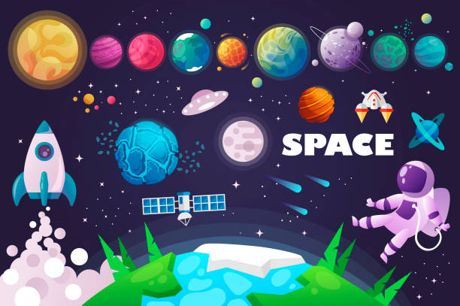
If you could go into space, would you? Why or why not?

Slide 7
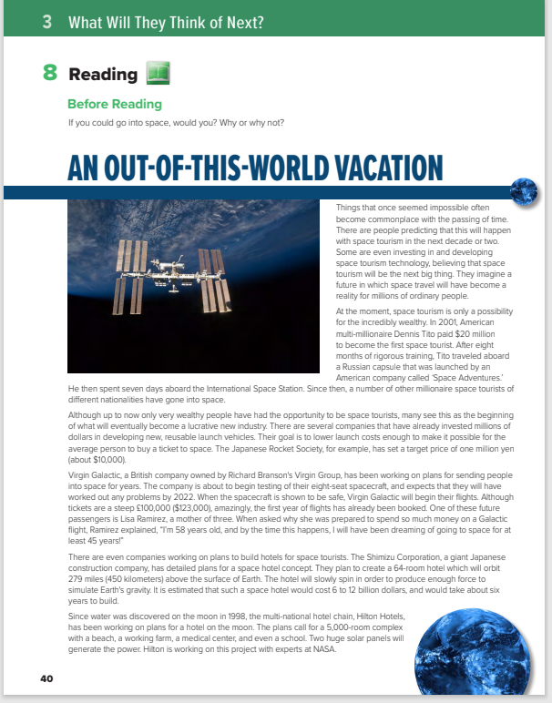
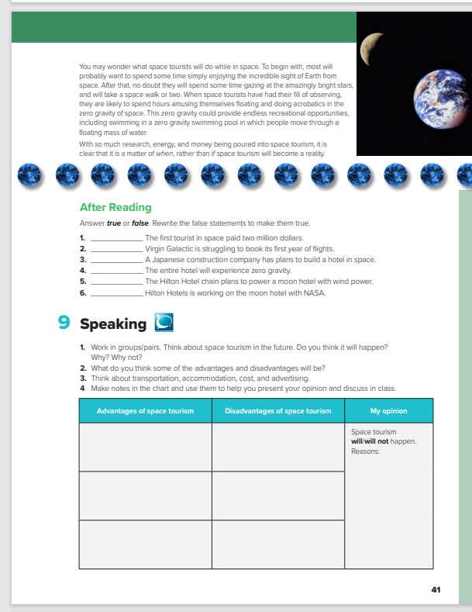

Students Book
P.40-41

Slide 8
7
8
1
2
3
…..Title
4
…..Paragraphs
5
6
…..Photos

Slide 9
What does ……………….?
(1) It means literally outside of our world, in outer space;
(2) it means extraordinarily exciting and great.

Slide 10

What does ……………….?
Ahmed is an out-of-this-world football player. He is sure to play on a professional team.
I had an out-of-this-world meal at the new Thai restaurant. It was the best food I’ve ever tasted.

Slide 11
Reading Strategy
Predicting

Slide 12
What do you think this article will be about?
space tourism
What do you think you will learn from this article?
I think I will learn who has taken a vacation in space

Slide 13



Book Closed & Listen

Slide 14
Read as along as you listen.

Slide 15
Does space tourism exist now?
Yes, but only for a few very wealthy people.
Does the author think that space tourism will become common in the future?
(yes)
What will space tourists do for fun?
(float around in the zero gravity, and observe the stars and surroundings)

Slide 16
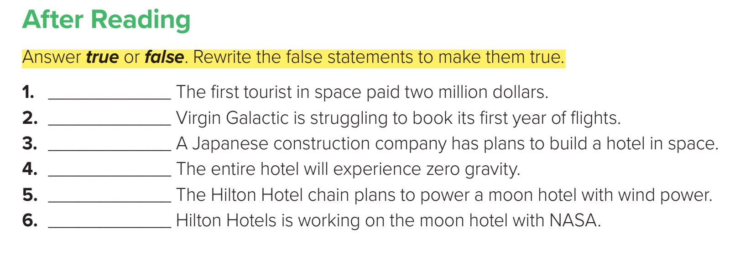
F
F
T
F
F
T

Slide 17
Speaking

Slide 18
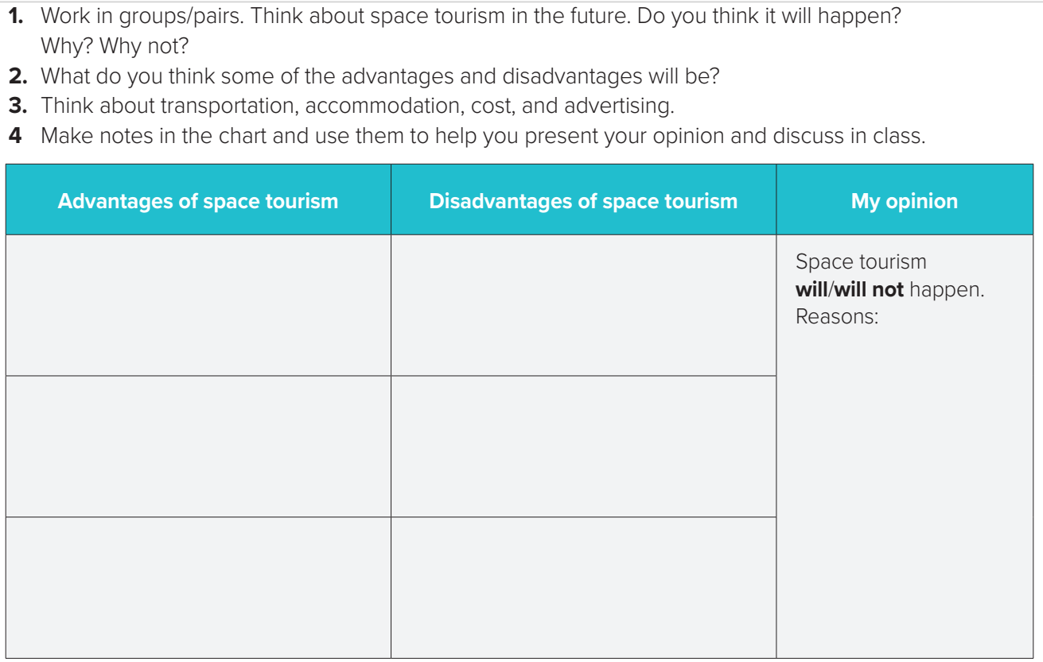

Slide 19
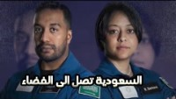
السعودية تصل الى الفضاء

Slide 20
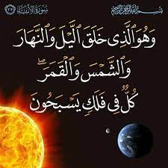

Slide 21


