Slide 1

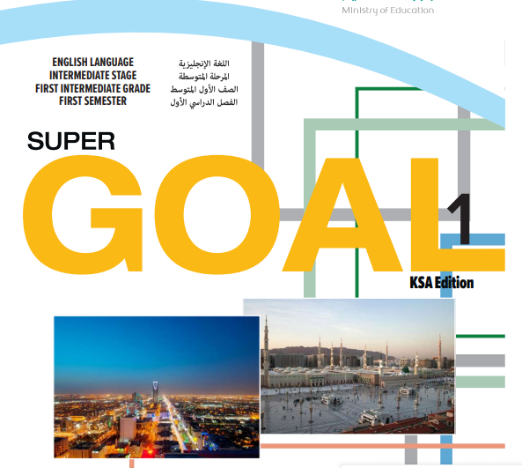
Super goal 1

Slide 2


{ وَآتِ ذَا الْقُرْبَى حَقَّهُ }

Slide 3
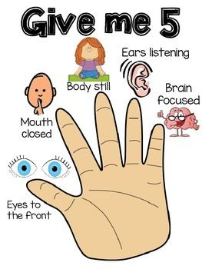

Slide 4

Page 45

Slide 5

Objectives:
At the end of the lesson, students will be able to:
Answer questions from the passage.
☞ Recognize the meanings of the new words.

Slide 6


Before reading
While reading
After reading

Slide 7


What do you know about Saudi Vision 2030?

Slide 8


Slide 9
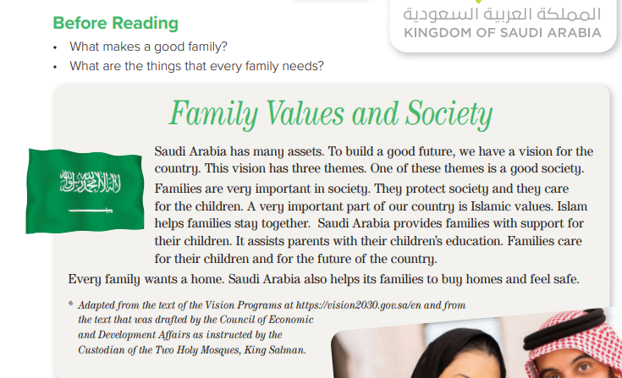
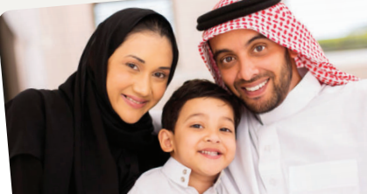


Page 45

Slide 10

Page 45
How many themes does the vision have?
How does Islam help families?
What does every family want?

Slide 11
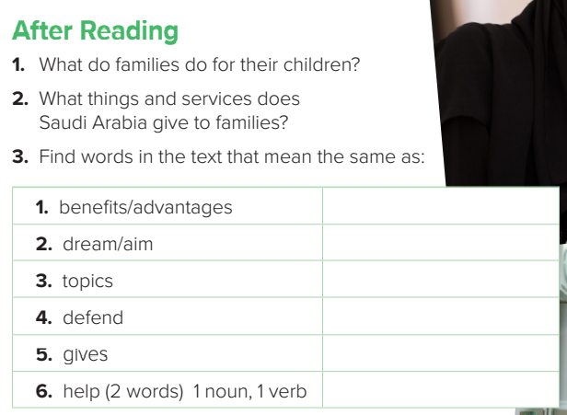

Page 45
assets
vision
themes
protect
provides
support (n) assist ( v)
1-Families care for their children and for the future of the country.
2-Saudi Arabia gives families support for their children, assists parents with their children’s education and helps them to buy homes and feel safe.

Slide 12
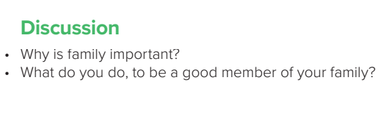

Page 45

Slide 13
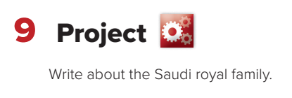
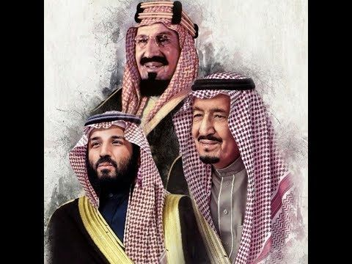
Page 46
brainstorming
What can you write about?

Slide 14

Homework:
Page: 109

