Slide 1
Grammar
In the name of Allah
Unit : 3
Lesson : 2
Far and away

Slide 2
*The Strategies are :
1- Brain Storming
2- Mind Maping.
3- Think , Pair ,Share.
4- Active learning
5- Information Gap
6 – One minute Strategy.
*إستراتيجيات الدرس :
1- العصف الذهني
2- خريطة المفاهيم
3- فكر , زاوج , شارك .
4- التعلم النشط
5-فجوة التعلم .
6- الدقيقة الواحدة.

Slide 3
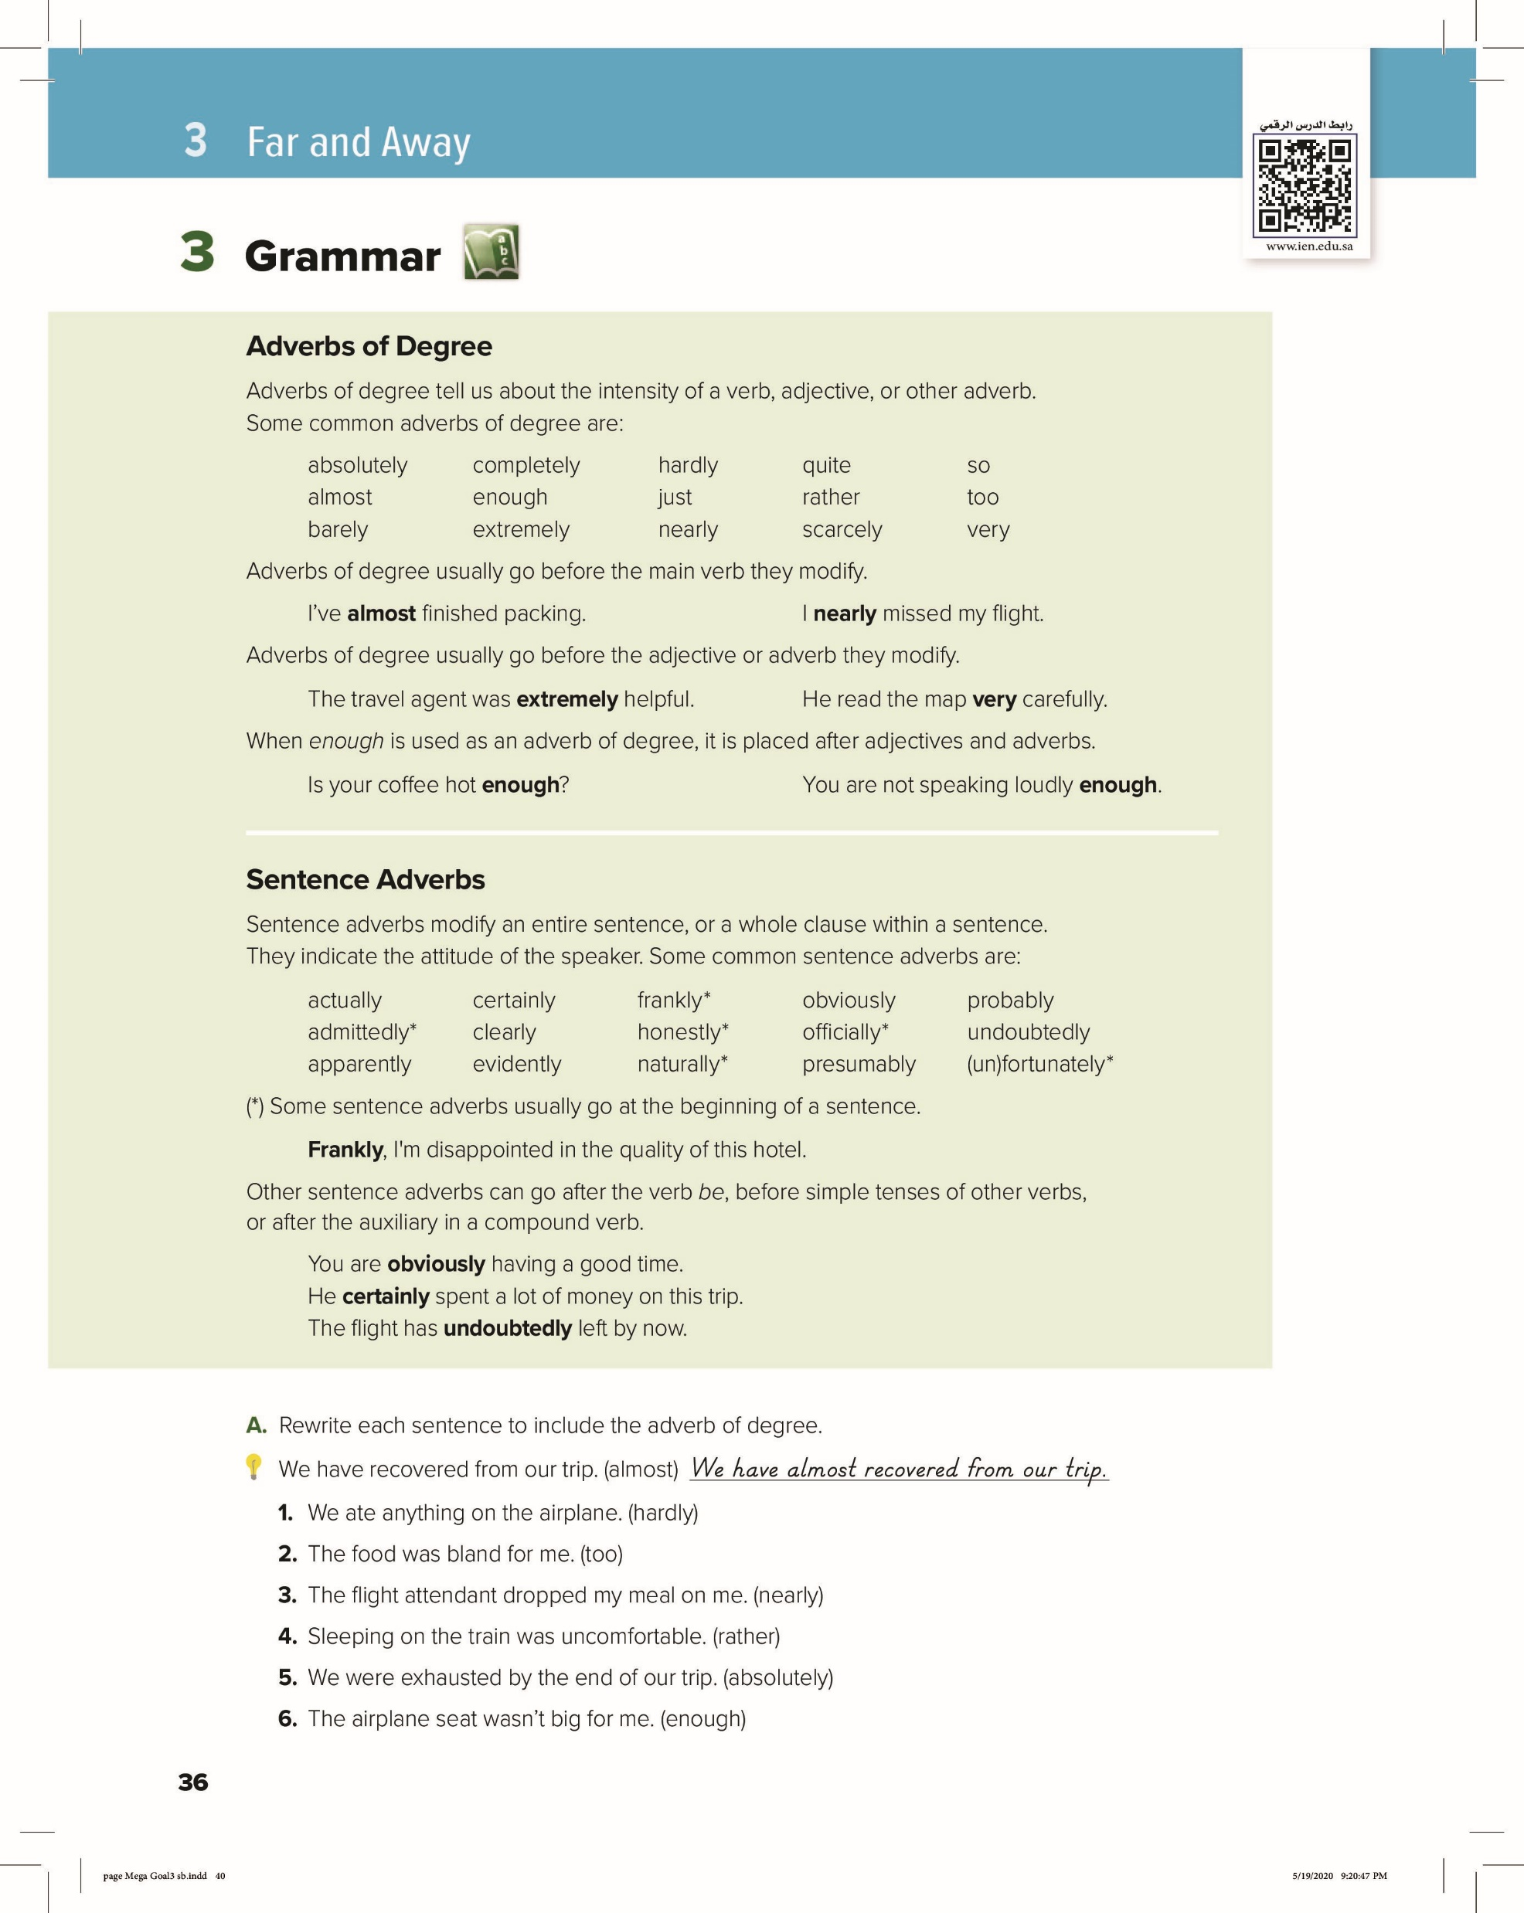
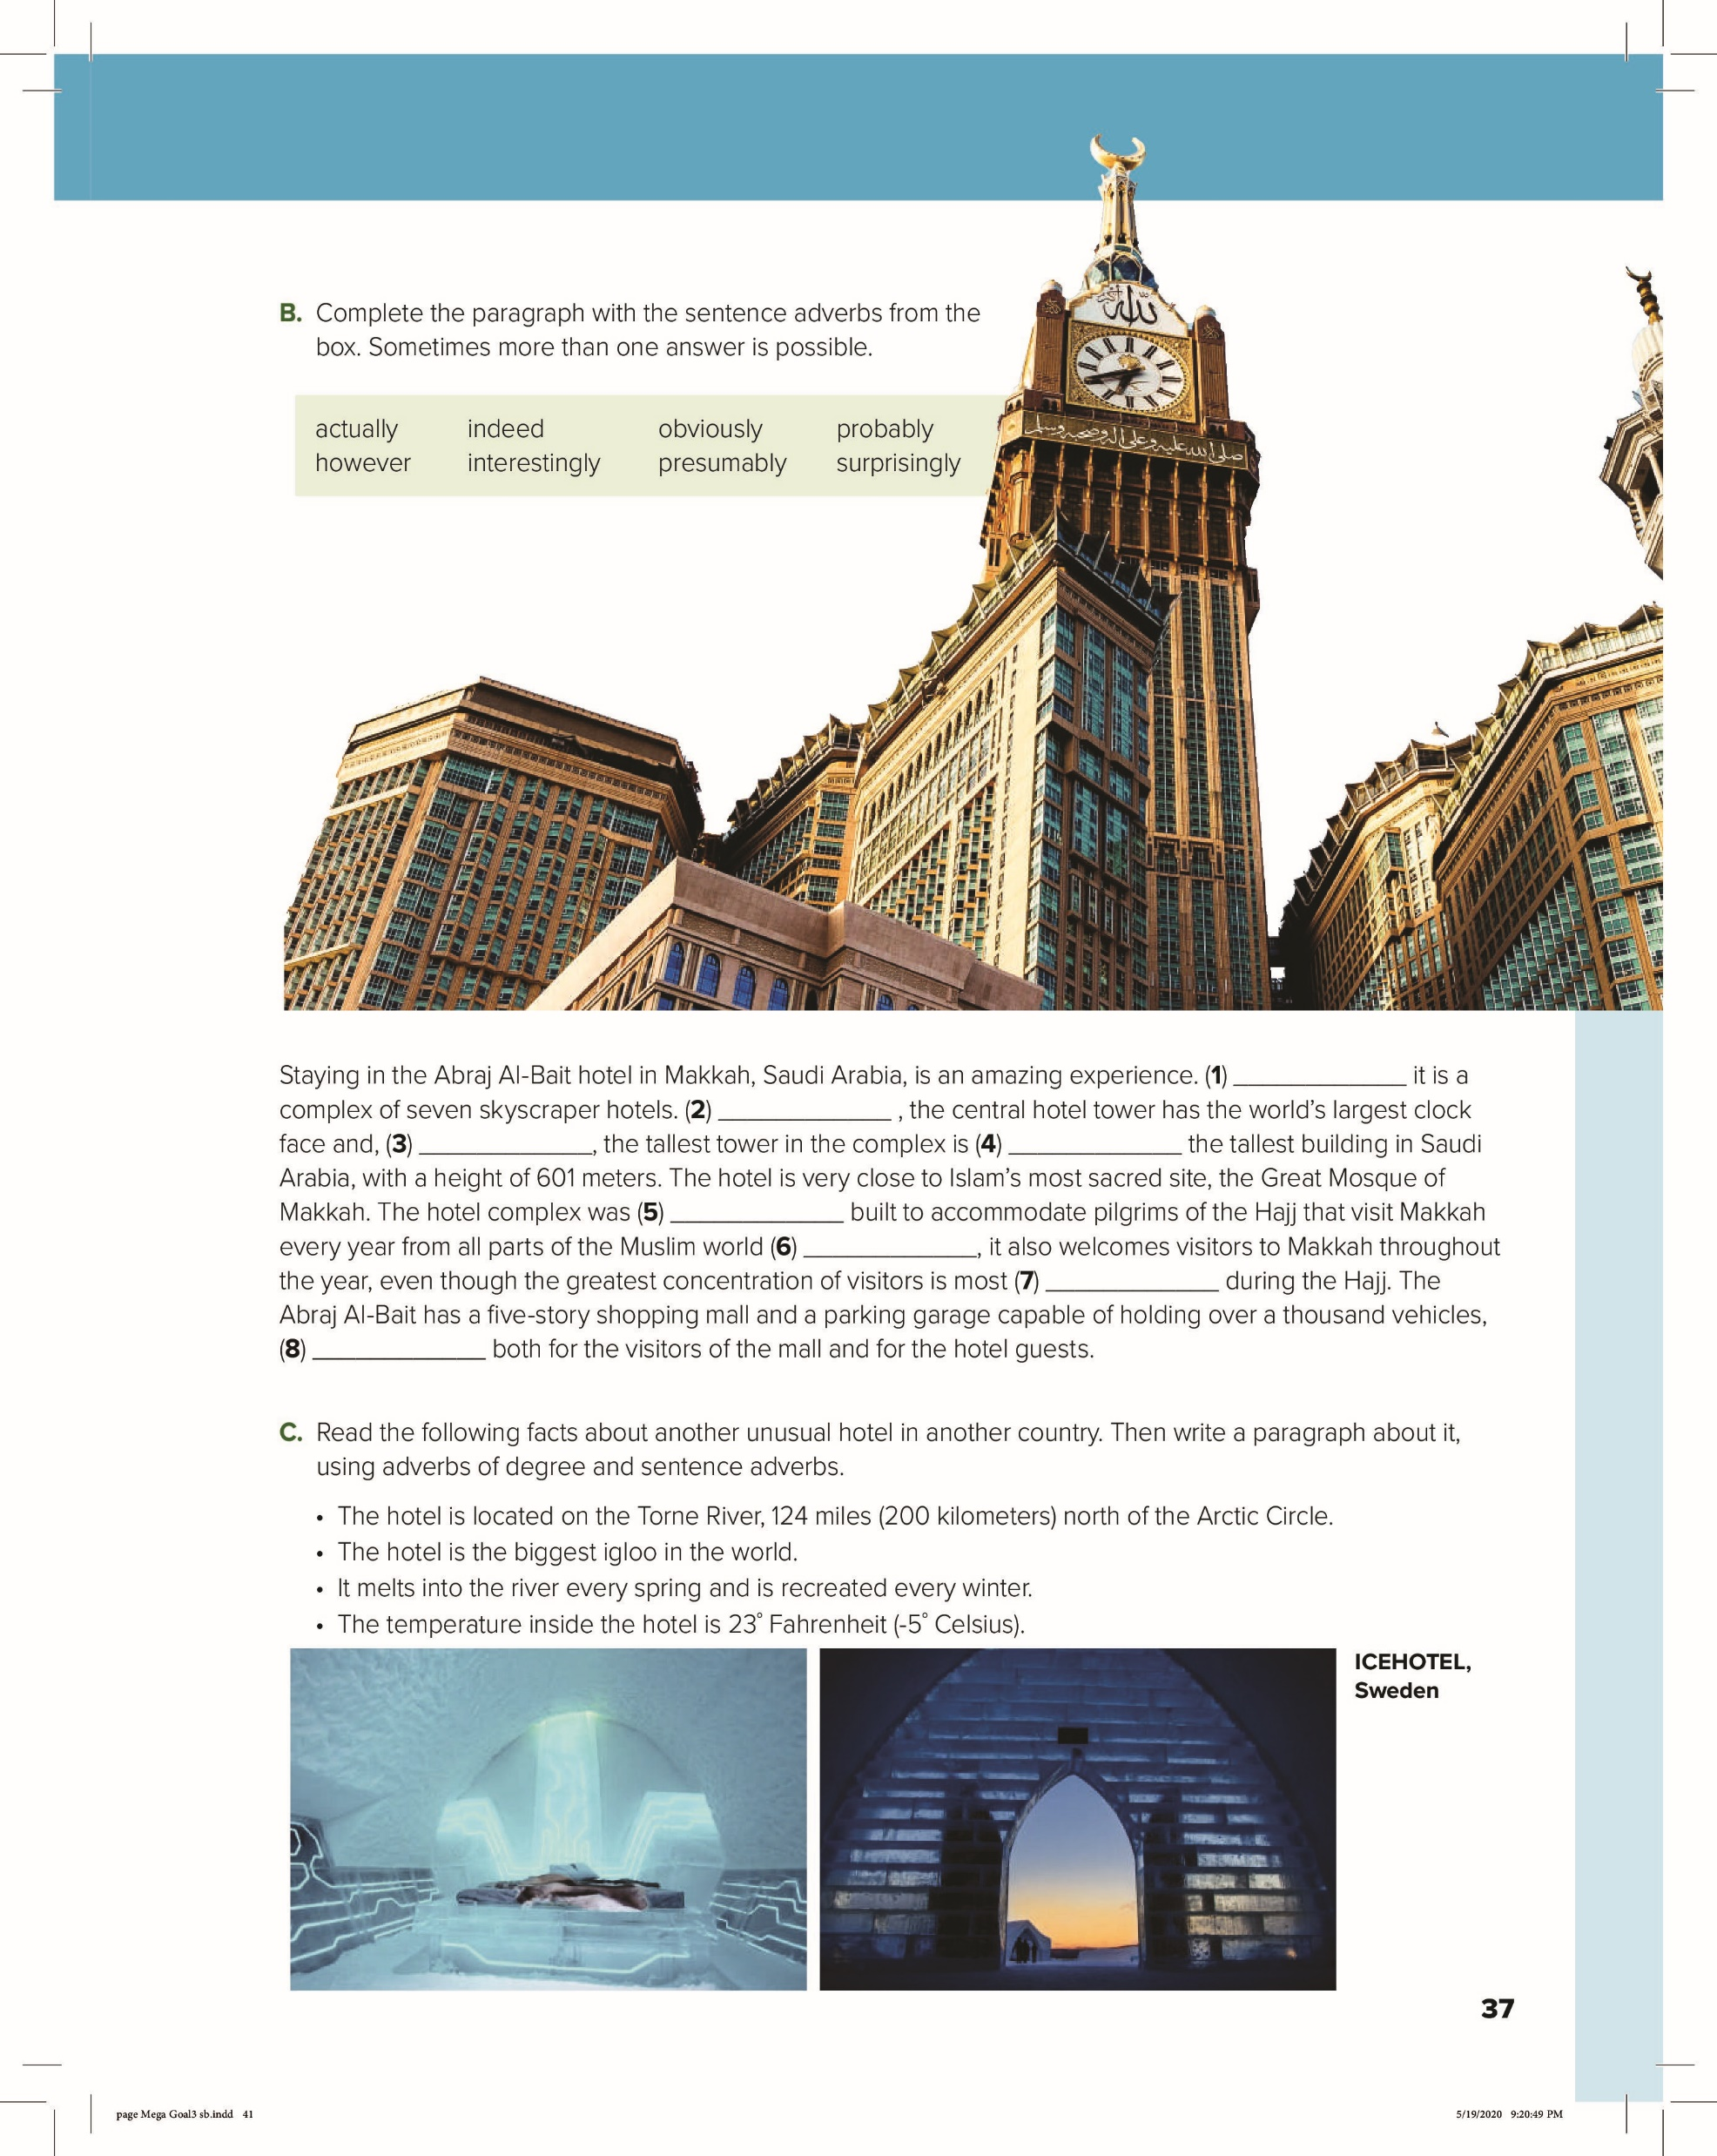


In this lesson you are going to :
● Use adverbs of degree.
● use sentence adverbs.
● rewrite sentences using adverbs.
● Complete a paragraph with sentence adverbs.
36
37

Slide 4

36

Slide 5
36

Slide 6
Sentences Adverbs
Adverbs of Degree
Before the V
Before the Adj /Adv
Enough After the Adj /Adv
*
Begining
After the H .V
Before the V
V Be (is- are – am)
Has/Have / Had

Slide 7
1. We hardly ate anything on the airplane.
2. The food was too bland for me.
3. The flight attendant nearly dropped my meal on me.
4. Sleeping on the train was rather uncomfortable.
5. We were absolutely exhausted by the end of our trip.
36
6. The airplane seat wasn’t big enough for me.

Slide 8


Interestingly
Surprisingly
obviously
actually
presumably
However
37
indeed
obviously

Slide 9

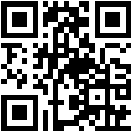

Let’s play
https://cutt.us/uCM9m

