Slide 1

Simple past : Be
Simple past : Regular & irregular verbs

Slide 2
Simple past : Be
Make the past simple (use positive / negative or question):
(I / be / at the cinema last night.)
I was at the cinema last night.
(how / the party / be?)
How was the party ?

Slide 3
Simple past : Regular and Irregular
Make the past simple (use positive / negative or question):
went
She ___________________ (go) home.
watched
We ___________________ (watch) a film.
did he arrive
When ________________ (he / arrive)?
did you live
Where ___________________ (you / live)?

Slide 4
Time expression
yesterday.
in 2006
ago
last night

Slide 5
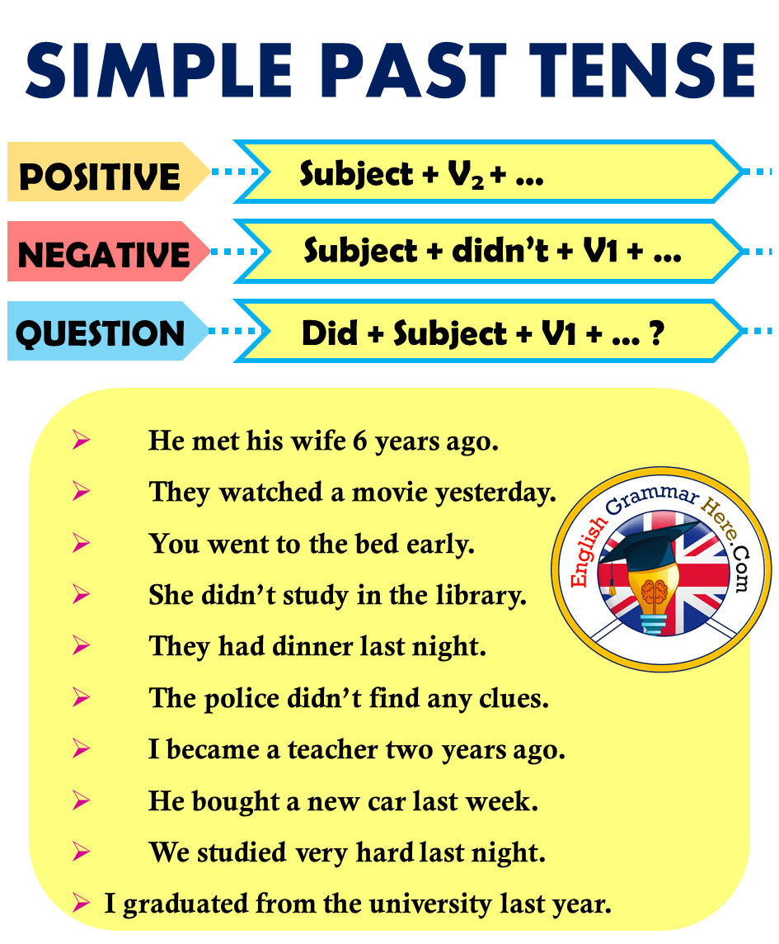

Slide 6

The Past with Used to and Would
We use used to + verb and would + verb to talk about past habits that are no longer true:
I used to have short hair when I was a teenager.
subject
verb
Used to
He would walk along the beach every evening before bed.

Slide 7
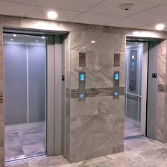
The Past with Used to and Would
We use used to + be to talk about past states that are no longer true:
I used to be afraid of elevators.
be
subject
Used to

Slide 8

The Past with Used to ( negative )
I didn’t use to like studying English , but I love it now
subject
verb
didn’t use to

Slide 9
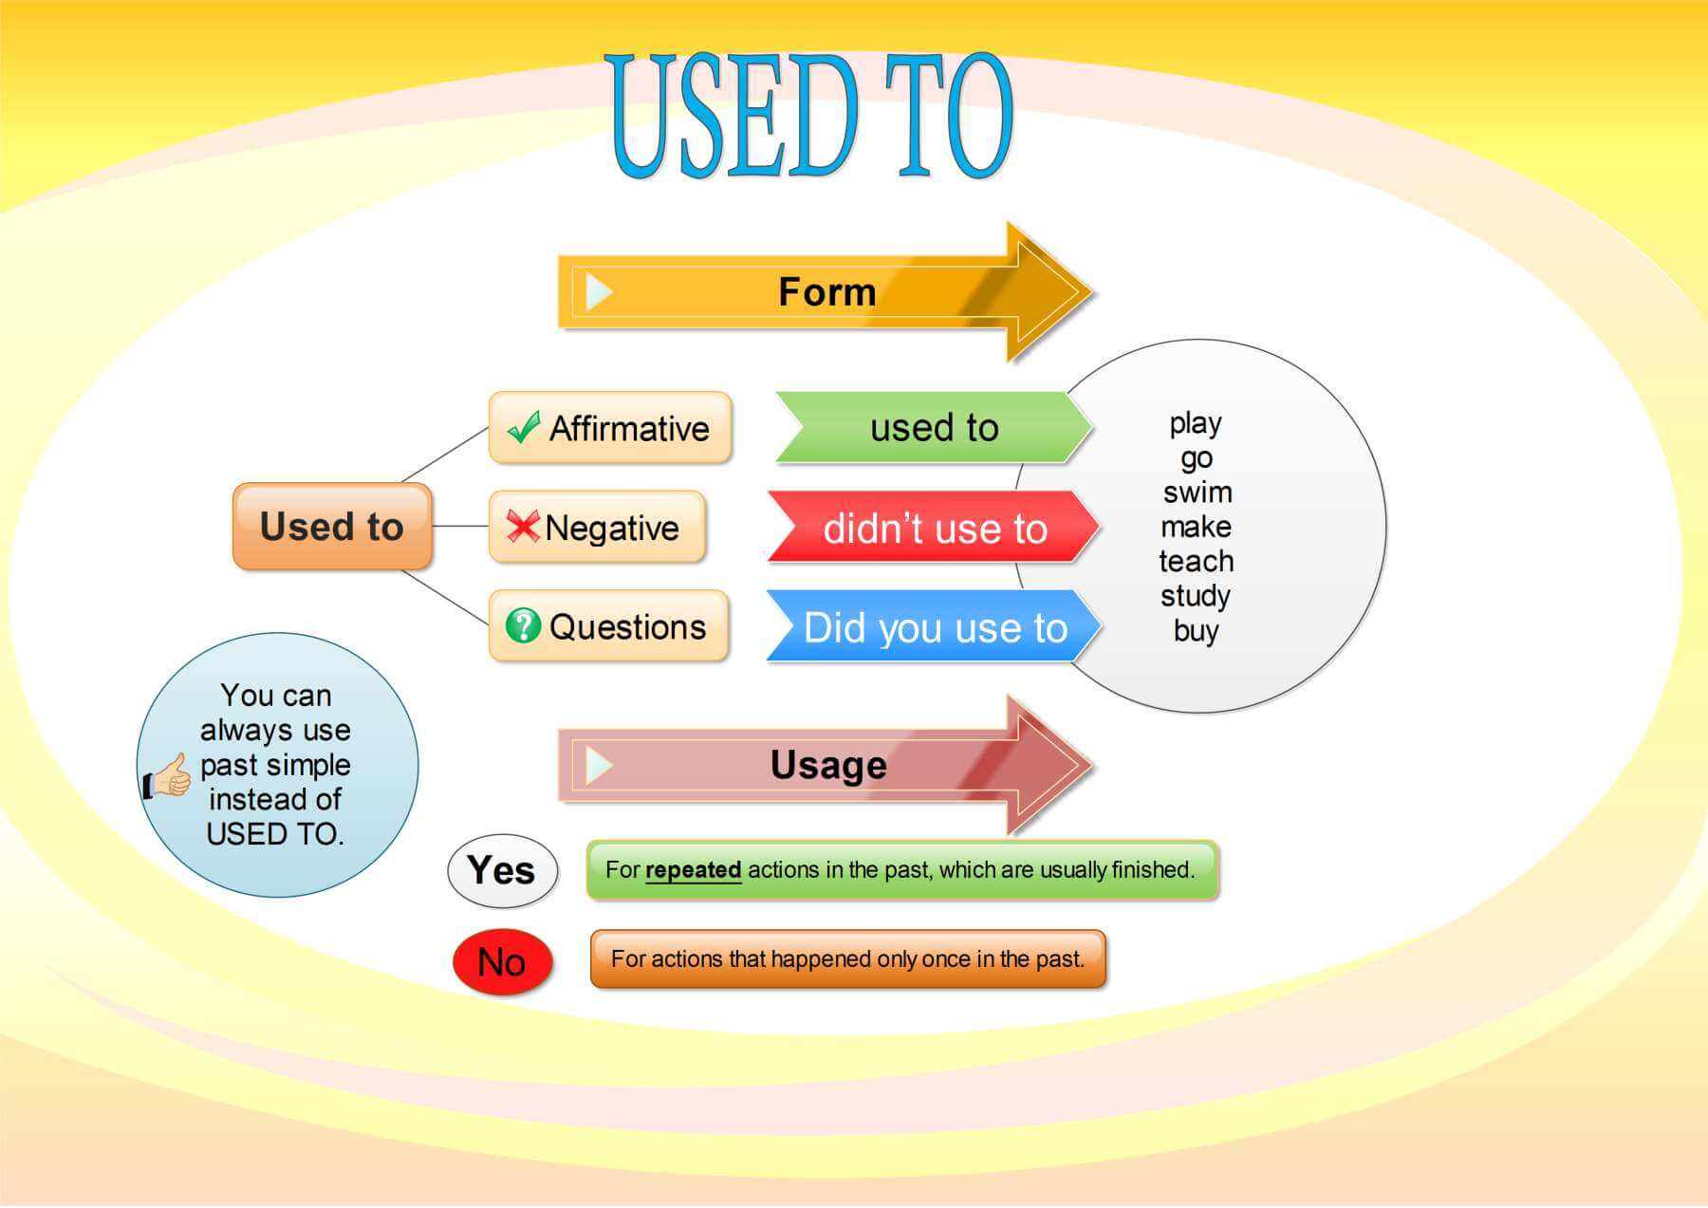

Slide 10
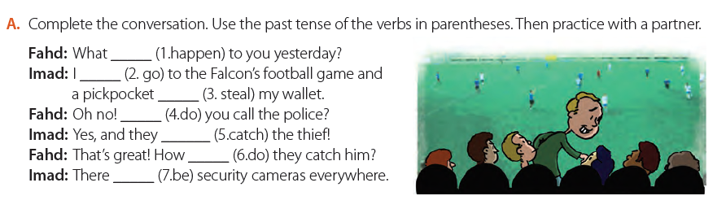
happened
went
stole
did
caught
did
were

Slide 11
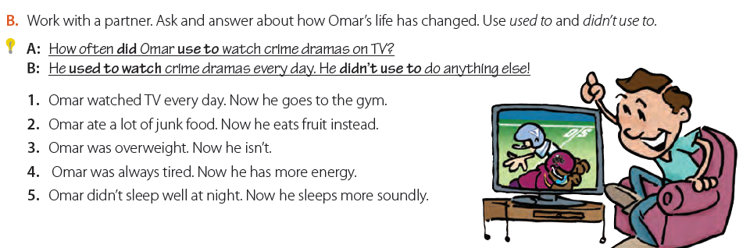
A: What did Omar use to do every day?
B: He used to (would) watch TV every day. He didn’t use to go the gym.

Slide 12
2. A: What did Omar use to eat?
B. He used to (would) eat a lot of junk food. He didn’t use to eat
fruit.
3. A: What did Omar use to look like?
B: Omar used to be overweight. He didn’t use to be slim.
4. A:How did Omar use to feel?
B: Omar used to always feel tired. He didn’t use to have much
energy.
5. A: How did Omar use to sleep?
B: Omar didn’t use to sleep well. He used to be awake most of
the night/ have insomnia

Slide 13

Past Progressive
We use the past progressive when we describe what was happening at a specific time in the past.
I was driving home from work.
subject
Was/were + ving

Slide 14
Past Progressive
We use the past progressive with always to describe a repeated or annoying action.
My neighbor’s son was always getting into trouble when he was younger.
We use the past progressive to describe a long action that is interrupted by a short action.
I was working on my computer when suddenly the power went out.

Slide 15


Past Progressive
We use the past progressive to describe two actions that were happening at the same time.
While I was studying, my brother was watching TV.

Slide 16
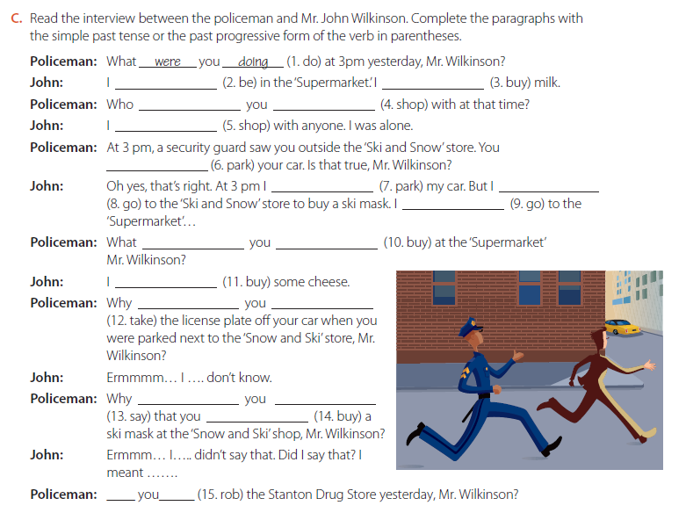

Slide 17
