Slide 1


Slide 2


Revision
Who is this?
What does he present?
Alex Trebek presents Jeopardy
S
V
O
Direct Object

Slide 3

Revision
applause
Alex Trebek gives applause for the winner.
S
V
O
Direct Object
Indirect Object

Slide 4


What did Nora send foe me?
email
Nora sent email to the teacher.
S
V
O
Direct Object
Indirect Object

Slide 5
Practice
The sentence | Direct Object | Indirect Object
She charged the phone for me.
They gave a gift to their mother.
I sold a watch to my friend.
The phone
me
a gift
their mother
a watch
my friend

Slide 6

Make a sentence with direct and indirect object.
Position in
the sentence
He gave flowers to his wife.
Direct Object
Indirect Object
If there is a preposition, the indirect object goes after the direct object.
OR
He gave his wife flowers.
Indirect Object
Direct Object
If there is no preposition, the indirect object goes before the direct object.

Slide 7


Answer the question using direct and indirect object using the preposition “to”:
Preposition
What did your mother tell?
to
My mother told a story to me.
Direct Object
Indirect Object
Use to if the indirect object is receiving something.
Use to with these verbs:
bring, confess, give, hand, lend, offer, pass, pay, promise, read, sell, send, show, take, tell, and write.
If there is “to”, the indirect object goes after the direct object.
Example

Slide 8
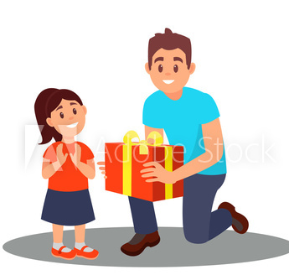

Answer the question using direct and indirect object using the preposition “for”:
Preposition
What did your father buy for you?
for
My father bought a gift for me.
Direct Object
Indirect Object
Use for if the indirect object is giving from some kind of help.
Use for with these verbs:
book, build, buy, cook, find, get, keep, leave, make, order, and reserve.
If there is “for”, the indirect object goes after the direct object.
Example

Slide 9
Position in
the sentence
D
ID
D
ID
My mother told a story to me.
My father bought a gift for me.
Say the sentence without “to”:
Say the sentence without “for”:
ID
D
ID
D
My mother told me a story.
My father bought me a gift.
Note: With some verbs, the preposition for cannot be omitted:
answer, cash, change, close, fix, open, prepare, pronounce, and translate.
D
ID
Laila opens the door for me.
Example

Slide 10
Open your books
Page 56-57

Slide 11
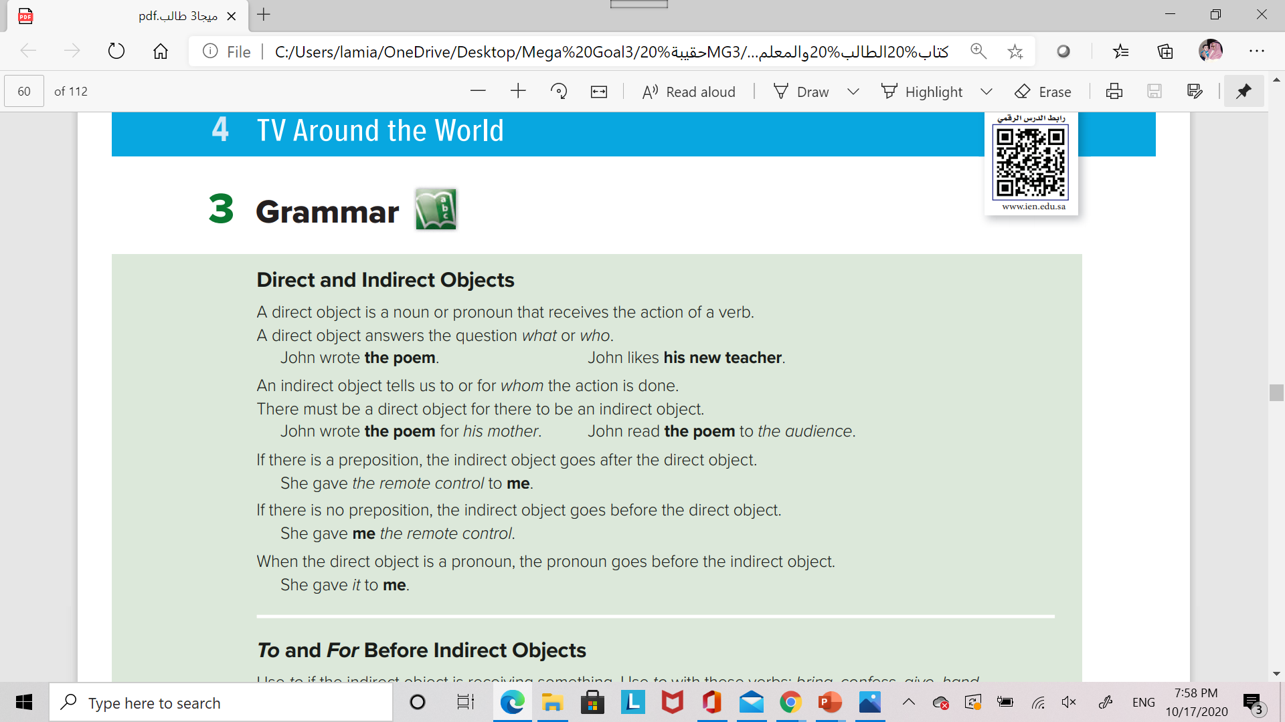

Slide 12
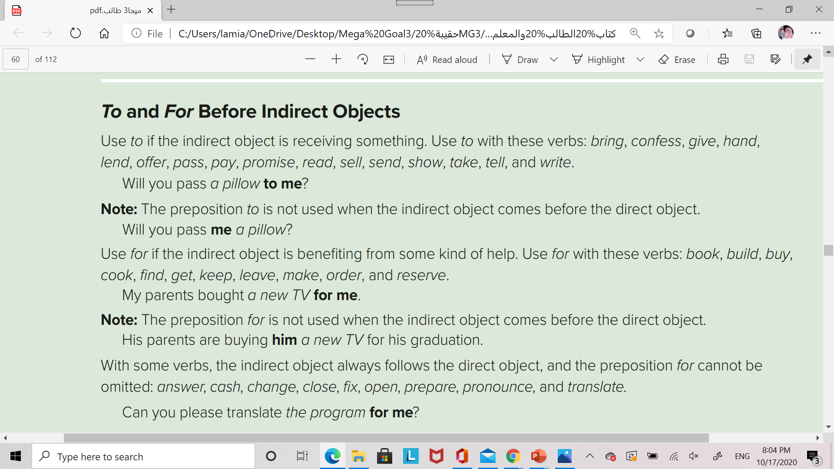

Slide 13


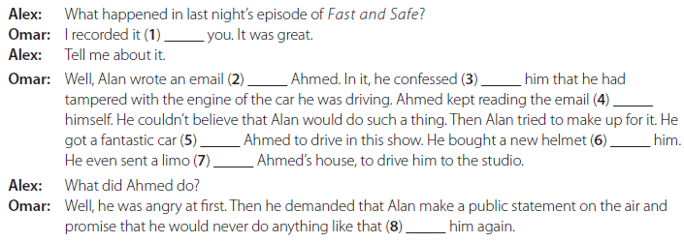
Practice
A. Complete the conversation with for or to.
for
to
to
to
for
for
to
to

Slide 14
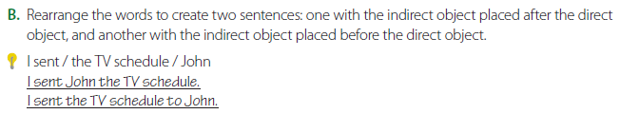
Practice
1. the comedian told / the audience / a joke
The comedian told the audience a joke. / The comedian told a joke to the audience.
2. a glass of water / the talk show host poured / the celebrity
The talk show host poured the celebrity a glass of water. / The talk show host poured a glass of water for the celebrity.
3. the sitcom dad gave / his wife / his wallet
The sitcom dad gave his wife his wallet. / The sitcom dad gave his wallet to his wife.
4. his cheese / the cat / the cartoon mouse offered
The cartoon mouse offered the cat his cheese. / The cartoon mouse off ered his cheese to the cat.

Slide 15
worksheet

Slide 16
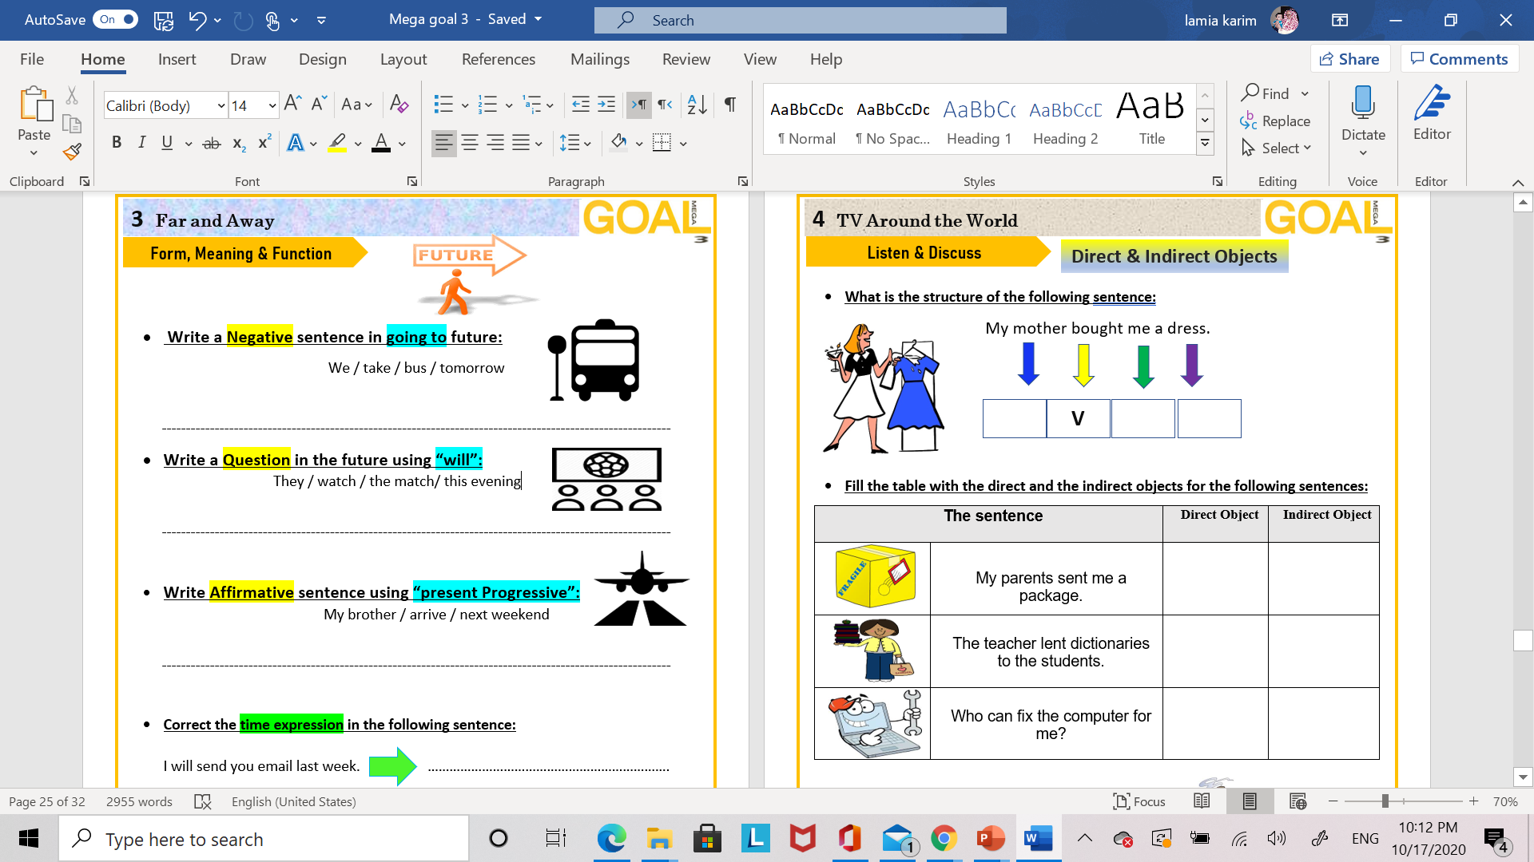
S
D O
I D
a package
me
dictionaries
students
computer
me

Slide 17
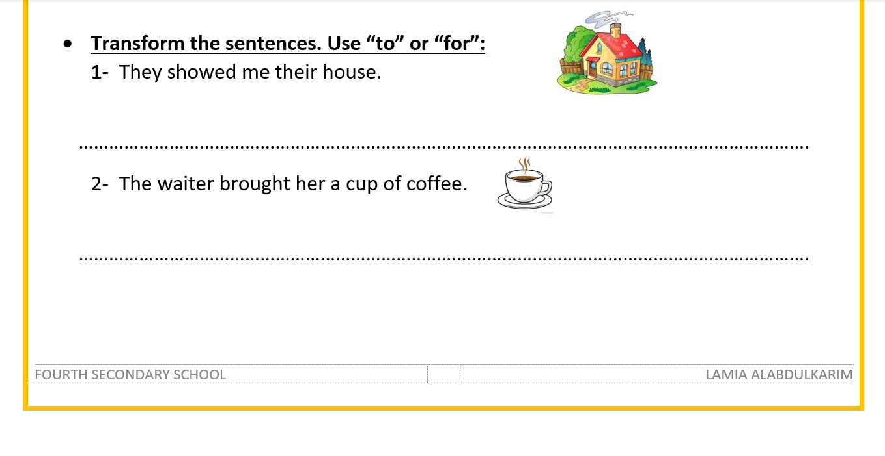
They showed their house to me.
The waiter brought a cup of coffee for her.

Slide 18
Homework
Workbook
Ex. C Page: 38
Ex. E Page: 39

