Slide 1


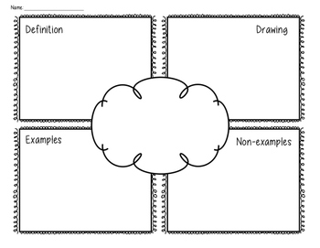
Frayer Model Strategy
Teacher : Huda Alsubhi

