Slide 1


Chores and Activities
Unit 4
Grammar in Action

Slide 2
Date
بسم الله الرحمن الرحيم
Day:

Slide 3
01.
distinguish the form of verb with different subjects
Learning
Objectives
02.
03.
chant the chores chant
build different sentences by drawing lines

Slide 4

Warm up

Slide 5
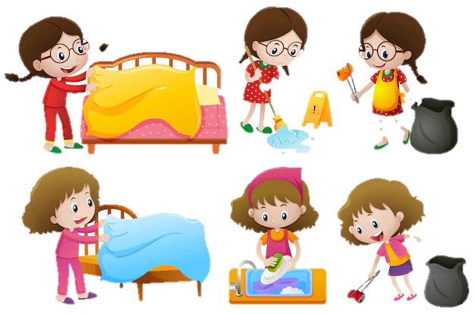
What chores do you do ?

Slide 6
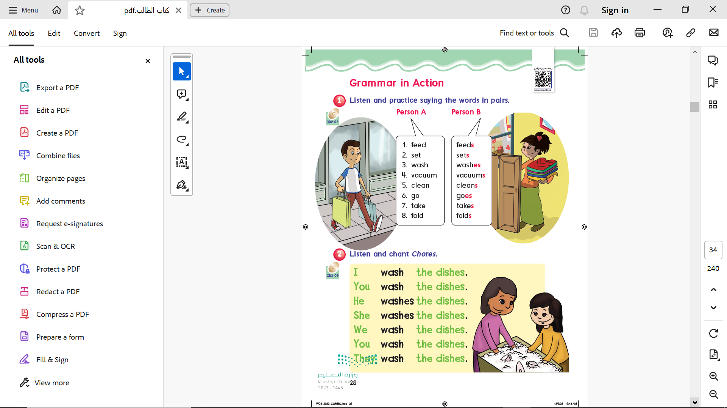

Page 28
I
You
We
They
He
She
It

Slide 7
Page 28

Slide 8
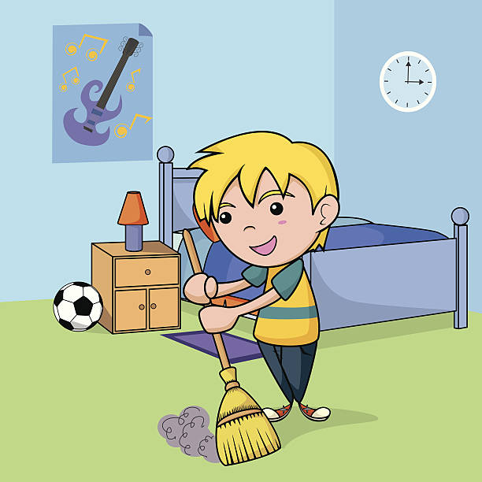
he
she
it
Verb + s
He cleans up his room.

Slide 9
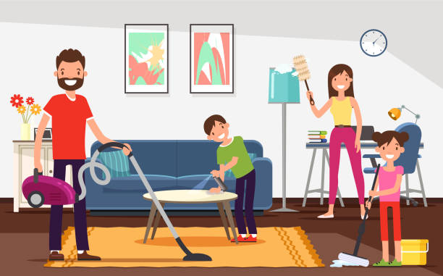
I
You
We
They
Verb
They clean up the house.

Slide 10
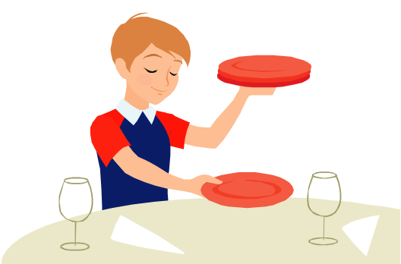
Choose the correct answer:
I ( sets – set ) the table

Slide 11
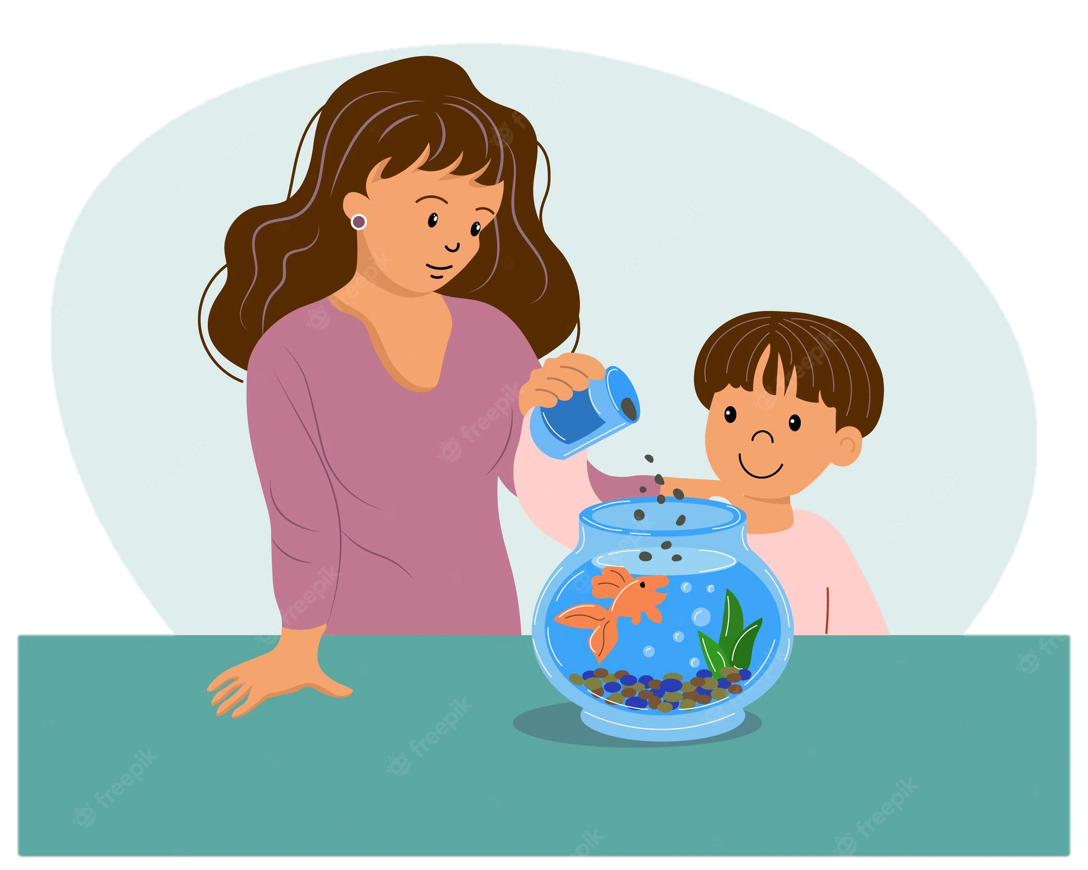
Choose the correct answer:
He ( feeds – feed ) the fish

Slide 12
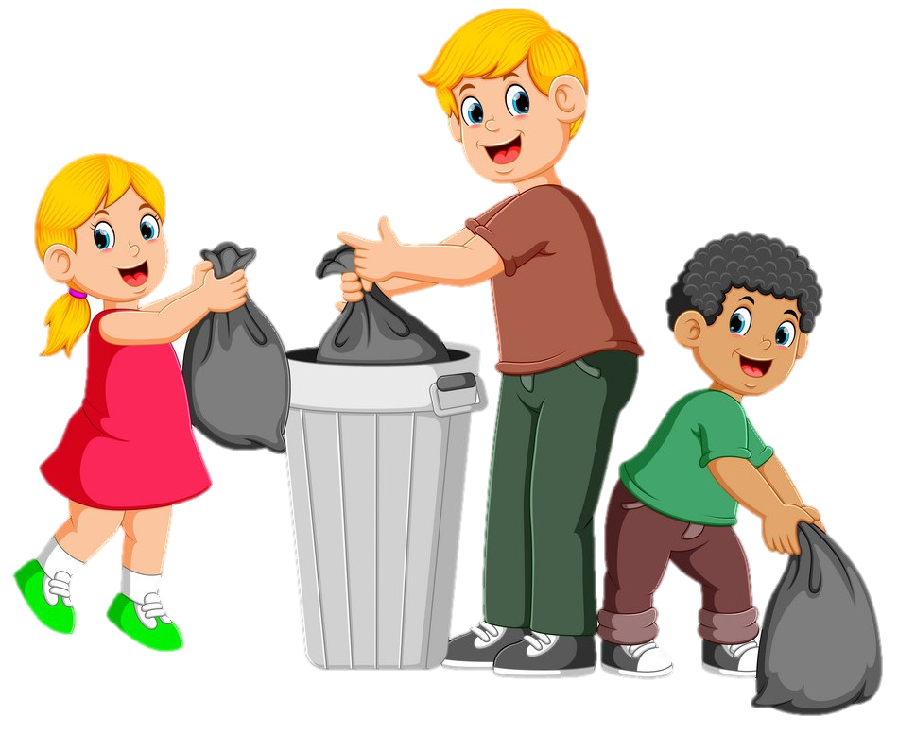
Choose the correct answer:
They ( takes – take ) out the trash

Slide 13
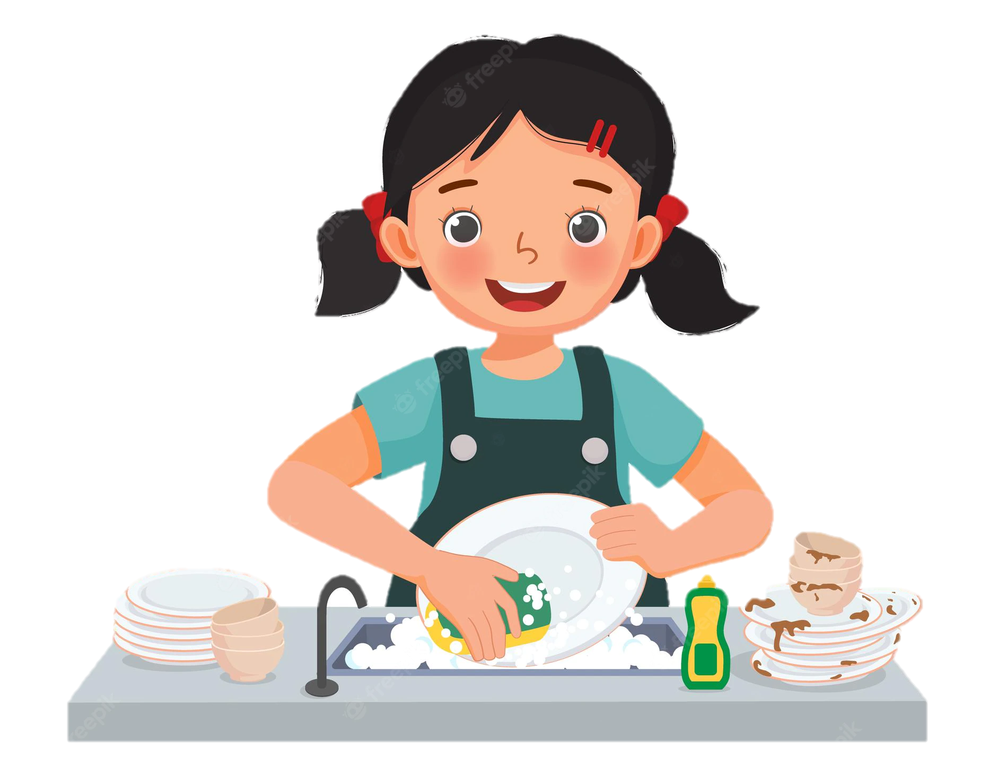
Choose the correct answer:
She ( washes – wash ) the dishes

Slide 14
Choose the correct answer:
They ( cleans – clean ) the house

Slide 15


Slide 16
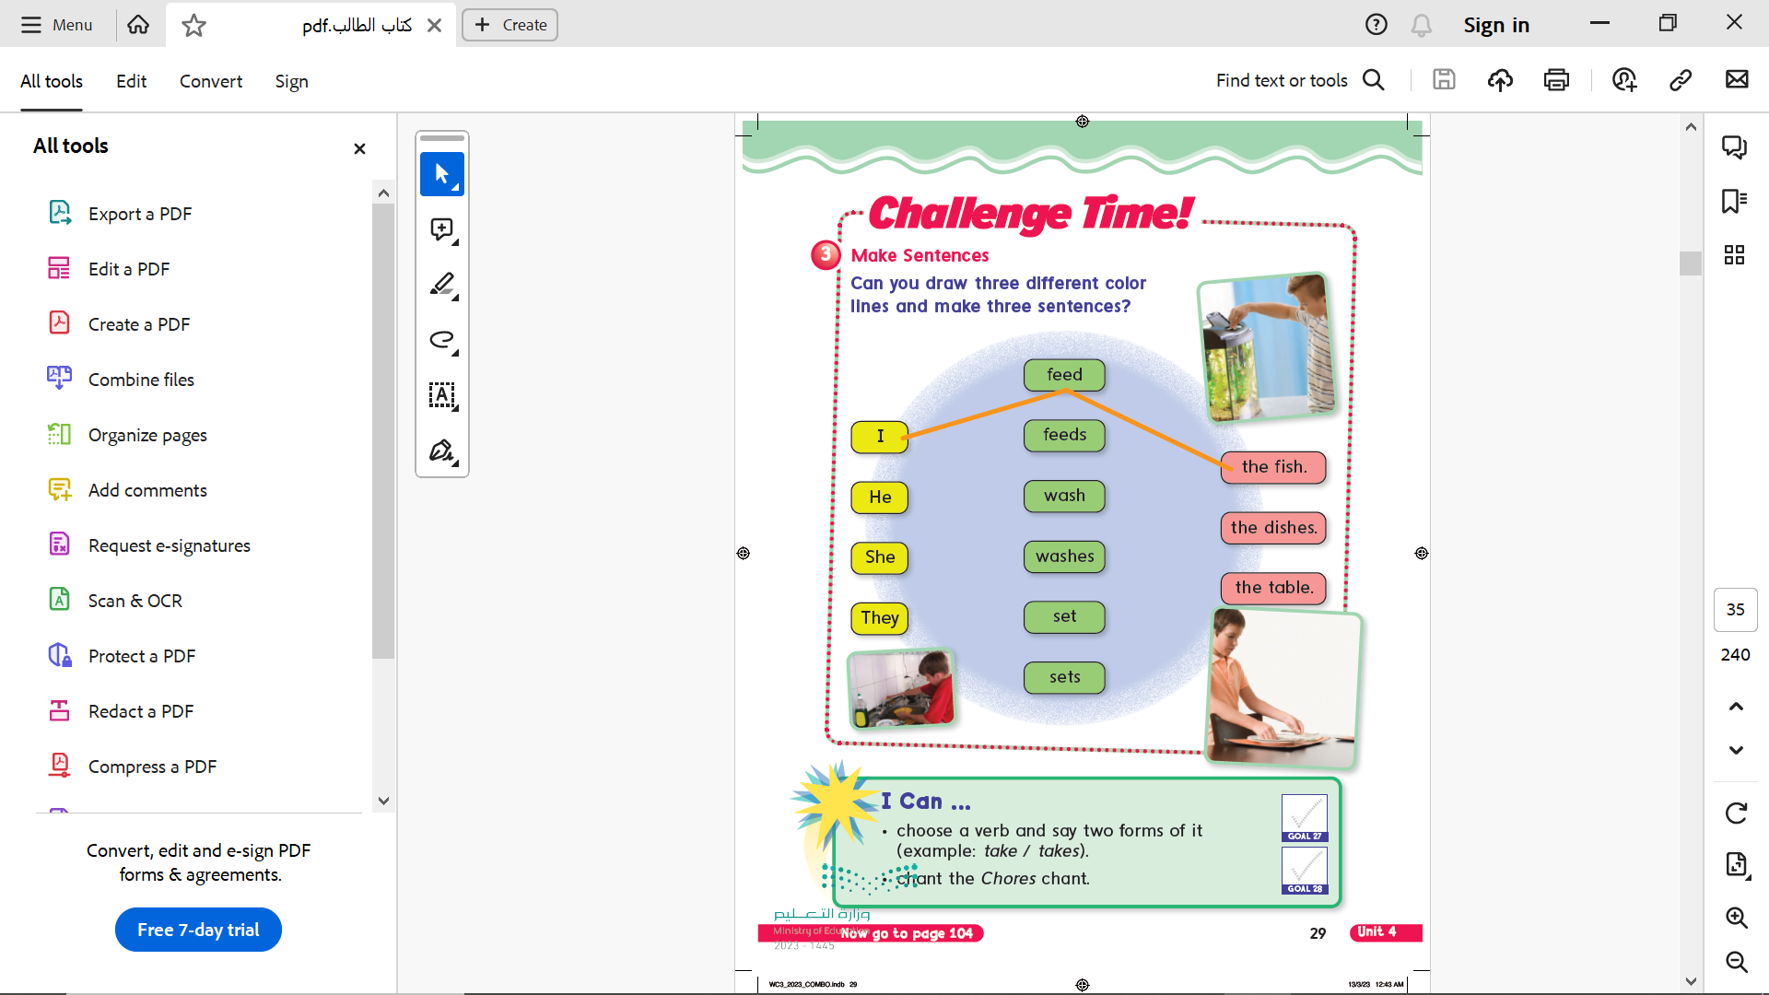
Page 29

Slide 17
Goals Check
Page 27

Slide 18


Practice

Slide 19

Write in your notebook
She washes the dishes.

Slide 20
Homework
Workbook ages 165 & 166

Slide 21
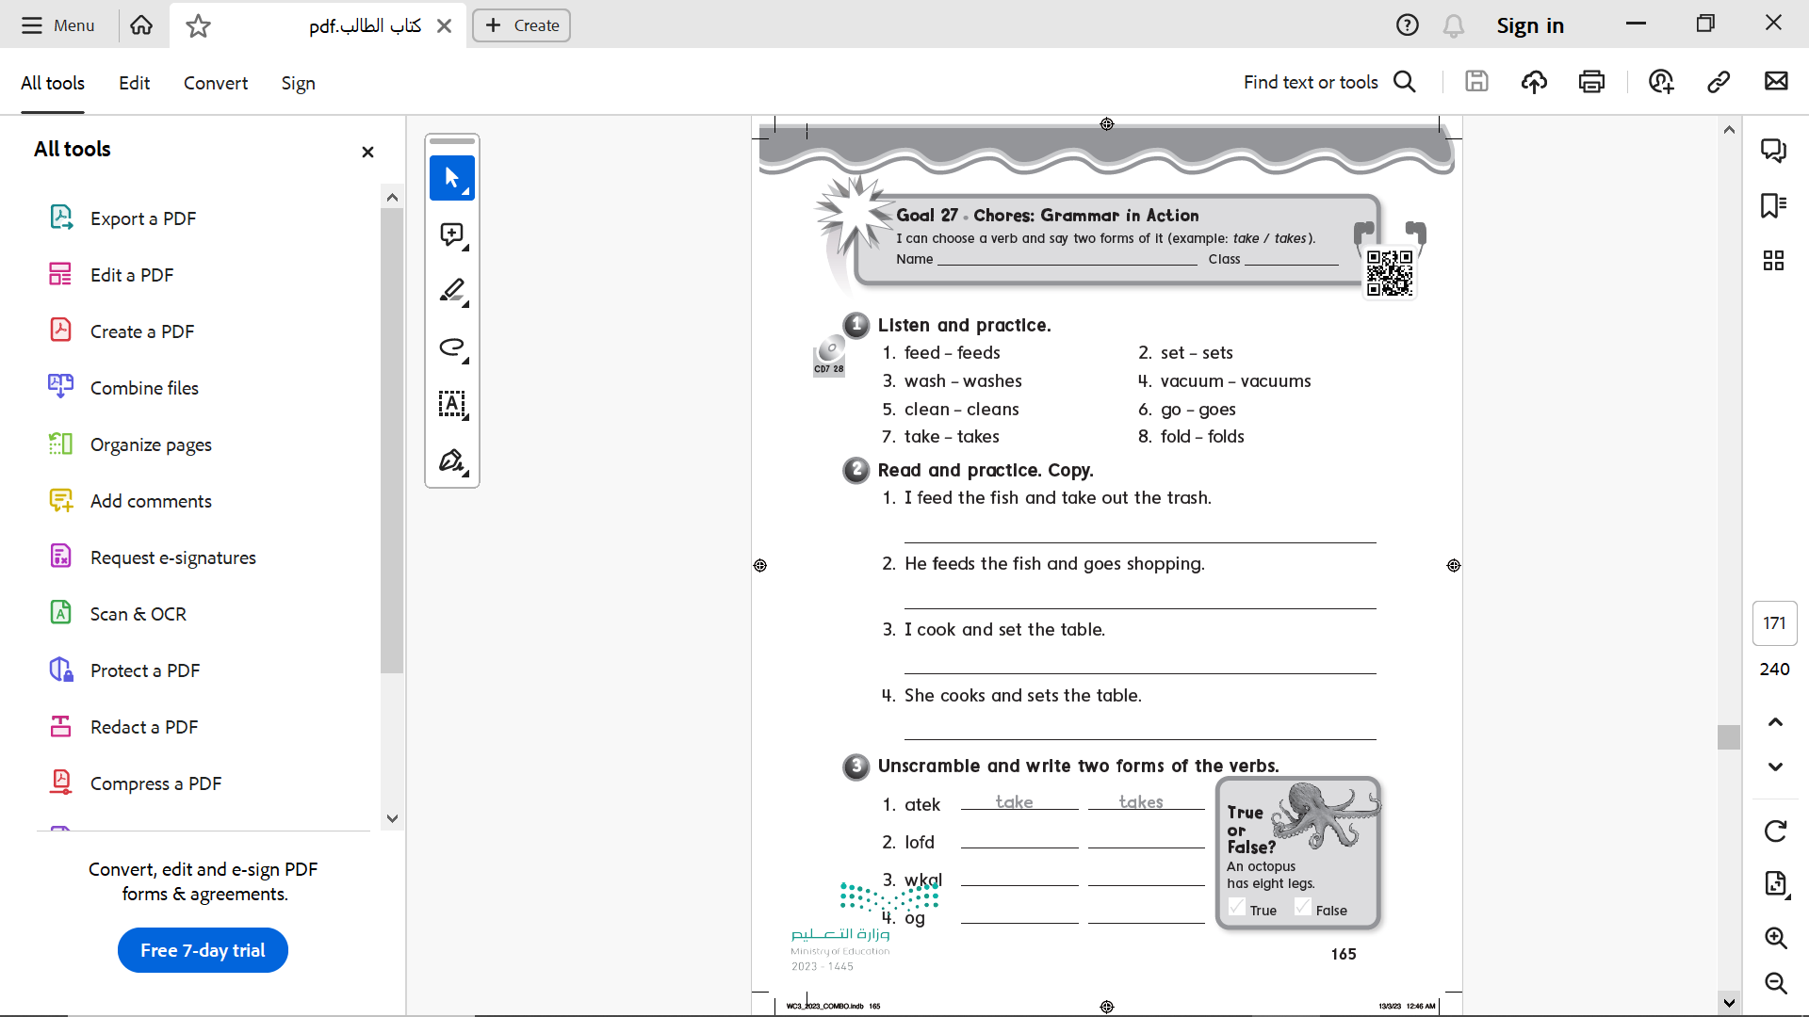
Page 165

Slide 22
Page 165
I feed the fish and take out the trash .
He feeds the fish and goes shopping .
I cook and set the table .
She cooks and sets the table .

Slide 23

Page 165
fold
folds
walk
walks
go
goes

Slide 24
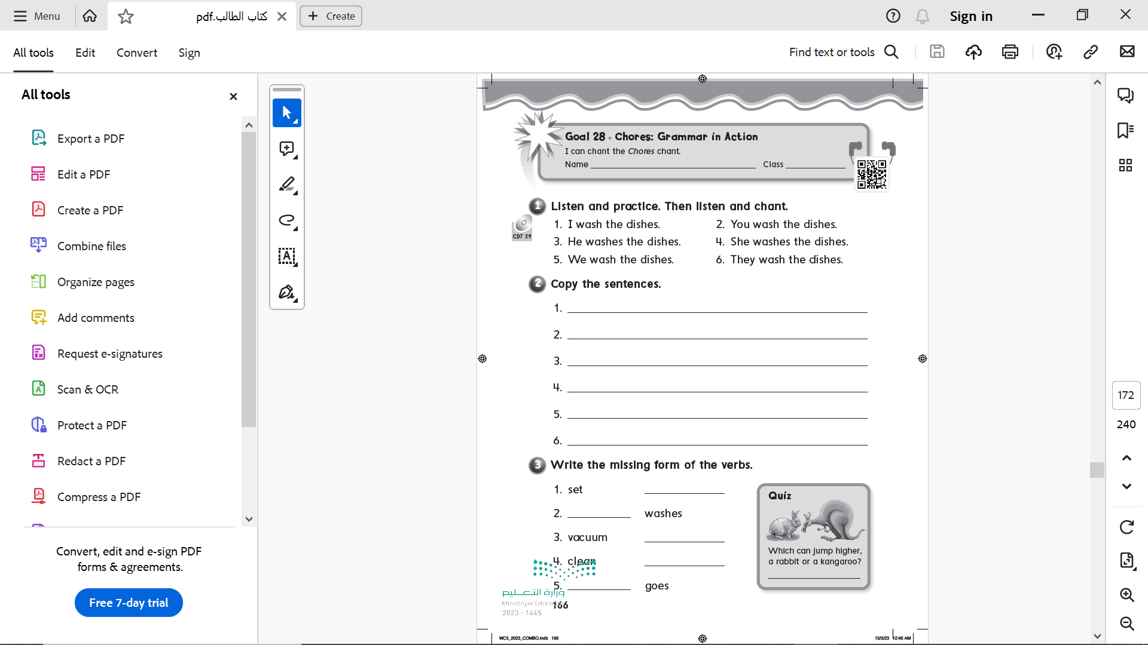
Page 166
I wash the dishes .
You wash the dishes .
He washes the dishes .
She washes the dishes
We wash the dishes .
They wash the dishes .

Slide 25
Page 166
sets
wash
vacuums
cleans
A kangaroo
go

