Slide 1


Chores and Activities
Unit 4
Finding Out Time

Slide 2
Date
بسم الله الرحمن الرحيم
Day:

Slide 3
01.
list a number of chores
Learning
Objectives
02.
03.
04.
establish a question and answer talk about chores
calculate scores of how often they do chores
compare results in groups to decide what kind of helper at home

Slide 4

Warm up

Slide 5
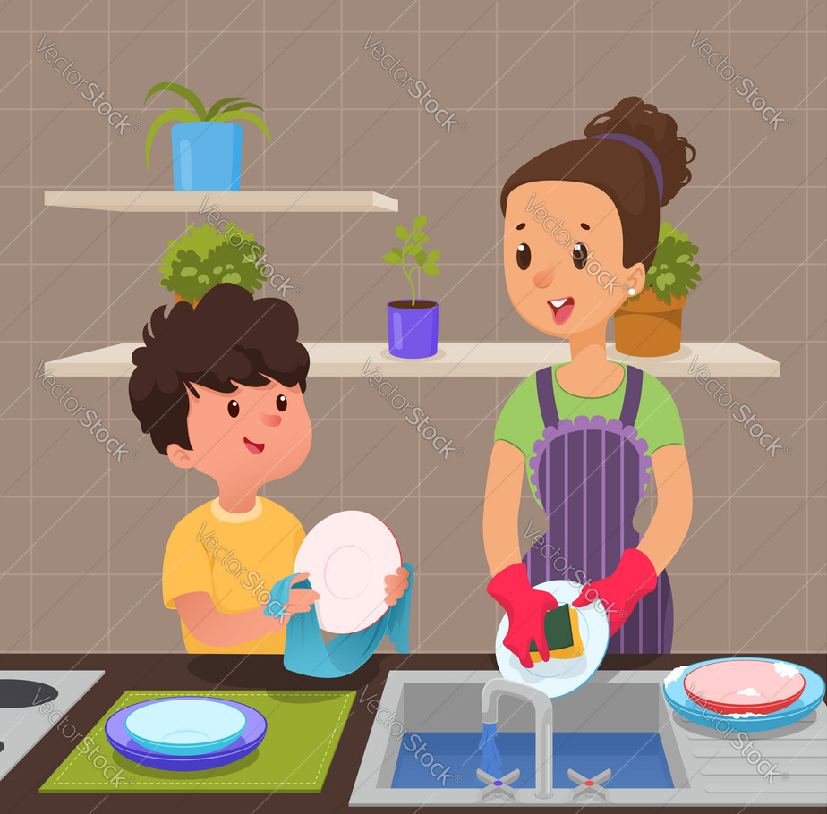
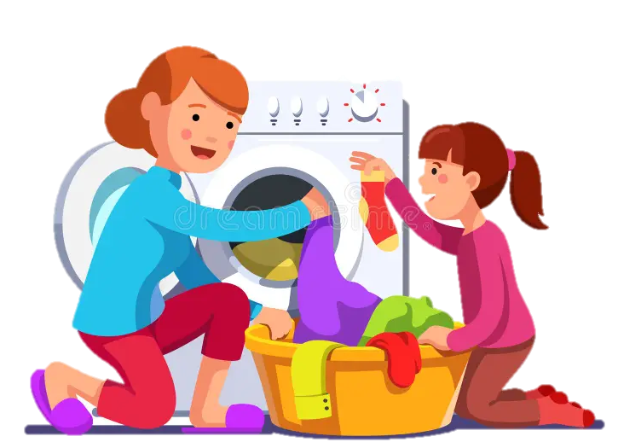
Do you help your Mom at home?
What do you do ?

Slide 6
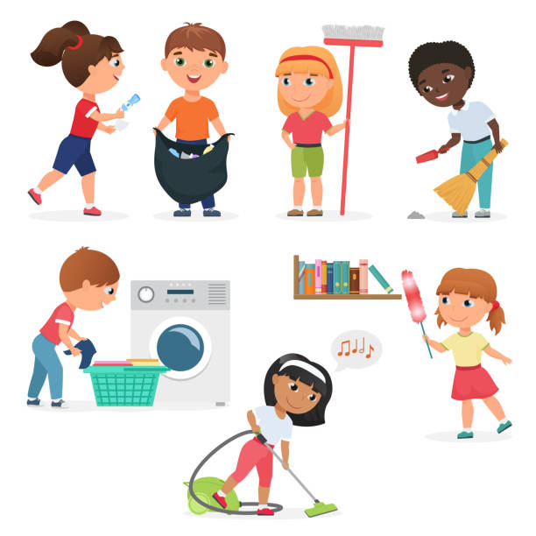


Slide 7
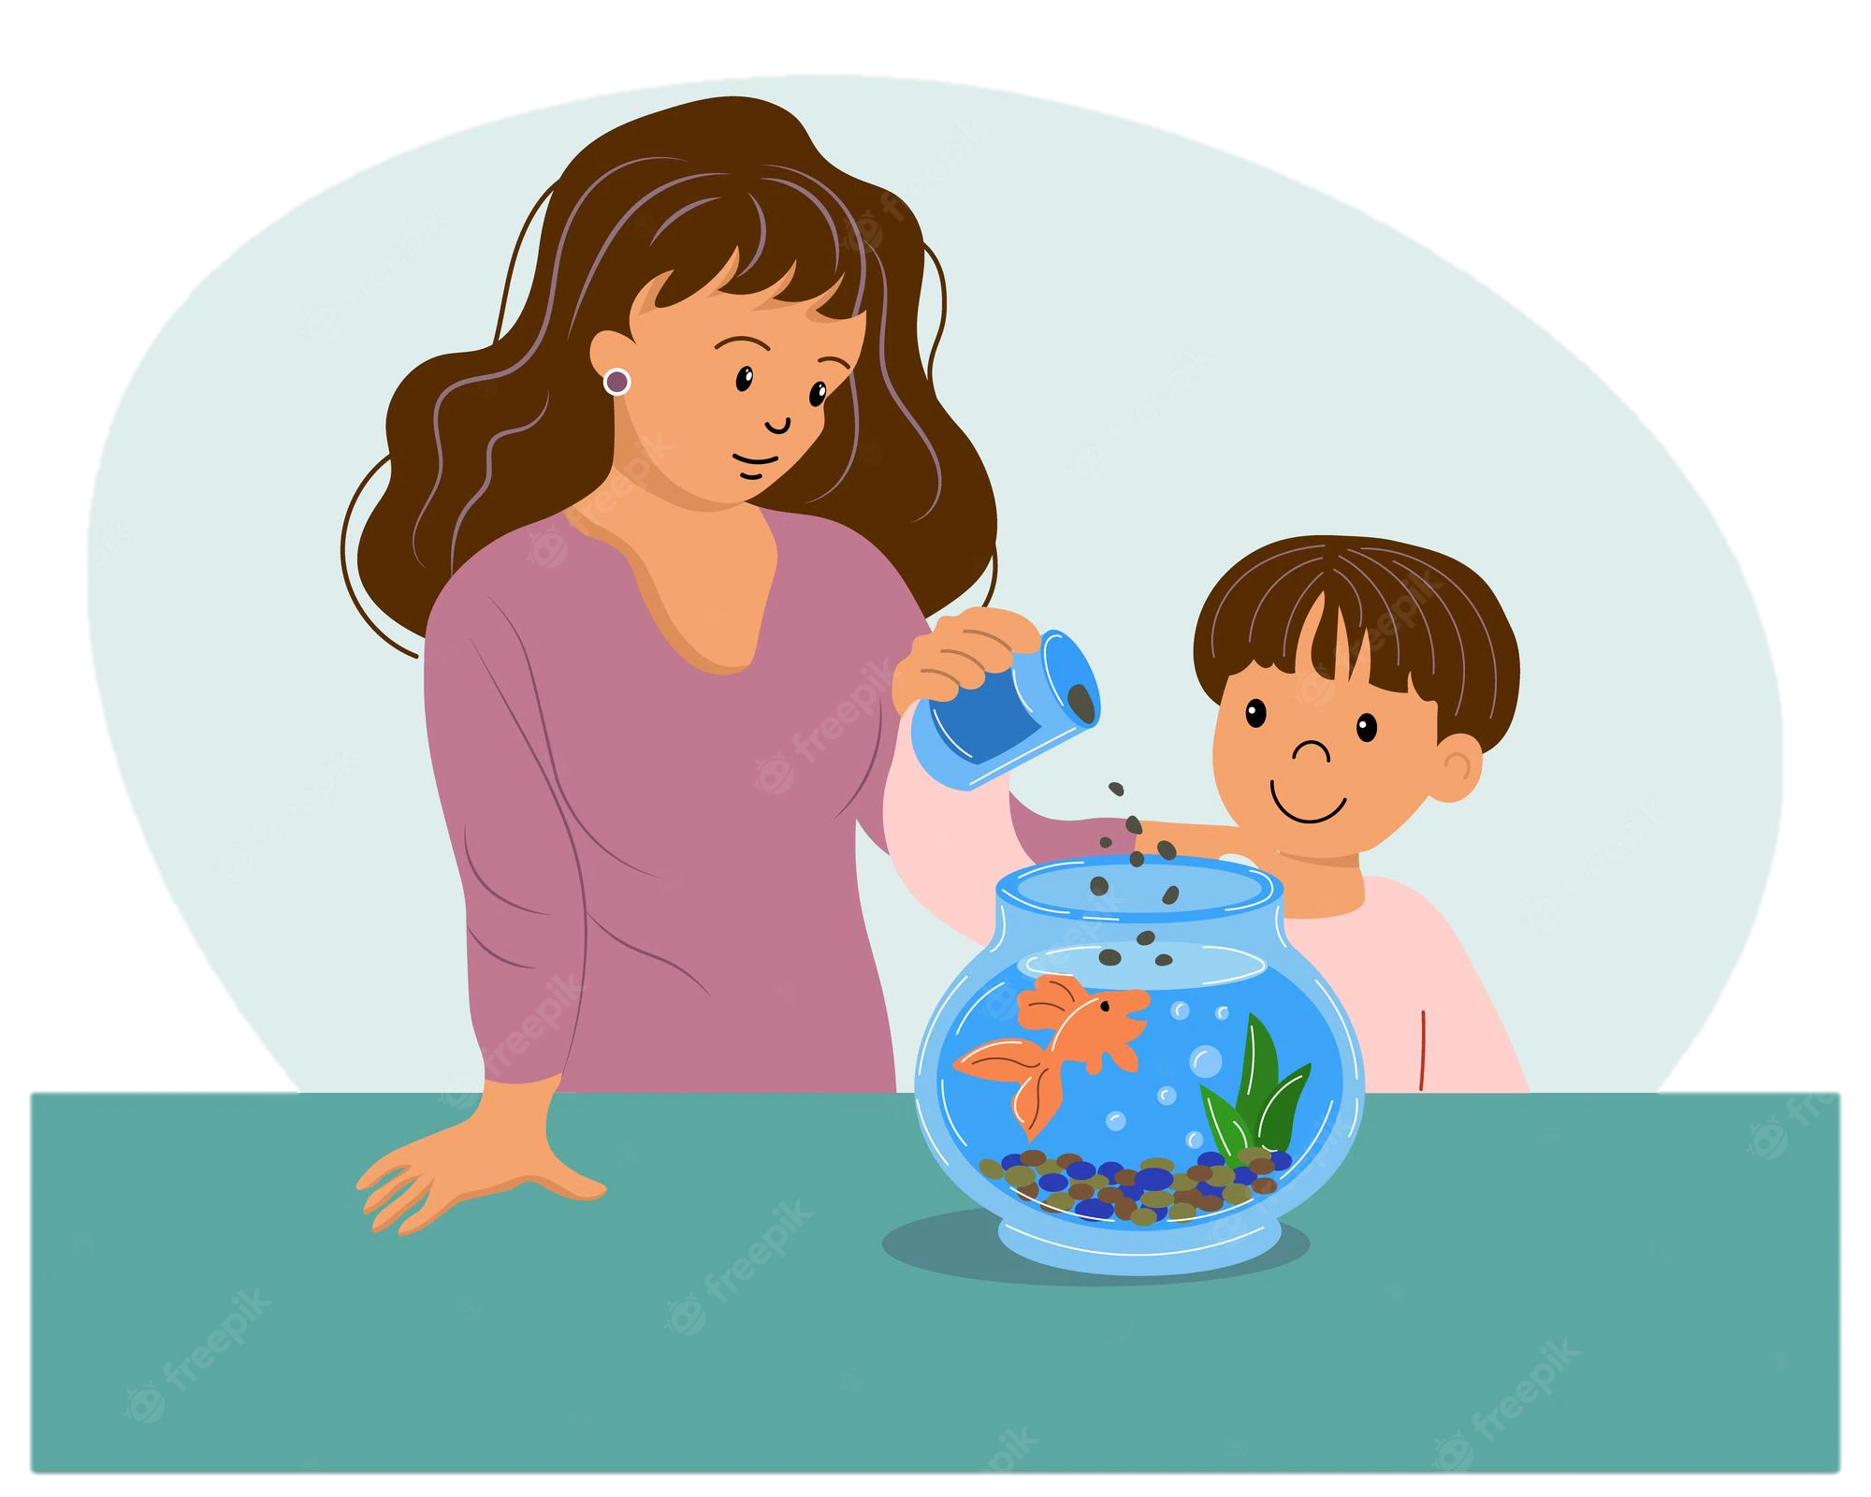
Feed the fish

Slide 8
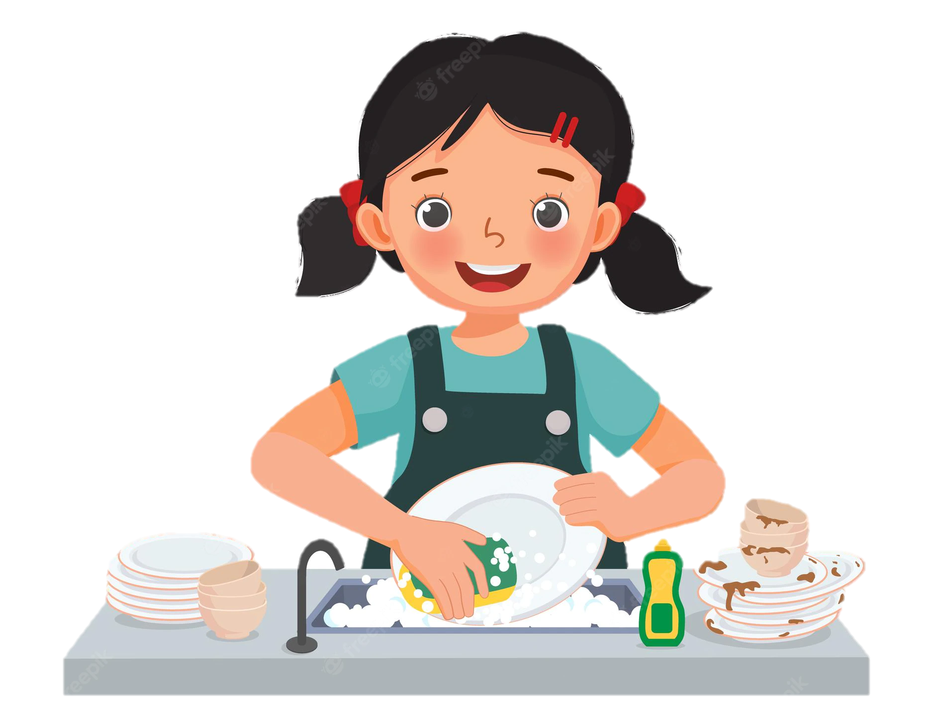
Wash the dishes

Slide 9

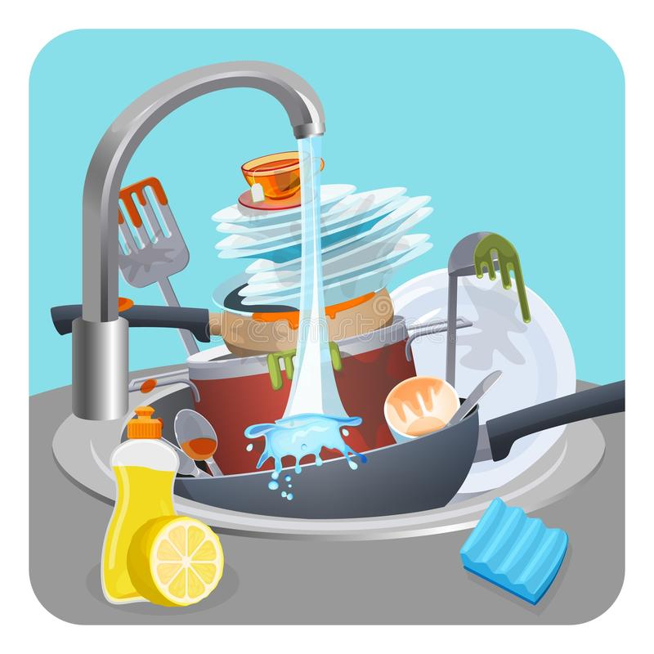
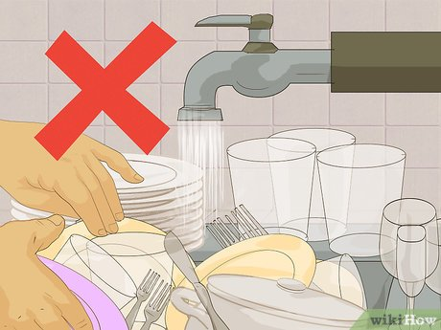
Is it a good behavior ?

Slide 10

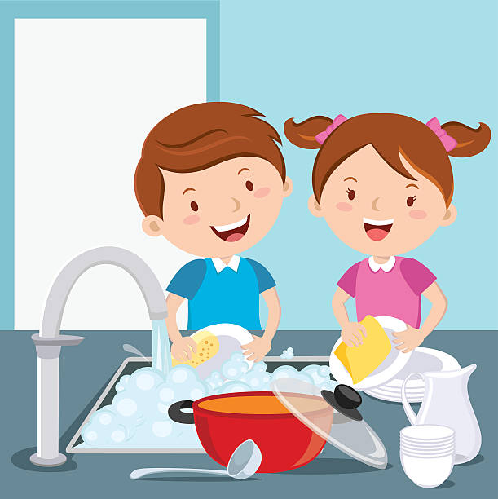
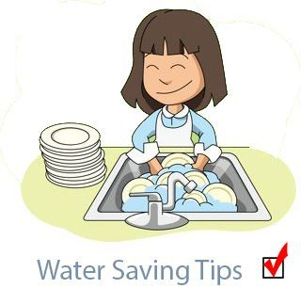


Save water
Turn off taps
after use.
do not let water run while washing dishes.

Slide 11
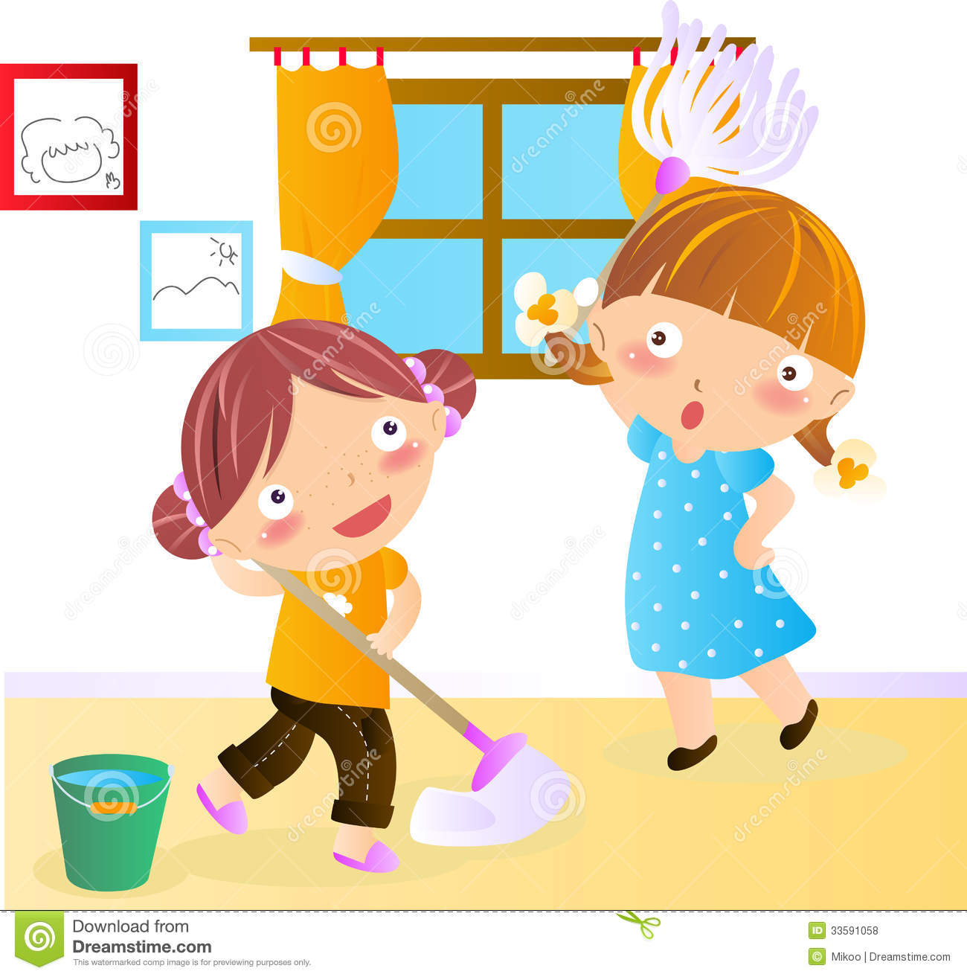
Clean up my room

Slide 12
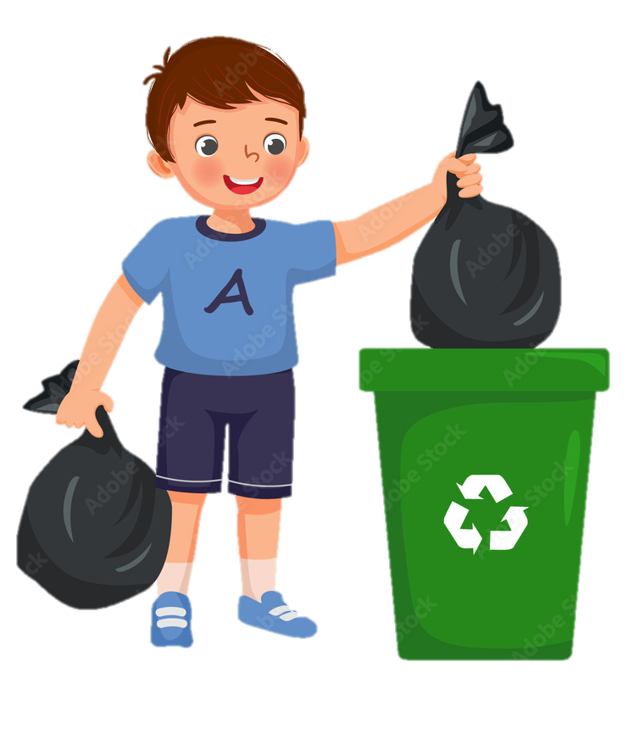

Take out the trash

Slide 13
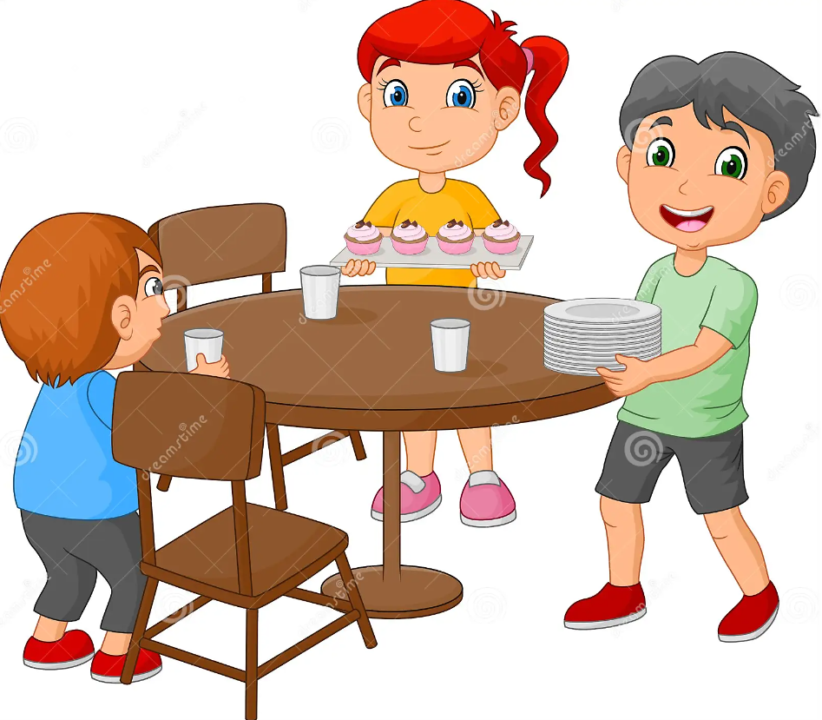
Set the table

Slide 14
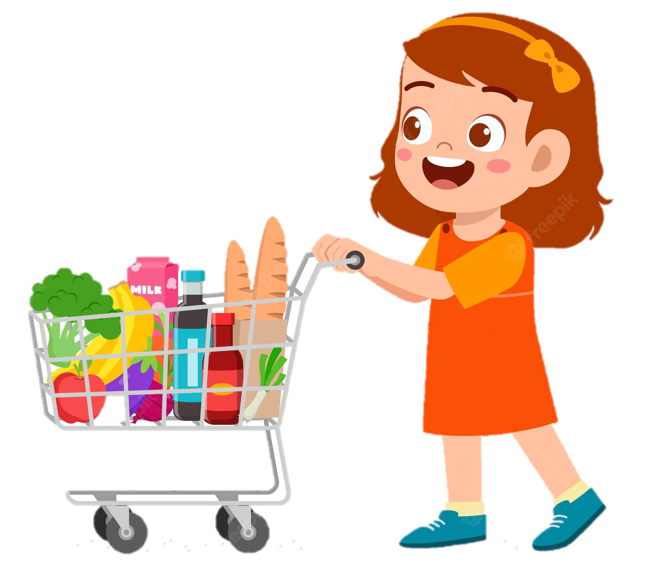
Go shopping

Slide 15
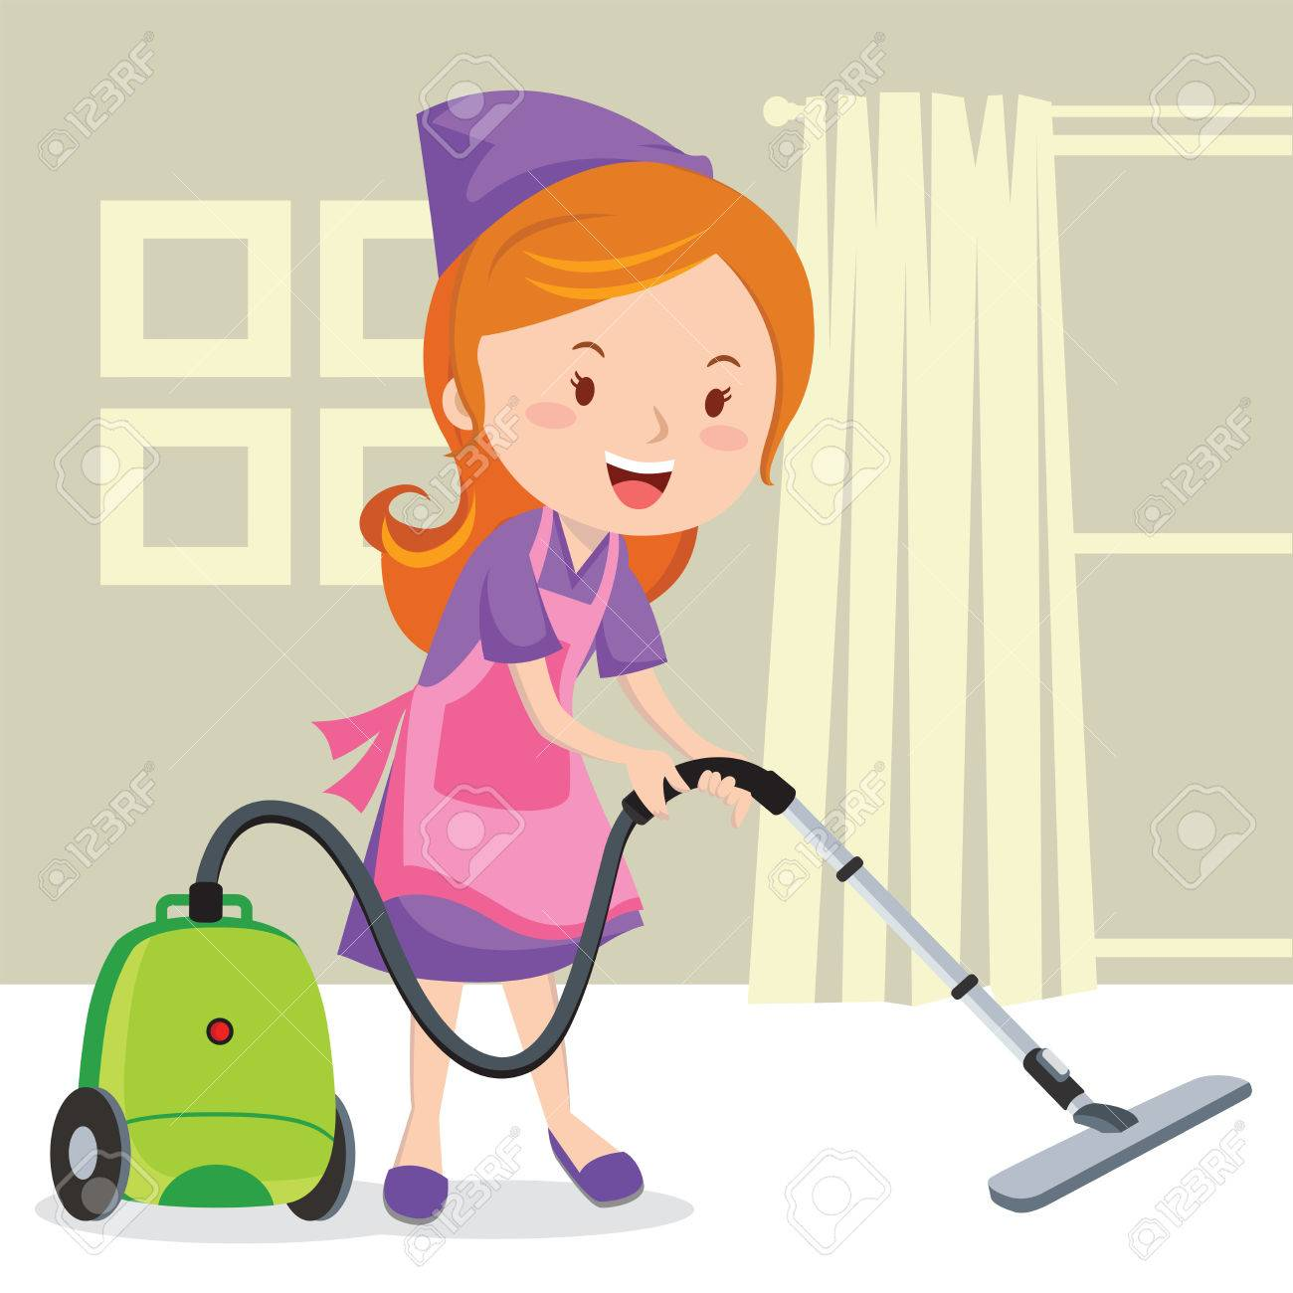
Vacuum the floor

Slide 16
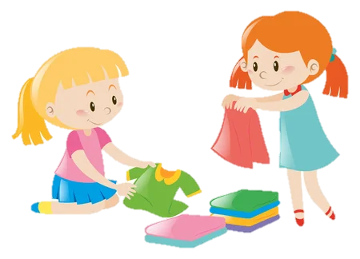
Fold the laundry

Slide 17
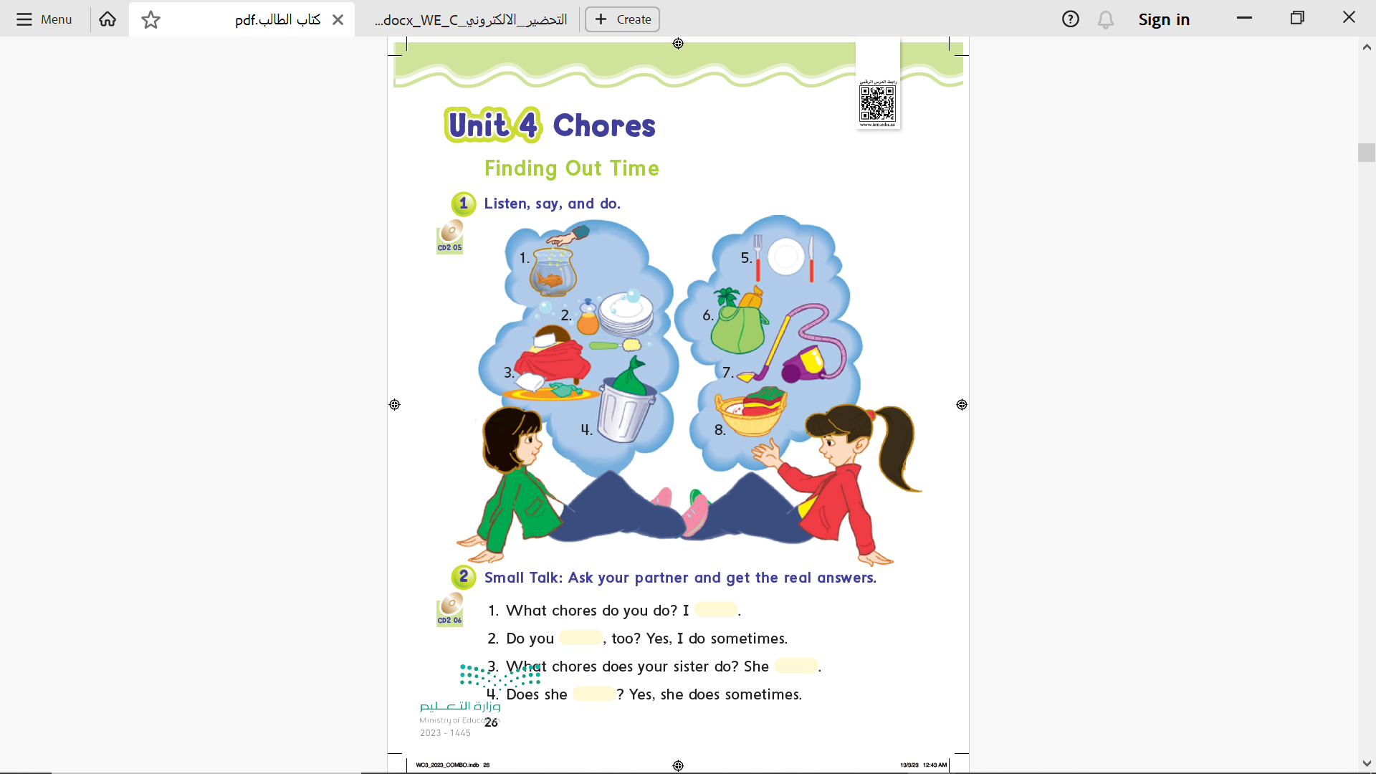

Page 26

Slide 18
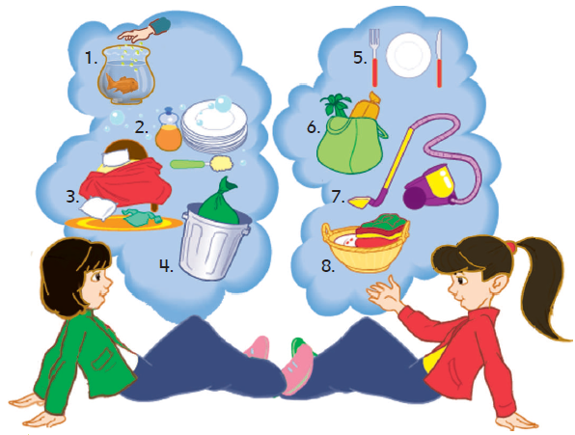
1- Feed the fish
2- Wash the dishes
3- Clean up the room
4- Take out the trash
5- Set the table
6- Go shopping
7- Vacuum the floor
8- Fold the laundry

Slide 19
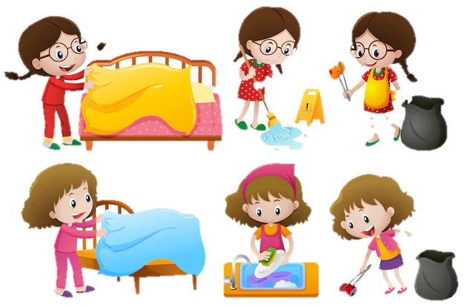
What chores do you do ?

Slide 20

Yes , I do .
No, I do not.
What chores do you do?
I …………………
Do you ……., too ?

Slide 21
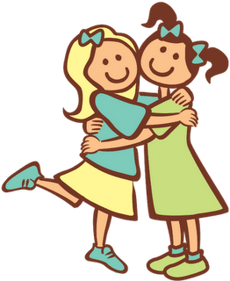
Yes , she does .
No, she doesn’t.
What chores does your sister do?
She …………………
Does she ……., too ?

Slide 22
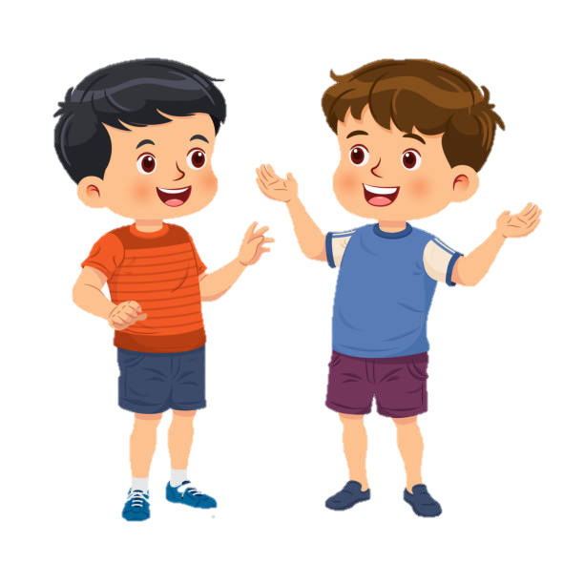
Yes , I do .
No, I do not.
What chores do you do?
I …………………
Do you ……., too ?

Slide 23

Yes , he does .
No, he does not.
What chores does your brother do?
He …………………
Do he ……., too ?

Slide 24
Page 26

Slide 25
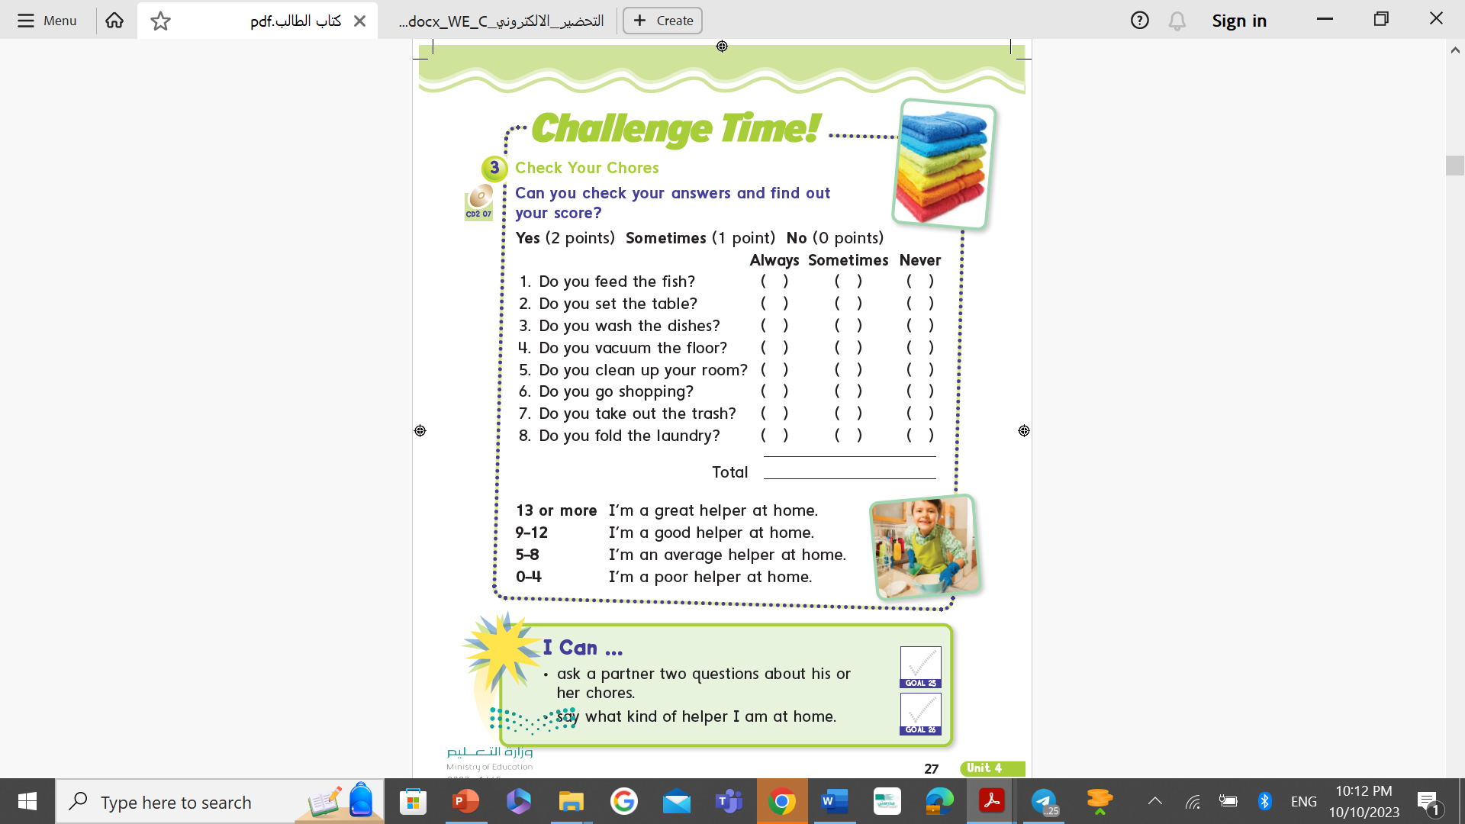
Page 27

Slide 26
Goals Check
Page 27

Slide 27


Practice

Slide 28

Write in your notebook
I clean up my room.

Slide 29
Homework
Workbook ages 163 & 164

Slide 30
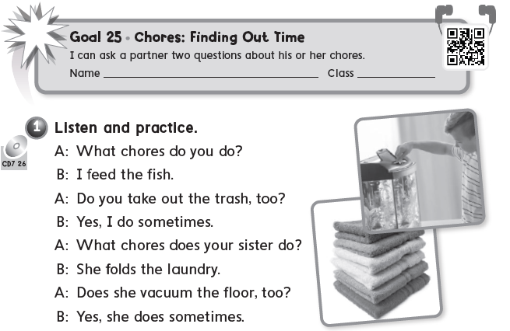
Page 163

Slide 31
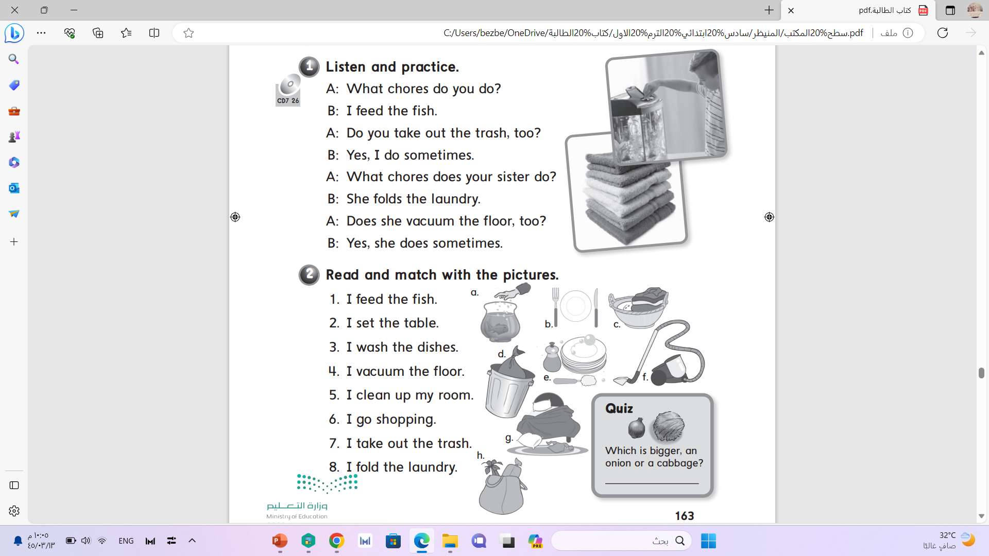
Page 163
a
b
e
f
g
h
d
c
a cabbage

Slide 32
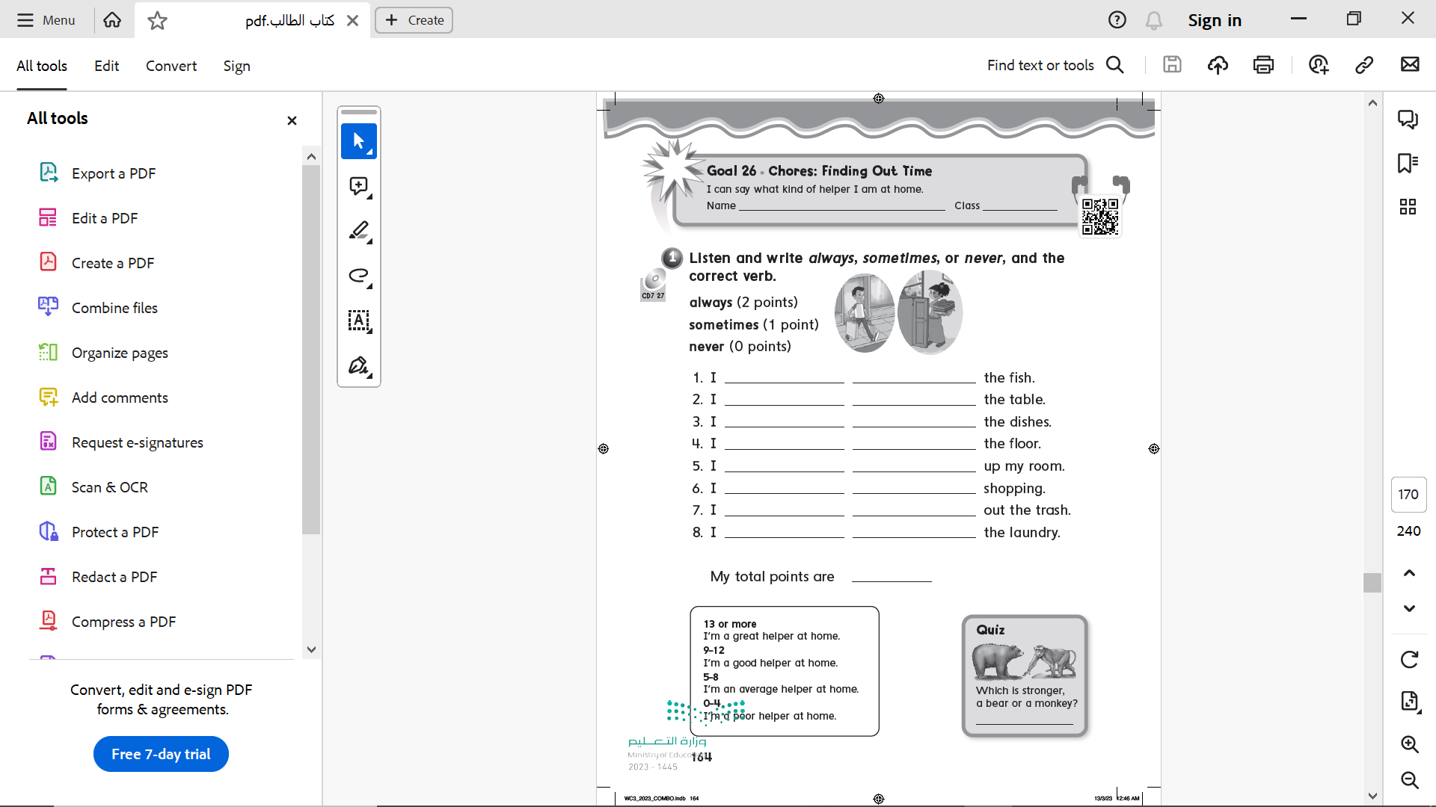
Page 164
always feed
sometimes set
always wash
sometimes vacuum
always clean
sometimes go
always take
never fold
A bear
11

