Slide 1


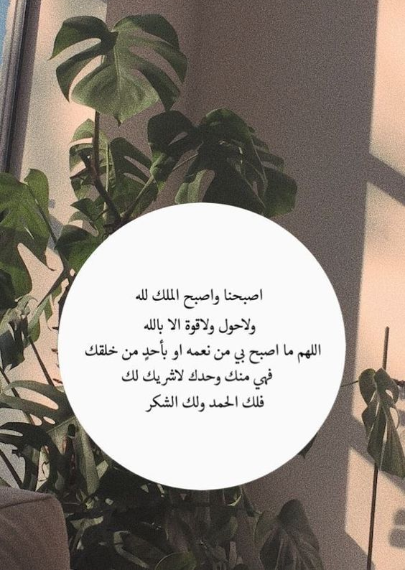

أهلاً
بالمبدعات
أساس نهضة الوطن

Slide 2
















Revision

Slide 3


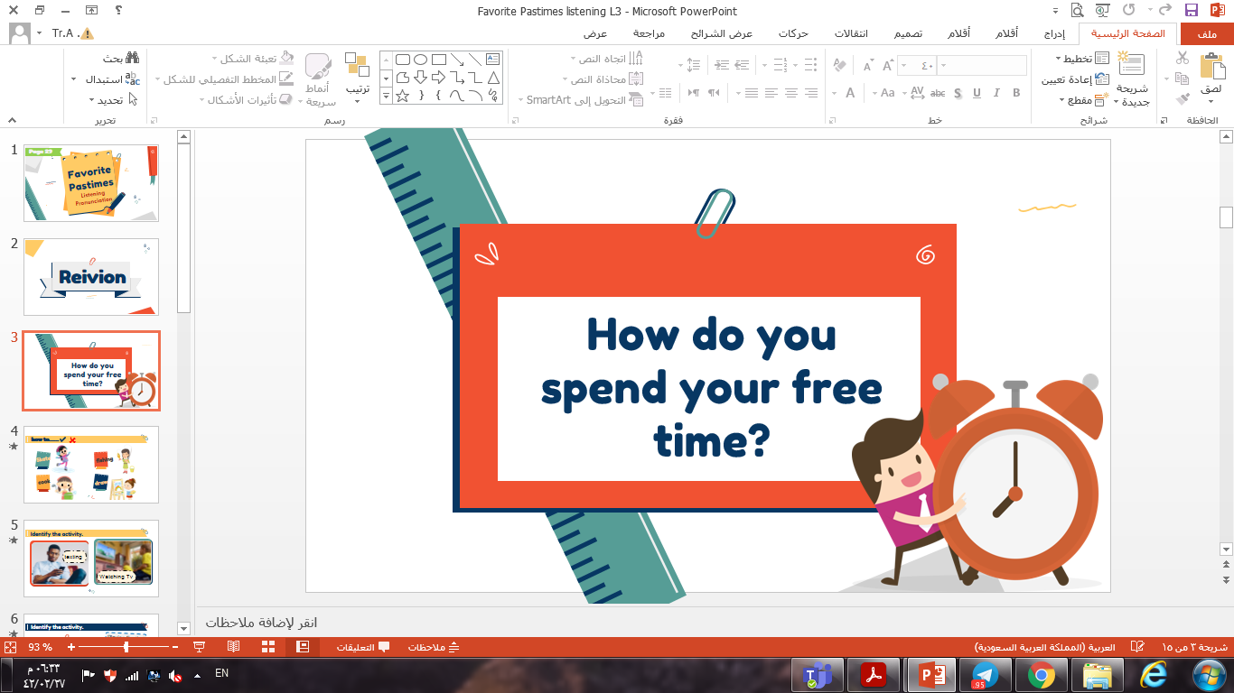
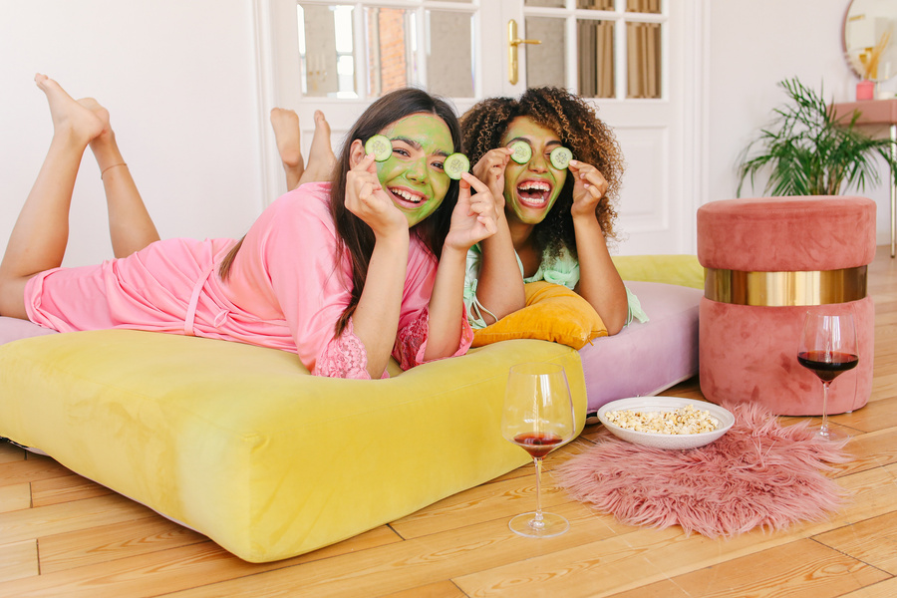

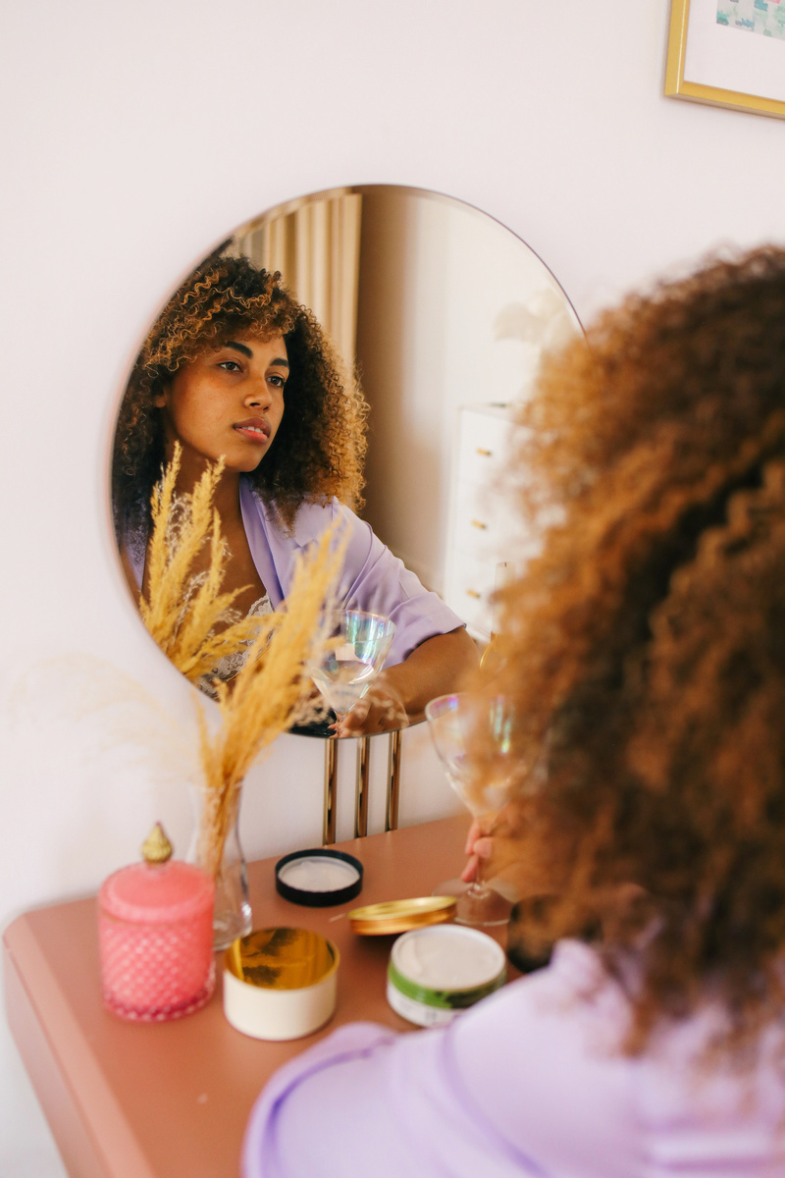



Slide 4
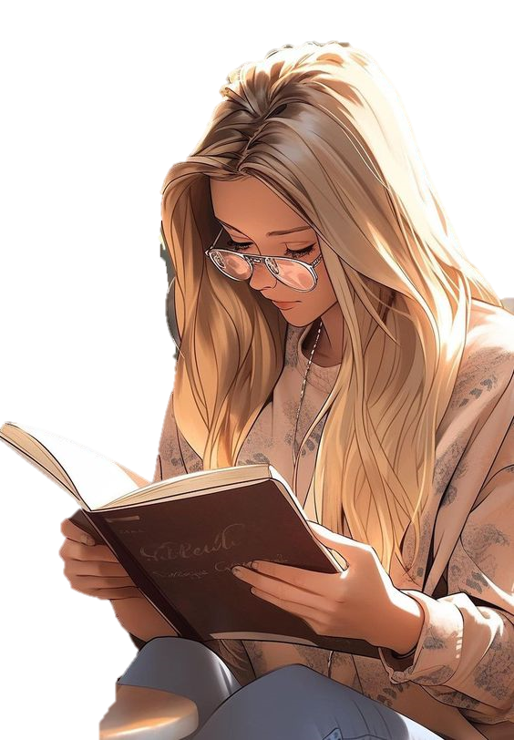


What’s your favorite hobby?

Slide 5



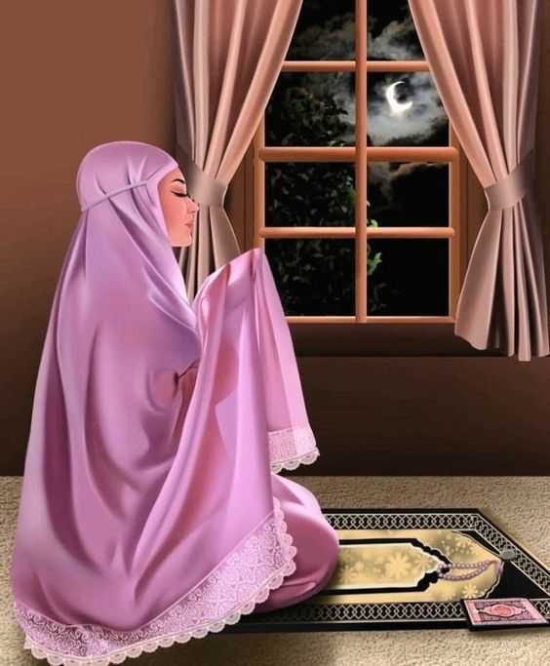
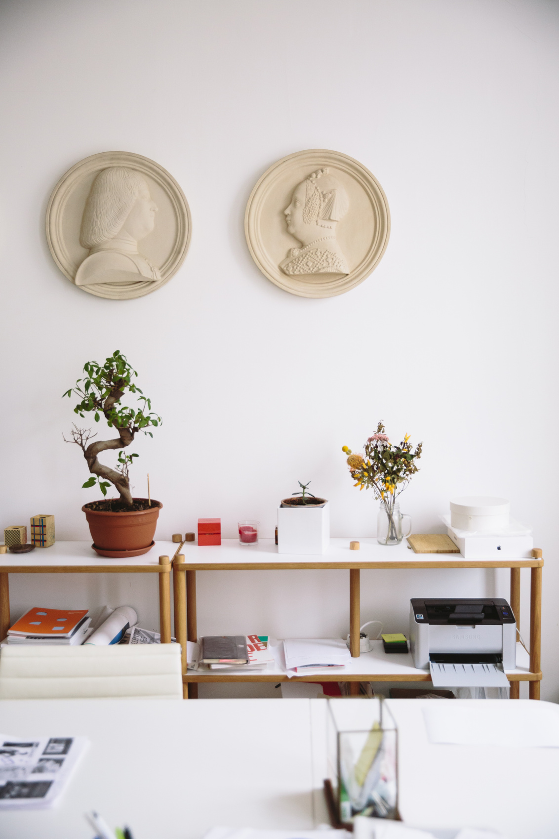


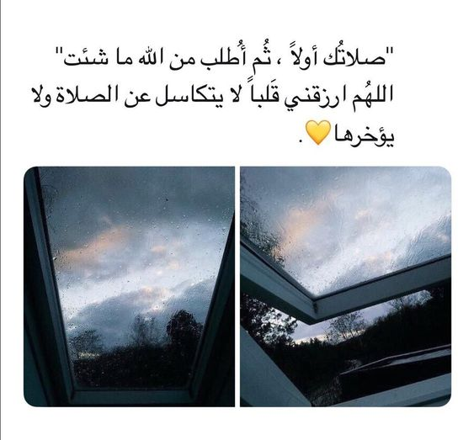
…. do you pray a day?
I pray Five times.
✓
❑
How Often
❑
What

Slide 6
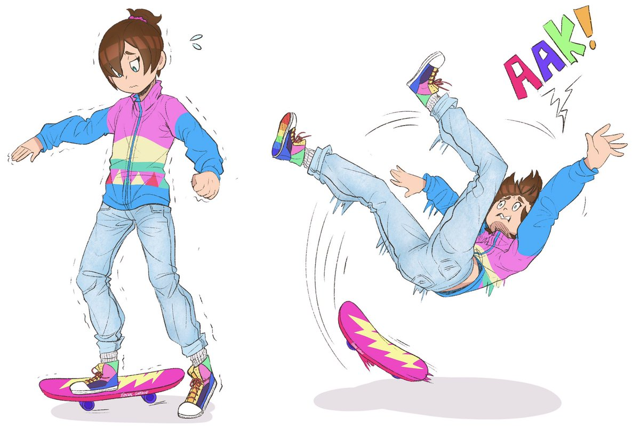
She ……… how to skate.
✓
❑
Doesn’t know
❑
Knows

Slide 7

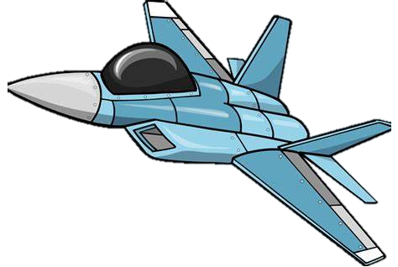
Conversation
U4: Favorite Pastimes
U4: Favorite Pastimes
U4: Favorite Pastimes
Page : 30

Slide 8
01
03
Read the conversation correctly
Answer question in the book
02
Use the "real talk" phrases in new sentence
Objectives

Slide 9
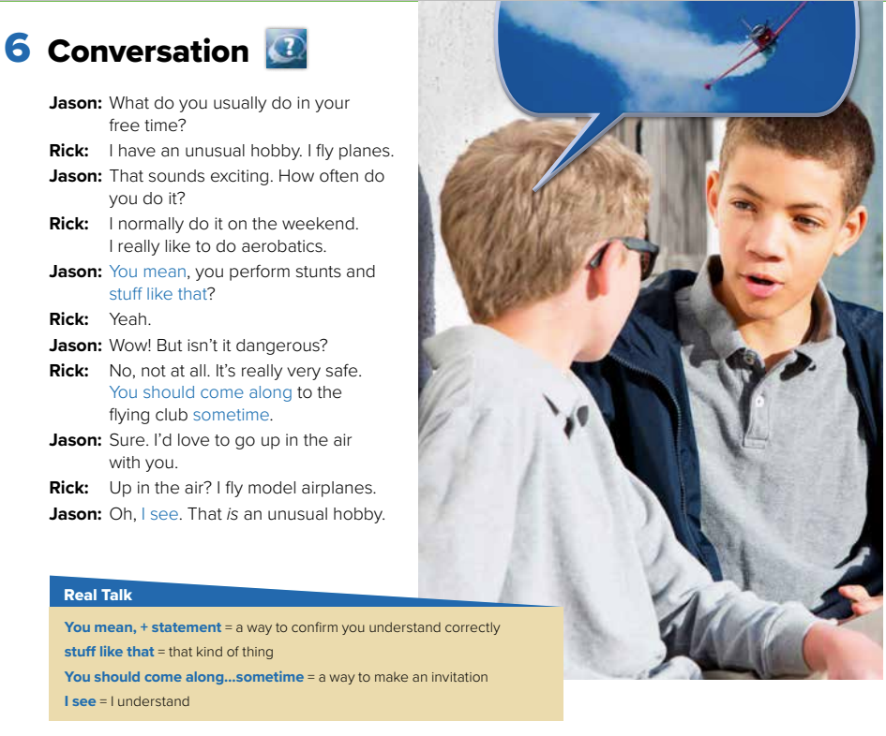
page 30

Slide 10
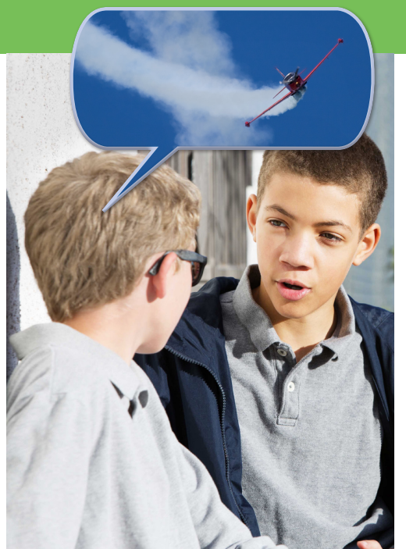

How many characters in this conversation?
Who are they ?

Slide 11
What are the people in the picture doing?
talking

Slide 12
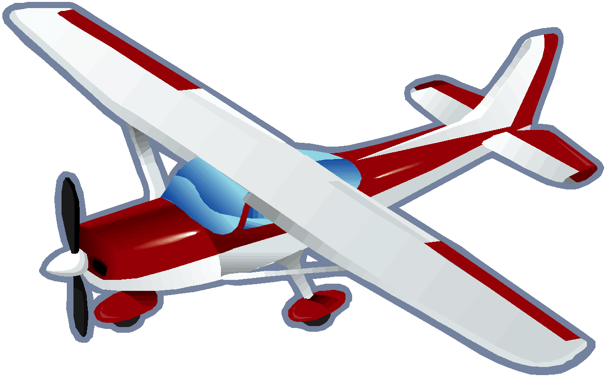
What are they talking about?

Slide 13
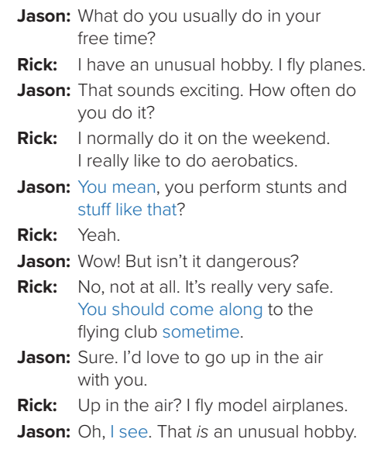

page 30

Slide 14
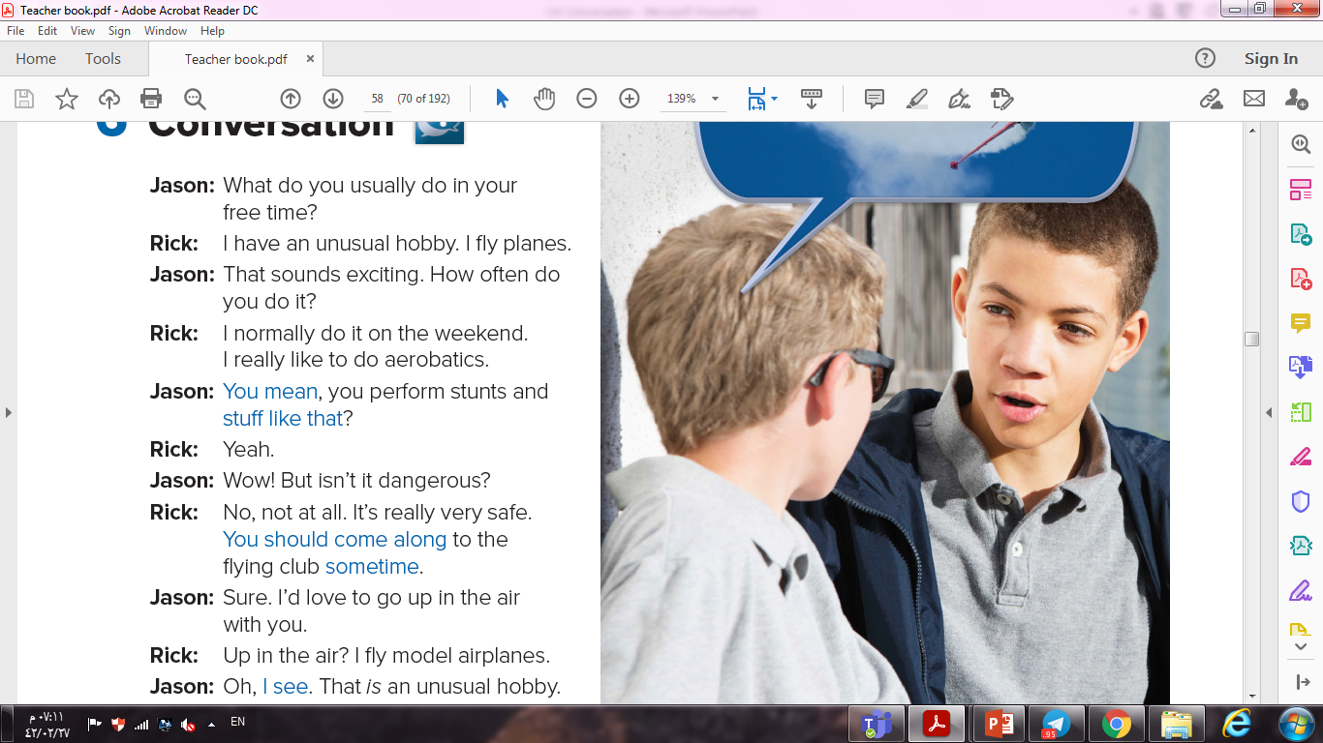

Slide 15
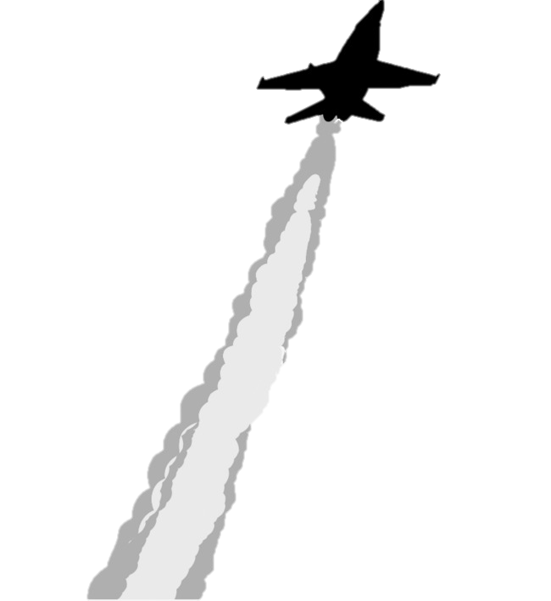
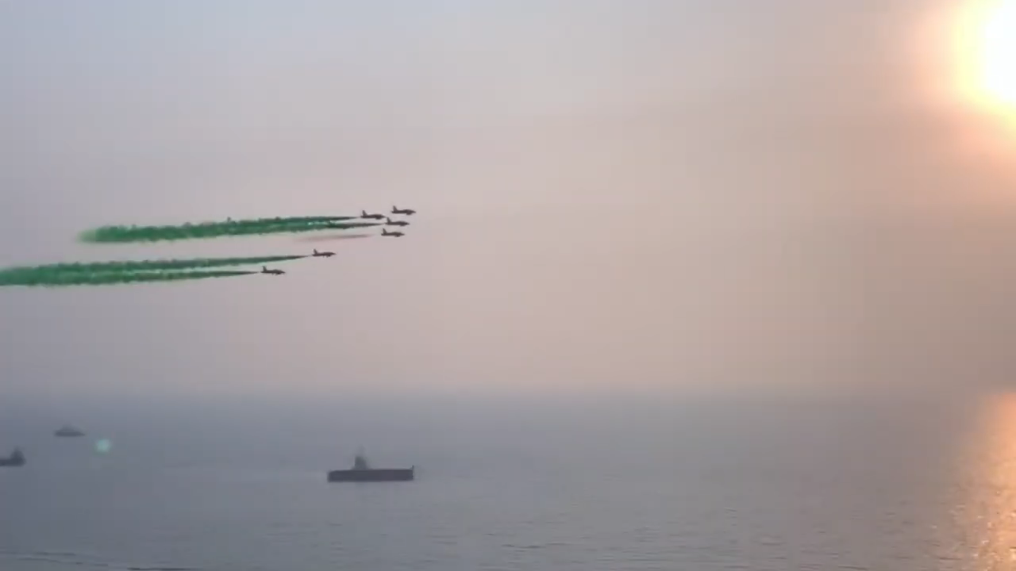

stunts
aerobatics

Slide 16
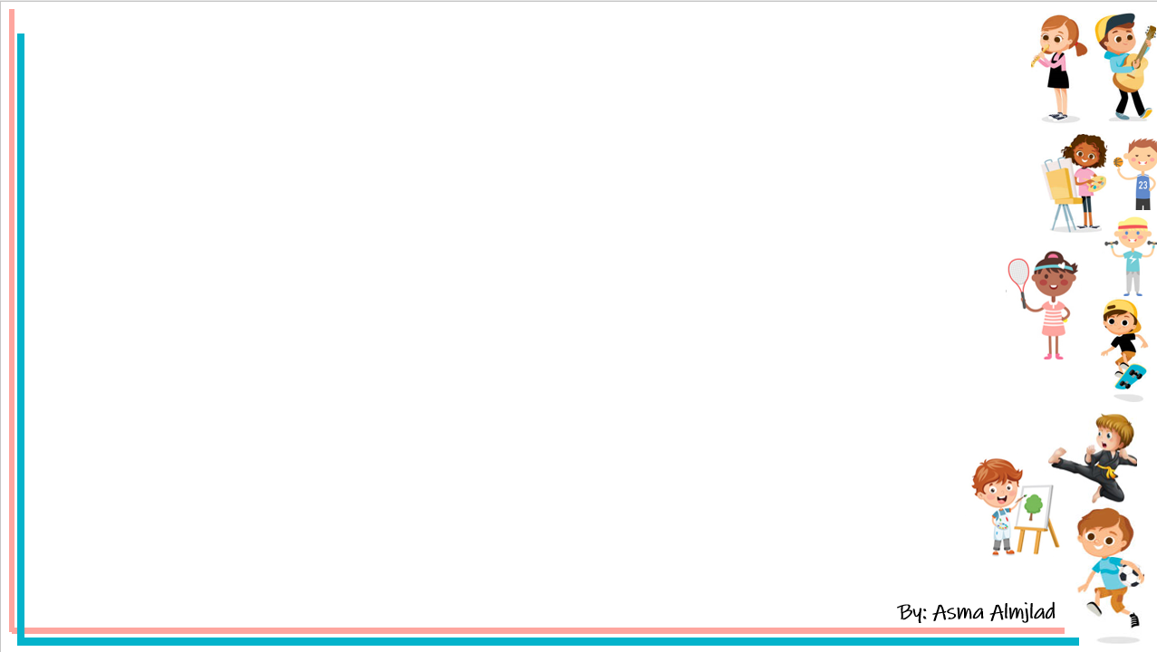
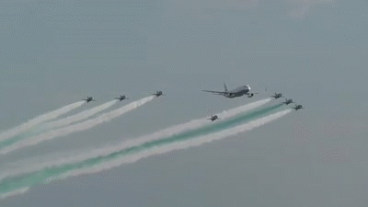
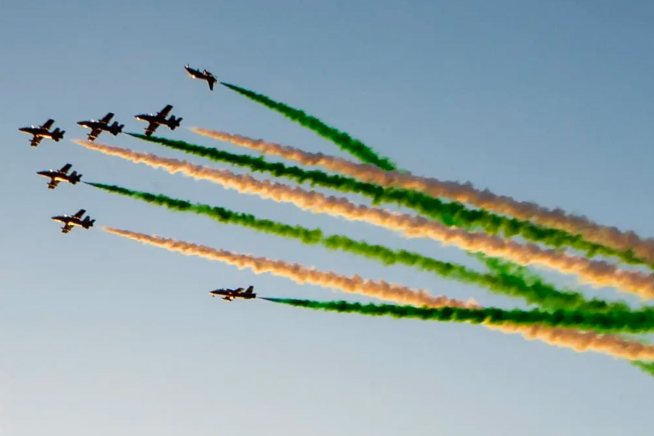
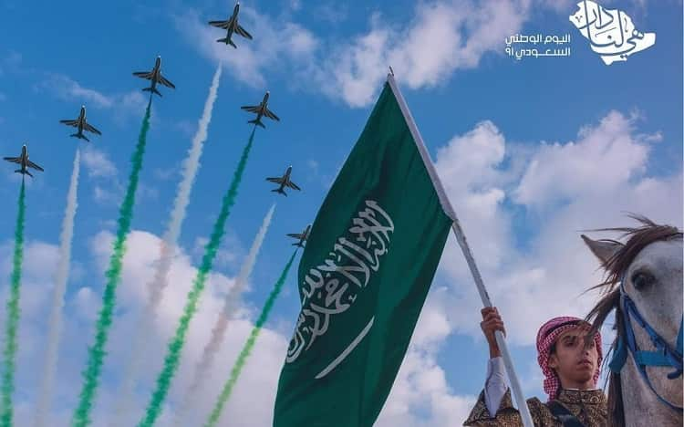


Slide 17
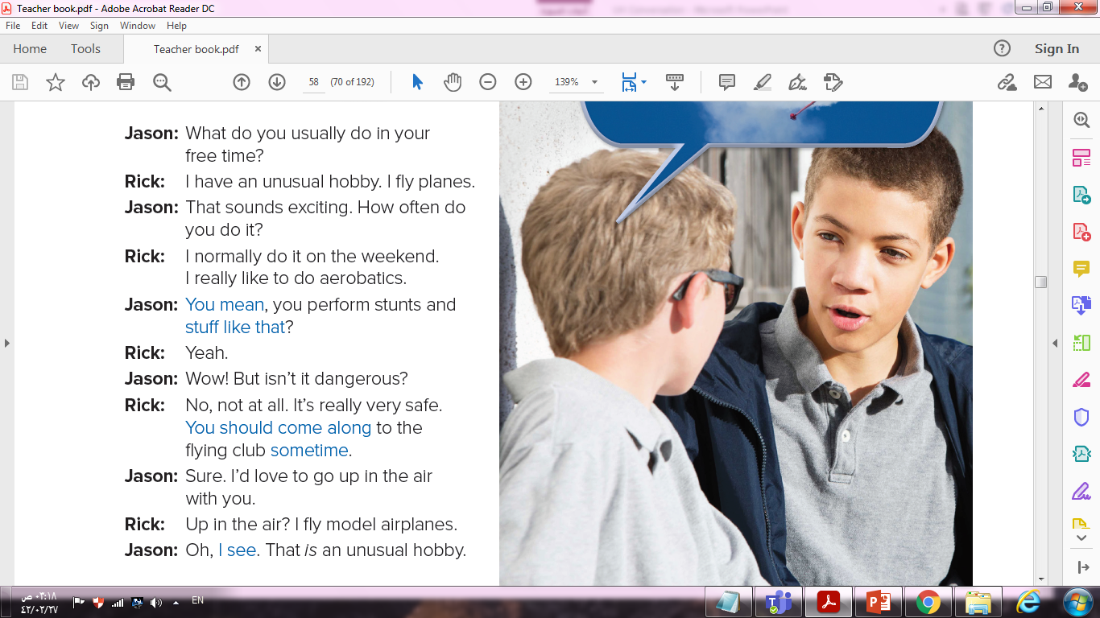

Slide 18
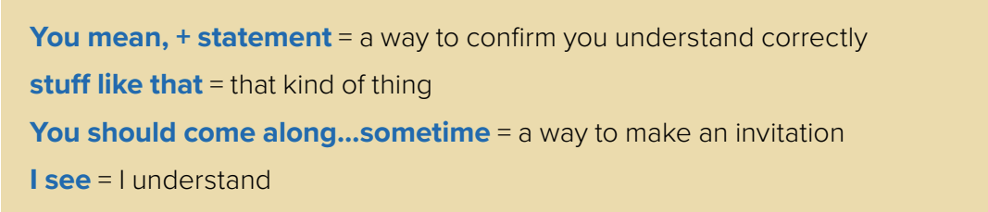
Real Talk

Slide 19
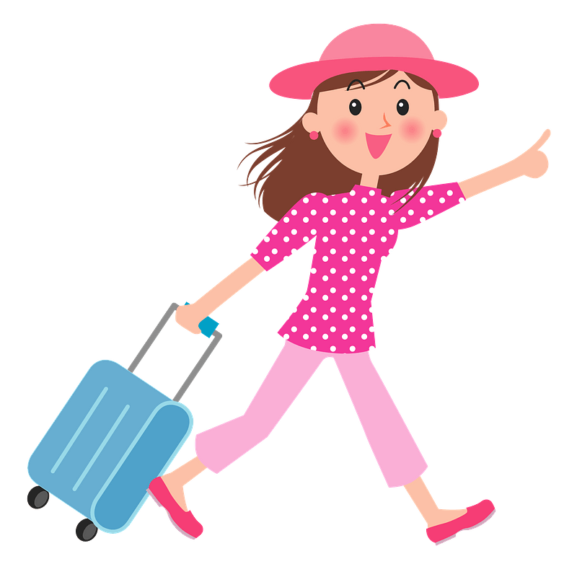
- My mom is traveling next week why don't you stay with me.
- ………………… I stay at your home
❑
I see
✓
❑
you mean

Slide 20

- I play football and basketball and ………….
- Good for you !
✓
❑
stuff like that
❑
you mean

Slide 21
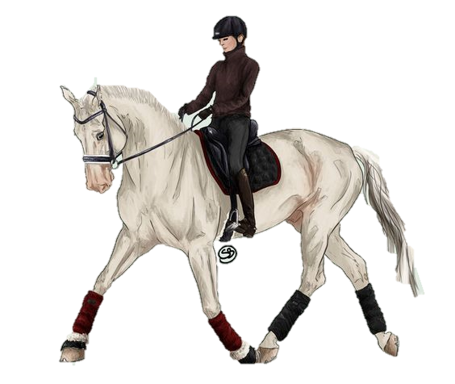
- Last week I was trained on riding a horse for the first time.
-That sounds dangerous!
-No, it is not. You ..................sometime.
✓
❑
Should come along
❑
you mean

Slide 22
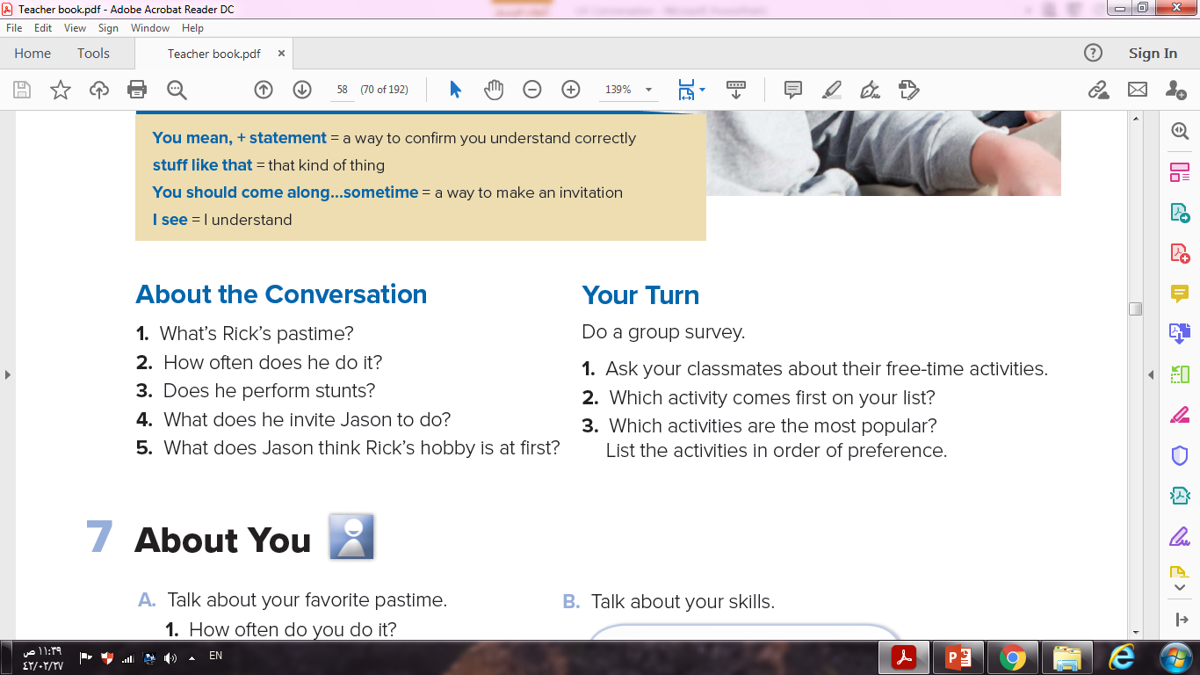

Slide 23

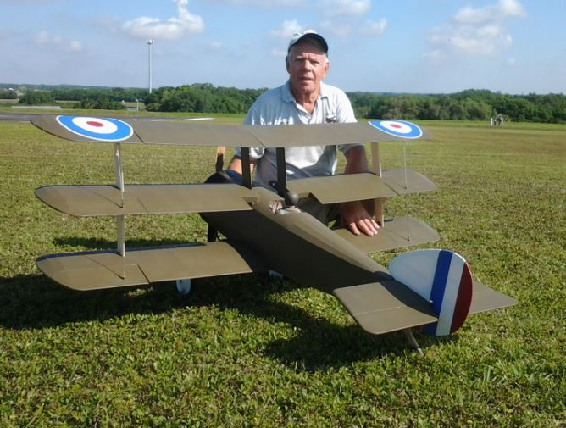
1. What’s Rick’s pastime?
He flies model airplanes.

Slide 24
2- How often does he do it?
He normally does it on the weekend.

Slide 25


3- Does he perform stunts?
Yes, he does.

Slide 26
4- What does he invite Jason to do?
He invites Jason to come along with him.

Slide 27

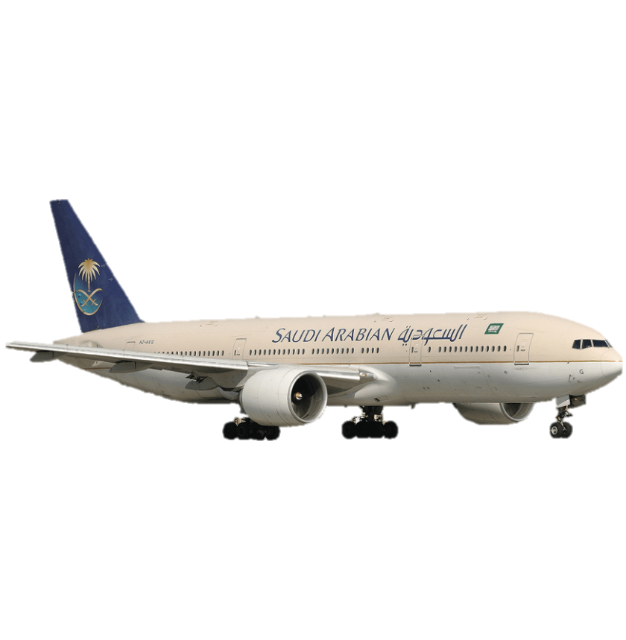
5-What does Jason think Rick’s hobby is at first?
He thinks Rick
flies planes.

Slide 28
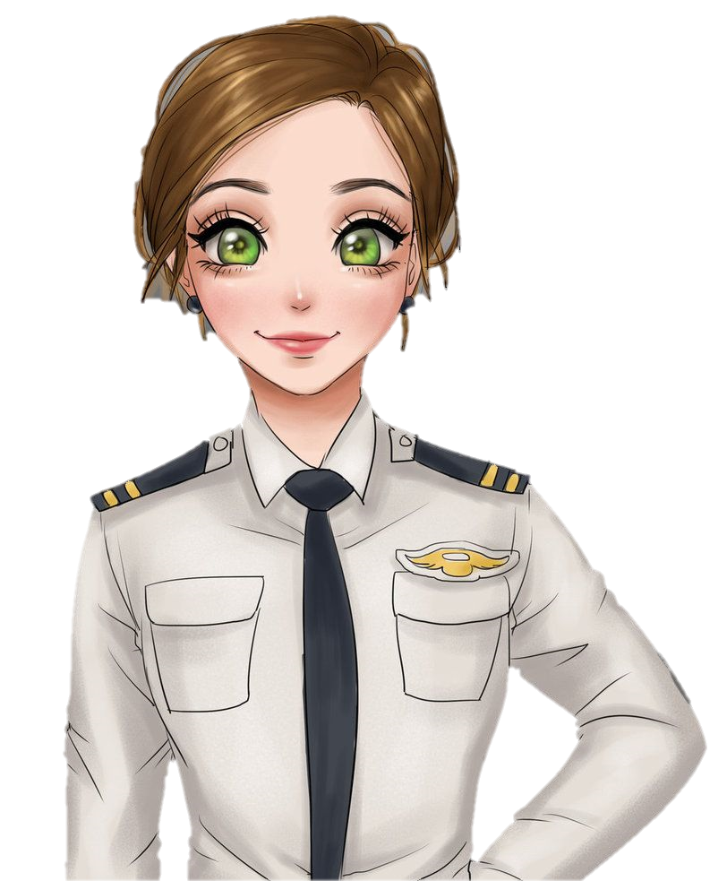
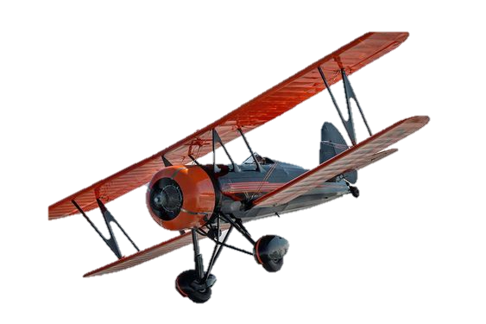
Is this a pastime you would like to do?
Why or Why not?

Slide 30
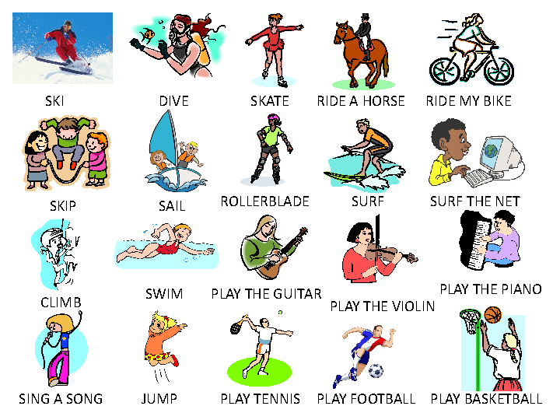
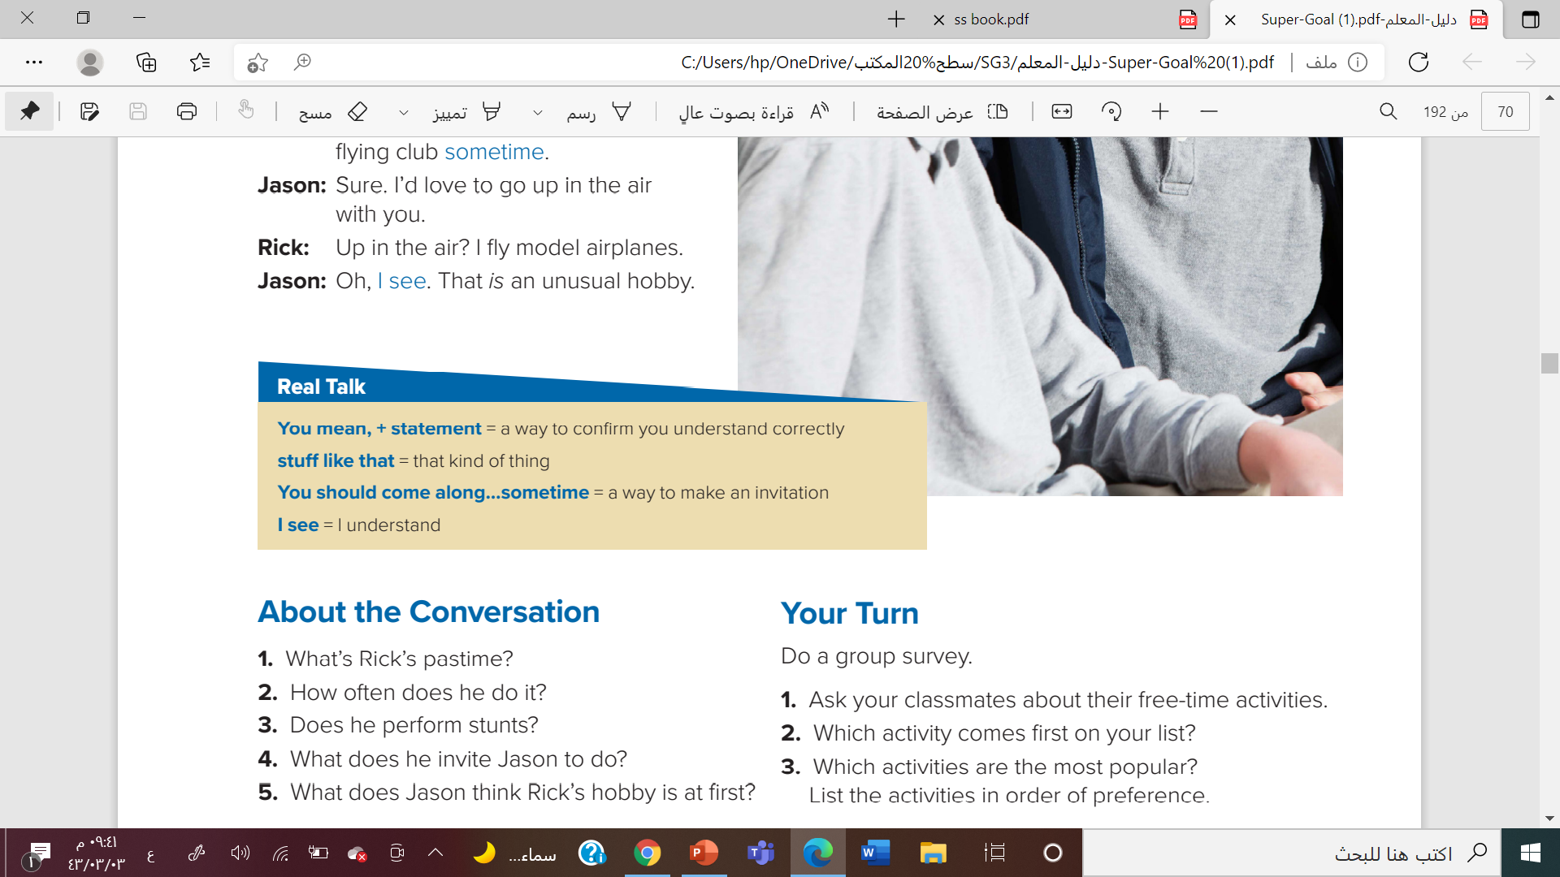


Slide 31

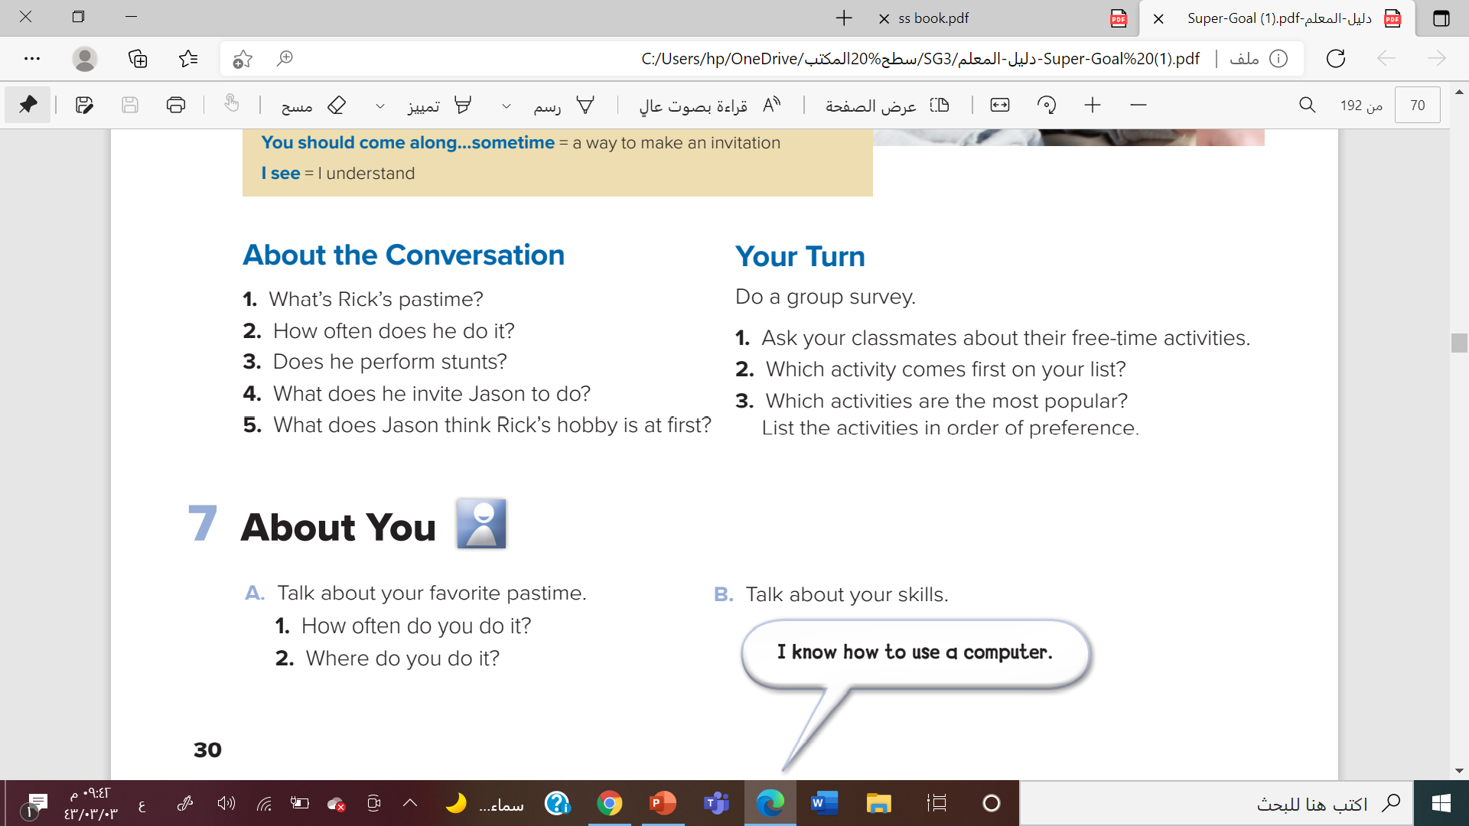
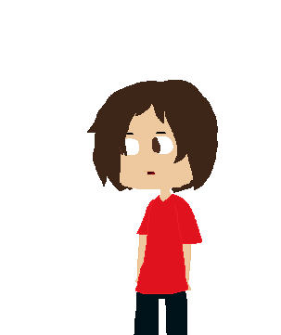

Slide 32
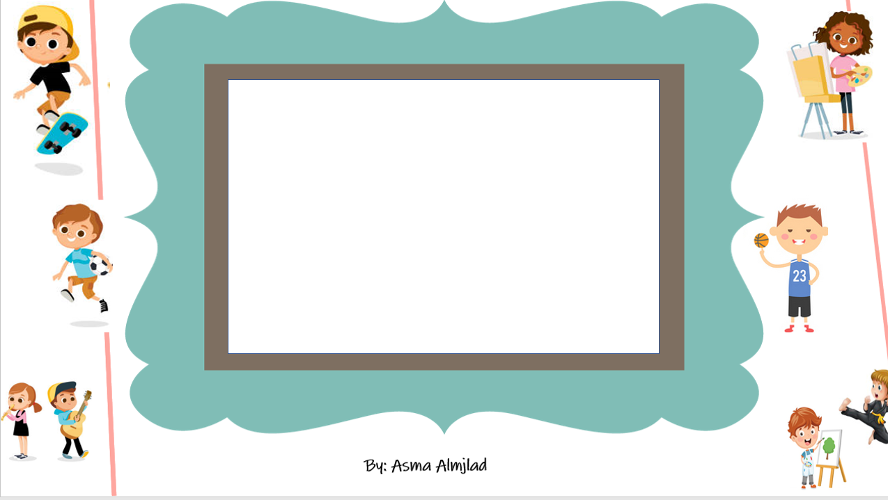

What is the opposite of usual ?
Unusual

Slide 33
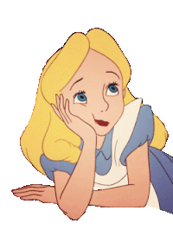
What is the opposite of exciting ?
Boring

Slide 34
What is the opposite of dangerous ?
safe

Slide 35

Awesome Girls

